Slide 1
ISM 6136
Data Mining
Dr. Tim Smith

Slide 2
Agenda
Introduce Neural Networks
Neurons
Perceptron
Artificial Neural Networks
Back-propagation
Example ANN with Code
Application of ML technique for regression
KNeighborsRegressor
ADABoostRegressor
MLPRegressor

Slide 3
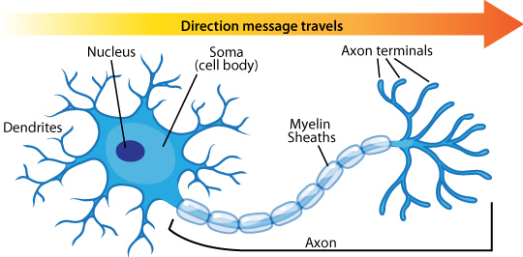
Neuron
Dendrites – Receive signals from other neurons
Soma – processing signal
Axon – Transmits the output of this neuron
Axon terminals/Synapses – Points of connections with other neurons

Slide 4
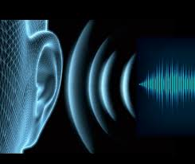

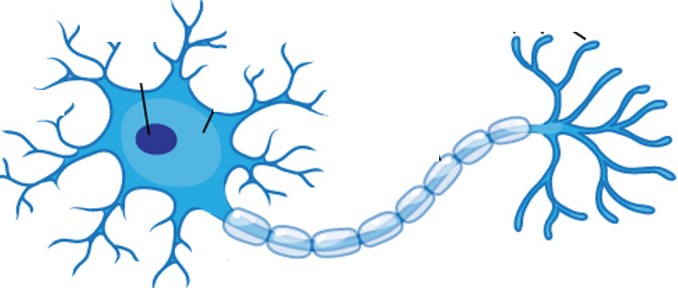
A network of neurons processes stimulus and calculates a response…
Likes this song

Slide 5

Different pathways can calculate different responses…
Doesn’t like this song

Slide 6
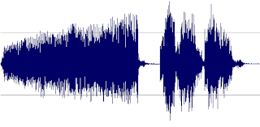
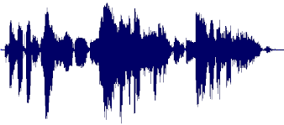
Our brains are a complex network of neurons…
Your brain is a massively parallel interconnected network of 10¹¹ neurons (100 billion), with over a 100 trillion connections!

Slide 7
Perceptron
Basic unit, or part, of a neural network
I single perceptron is the simplest neural network

Slide 8
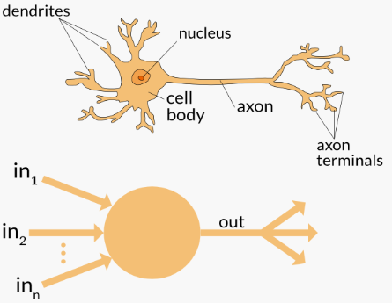
Biology VS Technology
Neuron
Perceptron (Perception Neuron)

Slide 9
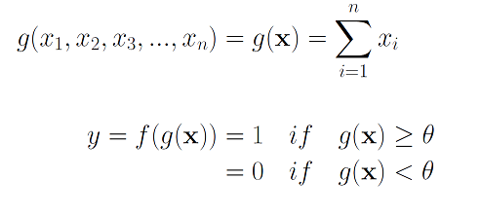

Perceptron History
McCulloch-Pitts Neuron – First mathematical model of biological neuron (1943)
Disadvantages of McCulloch-Pitts neuron was its simplicity. It only allowed for binary inputs and outputs, it only used the threshold step activation function and it did not incorporate weighting the different inputs.
x₁
x₂
g
f
y
x₃
x_{n}

Slide 10
Hebb’s Rule (1949)
“When an axon of cell A is near enough to excite a cell B and repeatedly or persistently takes part in firing it, some growth process or metabolic change takes place in one or both cells such that A’s efficiency, as one of the cells firing B, is increased.”
Hebb was proposing
when two neurons fire together the connection between the neurons is strengthened
Also, this activity is one of the fundamental operations necessary for learning and memory.
[1] Hebb, Donald O. (1949). The Organization of Behavior. New York: Wiley, pg. 62.

Slide 11
Resenblatt’s “Perceptron” (1958)
Incorporating ideas from Hebb’s rule, Frank Rosenblatt improved upon McCulloch-Pitts Neuron and created what he called a “Perceptron”
Rosenblatt updated the McColloch-Pitts neuron to include weights and biases.
Also, instead of a threshold step function, other functions were explored – these served the role of “activation” functions (i.e. Sigmoid)

Slide 12
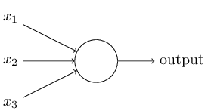

Perceptron
Input
Weight
-1

Slide 13
Rosenblatt’s Enthusiasm
Rosenblatt was quite enthusiastic about the possibilities for perceptron's…
"Given an elementary α-perceptron, a stimulus world W, and any classification C(W) for which a solution exists; let all stimuli in W occur in any sequence, provided that each stimulus must reoccur in finite time; then beginning from an arbitrary initial state, an error correction procedure will always yield a solution to C(W) in finite time…”
Later, Marvin Minsky (1969) demonstrated this was not the case (the contrary example used by Minsky was XOR; which a perceptron couldn’t model).
Minsky stated that perceptron research “was doomed to failure because of these limitations”
Rosenblatt, Frank (1962). Principles of neurodynamics. New York: Spartan. Cf. Rumelhart, D.E., J. L. McClelland and the PDP Research Group (1986). Parallel Distributed Processing vol. 1&2. Cambridge: MIT.
https://mitpress.mit.edu/books/perceptrons

Slide 14
Rise of Neural Networks
Later researchers began to connect multiple perceptron’s together as a network.
By connecting perceptron's together into networks, these networks of perceptron's were able to recreate XOR, and also solve much more difficult problems.
This has given rise to many complex network architectures and approaches
Feed Forward neural networks
Convolutional Neural Networks
Recurrent Neural Networks
Symmetrical Connect Neural Networks
Long-Short Memory Network
Despite these complexities, many of the artificial neural networks in use today still stem from the early advances of the McCulloch-Pitts neuron and the Rosenblatt perceptron.

Slide 15
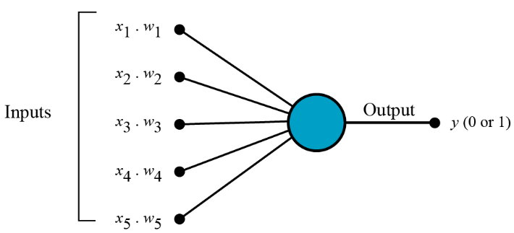
Multiply each input value by weights
1. All the inputs (signals) x are multiplied with their weights w.
w_{i}x_{i}
𝛳

Slide 16
Sum up all these multiplications
2. All input (signals) are summed up
w_{i}x_{i}
𝛳
Add all the multiplied values and call them Weighted Sum.

Slide 17
Add bias values
3. Adding in a Bias value
b
Bias added
w_{i}x_{i}+b
𝛳
Add all the multiplied values and call them Weighted Sum.

Slide 18
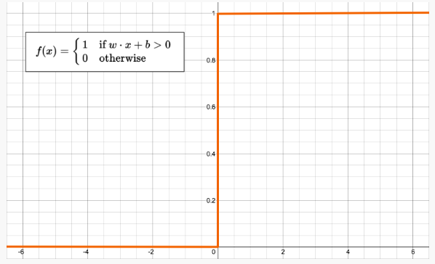
Input this sum into an activation function
Class 1
4. Activation
1
-1 otherwise
Class 2
-1

Slide 19
Example: good movie or bad movie?
b
=0
Let’s synthesize data…
Our ‘perceptron’ model
x1 | x2 | y
1 | 1 | 0
10 | 2 | 1
5 | 3 | 1
x₁ * w₁
x_{i}w_{i}+b
𝛳
y
x₂ * w₂
Our ‘activation’ function 𝛳
Every Observation (row) is a Movie
x1 = Number of reviews
x2 = Average Number of positive words in a review
y = 1 is good, 0 if bad
y=1
y=0
x <= 0
x > 0

Slide 20
Example: good movie or bad movie?
x1 | w1 | x2 | w2 | y | Pred
1 | 7 | 1 | 5 | 0 | 1
10 | 7 | 2 | 5 | 1 | 1
5 | 7 | 3 | 5 | 1 | 1
x1 | w1 | x2 | w2 | y | Pred
1 | 6 | 1 | 4 | 0 | 1
10 | 6 | 2 | 4 | 1 | 1
5 | 6 | 3 | 4 | 1 | 1
Error!
Since pred value is to high, we need to decrease the weights
w = w - X[i]
w₁ = w₁ - x1
w₂ = w₂ – x₂
7 - 1
5 - 1
Iteration 1
6
4

Slide 21
Example: good movie or bad movie?
x1 | w1 | x2 | w2 | y | Pred
1 | 6 | 1 | 4 | 0 | 1
10 | 6 | 2 | 4 | 1 | 1
5 | 6 | 3 | 4 | 1 | 1
x1 | w1 | x2 | w2 | y | Pred
1 | 6 | 1 | 4 | 0 | 1
10 | 6 | 2 | 4 | 1 | 1
5 | 6 | 3 | 4 | 1 | 1
Iteration 1
Iteration 1

Slide 22
Example: good movie or bad movie?
x1 | w1 | x2 | w2 | y | Pred
1 | 6 | 1 | 4 | 0 | 1
10 | 6 | 2 | 4 | 1 | 1
5 | 6 | 3 | 4 | 1 | 1
x1 | w1 | x2 | w2 | y | Pred
1 | 6 | 1 | 4 | 0 | 1
10 | 6 | 2 | 4 | 1 | 1
5 | 6 | 3 | 4 | 1 | 1
Iteration 1
Iteration 1

Slide 23
Example: good movie or bad movie?
x1 | w1 | x2 | w2 | y | Pred
1 | 6 | 1 | 4 | 0 | 1
10 | 6 | 2 | 4 | 1 | 1
5 | 6 | 3 | 4 | 1 | 1
x1 | w1 | x2 | w2 | y | Pred
1 | 5 | 1 | 3 | 0 | 1
10 | 5 | 2 | 3 | 1 | 1
5 | 5 | 3 | 3 | 1 | 1
Error!
Since pred value is to high, we need to decrease the weights
w = w - X[i]
w₁ = w₁ - x1
w₂ = w₂ – x₂
6 - 1
5 - 1
Iteration 2
5
3

Slide 24
Example: good movie or bad movie?
x1 | w1 | x2 | w2 | y | Pred
1 | 5 | 1 | 3 | 0 | 1
10 | 5 | 2 | 3 | 1 | 1
5 | 5 | 3 | 3 | 1 | 1
x1 | w1 | x2 | w2 | y | Pred
1 | 5 | 1 | 3 | 0 | 1
10 | 5 | 2 | 3 | 1 | 1
5 | 5 | 3 | 3 | 1 | 1
Iteration 2

Slide 25
Example: good movie or bad movie?
x1 | w1 | x2 | w2 | y | Pred
1 | 5 | 1 | 3 | 0 | 1
10 | 5 | 2 | 3 | 1 | 1
5 | 5 | 3 | 3 | 1 | 1
x1 | w1 | x2 | w2 | y | Pred
1 | 5 | 1 | 3 | 0 | 1
10 | 5 | 2 | 3 | 1 | 1
5 | 5 | 3 | 3 | 1 | 1
Iteration 2

Slide 26
Example: good movie or bad movie?
x1 | w1 | x2 | w2 | y | Pred
1 | 5 | 1 | 3 | 0 | 1
10 | 5 | 2 | 3 | 1 | 1
5 | 5 | 3 | 3 | 1 | 1
x1 | w1 | x2 | w2 | y | Pred
1 | 4 | 1 | 2 | 0 | 1
10 | 4 | 2 | 2 | 1 | 1
5 | 4 | 3 | 2 | 1 | 1
Error!
Since pred value is to high, we need to decrease the weights
w = w - X[i]
w₁ = w₁ - x1
w₂ = w₂ – x₂
5 - 1
3 - 1
Iteration 3
4
2

Slide 27
Example: good movie or bad movie?
x1 | w1 | x2 | w2 | y | Pred
1 | 4 | 1 | 2 | 0 | 1
10 | 4 | 2 | 2 | 1 | 1
5 | 4 | 3 | 2 | 1 | 1
x1 | w1 | x2 | w2 | y | Pred
1 | 4 | 1 | 2 | 0 | 1
10 | 4 | 2 | 2 | 1 | 1
5 | 4 | 3 | 2 | 1 | 1
Iteration 3

Slide 28
Example: good movie or bad movie?
x1 | w1 | x2 | w2 | y | Pred
1 | 4 | 1 | 2 | 0 | 1
10 | 4 | 2 | 2 | 1 | 1
5 | 4 | 3 | 2 | 1 | 1
x1 | w1 | x2 | w2 | y | Pred
1 | 4 | 1 | 2 | 0 | 1
10 | 4 | 2 | 2 | 1 | 1
5 | 4 | 3 | 2 | 1 | 1
Iteration 3

Slide 29
Example: good movie or bad movie?
x1 | w1 | x2 | w2 | y | Pred
1 | 4 | 1 | 2 | 0 | 1
10 | 4 | 2 | 2 | 1 | 1
5 | 4 | 3 | 2 | 1 | 1
x1 | w1 | x2 | w2 | y | Pred
1 | 3 | 1 | 1 | 0 | 1
10 | 3 | 2 | 1 | 1 | 1
5 | 3 | 3 | 1 | 1 | 1
Error!
Since pred value is to high, we need to decrease the weights
w = w - X[i]
w₁ = w₁ - x1
w₂ = w₂ – x₂
4 - 1
2 - 1
Iteration 3
3
1

Slide 30
Example: good movie or bad movie?
x1 | w1 | x2 | w2 | y | Pred
1 | 3 | 1 | 1 | 0 | 1
10 | 3 | 2 | 1 | 1 | 1
5 | 3 | 3 | 1 | 1 | 1
x1 | w1 | x2 | w2 | y | Pred
1 | 3 | 1 | 1 | 0 | 1
10 | 3 | 2 | 1 | 1 | 1
5 | 3 | 3 | 1 | 1 | 1
Iteration 3

Slide 31
Example: good movie or bad movie?
x1 | w1 | x2 | w2 | y | Pred
1 | 3 | 1 | 1 | 0 | 1
10 | 3 | 2 | 1 | 1 | 1
5 | 3 | 3 | 1 | 1 | 1
x1 | w1 | x2 | w2 | y | Pred
1 | 3 | 1 | 1 | 0 | 1
10 | 3 | 2 | 1 | 1 | 1
5 | 3 | 3 | 1 | 1 | 1
Iteration 3

Slide 32
Example: good movie or bad movie?
x1 | w1 | x2 | w2 | y | Pred
1 | 3 | 1 | 1 | 0 | 1
10 | 3 | 2 | 1 | 1 | 1
5 | 3 | 3 | 1 | 1 | 1
x1 | w1 | x2 | w2 | y | Pred
1 | 2 | 1 | 0 | 0 | 1
10 | 2 | 2 | 0 | 1 | 1
5 | 2 | 3 | 0 | 1 | 1
Error!
Since pred value is to high, we need to decrease the weights
w = w - X[i]
w₁ = w₁ - x1
w₂ = w₂ – x₂
3 - 1
1 - 1
Iteration 3
2
0

Slide 33
Example: good movie or bad movie?
x1 | w1 | x2 | w2 | y | Pred
1 | 2 | 1 | 0 | 0 | 1
10 | 2 | 2 | 0 | 1 | 1
5 | 2 | 3 | 0 | 1 | 1
x1 | w1 | x2 | w2 | y | Pred
1 | 2 | 1 | 0 | 0 | 1
10 | 2 | 2 | 0 | 1 | 1
5 | 2 | 3 | 0 | 1 | 1
Iteration 5

Slide 34
Example: good movie or bad movie?
x1 | w1 | x2 | w2 | y | Pred
1 | 2 | 1 | 0 | 0 | 1
10 | 2 | 2 | 0 | 1 | 1
5 | 2 | 3 | 0 | 1 | 1
x1 | w1 | x2 | w2 | y | Pred
1 | 2 | 1 | 0 | 0 | 1
10 | 2 | 2 | 0 | 1 | 1
5 | 2 | 3 | 0 | 1 | 1
Iteration 5

Slide 35
Example: good movie or bad movie?
x1 | w1 | x2 | w2 | y | Pred
1 | 2 | 1 | 0 | 0 | 1
10 | 2 | 2 | 0 | 1 | 1
5 | 2 | 3 | 0 | 1 | 1
x1 | w1 | x2 | w2 | y | Pred
1 | 1 | 1 | -1 | 0 | 1
10 | 1 | 2 | -1 | 1 | 1
5 | 1 | 3 | -1 | 1 | 1
Error!
✅
✅
Convergence!
✅
Since pred value is to high, we need to decrease the weights
w = w - X[i]
w₁ = w₁ - x1
w₂ = w₂ – x₂
2 - 1
0 - 1
Iteration 6
1
-1

Slide 36
See notebook implementation
Download and run W10_percepton.ipynb from Canvas

Slide 37
Other activation functions…
1
arctan
Elliott
logistic
Activation
0
tanh
−1
0
Input

Slide 38
SKLearn support
SKLearn MLPClassifier supports 4 activation functions
‘identity’ – linear, rarely used
‘logistic’ – non-linear (same as logistic regression function)
‘tanh’ – non-linear – uses hyperbolic tan function
‘relu’ – (rectified linear unit) non-linear Default
Note: Research into the best performing activation functions is ongoing.
For more detail, see Szandała, T. (2021).. Studies in Computational Intelligence, 903, 203–224. (posted to canvas) Review and comparison of commonly used activation functions for deep neural networks

Slide 39
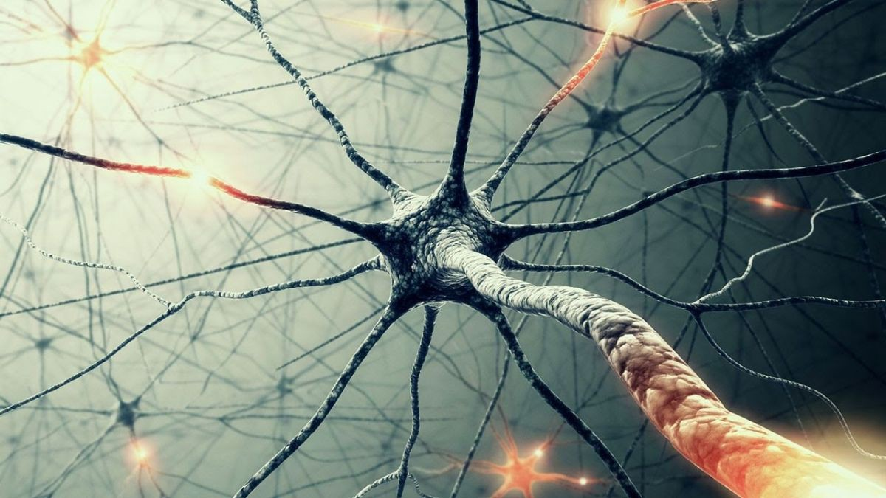
Neural networks
Input Layer
(predictors)
Hidden Layers
Output Layer
(Target)

Slide 40
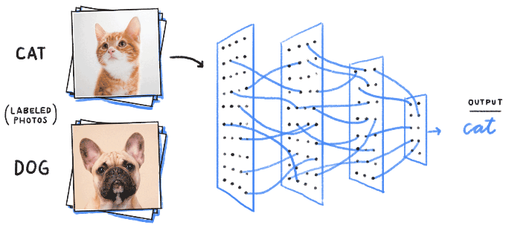
Neural Network = A multi-layer perceptron

Slide 41
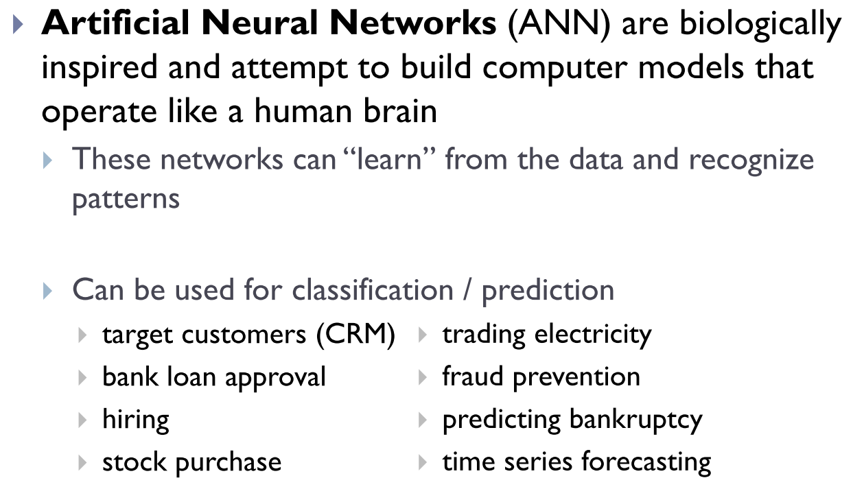
Artificial Neural Networks

Slide 42
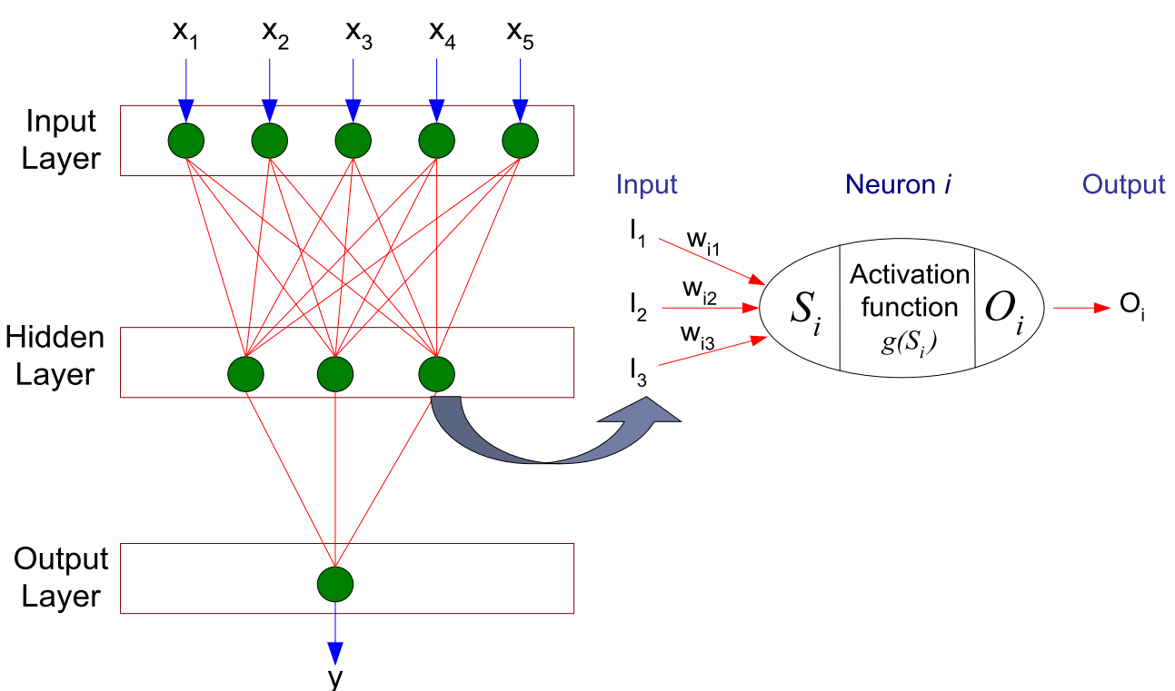
General Structure of ANN
Input layer: the raw information that is fed into the network.
Hidden layer: determined by the activities of the input units and the weights on the connections between the input and the hidden units.
Output layer: depends on the activity of the hidden units and the weights between the hidden and output units.

Slide 43
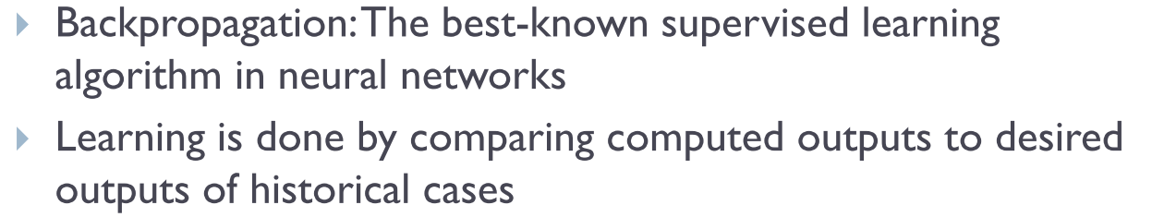
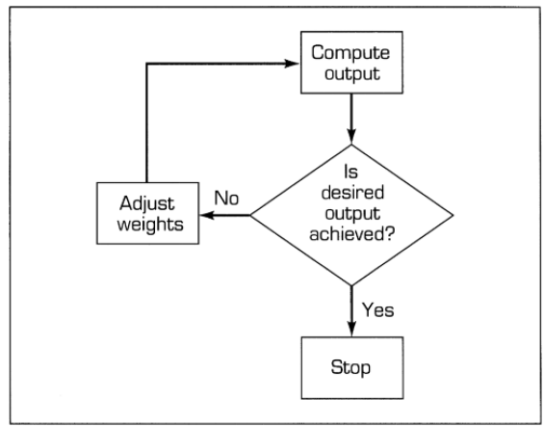
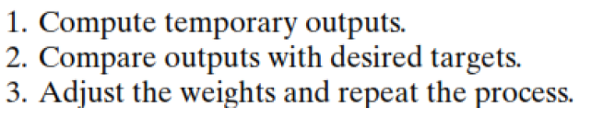
How a network learns?

Slide 44
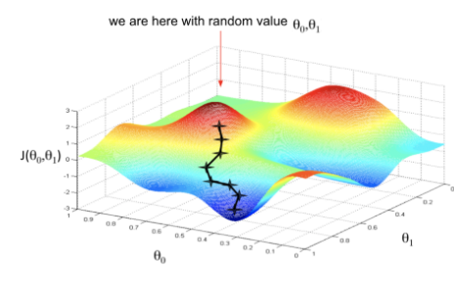
How does a neural network find the best solution?
Our sample network (for the following example created by MLPClassifer) is a feed-forward Network” that ‘learns’ through back-propagation.
Weights are randomly selected, and inputs are then “fed forward” through the model.
A “loss function” measures the error of the results
Weights are then adjusted, and then re-fed forward through the model.
This continues until the incremental decrease in loss value falls below a threshold, or the maximum number of iterations is reached.
Start with a set of weights. Keep changing these weights until we end up at a global minimum for the loss/cost function.

Slide 45
Example of ANN
Handwriting recognition

Slide 46
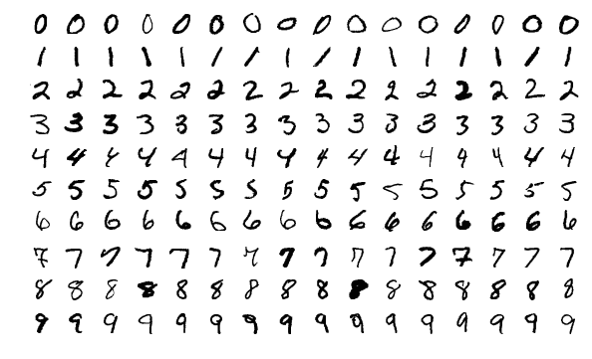
Detecting Handwritten Digits
The MNIST database (Modified National Institute of Standards and Technology database) is a large database of handwritten digits that is commonly used for training various image processing systems
The MNIST database of handwritten digits consists of 70,000 samples.

Slide 47
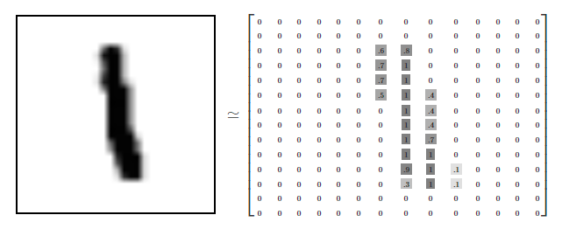
MNIST Data
Each image is encoded in a 28x28 pixel grid
This grid is represented as 784 x values (28*28)
Each observation is a vector of 784 values the represent the intensity of grey found in the image for that location.

Slide 48
Potential Network
Output Layer
(Target)
Input Layer
(predictors)
Hidden Layers
0
x₁
1
x₂
2
x₃
3
x₄
4
x₅
5
40 neurons
6
…
7
x₆₃
50 neurons
8
x₆₄
60 neurons
9

Slide 49
Potential Network
Output Layer
(Target)
Input Layer
(predictors)
Hidden Layers
0
x₁
1
x₂
2
x₃
3
x₄
4
x₅
5
40 neurons
6
…
7
x₇₈₃
50 neurons
8
x₇₈₄
60 neurons
9

Slide 50
Potential Network
Output Layer
(Target)
Input Layer
(predictors)
Hidden Layers
0
x₁
1
x₂
2
x₃
3
x₄
4
x₅
5
40 neurons
6
…
7
x₇₈₃
50 neurons
8
x₇₈₄
60 neurons
9

Slide 51
There are many, many, more neural network architectures and learning options/methods
SKLearn is somewhat limited in the neural network options available.
Recently, many large projects have developed advanced “deep learning” libraries.
The two most popular open-sourced options are:
TensorFlow (Developed by Google Brain team – released to public)
Keras – Opensource library Python interface to TensorFlow
PyTorch (Facebook’s AI research lab)
Tesla Autopilot build using PyTorch
Sign up for data science programming next semester – we will cover deep learning models using TensorFlow!

Slide 52
Sample neural network using SKLearn
Download and review w10_ann_handwriting.ipynb from Canvas.

Slide 53
Using ML techniques for Regression
May of the ML techniques we’ve used for classification problems can also be used for regression.
Regression models are much simpler to evaluate than classification problems – we just need a metric that indicates how far off our predictions are.
Common metric is root mean squared errors. The name itself explains how this is calculated.
All the errors are squared, the average of the resulting value is taken to the power ½.

Slide 54
Example Regressors…
See week09_hide.ipynb and week09_seek.ipynb for sample code illustrating the use of KNN, XGBoost and MLPRegressor to fit continuous target variables
NOTE: These examples simply fit the data, they do not split into train and test. Adding this additional step should be relatively easy for you now.

Slide 55
Happy Learning!

