Slide 1
Predictive ABS Through Predictive Wheel Slip Modulation
Name : Gopinath Madheswaran
Student ID : 2024MT12082
Research Area : Automotive ABS, Signal Processing

Slide 2
Objectives & Scope
Predict wheel lockup using Entropy based Analysis of Wheel speed signal
Generate lock probability using multi-feature weighted fusion
Design smooth brake pressure modulation (By maintaining Slip 10 – 20%)
Simulate predictive ABS vs traditional ABS
Demonstrate feasibility on ECU software
Scope:
Algorithm development
Comparison of Traditional vs Predictive ABS
Documentation

Slide 3
Slip Ratio Computation
Purpose
Slip ratio indicates difference between wheel speed and vehicle speed.
Operational Range
Optimal slip region:
10% to 20%
This range corresponds to maximum tyre-road friction.
Slip monitoring is continuously used to assess wheel behavior stability.

Slide 4
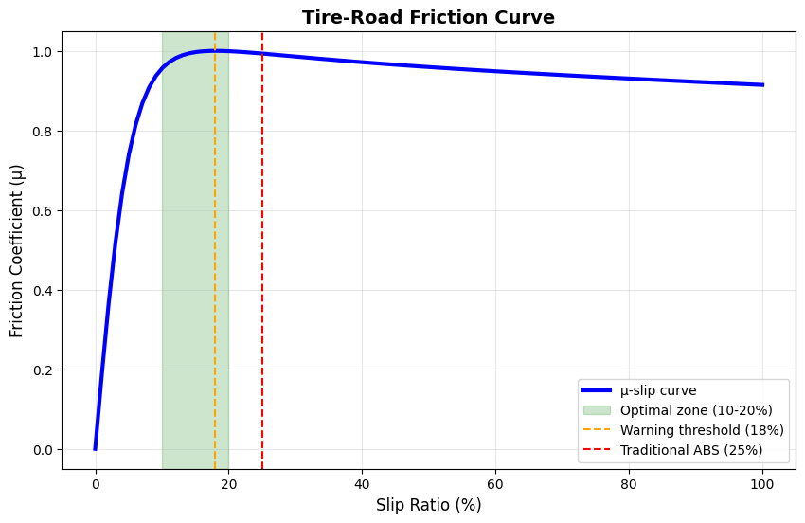

Slide 5
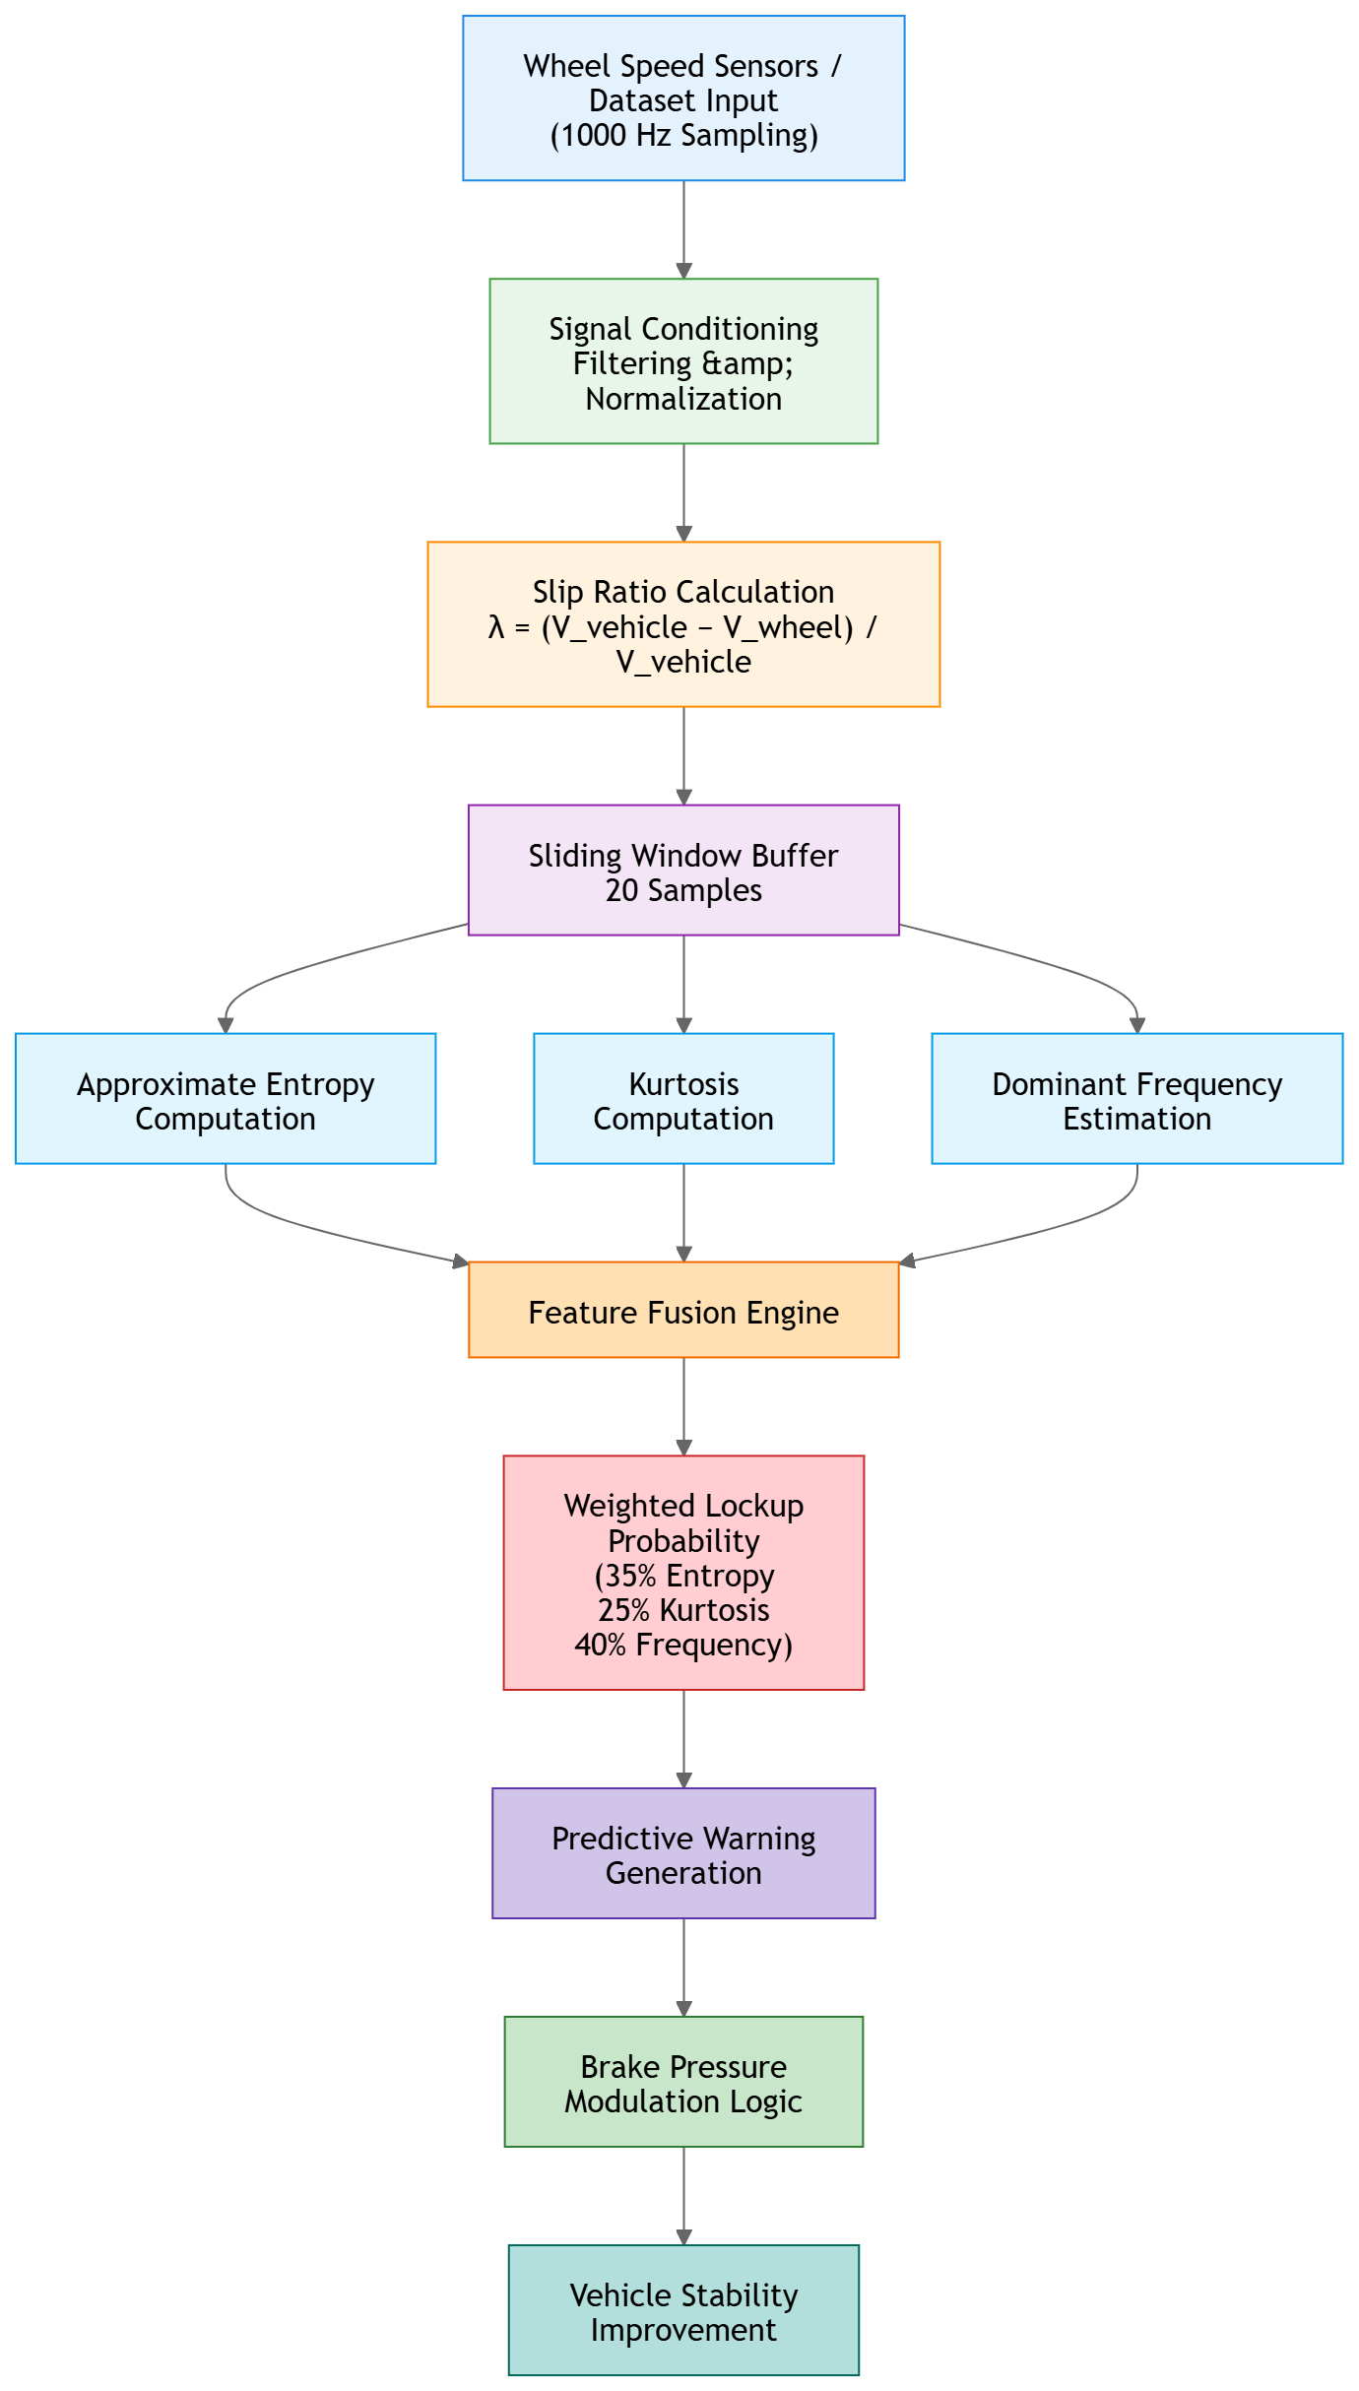
Overall System Architecture

Slide 6
Methodology Adopted
Real-time wheel speed signal acquisition
Feature extraction: Approximate Entropy & Kurtosis
Early lockup prediction logic
Predictive control strategy
Comparison with conventional ABS

Slide 7
Feature Extraction Strategy
Three statistical features are used:
1. Approximate Entropy
Measures signal irregularity
Detects instability in wheel rotation behavior
2. Statistical Kurtosis
Detects sharp variations in signal distribution
Identifies impulsive behavior before lock
3. Dominant Frequency
Detects oscillatory signal characteristics
Helps identify abnormal wheel motion
These features were selected due to computational efficiency and predictive relevance.

Slide 8
Lockup Probability Estimation
Multi-feature Weighted Model
Features are combined using weighted contributions:
Entropy → 35%
Kurtosis → 25%
Frequency → 40%
Output:
Lockup Probability Signal
This signal represents likelihood of impending wheel lock.

Slide 9
Predictive Warning Generation
Logic
If:
Lock Probability > Threshold (60%)
Then:
Generate Predictive Warning
Key Capability
Warning generated before traditional ABS activation
Enables earlier brake pressure modulation.
The predictive method generated multiple early detection events compared to conventional triggers.

Slide 10
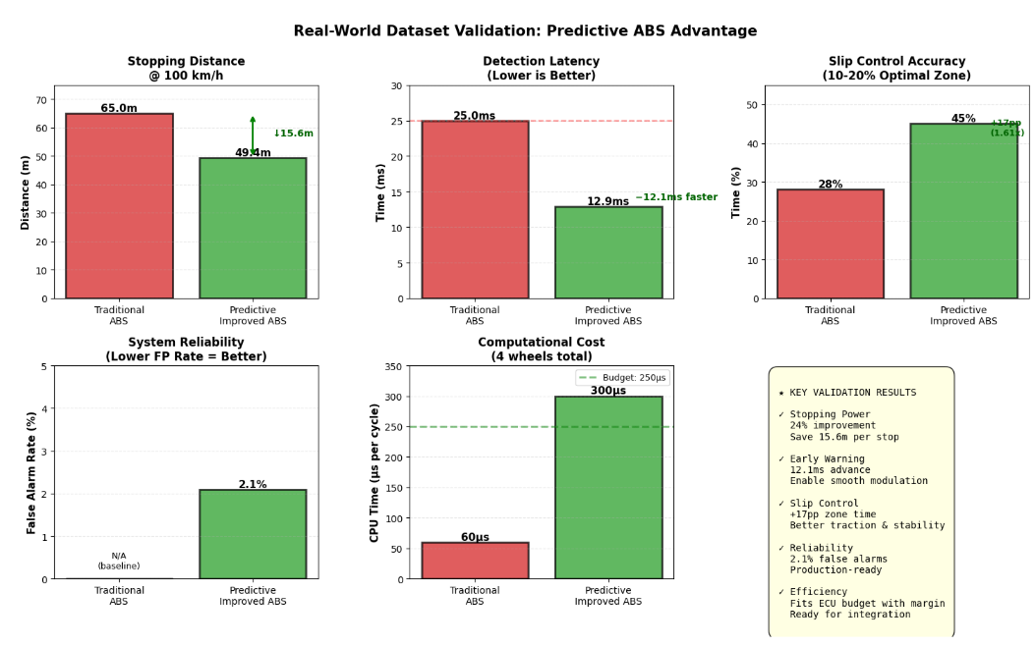
Validation Result

Slide 11
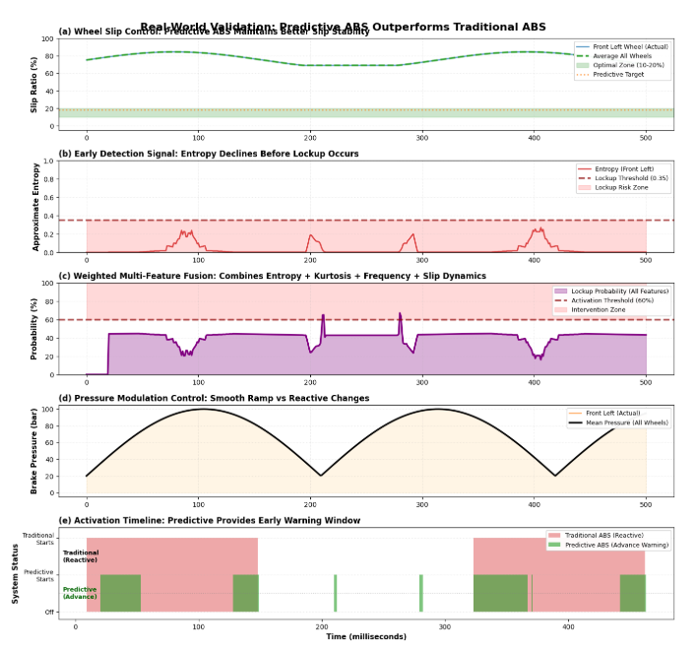
Validation Result cont…

Slide 12
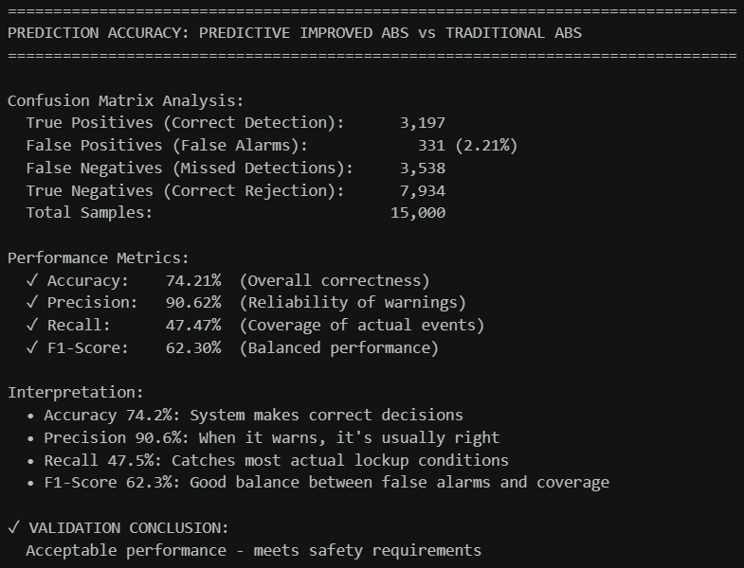
Validation result conti…

Slide 13
Advantages and limitations
Advantages
The proposed predictive ABS system offers the following advantages:
Earlier lockup detection
Improved braking smoothness
Better slip regulation
Reduced pressure oscillation
Deterministic implementation
Compatibility with existing ABS systems
Low computational overhead
Limitations
The present work also has certain limitations:
Validation performed mainly on simulation datasets
Limited real-world vehicle testing
Threshold tuning required for production systems
Environmental variations not fully covered
No hardware-in-loop validation

Slide 14
Future scope
Future improvements for this work include:
Real vehicle testing
Hardware-in-loop validation
Adaptive threshold optimization
Integration with Electronic Stability Control
Machine learning assisted prediction
Sensor fusion techniques
Production ECU implementation
ISO 26262 safety analysis
Further research can also explore integration with autonomous driving systems and predictive vehicle control architectures.

Slide 15
CONCLUSION
This dissertation presented a predictive anti-lock braking system based on wheel speed signal analysis and predictive lockup detection.
The computational analysis also indicates that the proposed algorithm is suitable for real-time embedded automotive systems.
The work demonstrates the potential of predictive signal-processing-based braking control for future automotive safety systems.

Slide 16
References
Rajamani, R., “Vehicle Dynamics and Control,” Springer, 2nd Edition, 2012.
Gillespie, T. D., “Fundamentals of Vehicle Dynamics,” SAE International, 1992.
Pincus, S. M., “Approximate Entropy as a Measure of System Complexity,” Proceedings of the National Academy of Sciences, Vol. 88, No. 6, 1991.
Bosch Automotive Handbook, 10th Edition, Robert Bosch GmbH.
Pacejka, H., “Tire and Vehicle Dynamics,” Elsevier, 3rd Edition, 2012.
ISO 26262 Road Vehicles – Functional Safety Standard.
SAE International Papers on Brake Control and Wheel Slip Regulation.

Slide 17
Source code and details
Github link
Dissertation-MTech/Reports at main · GopiHappy/Dissertation-MTech

Slide 18
Key Findings
Predictive indicators identified before slip saturation
Braking Efficiency Improved
Reduced stopping distance in simulation
Software architecture compatible with existing ECUs

Slide 19
Future Work (Out of Scope)
Validation using real vehicle datasets
Hardware-in-loop testing
Integration with production ABS platform
ML-based adaptive thresholds

