Slide 1

Model Compression Techniques & VAE
Gopi Kishan
GCDSL, IISc

Slide 2
Overview
Knowledge Distillation (KD)
Auto Encoders
Variational AutoEncoders (VAE)
Exploring other prior of VAE
Other Compression techniques
Micronet Challenge hosted at NeurIPS 2019

Slide 3
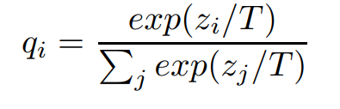
Distilling the Knowledge in a Neural Network
Neural networks typically produce class probabilities by using a “softmax” output layer that converts the logit, zi , computed for each class into a probability, qi , by comparing zi with the other logits.
where T is a temperature that is normally set to 1. Using a higher value for T produces a softer probability distribution over classes.

Slide 4
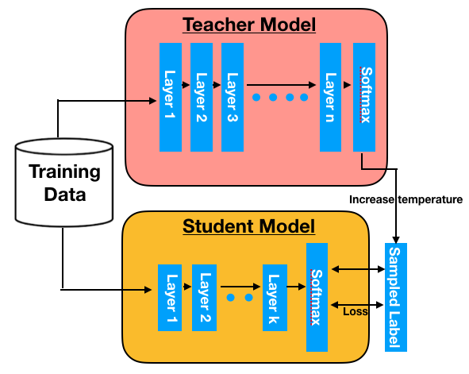

Slide 5



Matching logits is a special case of distillation
The cross-entropy gradient, dC/dzi is given by :
If the temperature is high compared with the magnitude of the logits, we can approximate:
If we now assume that the logits have been zero-meaned separa P tely for each transfer case so that

Slide 6
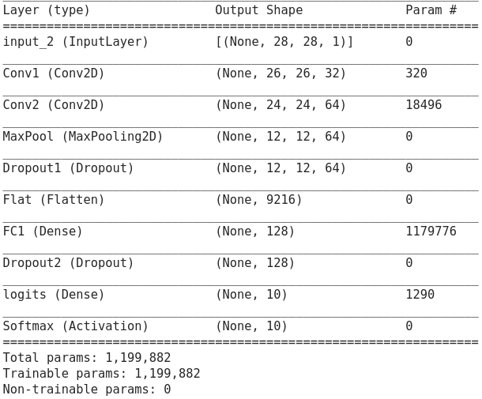
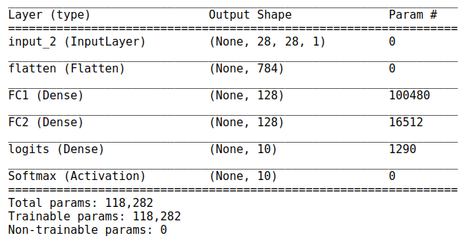
Knowledge Distillation on MNIST
Teacher Model
Student Model

Slide 7
Prediction over MNIST
All the models are trained for 10 epoches with batch size = 64
Models | Test Accuracy
Teacher Model | 0.9924
Student Model | 0.9871
Student Model without teacher guidance | 0.9632

Slide 8
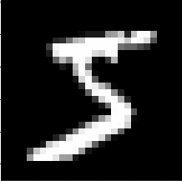
Probability distribution over number at Temperature value = 4
Unsoftened probabilities: [2.9399757e-23 7.7865502e-24 3.3027068e-24 6.2618165e-16 1.4026793e-27
7.1093457e-12 2.4744464e-21 3.6832551e-24 9.0432768e-20 5.3667499e-19]
Prediction based on unsoftened probability for: 5
Softened probabilities: [5.1947024e-09 3.7265848e-09 3.0074072e-09 3.5289850e-07 4.3173209e-10
3.6427730e-06 1.5734186e-08 3.0905281e-09 3.8686210e-08 6.0381318e-08]
Prediction based on Softened probability for: 5

Slide 9
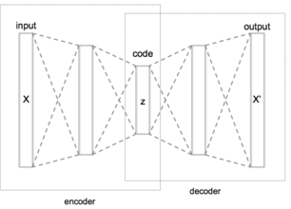
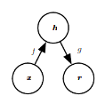


AutoEncoders
The learning process is described simply as minimizing a loss function
Where L is a loss function penalizing g(f(x)) for being dissimilar from x, such as the mean squared error is given by :

Slide 10
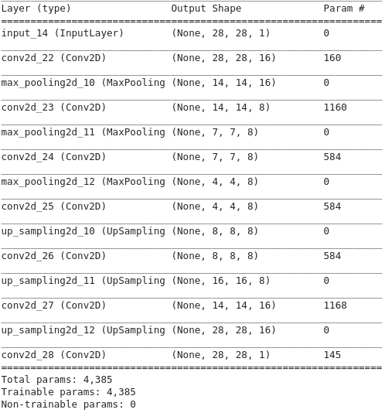
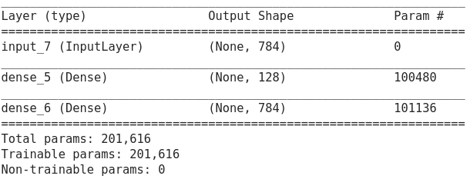
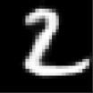
Results on MNIST
Model description

Slide 11



Loss = Cross_Entropy + alpha * MSE(Encoded_S - Endoded_T)*temp**2
At training temperature = 4 and alpha = 0.5
Models | Result
Teacher Model
DNN
DNN with teacher guidance

Slide 12
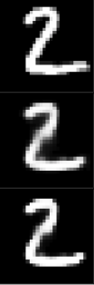
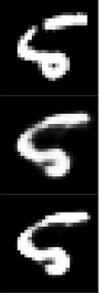
MNIST Image sharpening with temp term
Recall
Original Image
AE reconstructed Image
AE reconstruction using temp = 0.6

Slide 13
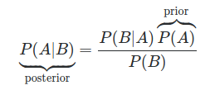
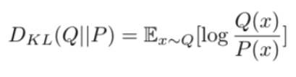
Bayes’ Theorem
KL Divergence
Maths review

Slide 14
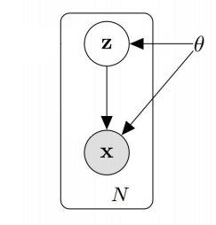
Variational Autoencoder
Variational autoencoders (VAEs) are a deep learning technique for learning latent representations.
Let’s define some notions:
X : data that we want to model
z: latent variable
P(X) : probability distribution of the data
P(z) : probability distribution of latent variable
P(X|z) : distribution of generating data given latent variable
Goal: To compute the distribution P(z|X)

Slide 15

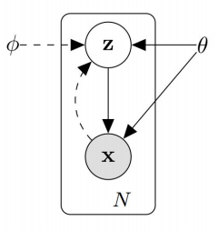





Alright, now let’s say we want to infer P(z|X) using Q(z|X). The KL divergence then formulated as follows:
Applying Bayes’ rule :

Slide 16
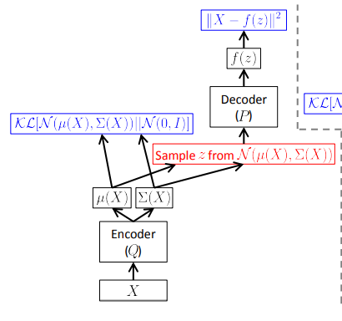

And this is it, the VAE objective function:
At this point, what do we have? Let’s enumerate:
Q(z|X) that project our data X into latent variable space
z, the latent variable
P(X|z) that generate data given latent variable.

Slide 17
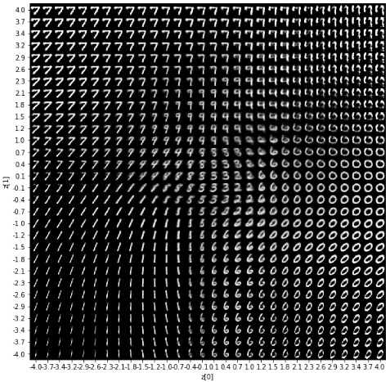
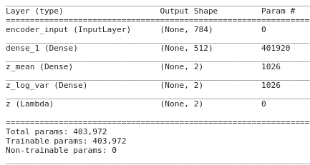
Result on MNIST
z = z_mean + sqrt(var) * epsilon
Where, epsilon = N(0,1)

Slide 18
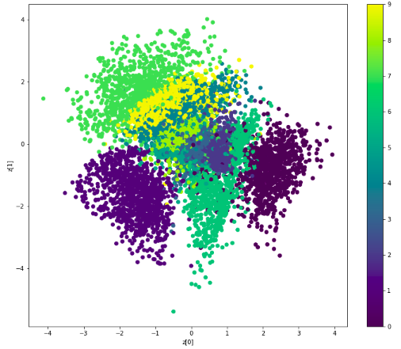

Slide 19
Exploring other priors in VAE
Current prior : bernoulli distribution and Gaussian distribution.
Motivation : Image pixel values follow multinomial distribution. So none of the above priors are suitable.
Proposal : Dirichlet Distribution

Slide 20
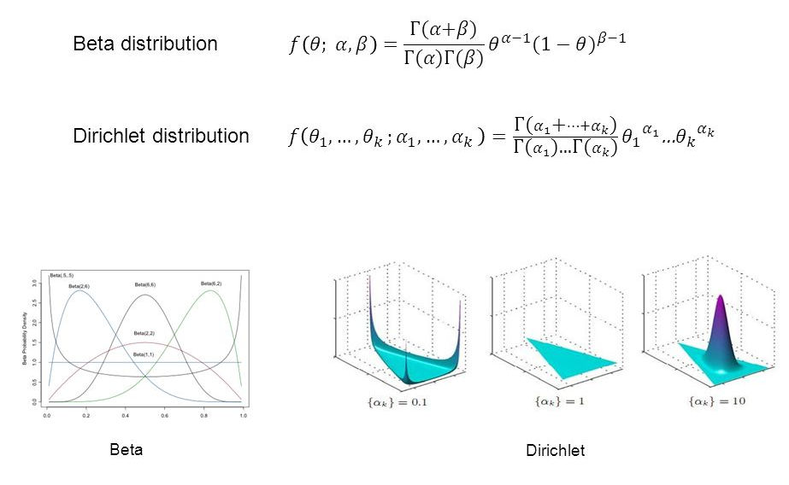

Dirichlet Distribution
Dirichlet distribution is a multivariate distribution with parameters α=[α1,α2,…,αK], with the following probability density function
It is a multivariate form of Beta distribution and conjugate prior to multinomial distribution.

Slide 21

Dirichlet VAE
Instead of using the standard Gaussian distribution, we use the Dirichlet distribution which is a conjugate prior distribution of the multinomial distribution.
A paper with the same idea was submitted in ICML 2019, but unfortunately was not accepted. It proposes DirVAE advantages as :
DirVAE models the latent representation result with the best log-likelihood compared to the baselines
DirVAE produces more interpretable latent values with no collapsing issues which the baseline models suffer from.
Better performance on MNIST and OMNIGLOT compared to the baseline VAEs

Slide 22
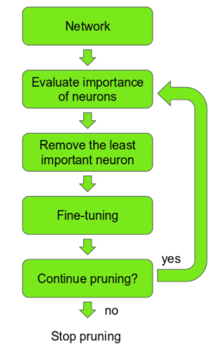
Other Compression techniques :
1. Pruning
Deciding importance of neuron :
The ranking can be done according to the L1/L2 mean of neuron weights, their mean activations, the number of times a neuron wasn’t zero on some validation set, and other creative methods .

Slide 23
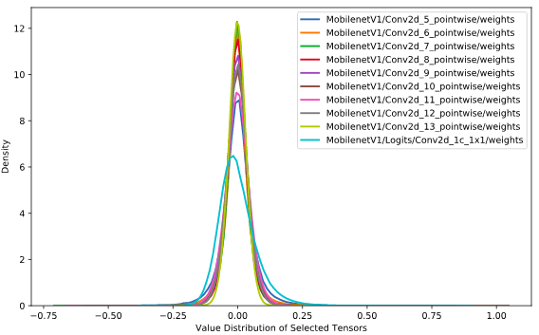

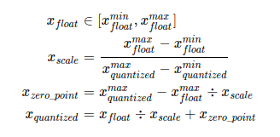
2. Quantisation
Key Idea: The value distribution of neural network weight is of small range, which is very close to 0.
With such value range in (−1,1), quantizing floating point is mapping FP32 to INT8 using
Figure 8 shows weight distribution of 10 layers (layers that have most value points) of MobileNetV1.
where , x_float denotes the FP32 weight,
x_quantized denotes the quantized INT8 weight, and
x_scale is the mapping fractor (scaling factor).

Slide 24


3. Weight matrix factorization using SVD
Singular Value Decomposition of any matrix is
where the columns of U are the left singular vectors,
S has singular values and is diagonal,
and V^{T} has rows that are the right singular vectors.
For a weight matrix A, if we apply SVD on it, we get
where ∑ is a diagonal matrix with A’s singular values on the diagonal in the decreasing order.
In this way we decompose matrix A into two smaller matrices U and N. For one single layer in a DNN model, we replace it with two layers, while the first one has no nonlinear function, and the second one does.

Slide 25
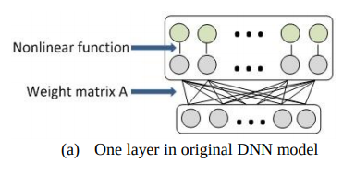
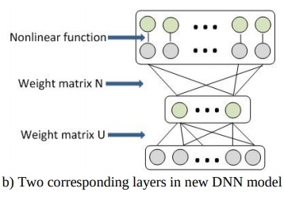
Note : The number of parameters changes from mn to (m+n)k. We reduce the model size significantly if k is much smaller than n.

Slide 26
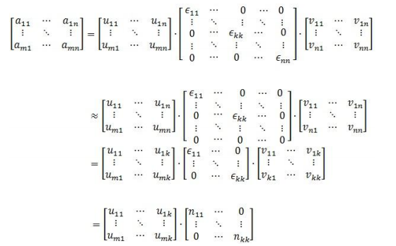
Illustration :

Slide 27
What Next?

Slide 28
MicroNet Challenge Hosted at NeurIPS 2019
Competition Start: June 1st, 2019.
Submission Deadline: Midnight Pacific Time, September 30th, 2019.
Scoring
Two factors will be taken into account when scoring an entry:
1. Parameter Storage: A 16-bit parameter counts as one parameter. If quantization is performed, a parameter of less than 16-bits will be counted as a fraction of one parameter.
2. Math Operations: The mean number of arithmetic operations per example required to perform inference on the test set. Multiplies and additions count separately.
BaseLine : For ImageNet and CIFAR-100, parameter storage, and compute requirements will be normalized relative to MobileNetV2 with width 1.4 (6.9M parameters, 1170M math operations).

Slide 29
References
G. Hinton, O. Vinyals and J. Dean. Distilling the Knowledge in a Neural Network. In NIPS 2014
Carl Doersch. Tutorial on Variational Autoencoders. stat.ML 2016
Song Han, Huizi Mao, William and J. Dally. Deep Compression: Compressing deep neural networks with pruning, trained quantization and huffman coding. In ICLR 2016.
J. Xue, J. Li, and Y. Gong. Restructuring of Deep Neural Network Acoustic Models with Singular Value Decomposition.
W. Joo, W. Lee, S. Park & Il-Chul Moon. Dirichlet Variational Autoencoder.

Slide 30
Thank You

