Slide 1
Automated Automation of REST APIs

Slide 2



Why REST APIs ?
Easy to build
Easy to use
Fast

Slide 3







Testing REST APIs

Slide 4
Ingredient 1 – REST Assured Wrappers
Break Rest Assured calls into parts :–
Create Request
Execute
Validate Response
API Object Model (AOM) on similar lines of Page Object Model (POM)
Reusability of Code
Better Maintenance

Slide 5
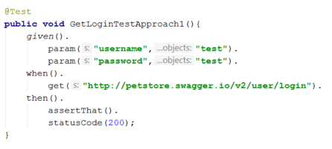
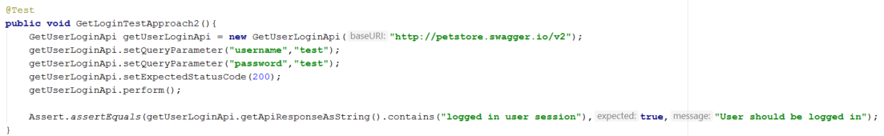
Ingredient 1 – REST Assured Wrappers

Slide 6
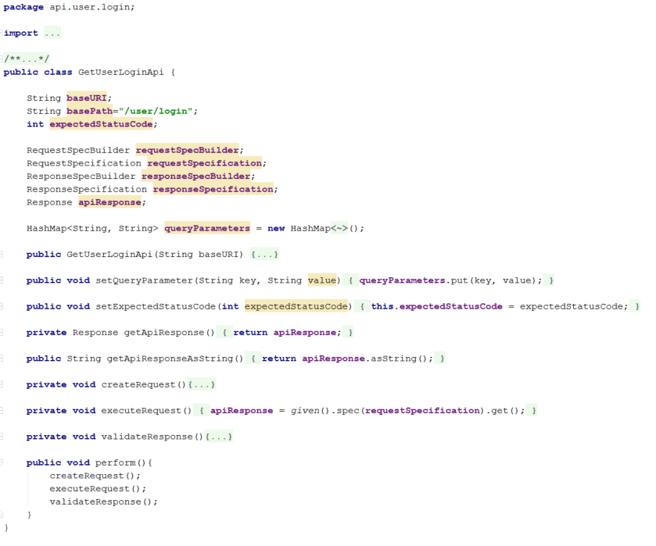
Ingredient 1 – REST Assured Wrappers

