Slide 1

Loan Approval Prediction
A classification workflow to predict loan approval from applicant data
Classification Workflow • Model Comparison • Risk Analysis • FastAPI Deployment

Slide 2

Problem Statement
Predict whether a loan application should be Approved or Rejected
Prediction is based on applicant information: income, education, employment, credit history, and property details
Framed as a binary classification problem (Approved / Rejected)
Goal: build a working, explainable, and deployable prediction system — not just a notebook model
Dataset
Public Loan Prediction dataset (Kaggle / Analytics Vidhya)
~600 applicant records
12 columns: demographics, income, loan terms, credit history, property area

Slide 3

Approach & Tasks
1
2
3
4
Handle Missing Values
Encode Categorical Data
Train Multiple Models
Compare Performance
Mode for categorical columns, median for numeric columns
Label-encode income bracket, education, employment, property area
Logistic Regression, Decision Tree, Random Forest
Accuracy, precision, recall, F1 score across all models
Build a simple prediction form
Cleaning and encoding logic lives in one training script (train_model.py)
Best model (by F1 score) is saved and reused by the prediction service
A minimal HTML form collects applicant details and displays the prediction

Slide 4

Model Comparison
Model | Accuracy | Precision | Recall | F1 Score
Logistic Regression | 0.883 | 0.908 | 0.961 | 0.934
Random Forest | 0.867 | 0.885 | 0.971 | 0.926
Decision Tree | 0.858 | 0.906 | 0.932 | 0.919
3
classification models trained & compared
Logistic Regression selected as the best model (highest F1 score)
All three models trained on the same cleaned, encoded data
Compared using accuracy, precision, recall, and F1 score — not accuracy alone
F1 score balances false approvals against false rejections
Simpler model (Logistic Regression) outperformed tree-based models here
93.4%
best F1 score (Logistic Regression)

Slide 5
Risk Analysis: Prediction Errors
False Approval
False Rejection
A loan that should be rejected is predicted approved
Model output: False Positive
Direct financial / credit risk to the lender
Money is lent to an applicant unlikely to repay
Highest-priority error to minimize in production
A loan that should be approved is predicted rejected
Model output: False Negative
Lost business for the lender
An unfair, costly outcome for a credit-worthy applicant
Trade-off usually accepted to reduce false approvals

Slide 6

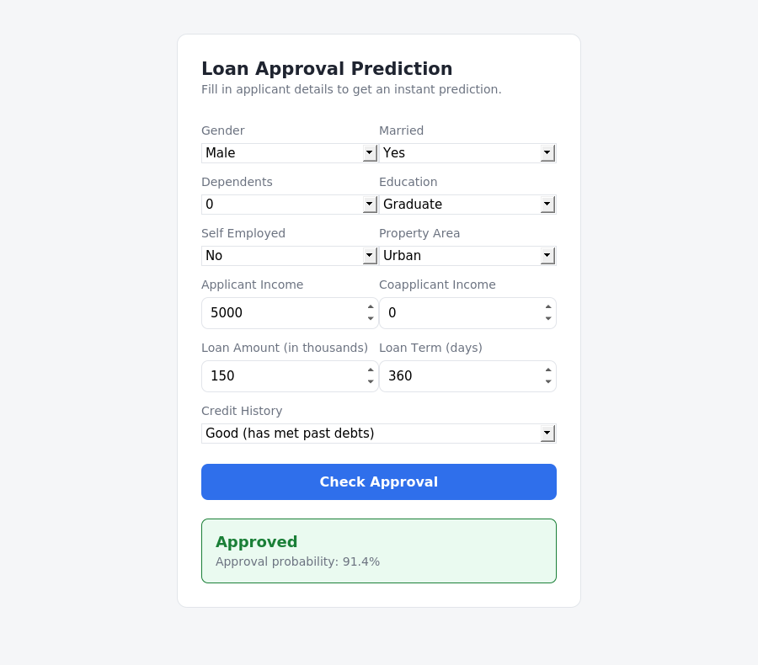
Deployment: API & Prediction Form
train_model.py — cleans, encodes, trains, and saves the best model
app.py — FastAPI service exposing POST /predict
frontend/index.html — minimal form for applicant input
User submits details → API returns decision + approval probability
Clear separation of training and serving reflects real deployment design
Frontend: applicant form + live prediction result

