Slide 1
DEEP FAKE AUDIO DETECTION

Slide 2
TABLE OF CONTENTS
INTRODUCTION
PROBLEM STATEMENT
OBJECTIVE
SYSTEM REQUIREMENTS
EXISTING SYSTEM
PROPOSED SYSTEM
DATA AND METHODOLOGY
ARCHITECTURE
ALGORITHMS
RESULTS
ADVANTAGES AND DISADVANTAGES
REFERENCES
CONCLUSION

Slide 3
INTRODUCTION
WHAT IS DEEP FAKE AUDIO?
Deepfake audio is a type of artificial intelligence (AI) that creates realistic speech that sounds like a specific person. It's also known as voice cloning.
ABSTRACT
Deepfake audio refers to audio recordings that are artificially generated or manipulated to mimic human voices.
With advancements in AI, creating highly realistic deepfake audio has become increasingly accessible, posing risks such as misinformation and fraud.
This project aims to leverage Long Short-Term Memory (LSTM) networks to identify deepfake audio with high accuracy.
The system focuses on feature extraction from audio signals and classifies them as genuine or fake using an LSTM-based model.

Slide 4
PROBLEM STATEMENT
The proliferation of deepfake technology has led to increased misuse in fields like social engineering, misinformation campaigns, and cybercrimes.
Current detection methods often struggle with accuracy, scalability, and adaptability to new types of deepfake audio.
The primary challenge is to build a robust detection system that can analyze audio effectively and identify manipulations.
.

Slide 5
OBJECTIVE
Develop an effective system for detecting deepfake audio using LSTM.
Minimize false positives and false negatives in detection.
Ensure the system is efficient and scalable for real-world applications.
Enhance user trust by identifying potential deepfake audio in various scenarios, including media and security.

Slide 6
SYSTEM REQUIREMENTS
HARDWARE REQUIREMENTS:
System Processor: Intel Core i3 or above.
Hard Disk: 1 TB HDD or 512 GB SSD (recommended), Minimum: 500 GB HDD.
RAM: 8 GB or higher (recommended), Minimum: 4 GB
Peripherals: Keyboard, mouse, and external storage devices for backup
SOFTWARE REQUIREMENTS:
Operating System: Windows 10/11 (64-bit) or Linux (Ubuntu 20.04 LTS)
Programming Language: Python 3.8 or above
Frameworks and Libraries: TensorFlow, Pandas, Seaborn, scikit-learn
IDE: Jupyter Notebook or Google Colab

Slide 7
EXISTING SYSTEM
Simplicity & Interpretability: Easy to implement and understand.
Low Computational Requirements: Efficient for small datasets.
Ease of Feature Engineering: Works with manually extracted features (e.g., pitch, energy).
CHALLENGES OF EXISTING SYSTEM
Limited Feature Representation: Struggles to detect sophisticated deep fake audio artifacts due to reliance on manually engineered features.
Sensitivity to Non-Linearity: Linear model struggles with non-linear patterns in synthetic speech.
Poor Performance on Large Datasets: Struggles with complex, high-dimensional data as dataset size grows.

Slide 8
FEATURES OF PURPOSED SYSTEM
Manual Analysis: Time-consuming and less adaptable.
Shallow Models: Struggle with advanced deep fake detection.
Limited Datasets: Poor generalizability to new data.
BENEFITS OF LSTM-BASED SYSTEM
Enhanced Accuracy: Captures long-term dependencies and improves detection accuracy.
Adaptability: Can easily adapt to new deep fake audio using updated datasets.
Real-Time Detection: Optimized for live monitoring systems.
Minimal Manual Intervention: Eliminates the need for feature engineering.

Slide 9
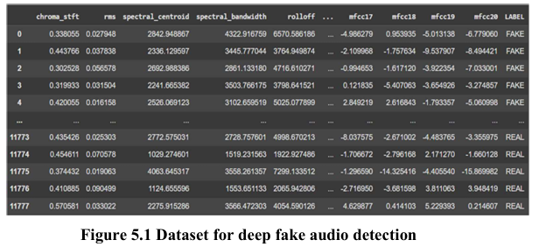
DATA AND METHODOLOGY
DATASETS:
Deepfake audio detection dataset is a collection of real and fake audios. It includes various input factors like chroma_stft, rms, spectral centroid, etc.
The dataset is taken from Kaggle Website (11,778 rows × 27 columns).

Slide 10
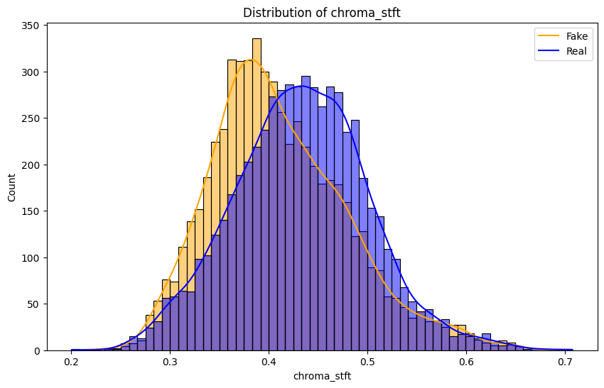
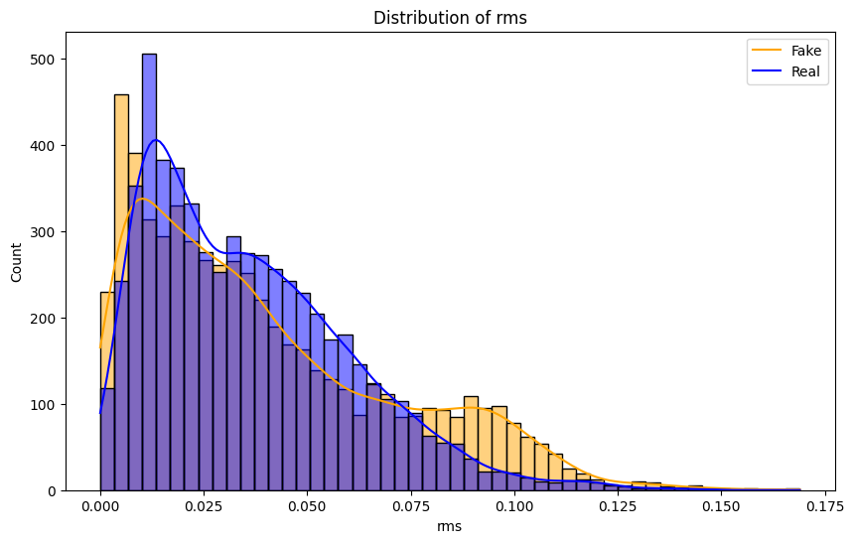
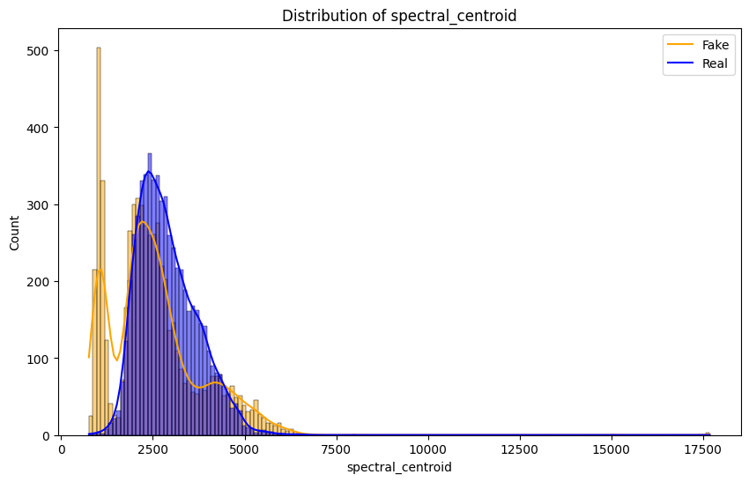
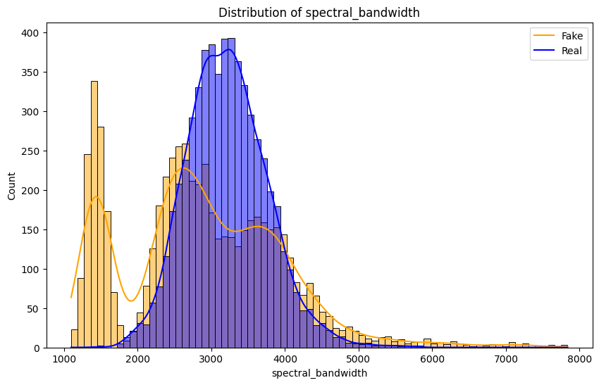
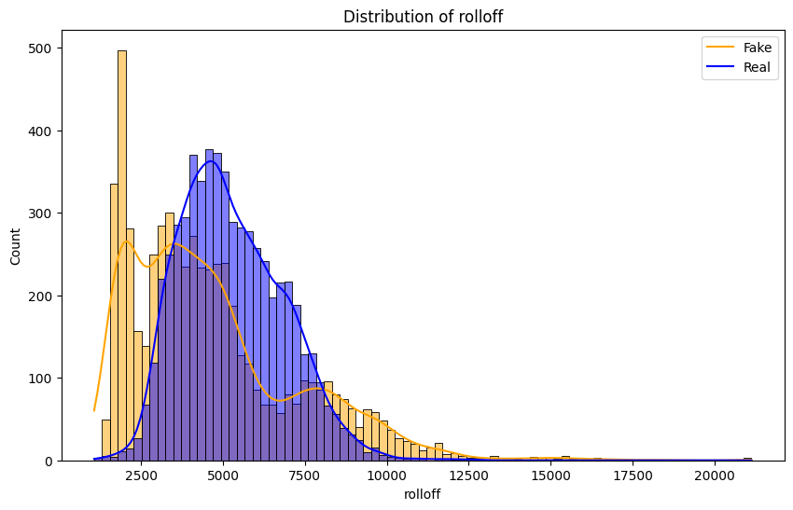
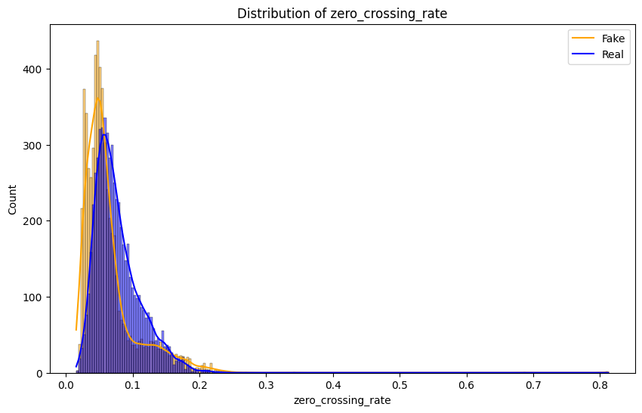
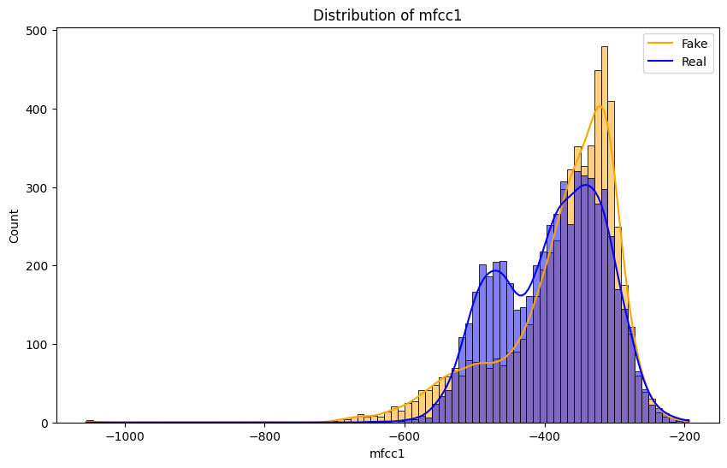
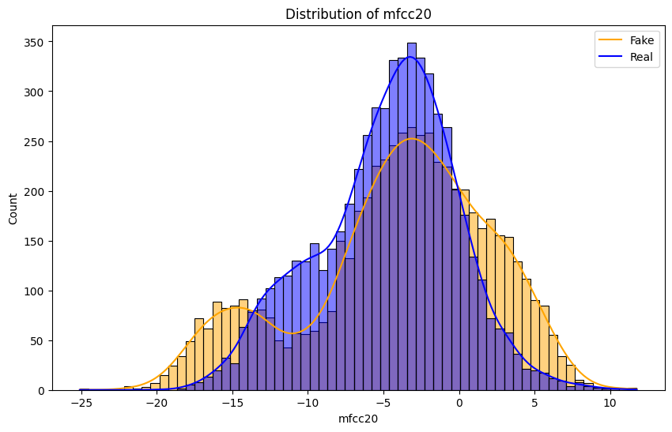
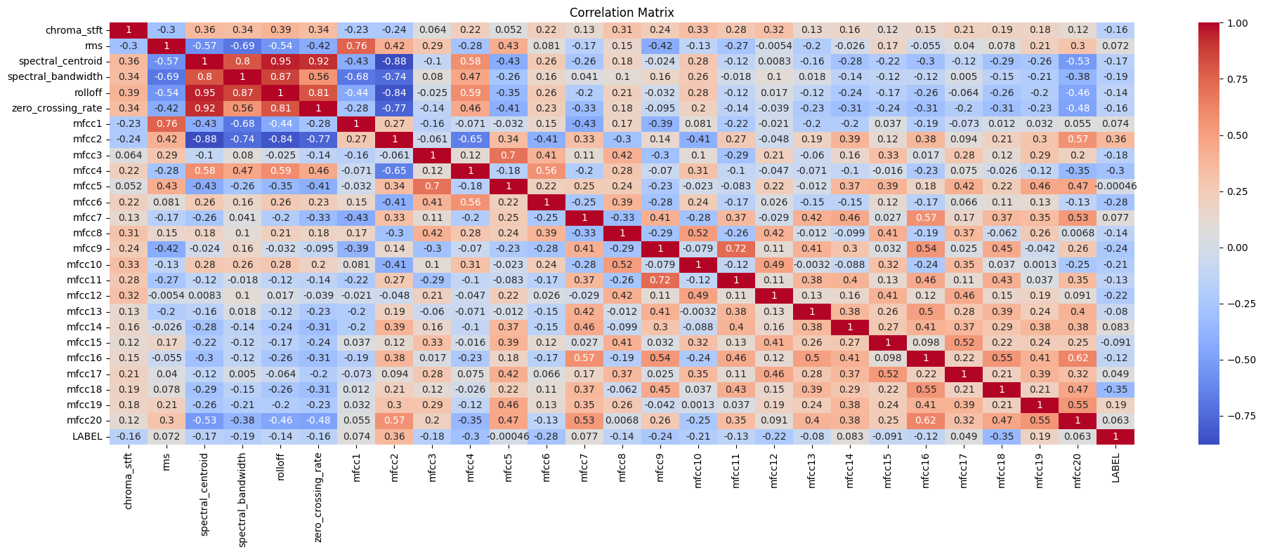

Slide 11
METHODOLOGY
Data Collection:
Gather authentic and manipulated audio samples from publicly available datasets.
Data Preprocessing:
Convert audio signals into features using MFCCs or spectrograms.
Normalize data for consistency.
Model Development:
Build an LSTM-based deep learning model to process sequential audio data.
Training and Validation:
Split the dataset into training, validation, and testing sets.
Train the model using the training set and evaluate using validation data.
Performance Evaluation:
Use metrics like accuracy, precision, recall, and F1-score to assess performance.
Data Collection
Data Preprocessing
Model Development
Training and Validation
Performance Evaluation

Slide 12
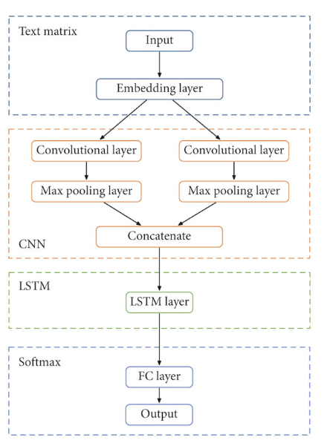
ARCHITECTURE
Input Layer: Raw audio samples are fed into the system.
Preprocessing Layer: Audio is preprocessed using techniques like noise reduction and feature extraction (e.g., Mel-frequency cepstral coefficients - MFCCs).
LSTM Model: The preprocessed data is fed into an LSTM network, designed to handle sequential data and identify patterns.
Output Layer: The system classifies the audio as genuine or fake.

Slide 13
ALGORITHMS
1. Long Short-Term Memory (LSTM):
Handles sequential and time-series data effectively.
Captures long-term dependencies, making it ideal for audio analysis.
2. Feature Extraction:
MFCCs: Extracts key audio features that represent the time-frequency domain of the signal.
Spectrograms: Visualizes the frequency spectrum of the signal over time.
Feature Extraction
Data feeding into LSTM
Classification

Slide 14
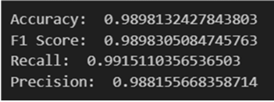
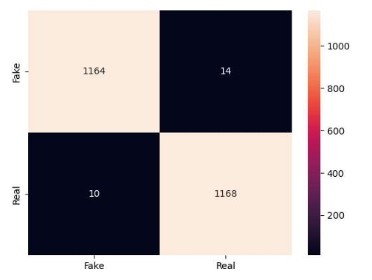
RESULTS
1. Evaluation Metrics:
Precision & Recall: Assess false positives and negatives.
F1-Score: Balance between precision and recall.
Accuracy: Measure the overall classification success.
2. Confusion Matrix:
Visualizes the classification results, showing the number of true positives, true negatives, false positives, and false negatives.

Slide 15
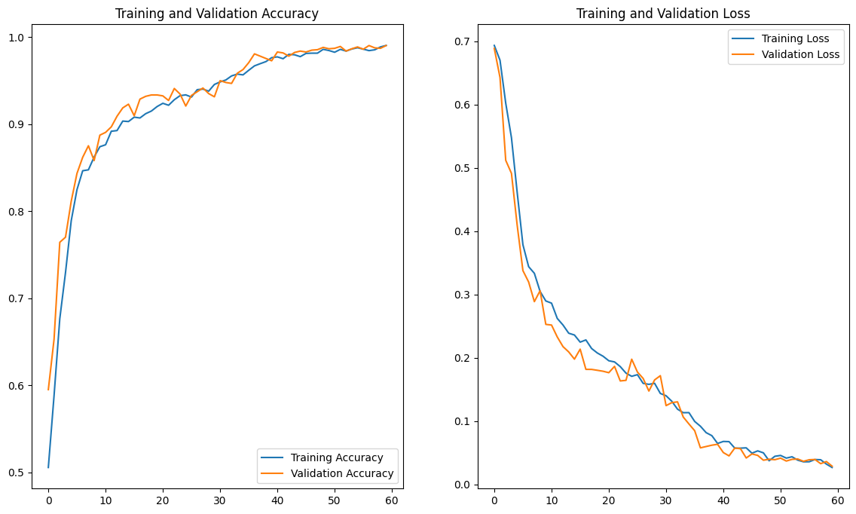
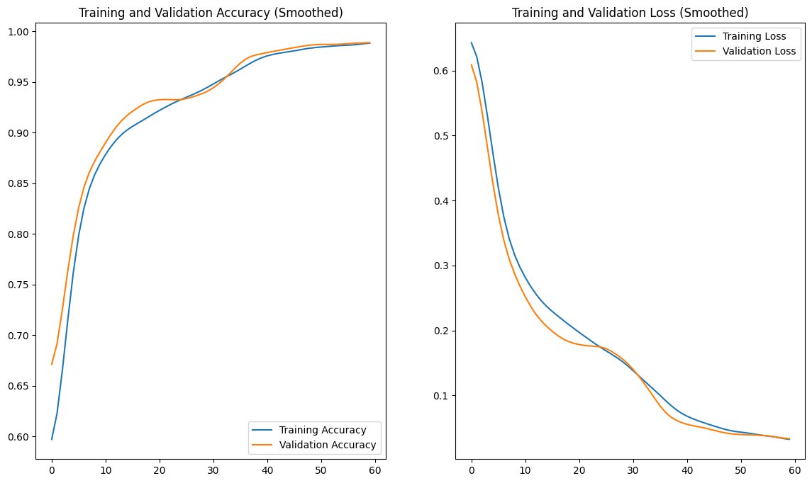
3. Training and Validation Metrics:
Training and validation accuracy/loss are plotted over epochs to observe the learning process.
a)Accuracy and Loss Curve
Smoothed curves (using Gaussian filtering) are provided for better visualization of trends
b)Smoothed Curve

Slide 16
ADVANTAGES AND DISADVANTAGES
Advantages:
High detection accuracy due to the use of advanced LSTM networks.
Scalability for processing large datasets.
Adaptable to different types of audio manipulations.
Disadvantages:
Computationally intensive during training.
Requires high-quality labeled datasets for optimal performance.

Slide 17
CONCLUSION
This project demonstrates the potential of LSTM in detecting deepfake audio with high accuracy.
It provides a scalable solution for combating the misuse of AI-generated audio.
Future Work:
Enhance real-time detection capabilities.
Experiment with other neural network architectures like Transformers.
Integrate the system into applications like social media monitoring and fraud detection

Slide 18
REFERENCES
Gulrajani, I., et al. (2020). Detecting Deep fake Audio Using Temporal Patterns in Speech. Proceedings of the IEEE International Conference on Acoustics, Speech, and Signal Processing (ICASSP).
Korshunov, P., & Marcel, S. (2018). Deep Fake Detection Using Recurrent Neural Networks.
Ian Goodfellow, Yoshua Bengio, and Aaron Courville. Deep Learning. MIT Press, 2016.
Jurafsky, D., & Martin, J. H. (2023). Speech and Language Processing (3rd ed.). Pearson.
"A Beginner’s Guide to LSTMs and How to Implement Them": https://towardsdatascience.com

Slide 19
THANK YOU..

