Slide 1
Wipro Tech Wear
An Ecommerce application for buying tech gadgets

Slide 2
Application Types
1. Web Application
2.Mobile Application

Slide 3
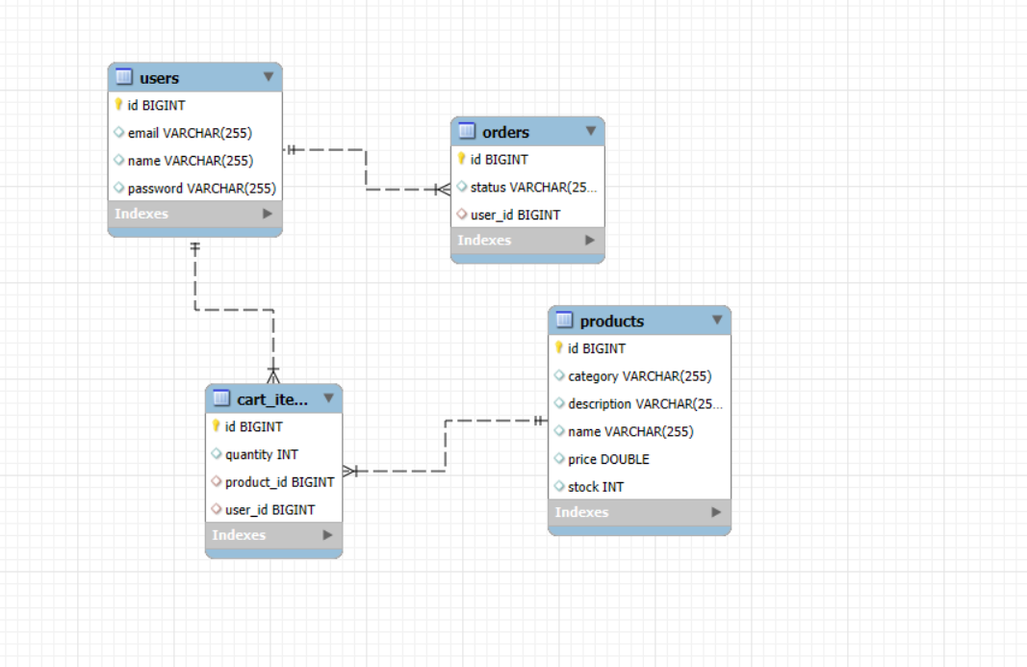
Web Application
Backend part

Slide 4
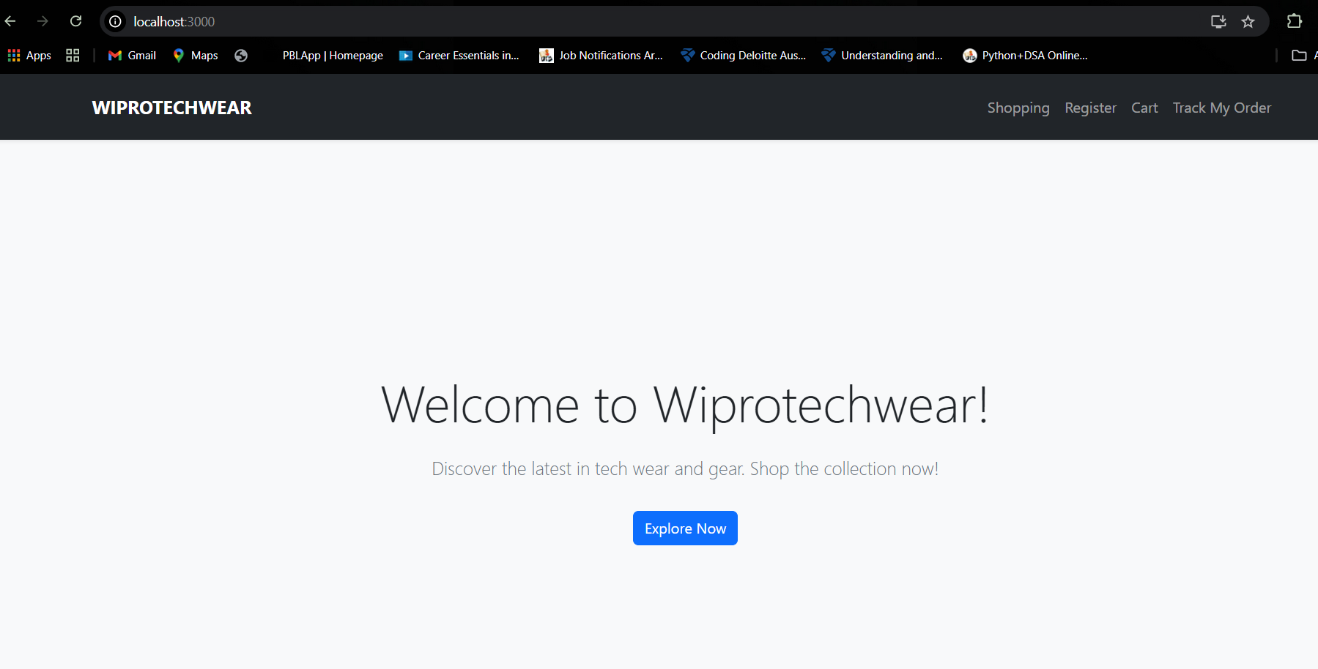
Front-end

Slide 5
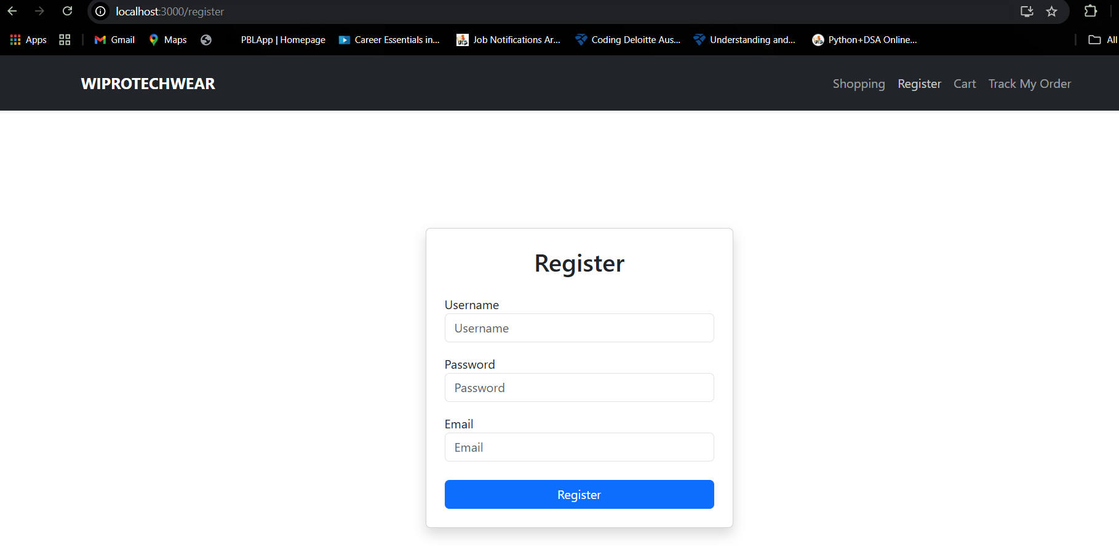
Register form

Slide 6
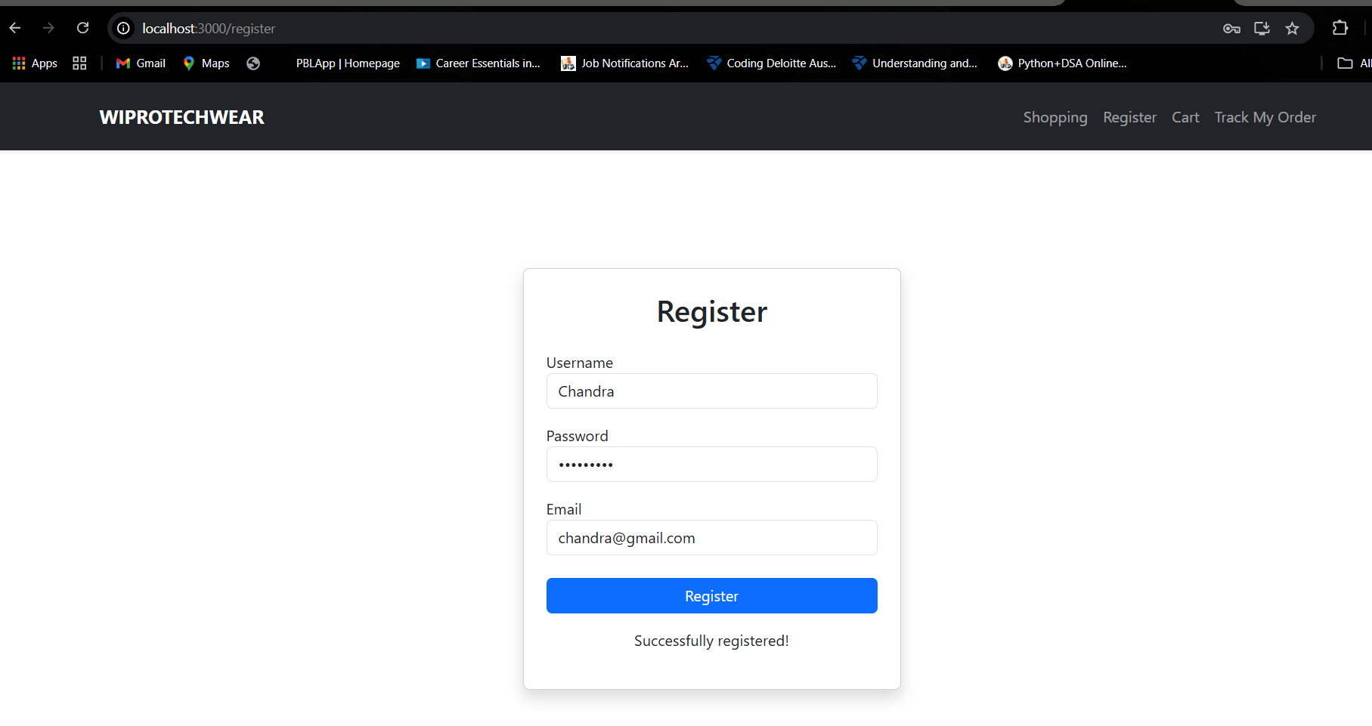
Register form

Slide 7
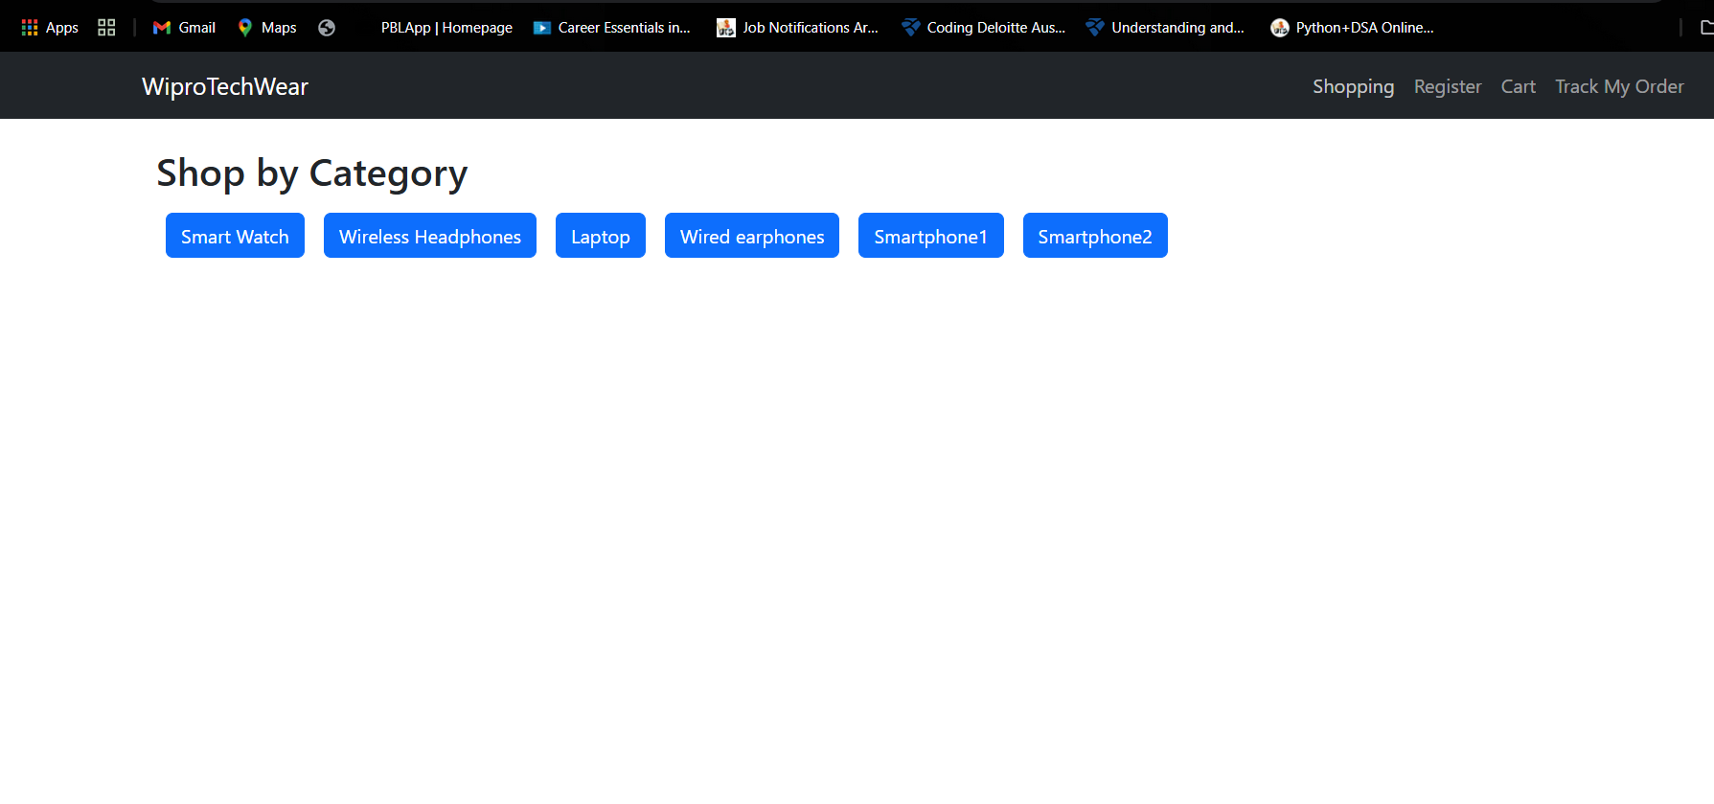
Shopping

Slide 8
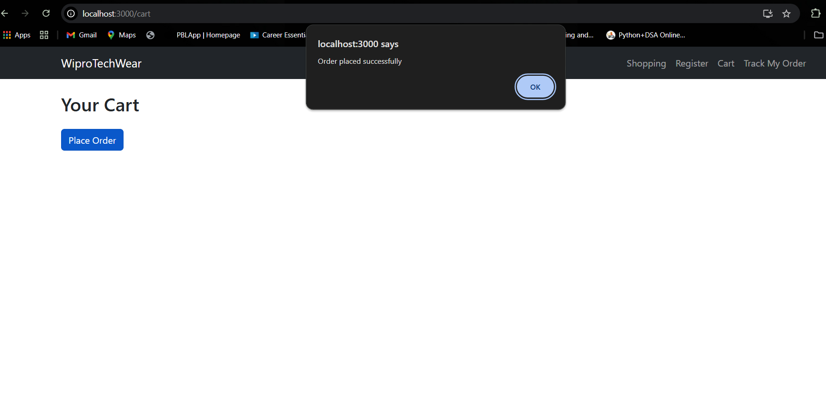
Cart

Slide 9
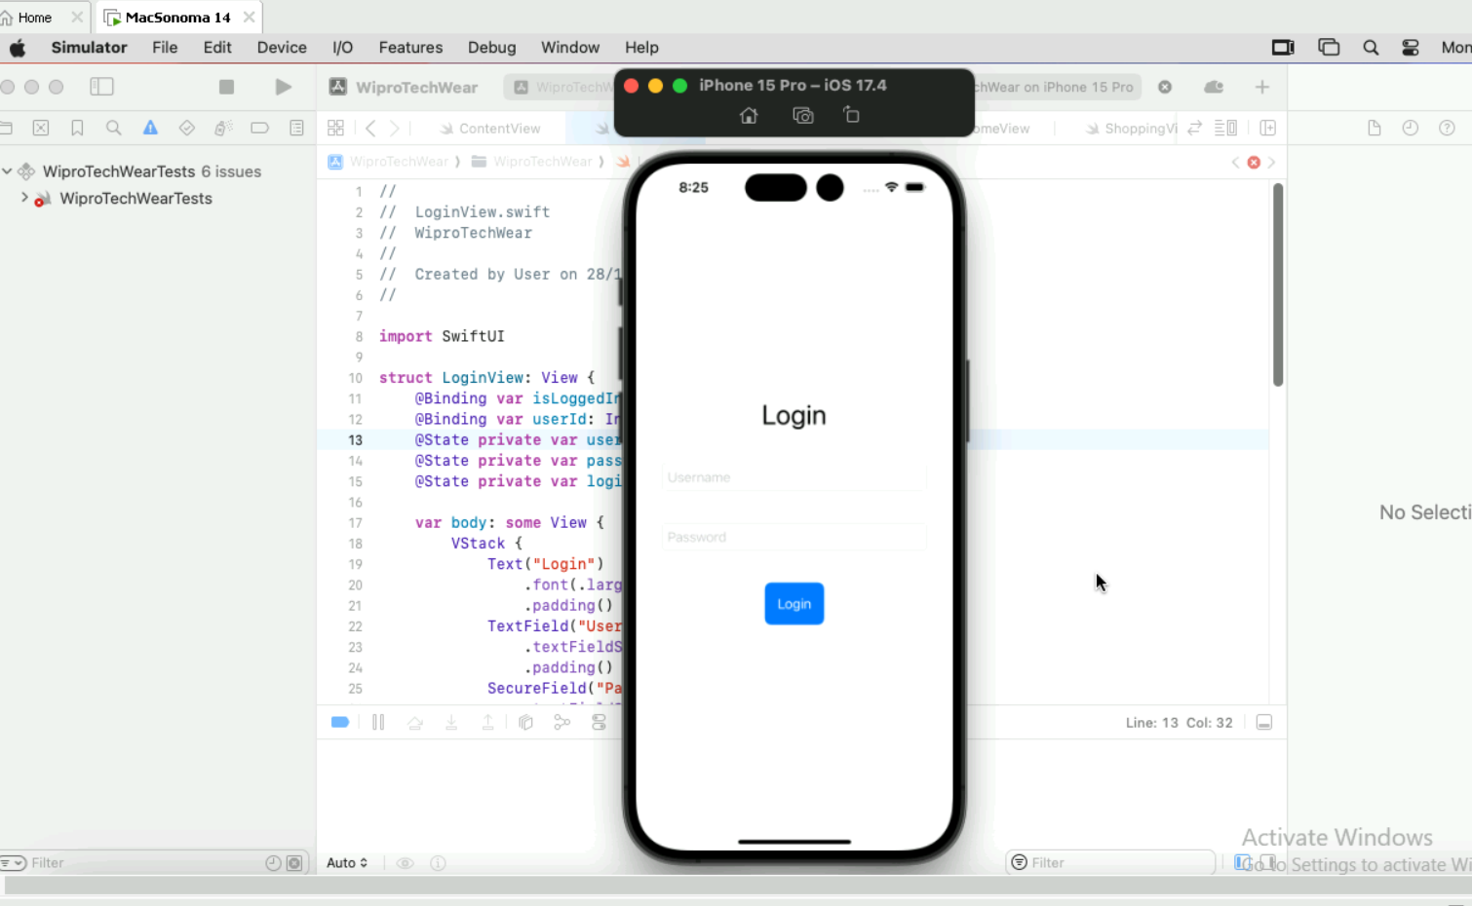
Mobile Application

Slide 10
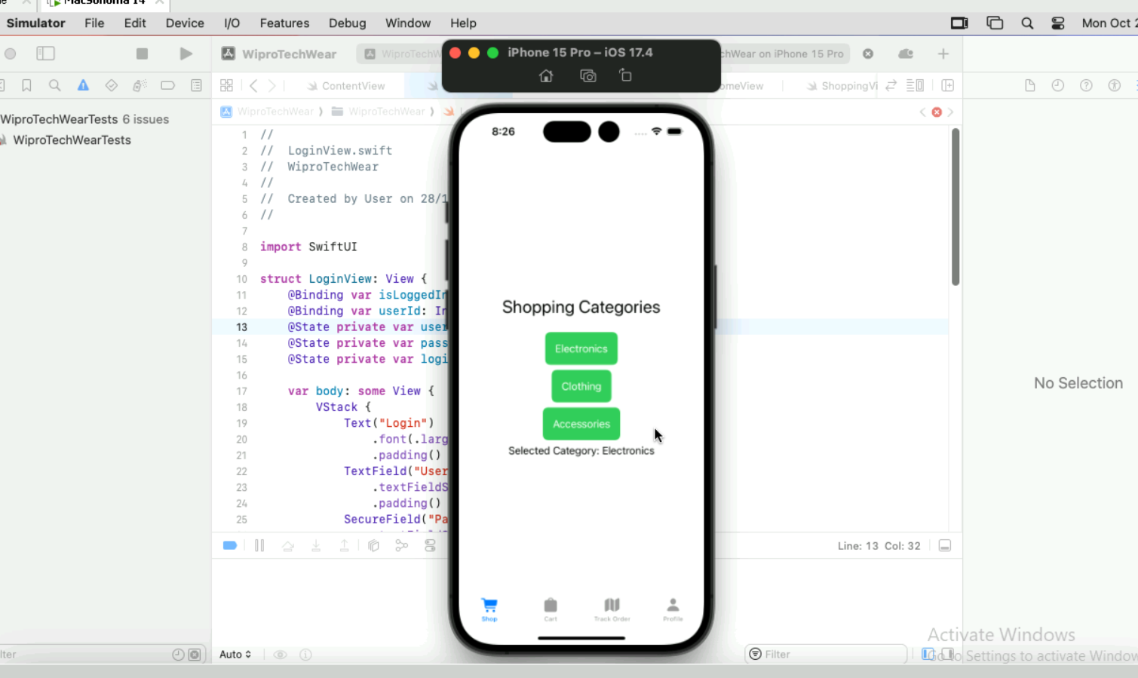
Shopping categories

Slide 11
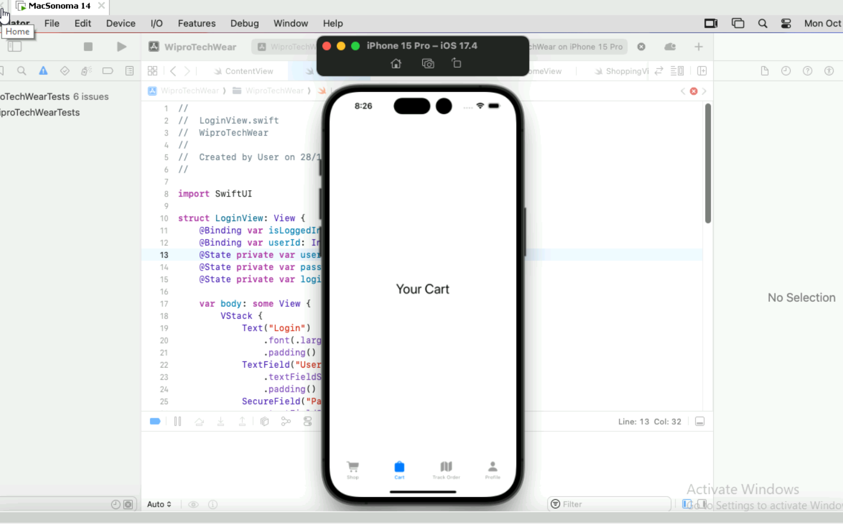
Cart

Slide 12
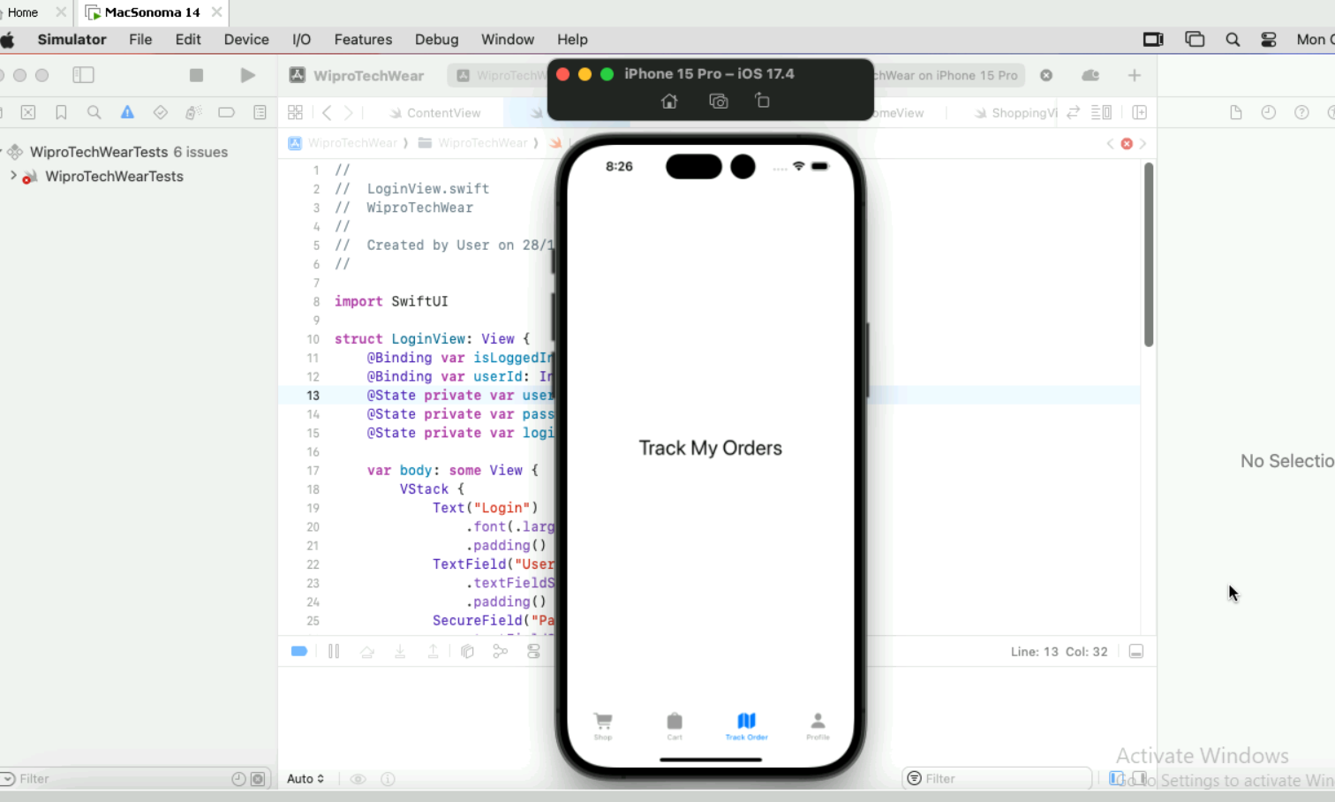
Track My Orders

Slide 13
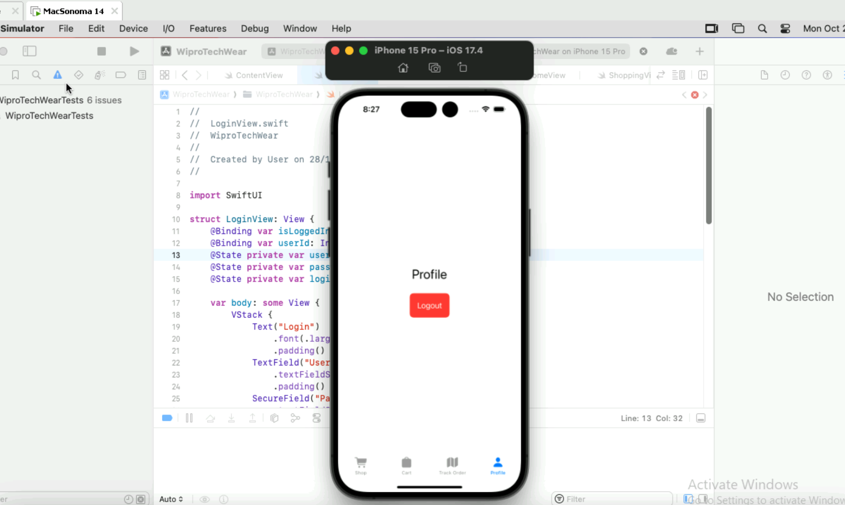
Profile Logout

Slide 14
Thank you…..

