Slide 1

KISAN ALERT
Smart Water, Crop & Advisory System
Voice-and-photo crop diagnosis and irrigation advisory for small and marginal farmers, in their own language.
Code for Communities · Kisan Alert Track · Built by Gopichand

Slide 2
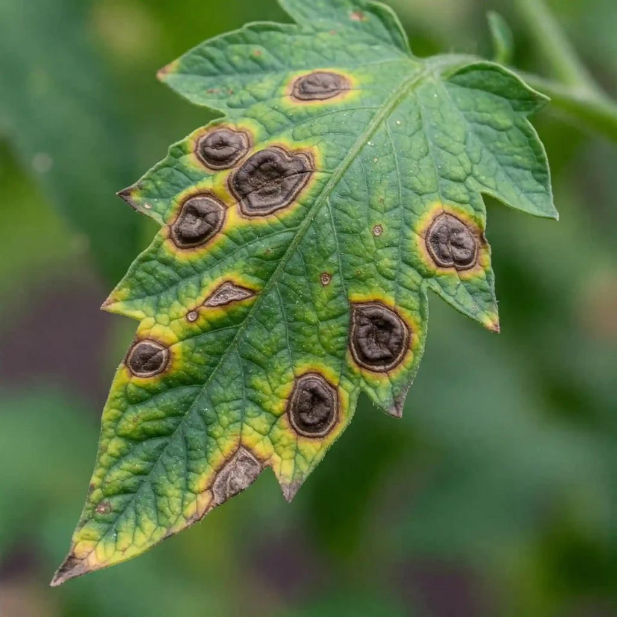
The Problem
Small and marginal farmers lose crops and money every season — not from lack of effort, but from lack of data.
Crop choices based on habit or hearsay
not soil health, groundwater, or rainfall data
Unpredictable monsoons
make timing irrigation and planting a guessing game
No fast expert help
when a disease or pest appears on a crop
This gap was submitted directly by a Member of Parliament's office — a real problem for real constituents.
Real tomato leaf blight — this exact problem, unaddressed
Kisan Alert · Code for Communities · Kisan Alert Track
2

Slide 3



Our Solution
A voice-and-photo agricultural intelligence platform, in Indic languages.
Crop Health Diagnosis
Weather & Irrigation Advisory
Crop Recommendation
Speak or type a description + upload a photo. Gemini diagnoses the issue and speaks the advisory back.
7-day rainfall forecast per village. Dry-spell alerts nudge irrigation before damage happens.
Satellite + soil data to suggest what to plant. Designed for Phase 2, shares the same data model.
BUILT & WORKING
BUILT & WORKING
PHASE 2 ROADMAP
Kisan Alert · Code for Communities · Kisan Alert Track
3

Slide 4





How It Works — The Farmer's Journey
1
2
3
4
5
Speak or type
Upload photo
AI diagnosis
Hear the answer
Expert follow-up
Farmer describes the crop problem, in their own language
A photo of the affected leaf, stem, or fruit
Gemini analyzes photo + description together
Advisory spoken back in the farmer's language
Uncertain/severe cases flagged to the local RSK
Same loop, different entry: for weather advisory, the farmer just enters their village name instead.
Kisan Alert · Code for Communities · Kisan Alert Track
4

Slide 5
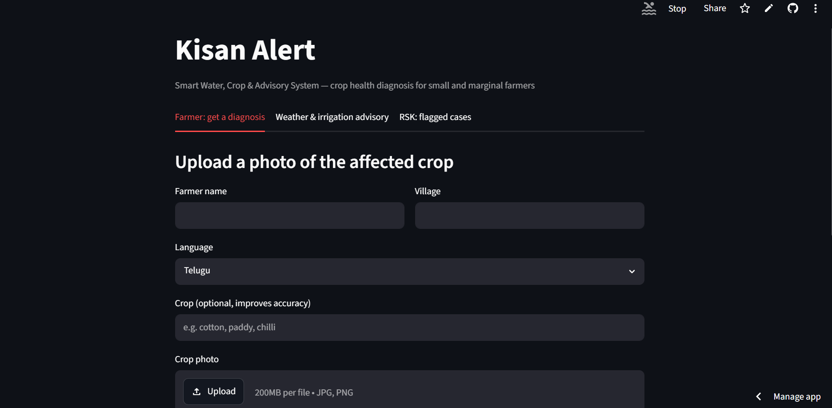
The Interface — Live and Working
Deployed and tested end-to-end — not a mockup.
Kisan Alert · Code for Communities · Kisan Alert Track
5

Slide 6
AI & Technical Approach
Photo + voice
Gemini API
(multimodal)
Diagnosis text
(translated)
Gemini TTS
Firestore log
+ RSK flag
One Gemini call replaces three separate APIs: it reads audio directly (no separate Speech-to-Text), reasons over the image, and writes the response in the target language (no separate Translation API).
Gemini's native speech generation converts the advisory to spoken audio in the farmer's own language.
Cases are automatically triaged: low-confidence or serious diagnoses are flagged for a human Rythu Seva Kendra expert — the AI knows when not to be the final word.
Kisan Alert · Code for Communities · Kisan Alert Track
6

Slide 7
Tech Stack — Built Entirely on Free Tiers
Layer | Technology | Cost
Diagnosis + voice + translation | Gemini API (Google AI Studio) | Free — no card
Weather forecast | Open-Meteo | Free — no key needed
Case logging | Firestore (Firebase Spark plan) | Free — no card
Interface | Streamlit (native mic recording) | Open source
Hosting | Streamlit Community Cloud | Free
Zero credit card, zero subscription — from local build to public deployment.
Kisan Alert · Code for Communities · Kisan Alert Track
7

Slide 8



Who It Serves
Small & marginal farmers
Rythu Seva Kendra network
Any smartphone
The majority of India's farming population, most exposed to crop loss from guesswork
Existing government infrastructure — no new institution needed, just a smarter front door
No specialized hardware or sensors — camera and microphone are enough
Andhra Pradesh alone has thousands of Rythu Seva Kendras — each one a potential pilot site.
Kisan Alert · Code for Communities · Kisan Alert Track
8

Slide 9

Why This Is Deployable, Not Just a Demo
Zero-cost infrastructure
Runs entirely on free tiers — a district or MP's office can pilot this with no procurement, no budget approval cycle.
Real institutional handoff
Ties directly into Rythu Seva Kendras, an existing network — not a parallel system that needs new staff or training.
Graceful failure handling
Rate limits and errors are caught and shown as calm messages, not crashes — built for real users, not just a demo.
No specialized hardware
Works on any farmer's existing smartphone — camera and mic only.
Kisan Alert · Code for Communities · Kisan Alert Track
9

Slide 10
Beyond the Pilot — Scale Roadmap
NOW
Diagnosis + Weather Advisory
Two working core flows, deployed and tested — the foundation for everything below.
PHASE 2
Crop Recommendation Engine
Satellite + soil data (Earth Engine) to recommend what to plant, writing into the same Firestore schema.
PHASE 3
SMS / IVR Gateway
Reach farmers without smartphones — same diagnosis pipeline, different entry point.
Every phase shares the same farmers/cases data model — no rebuild, just extension.
Kisan Alert · Code for Communities · Kisan Alert Track
10

Slide 11

From Guesswork to Guidance
Kisan Alert turns “something is wrong with my crop” into “here's what to do, in my own language” — in under a minute, at zero infrastructure cost.
Working prototype · Live deployment · Ready for pilot
Thank you.

