Slide 1
Movie Performance
Analysis
presented by
Gopika

Slide 2
Introduction
The Movie Performance Analysis project examines a dataset of over 12,000 movies spanning from 1850 to 2024. Analyzing this data helps understand audience behavior, revenue trends, top-performing genres, and global production patterns.
Power BI is a business intelligence and data visualization tool that transforms raw movie data into interactive dashboards and insightful reports. It helps explore data, identify patterns, and make data-driven decisions effectively.
A Power BI dashboard built on this movie dataset can simplify analysis and provide actionable insights for industry stakeholders.

Slide 3
Problem Statement
Movie industry data is large and complex, making it difficult to analyse performance and identify meaningful patterns using traditional methods. Without proper visualization and analysis, it becomes challenging to track revenue trends, evaluate genre performance, and make informed business decisions.
This project aims to address this by developing a Movie Performance Analysis Dashboard using Power BI that converts raw data into interactive visualizations for effective analysis and decision-making.

Slide 4
Business Problem:
Which movie genres and genre combinations generate the highest total revenue, and which genres perform best overall?
How does movie revenue change over the years, and what overall trend can be observed in terms of growth or decline?
What is the distribution of movies across different status categories, and which status category dominates the dataset?
Which original language has the highest number of movies, and how are movies distributed across different languages?
What is the proportion of adult versus non-adult movies in the dataset?
How does revenue vary across different genres and original languages, and which combination generates the highest revenue?
Which countries produce the highest number of movies, and how is movie production distributed globally?

Slide 5
Data Overview
✓ Data Fields:
• Movie ID & Title
• vote_count
• Genre & Genre Combinations
• Original Language
• Release Year & Date
• Production Country
• Revenue & Budget
• Movie Status (Released / In Production / Planned etc.)
• Profit
• Adult Classification (True / False)

Slide 6
Technology Used
► Data Source:
Movie Dataset (Excel / CSV format)
► Data Preparation & Transformation (ETL):
Power Query: To clean, transform, and structure data
Data Modeling: Creating tables for Genre, Language, Country
► Data Analysis & Visualization:
Power BI:
Charts: Area chart, Bar chart, Donut chart, Line chart, Map
Measures using DAX
► Data Insights & Reporting:
Power BI Dashboard: Interactive visualizations
Filters & Slicers: By genre, language, country, year, status

Slide 7
Data Preprocessing
The Best Tool For Cleaning And Preprocessing The Data Is Called Power Query Editor.
It Is Used For Extracting The Data, Transforming The Data And Loading Into Power BI.
✓ Data Cleaning steps :
Changing the data types of columns such as release date, rating, revenue, and budget appropriately.
Removing unnecessary columns to improve data quality and model performance.
Handling missing values by replacing nulls in revenue and budget with 0 and filling missing genres with “Unknown”.
Cleaning text fields by removing extra spaces and inconsistencies using Trim & Clean operations.
Splitting the genre column into multiple values for better genre-wise analysis.
Creating new columns such as Profit (Revenue – Budget) and movie category (Hit / Average / Flop).
Removing duplicate movie entries to ensure accurate analysis.

Slide 8
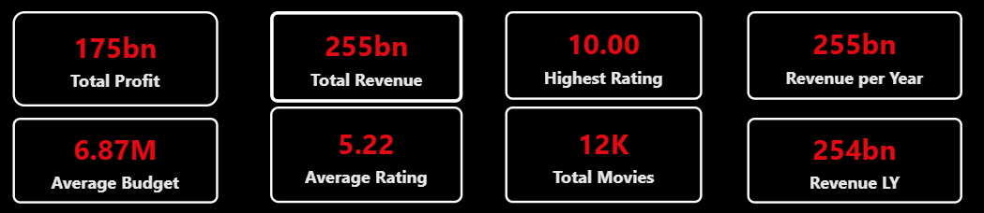
Key Metrics and KPI's
These KPIs give a quick snapshot of movie industry performance
e

Slide 9
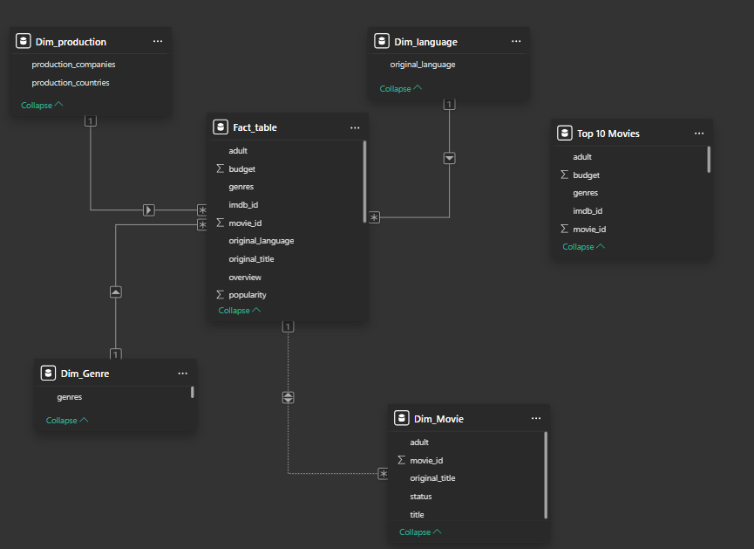
Data Modelling – Overview
The Power BI data model is built on a star-schema structure with the central fact table connected to multiple dimension tables:

Slide 10
DAX Measures
DAX is called as Data Analytic Expression.
DAX is a formula language used in Power BI to perform calculations and data analysis.
✓ Measures:
Total Revenue = SUM('Movie Data'[Revenue])
Total Profit = SUM('Movie Data'[Revenue]) - SUM('Movie Data'[Budget])
Total Movies = DISTINCTCOUNT('Movie Data'[Movie_ID])
Average Rating = AVERAGE('Movie Data'[Rating])
Average Budget = AVERAGE('Movie Data'[Budget])
Revenue LY = CALCULATE([Total Revenue], SAMEPERIODLASTYEAR('Calendar'[Date]))

Slide 11
Power BI Dashboard Overview
The Movie Performance Dashboard in Power BI is designed to provide a comprehensive, at-a-glance view of the entire movie industry dataset.
KPI Cards
Genre Revenue Chart
Total Revenue · Total Profit · Total Movies · Avg Rating · Avg Budget
Horizontal bar chart showing top genres by total revenue
Revenue Trend Line
Status Donut
Area/line chart showing revenue growth from 1850–2024
Pie/donut showing Released vs In Production vs others
Language Treemap
Country Map
Visual map of movie count by original language
Global map of movie production volume by country

Slide 12
Overall Revenue Trend Analysis
Area Chart: It clearly shows total revenue over time and allows you to see growth patterns and peaks.
X-axis: Year (1850 → 2024)
Y-axis: Revenue Index

Slide 13
Top Selling Genre based on Revenue
Donut chart → Shows Percentage contribution of each genre to total revenue
Legend: Genre Combination
Values: % of Total Revenue
22% Action+Adventure+Sci-Fi
18% Adventure+Sci-Fi
15% Drama+Romance
13% Adventure+Action

Slide 14
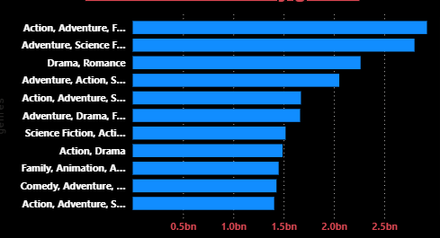
Identify Top Genres by Revenue
Stacked bar chart → Horizontal bars for easy comparison across genres. Y-axis: Genre Name | X-axis: Total Revenue (bn)

Slide 15
Distribution of Movies by Status
Donut chart: Shows customer demand and distribution of movies across production stages.
X-Axis: Status Category
Y-Axis: Number of Movies
98%
Released — dominates
0.81%
Still in pipeline
<0.2%
Canceled / Rumored

Slide 16
Movie Count by Original Language
Treemap / Bar chart: Shows which original language has the highest number of movies. X-Axis: Language | Y-Axis: Movie Count

Slide 17
Identify Orders Based on Adult Classification
Bar Chart: Analyses adult vs non-adult content distribution in the dataset.
X-Axis: Classification (Adult / Non-Adult)
Y-Axis: Number of Movies
50.53%
Adult content
~6M movies
49.47%
Non-Adult content
~5M movies

Slide 18
Analyse Genre-wise Revenue Trend
Line Chart: These charts show revenue variation across genres and languages. X-axis: Genre | Y-axis: Revenue (bn) | Legend: Language

Slide 19
Movie Production by Country
Map / Bar Chart: Shows which countries produce the highest number of movies. X-Axis: Country | Y-Axis: Number of Movies

Slide 20
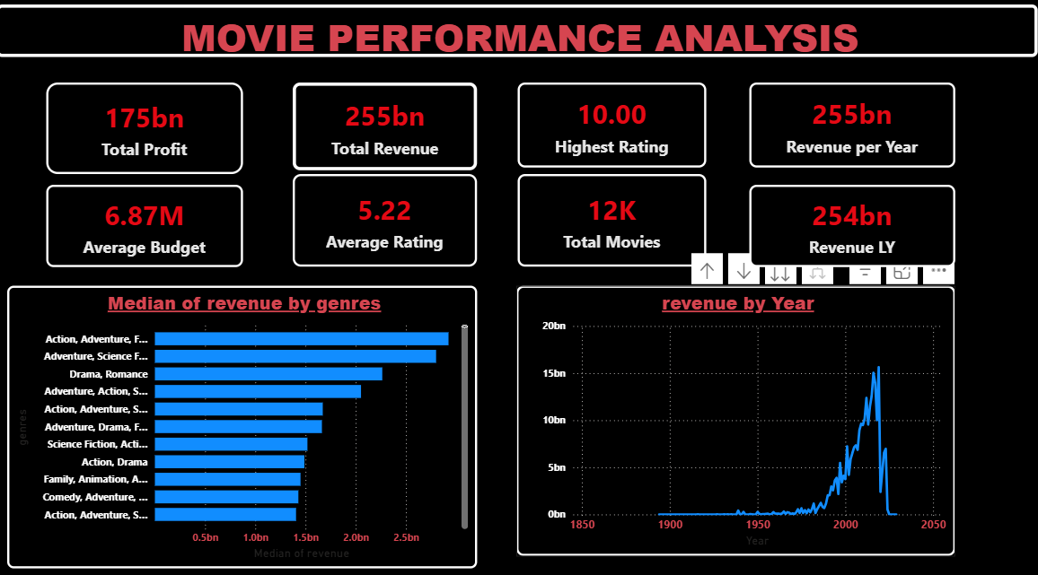
DASHBOARD

Slide 21
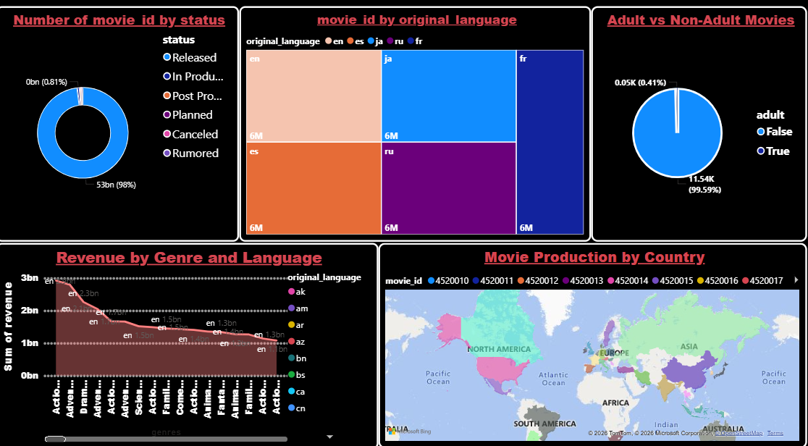

Slide 22
Conclusion
The Movie Performance Dashboard in Power BI provides a comprehensive view of revenue trends, genre performance, and global production insights, enabling data-driven decisions and optimized strategies.
The dashboard highlights strong industry performance, with Total Revenue reaching 255bn and Total Profit at 175bn across 12K movies. This indicates consistent demand and healthy financial returns.
Revenue trends show significant growth from the 1990s through 2010s, with a peak around 2008–2012, followed by a COVID-era dip in 2020 and early signs of recovery thereafter, suggesting clear cyclical patterns.
Genre analysis reveals that Action+Adventure+Sci-Fi multi-genre combinations consistently outperform single-genre titles, while English-language productions command disproportionately higher revenue per title compared to other languages.

Slide 23
Thank you

