Slide 1
Namma Yatri data analysis -Data-Driven insight & strategic recommendations
Technical perspective
Gopika Rajkumar
Haripriya althi
Divyanshu Shekhar

Slide 2
Introduction
Namma Yatri is a Direct-to-Driver open mobility platform, developed by Juspay, powering the next-generation of mobility applications in India.app that has become Bengaluru's most loved auto app, since its formal launch in January 2023.

Slide 3
Purpose and Goals
Project Overview:
Review of data analysis findings to inform technical development.
Focus on system optimization, feature enhancement, and performance.
Translating insights into actionable development tasks.
Key Objective: Understand user behavior, ride performance, and revenue drivers
Outcome: Actionable insights and technical suggestions.

Slide 4
Data Integration and Structure
Overview of the data sources and tables (Assembly, Duration, Payment, Trip Details, Trips)
Explanation of the data joins and relationships
Discussion of data types and potential normalization/optimization.

Slide 5
Handling Peak Demand
Highlighting peak demand periods (8-10 AM, 5-8 PM).
Implications for server load, database performance, and scalability.
Strategies for load balancing, caching, and queue management.

Slide 6
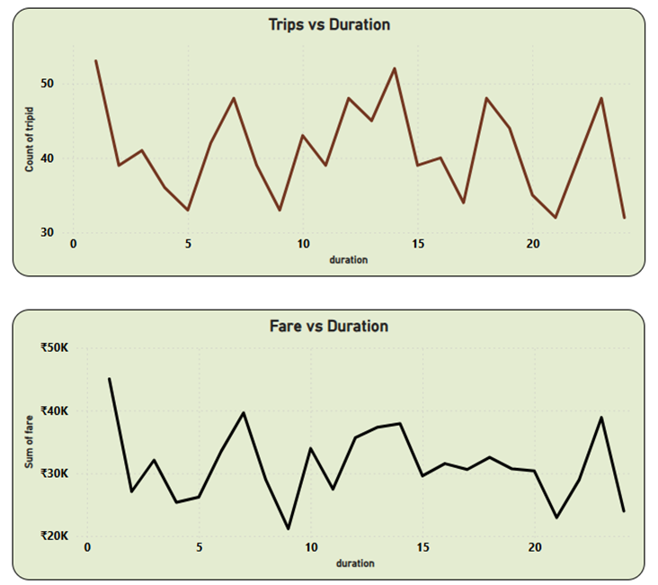
Revenue-Related Data Points
Analysis of fare data and its relation to trip duration and time of day.
Considerations for dynamic pricing algorithms or surge pricing features
Secure and efficient handling of payment data
Technical Considerations
Implementation of fare calculation logic.
Integration with payment gateways.
Data security and compliance (e.g., PCI DSS).

Slide 7
Geospatial Data and Analysis
Importance of location data (loc_from, loc_to, Assembly).
Technical challenges and opportunities related to location accuracy, geocoding, and routing.
Analysis of high-performing zones and implications for service availability.
Technical Considerations:
Use of mapping libraries and APIs.
Optimization of location-based queries.
Real-time location updates and tracking.

Slide 8
User Behaviour - Feature Development
Analysis of user interactions (searches, estimates, quotes, OTP).
Insights into user behaviour and potential areas for feature improvement.
Emphasis on the impact of quote searches on trip completion.
Technical Considerations:
Implementation of search and quote functionality.
User interface/user experience (UI/UX) considerations.
Data logging and analytics for user behaviour tracking.

Slide 9
Handling Cancellations
Review of cancellation rates and their impact on the system.
Technical strategies for reducing cancellations (e.g., real-time updates, communication features).
Importance of cancellation reason tracking.
Technical Considerations:
Implementation of cancellation mechanisms.
Notification systems and real-time updates.
Data storage and analysis of cancellation reasons.

Slide 10
System Performance
Identifying key performance indicators (KPIs) (e.g., response time, error rates).
Strategies for monitoring, testing, and optimizing system performance.
Importance of scalability and reliability.
Technical Considerations:
Load testing and performance profiling.
Code optimization and refactoring.
Server infrastructure and resource management.

Slide 11
API Design and Integration
Review of API endpoints and data exchange formats.
Security considerations for APIs.
Strategies for API versioning and documentation.
Technical Considerations:
API design principles (e.g., RESTful APIs).
Authentication and authorization.
Data serialization and deserialization (e.g., JSON).

Slide 12
Future Development- Next Steps
Roadmap for implementing recommended features and optimizations.
Prioritization of development tasks.
Considerations for new technologies or architectural changes.
Discussion Points:
Microservices architecture.
Real-time data streaming.
Machine learning for predictive analysis.

Slide 13
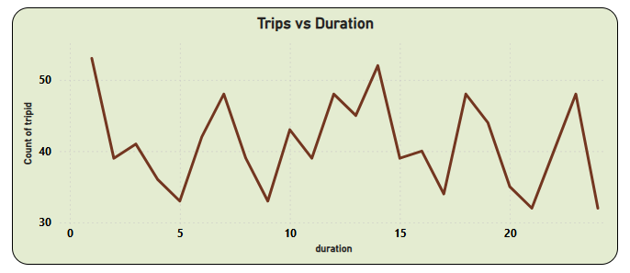
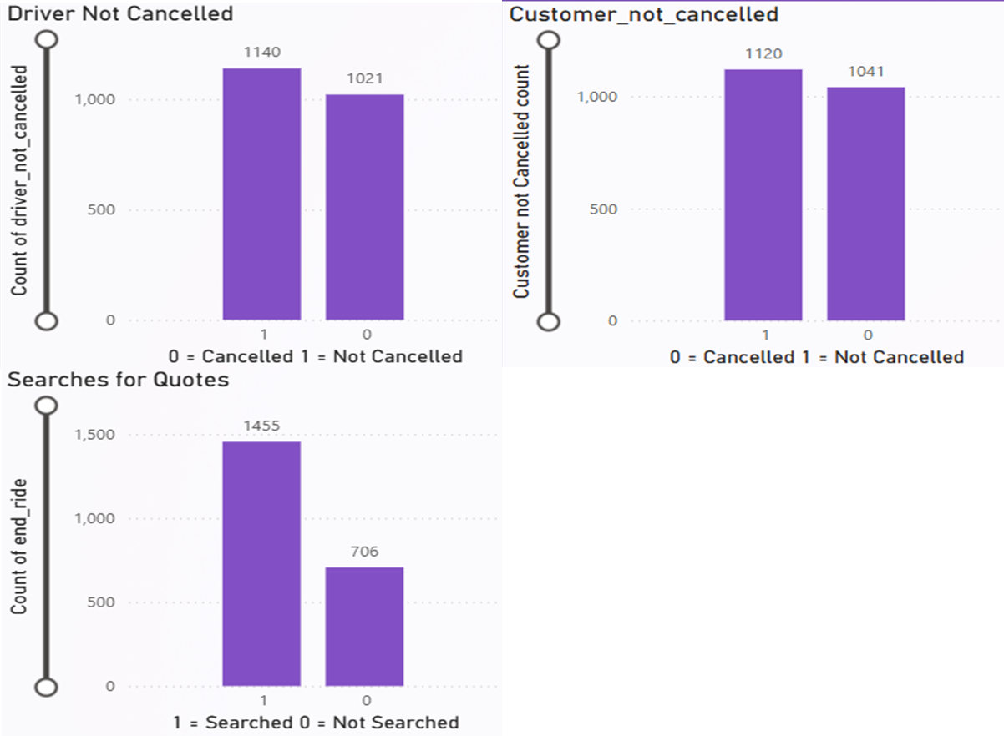
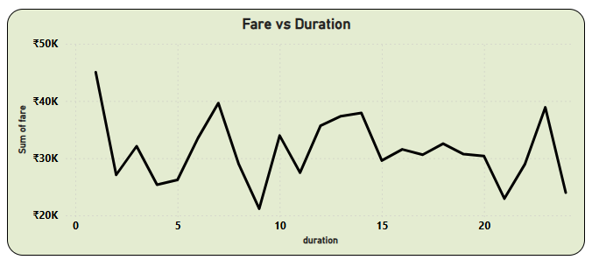
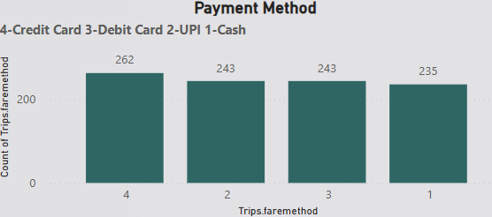
Namma Yatri Dashboard using Power BI

