Slide 1
TASK 4
Supermart Grocery Sales
Dashboard
Interactive dashboard design & business insights
14,956,982
Total Sales
3,747,121
Total Profit
9,994
Total Orders
Created in Tableau Public

Slide 2
Activity Overview
Task 4: Dashboard Design — requirements and approach
OBJECTIVE
DELIVERABLES
Business goal
• Design an interactive dashboard for business stakeholders.
• Use Tableau to combine KPIs, charts and filters in one view.
• Highlight sales, profit, order volume and growth patterns.
• Make the dashboard easy to understand and suitable for decision-making.
What was built
• Interactive Tableau dashboard.
• KPI cards for total sales, total profit and total orders.
• Time-series analysis of monthly sales.
• Category, sub-category and regional analysis.
• Filters/slicers for Category and Region.
• PPT summary of the completed activity.
Supermart Grocery Sales Dashboard • Tableau Public 2

Slide 3
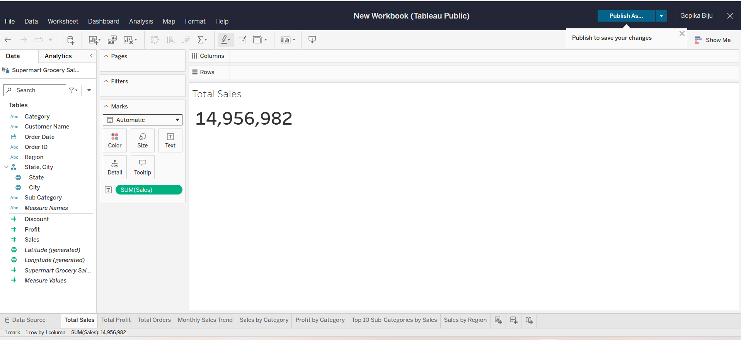
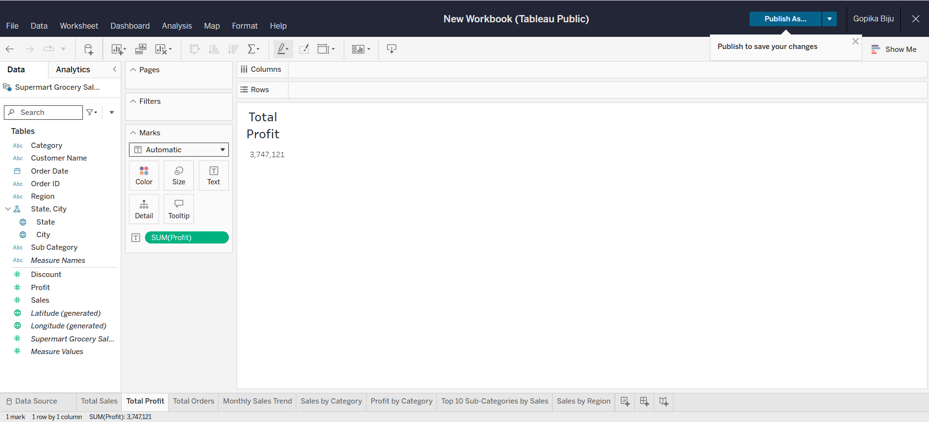
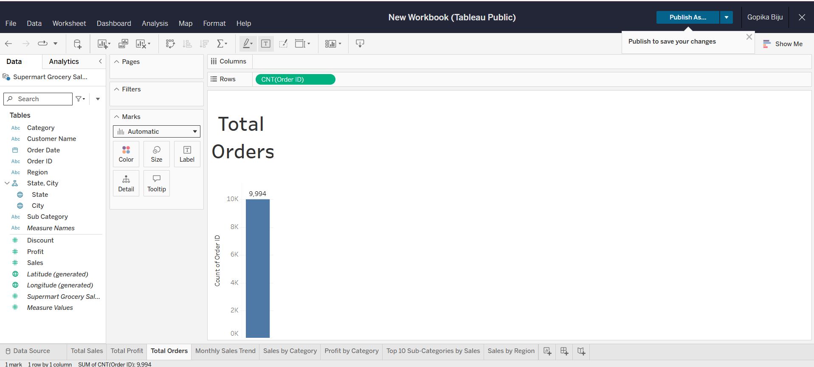
Key Performance Indicators
Three headline metrics used to summarize business performance
TOTAL SALES
14,956,982
Overall sales generated
TOTAL PROFIT
3,747,121
Overall profit generated
TOTAL ORDERS
9,994
Orders recorded
Supermart Grocery Sales Dashboard • Tableau Public 3

Slide 4
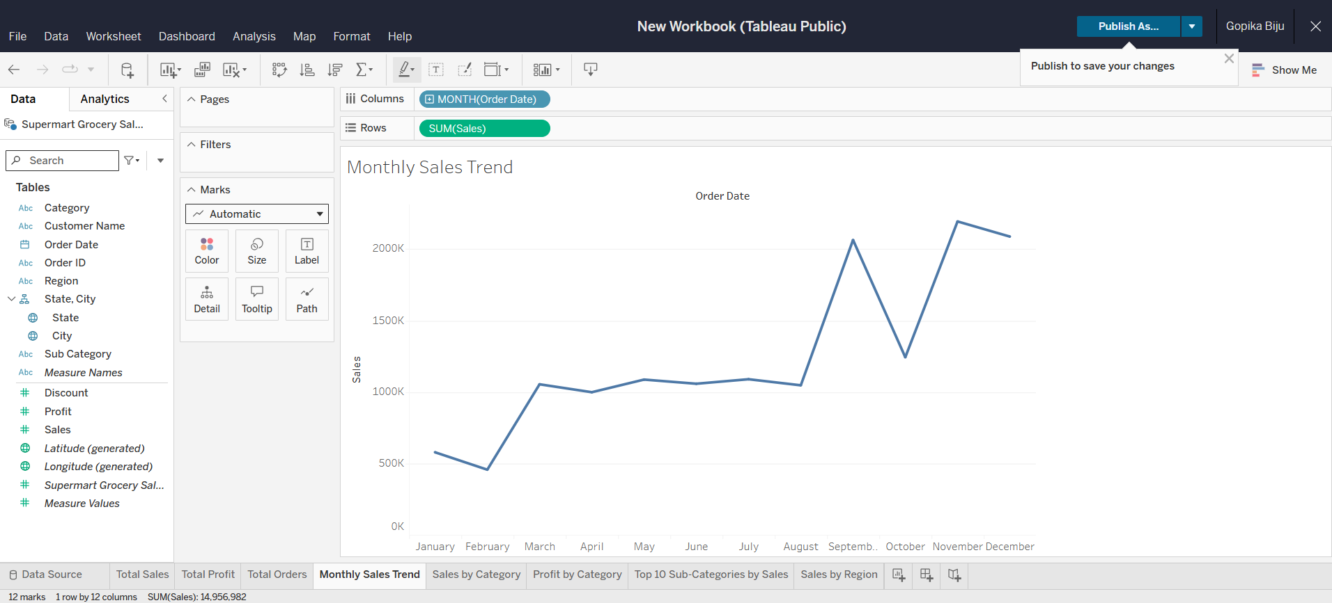
Time-Series Analysis: Monthly Sales
Sales trend across January–December
Observed pattern
• Sales are comparatively low in January and February.
• Sales rise sharply from August to September.
• October shows a noticeable dip.
• November reaches the highest point, followed by a slight December decline.
Supermart Grocery Sales Dashboard • Tableau Public 4

Slide 5
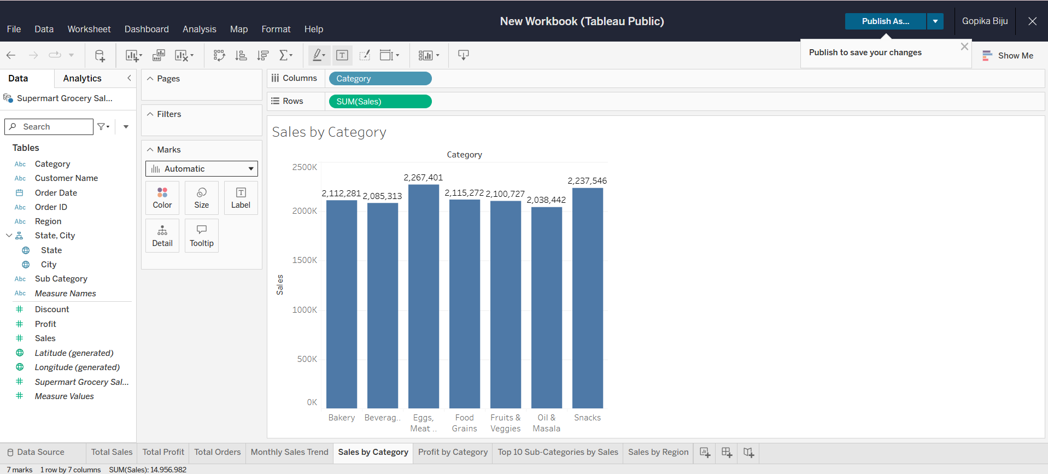
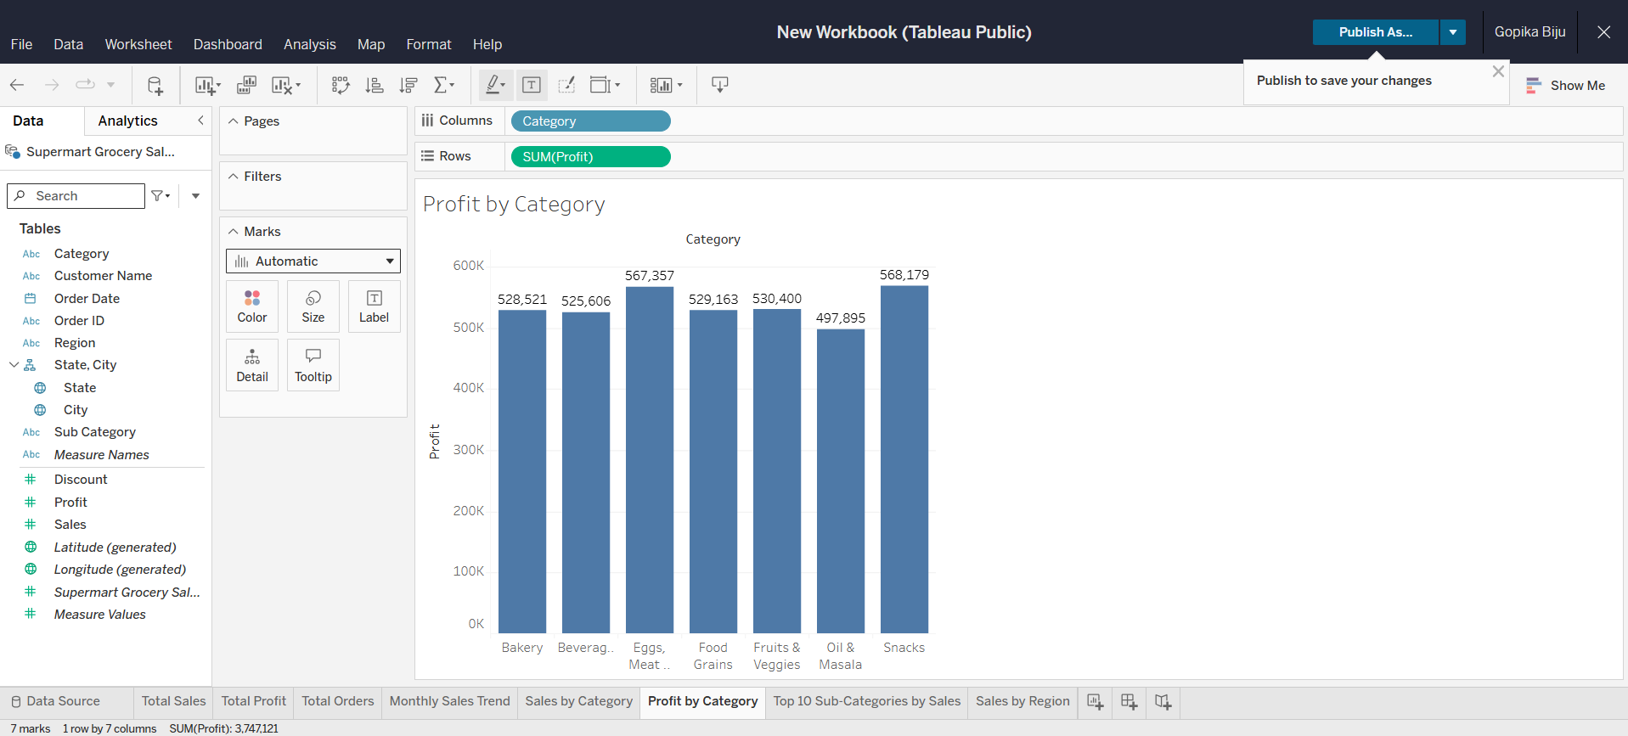
Category Performance
Compare sales contribution with profit contribution
Highest sales category: Eggs, Meat & Fish • Highest profit category: Snacks
Supermart Grocery Sales Dashboard • Tableau Public 5

Slide 6
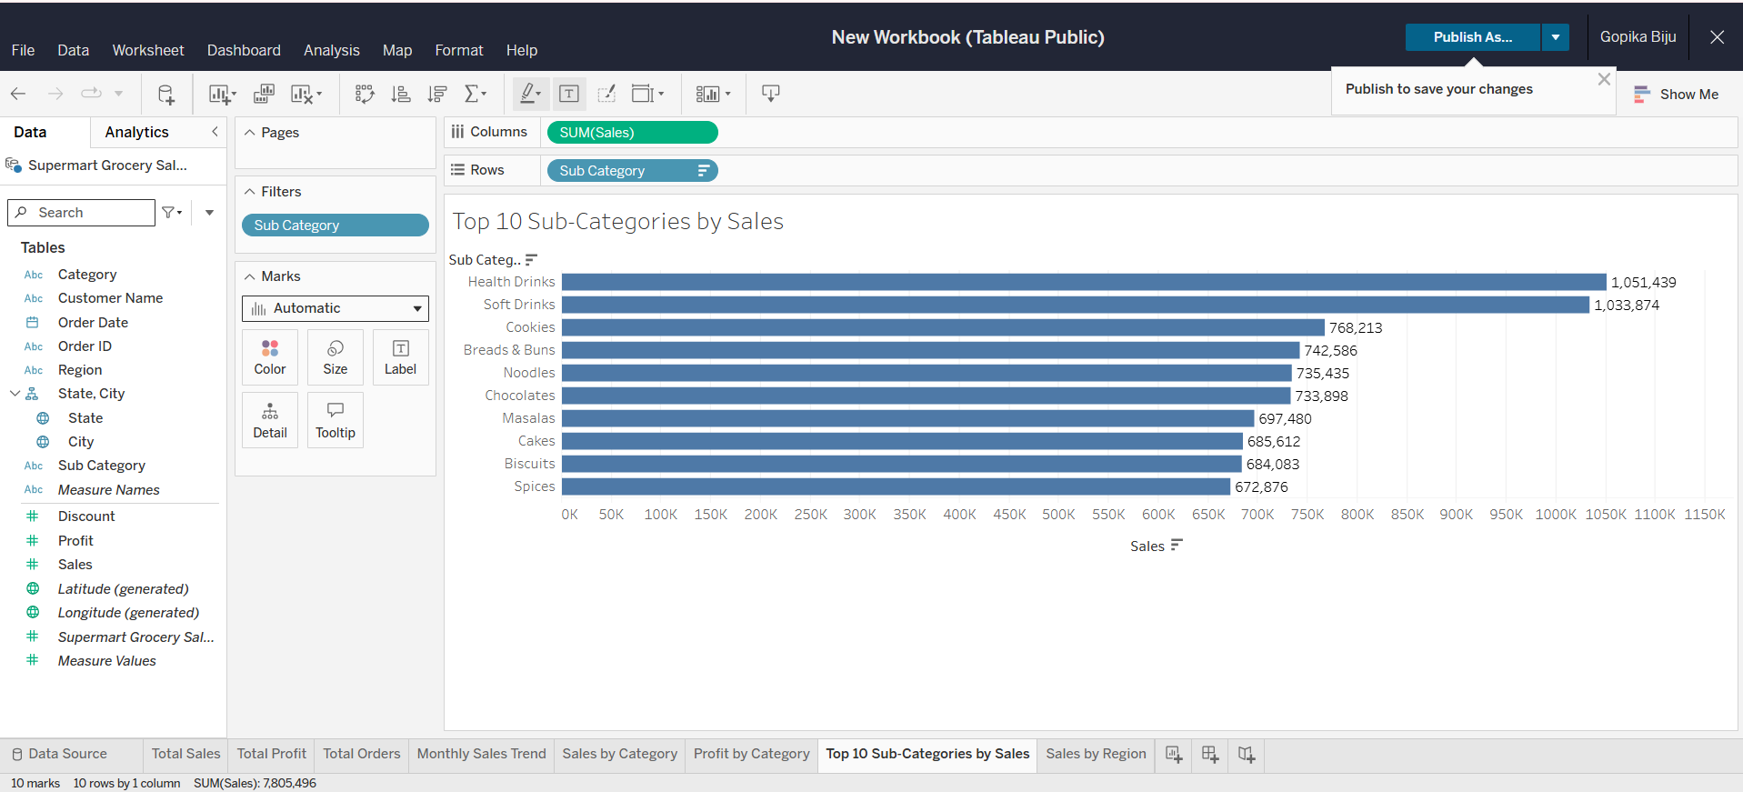
Top 10 Sub-Categories by Sales
A ranking view to identify the strongest product segments
Key takeaways
• Health Drinks leads the ranking.
• Soft Drinks is a close second.
• Cookies, Breads & Buns and Noodles form the next tier.
• The chart supports product-level prioritization.
Supermart Grocery Sales Dashboard • Tableau Public 6

Slide 7
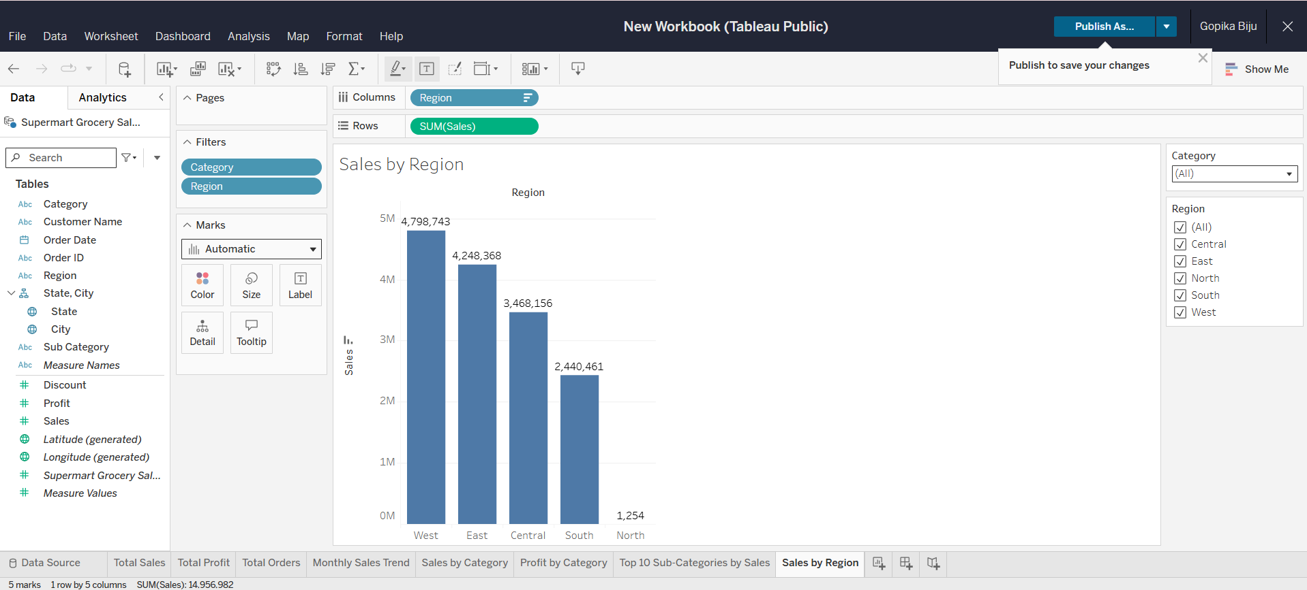
Regional Sales Performance
Compare sales across Central, East, North, South and West
Regional insight
• West is the strongest region by sales.
• East is the second-largest contributor.
• Central and South contribute substantial sales.
• North is extremely low relative to the other regions, making it a potential area for investigation.
Supermart Grocery Sales Dashboard • Tableau Public 7

Slide 8
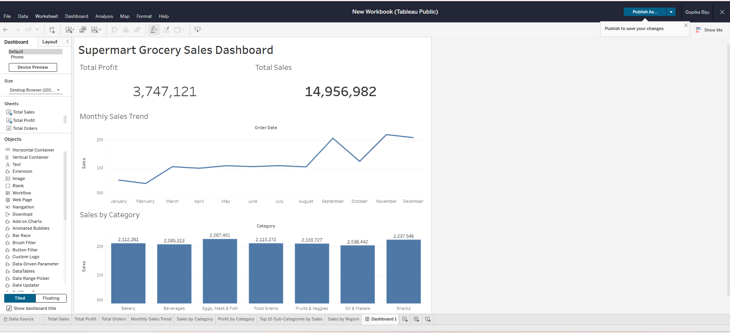
Interactivity & Dashboard Design
Filters and a consolidated dashboard improve stakeholder usability
Design choices
• Category filter enables focused product analysis.
• Region filter enables geographic comparison.
• KPI cards provide immediate business context.
• Charts cover trend, category, profit and product ranking.
• Consistent blue/white styling keeps the dashboard readable.
Supermart Grocery Sales Dashboard • Tableau Public 8

Slide 9
Final Interactive Dashboard
Completed Tableau dashboard combining KPIs, trend and category views
Supermart Grocery Sales Dashboard • Tableau Public 9

Slide 10
Business Summary & Conclusion
What the dashboard communicates to stakeholders
Key findings
• The dashboard gives a single view of sales, profit and order performance.
• Monthly sales show a strong late-year increase, especially in September and November.
• Eggs, Meat & Fish leads sales by category, while Snacks has the highest category profit.
• Health Drinks and Soft Drinks are the top two sub-categories by sales.
• West and East are the strongest regions; North stands out as an area requiring attention.
• Filters make the analysis interactive and allow stakeholders to explore categories and regions.
Dashboard value
• KPI cards → quick performance snapshot
• Line chart → growth and seasonality
• Category charts → product mix and profitability
• Top-10 chart → high-performing sub-categories
• Regional chart → geographic performance
• Interactive filters → stakeholder exploration
Overall: the completed Tableau dashboard meets the Task 4 objective of creating an interactive, business-focused dashboard.
Supermart Grocery Sales Dashboard • Tableau Public 10

