Slide 1


FOOD ORDERING SYSTEM
JAVA PROJECT
By
C.GOKULNATHAN(23EIR030)
M.GOPIKA(23EIR032)
S.R.GOPIKA(23EIR033)

Slide 2
PROBLEM STATEMENT
Design and implement a Food Ordering System to manage customer orders and calculate bills. The system should store dish information, customer data, and order history. It should allow customers to search and order dishes, and calculate bills with applicable taxes (CGST and SGST). Ensure data validation, error handling, and a user-friendly interface. Develop the system using Java, incorporating object-oriented programming principles.

Slide 3
ABSTRACT
The Food Ordering System demonstrates object oriented programming principles, utilizing classes and objects to represent dishes, customers, and orders. The system ensures data validation, handles errors, and provides a user-friendly interface. This application can be further enhanced to integrate online payment gateways, customer loyalty programs, and real-time order tracking.

Slide 4
METHODOLOGY
The Food Ordering System was developed using an object-oriented programming approach. The system's requirements were gathered through a thorough analysis of the food ordering process. A modular design was adopted to ensure scalability and maintainability. Java was chosen as the programming language due to its platform independence and robustness. The system's functionality was tested using unit testing and integration testing.

Slide 5
CODING
import java.util.ArrayList;
import java.util.Scanner;
// Class to represent a customer
class Customer {
String name;
String phoneNumber;
double discountPercent;
Customer(String name, String phoneNumber, double discountPercent) {
this.name = name;
this.phoneNumber = phoneNumber;
this.discountPercent = discountPercent;
}
}
// Class to represent a dish
class Dish {
String hotelName;
String dishName;
double price;
String designation;
Dish(String hotelName, String dishName, double price, String designation) {
this.hotelName = hotelName;
this.dishName = dishName;
this.price = price;
this.designation = designation;
}
}
public class FoodOrderingSystem {
private ArrayList<Customer> customers;
private ArrayList<Dish> dishes;
// Constructor to initialize the system with sample data
public FoodOrderingSystem() {
customers = new ArrayList<>();
// Sample customers
customers.add(new Customer("Alice", "1234567890", 10.0)); customers.add(new Customer("Bob", "0987654321", 5.0));

Slide 6
customers.add(new Customer("Charlie", "1111111111", 15.0)); customers.add(new Customer("David", "2222222222", 20.0)); customers.add(new Customer("Eve", "3333333333", 0.0));
dishes = new ArrayList<>();
// Sample dishes
dishes.add(new Dish("Hotel A", "Pizza", 200.0, "Available")); dishes.add(new Dish("Hotel B", "Burger", 150.0, "Available")); dishes.add(new Dish("Hotel C", "Pasta", 180.0, "Available")); dishes.add(new Dish("Hotel D", "Salad", 100.0, "Available")); dishes.add(new Dish("Hotel E", "Sushi", 250.0, "Available"));
}
// Method to place an order
public void placeOrder(String dishName) {
Scanner scanner = new Scanner(System.in);
Dish selectedDish = null;
// Search for the dish
for (Dish dish : dishes) {
if (dish.dishName.equalsIgnoreCase(dishName)){
selectedDish = dish;
break;
}
}
if (selectedDish == null) {
System.out.println("Dish not available.");
return;
}
System.out.print("Enter your phone number: ");
String phoneNumber = scanner.nextLine();
Customer existingCustomer = null;
for (Customer customer : customers) {
if (customer.phoneNumber.equals(phoneNumber)) { existingCustomer = customer;
break;
}

Slide 7
}
// Add new customer if not found
if (existingCustomer == null) {
System.out.print("Enter your name: ");
String name = scanner.nextLine();
customers.add(new Customer(name, phoneNumber, 0.0)); existingCustomer = customers.get(customers.size() - 1);
}
System.out.print("Enter your address: ");
String address = scanner.nextLine();
// Calculate the final amount
double totalAmount = selectedDish.price;
double cgst = totalAmount * 0.09;
double sgst = totalAmount * 0.09;
double discountAmount = totalAmount * (existingCustomer.discountPercent / 100);
double finalAmount = totalAmount + cgst + sgst - discountAmount; System.out.println("Total amount to be paid: " + finalAmount); System.out.print("Do you wish to continue? (yes/no): ");
String choice = scanner.nextLine();
if (choice.equalsIgnoreCase("yes")) {
System.out.print("Enter payment method (cash/card): ");
String paymentMethod = scanner.nextLine();
if (paymentMethod.equalsIgnoreCase("cash")) { System.out.println("Order placed successfully!");
} else if (paymentMethod.equalsIgnoreCase("card")) { System.out.print("Enter your bank balance: ");
double bankBalance = scanner.nextDouble();
if (finalAmount <= bankBalance) {
System.out.println("Amount paid successfully! Your order has been placed.");
} else {
System.out.println("Insufficient balance. Order not placed."); } } else {
System.out.println("Invalid payment method. Order not placed."); } } else {
System.out.println("Order cancelled.");
}
} public static void main(String[] args) {
FoodOrderingSystem system = new FoodOrderingSystem();
Scanner scanner = new Scanner(System.in);
System.out.print("Enter the dish name to order: ");
String dishName = scanner.nextLine(); system.placeOrder(dishName);
}
}

Slide 8
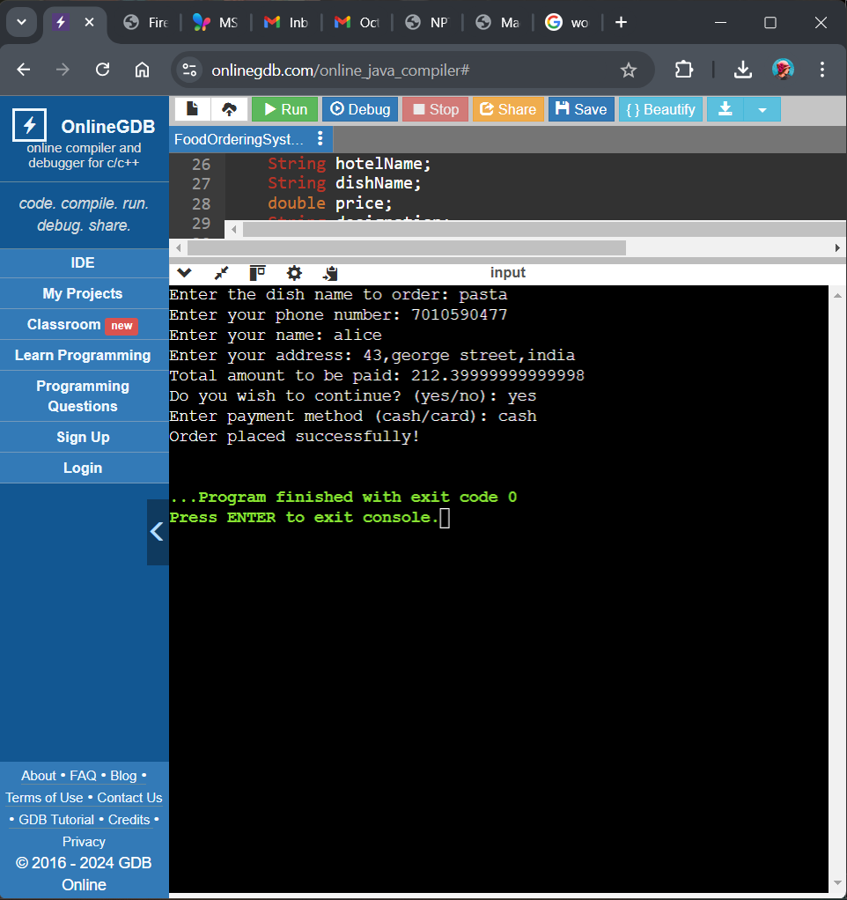
OUTPUT

