Slide 1
Arunai engineering college code :5104
Department Of Information Technology

Slide 2
Disaster Recovery With IBM Cloud Virtual Server
PRESENTED BY:G.Gopika
GUIDED BY:K.Hari Priya

Slide 3
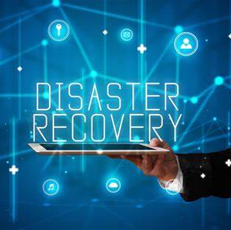
Agenda
Introduction
Design thinking
Project Objective
Recovery Time Objective
Source Code
Output
Recovery Point Objective
Summary

Slide 4

Introduction
Disaster recovery with IBM Cloud Virtual Servers involves planning and implementing strategies to ensure the availability and resilience of your virtual server instances in the event of unexpected disruptions or disasters. IBM Cloud offers a range of services and features that can help you establish a robust disaster recovery plan for your virtual servers.

Slide 5
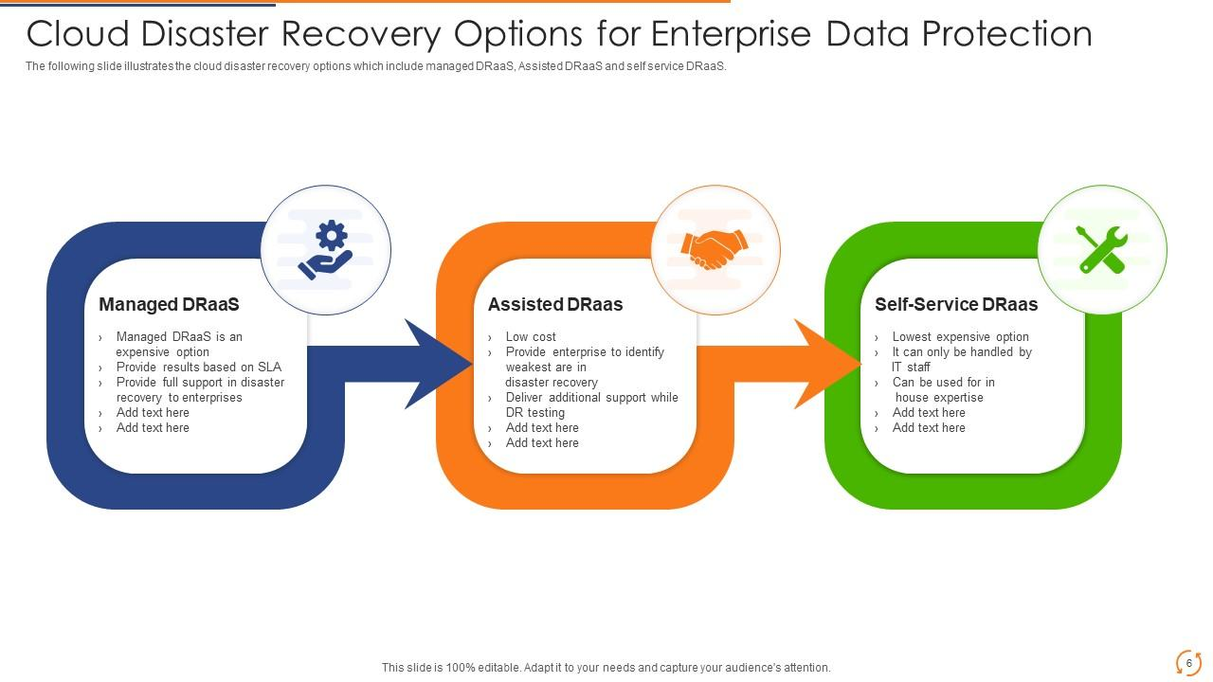
Design Thinking
Empathize: Understand the needs and challenges of IBM's cloud clients in disaster recovery. Define: Clearly define the problem and identify key stakeholders. Ideate: Brainstorm innovative solutions, considering data replication, backup, and failover strategies. Prototype: Create and test mock-ups or proof-of-concept designs
Test: Conduct real-world testing and gather feedback for refinement. Implement: Develop and deploy the chosen disaster recovery solutions, ensuring integration with IBM's cloud services

Slide 6

Project Objectives
High Availability: Ensure that critical services and data remain available and accessible even in the event of a disaster.
Data Backup and Recovery: Implement robust data backup and recovery mechanisms to prevent data loss and facilitate the quick restoration of data in case of corruption or failure.
Rapid Recovery: Minimize downtime by designing and implementing a disaster recovery solution that enables rapid recovery of systems and data.
Testing and Validation: Regularly test and validate your disaster recovery plan to ensure that it works effectively.

Slide 7
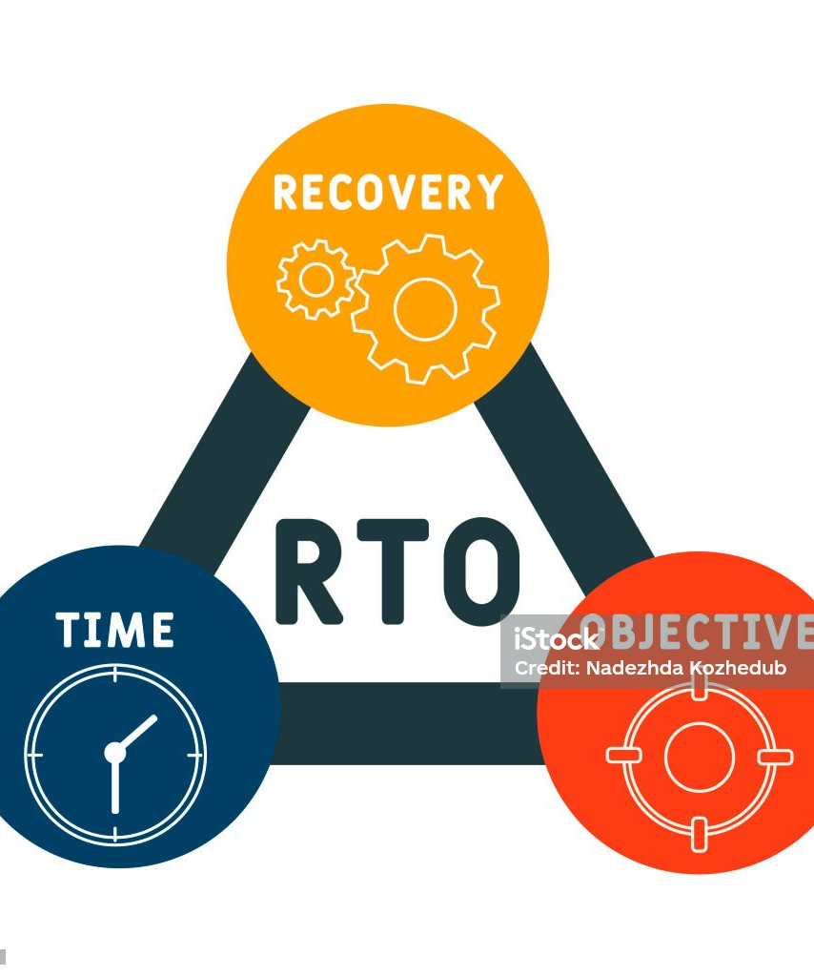
Recovery Time Objective:
Recovery Time Objective (RTO) is a critical metric in disaster recovery and business continuity planning. It represents the maximum acceptable downtime for a system, application, or service following a disruption. In other words, RTO defines the time within which a system must be restored to avoid significant business impact.

Slide 8
Source Code
import time
# Simulate system recovery (replace this with your actual recovery process)
def recover_system():
print("Recovering the system...")
time.sleep(5)
# Simulating recovery time (5 seconds in this case)
if _name_ == "_main_":
start_time = time.time()
recover_system()
end_time = time.time()
recovery_time = end_time - start_time
print(f"Recovery Time: {recovery_time} seconds")
# Compare recovery_time to your defined RTO and take appropriate actions defined_rto = 10
# Replace with your actual RTO
if recovery_time <= defined_rto:
print("Recovery within RTO")
else:
print("Recovery time exceeded RTO")

Slide 9
output
Recovering the system...
Recovery Time: 5.0 seconds
Recovery within RTO

Slide 10

Recovery Point Objective:
Crucial metric in disaster recovery and data protection. It represents the maximum tolerable amount of data loss that an organization can accept in the event of a system failure or data disruption. In other words, RPO defines the point in time to which data must be successfully restored after a disruption.

Slide 11
summary
Disaster recovery in cloud computing is a set of strategies and practices aimed at safeguarding data and applications hosted in the cloud against catastrophic events such as hardware failures, natural disasters, cyberattacks, or human errors. Key elements of cloud-based disaster recovery include data backup, replication, automated failover, and rapid recovery to ensure minimal downtime and data loss. Cloud services offer scalability, redundancy, and cost-effectiveness, making them an attractive option for disaster recovery. Regular testing, security measures, and compliance considerations are vital for a robust disaster recovery plan in the cloud.

Slide 12




Thank you

