Slide 1
Project Presentation of CO-OP Project at Industry (Module-2) (22CS421)
On
Machine Learning-Based Cyber Attack Detection Using Security Event Data
Gopika Ashutosh Goyal
2210990328
Supervised By :-
Dr. Gifty Gupta
Department of Computer Science and Engineering,
Chitkara University, Punjab

Slide 2
Index
Introduction
Problem Statement and Objectives
Related Work
Proposed Methodology
Implementation
Results
Conclusion and Future Scope
References

Slide 3
Introduction
Increasing dependence on digital systems has led to a rapid rise in cyber threats.
Traditional rule-based security systems struggle to detect modern and evolving attacks.
Common cyber attacks include:
Malware
Phishing
Ransomware
DDoS Attacks
Large-scale security event data makes manual monitoring inefficient and error-prone.
Machine Learning enables intelligent and automated threat detection by identifying hidden attack patterns.
The objective of this project is to develop a Machine Learning-based cyber attack detection system using cybersecurity event data.

Slide 4
Problem Statement and Objectives
Problem Statement
Traditional rule-based systems struggle to detect evolving cyber attacks.
Large-scale security data makes manual monitoring inefficient.
High false positives reduce detection reliability.
Objectives
Analyze and preprocess cybersecurity event data.
Apply Machine Learning algorithms for attack detection.
Evaluate performance using accuracy, precision, recall, and F1-score.
Improve automated threat detection efficiency.

Slide 5
Related Work
Traditional cybersecurity systems mainly use signature-based and rule-based detection methods.
Machine Learning techniques such as:
Decision Trees
Support Vector Machines (SVM)
Random Forest
are widely used for cyber attack detection.
Deep Learning models like CNNs and RNNs are used for detecting complex attack patterns.
Existing approaches still face challenges related to:
False positives
Data quality
Real-time detection
Feature selection

Slide 6
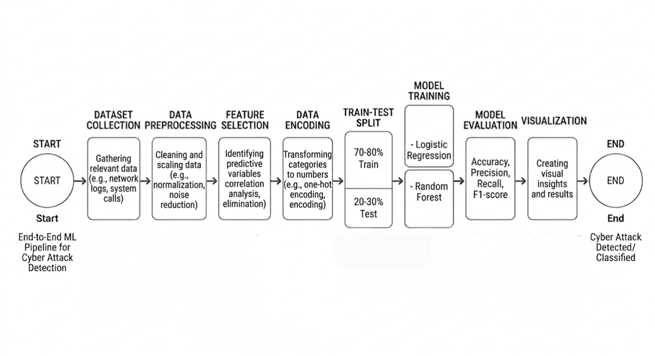
Proposed Methodology
The proposed system follows a structured Machine Learning pipeline for cyber attack detection, including preprocessing, model training, evaluation, and result analysis.
Fig. 1 Flowchart of Proposed Methodology

Slide 7
Implementation
Tools and Technologies
Python
Jupyter Notebook
Pandas, NumPy
Scikit-learn
Matplotlib, Seaborn
Data Processing
Removed irrelevant features and handled missing values
Applied label encoding for categorical data
Performed train-test split (80:20)
Machine Learning Models
Logistic Regression
Random Forest

Slide 8
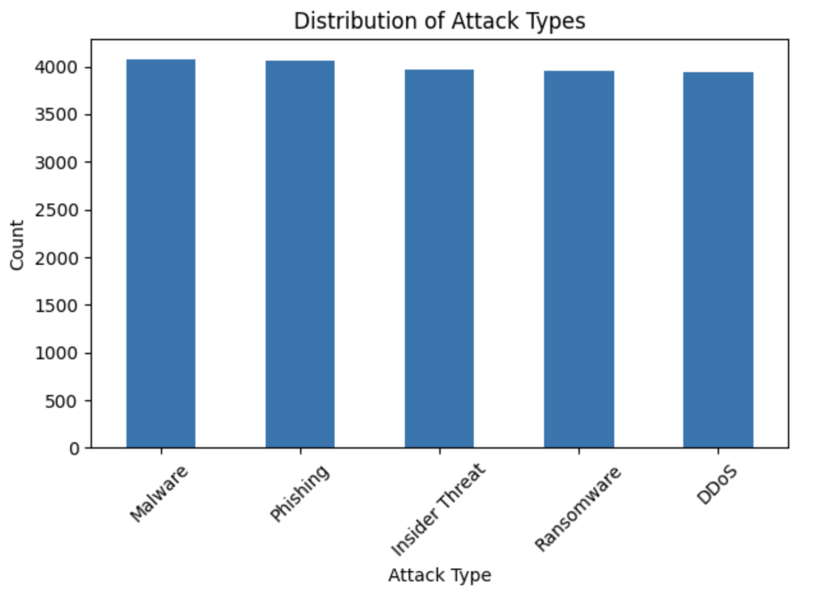
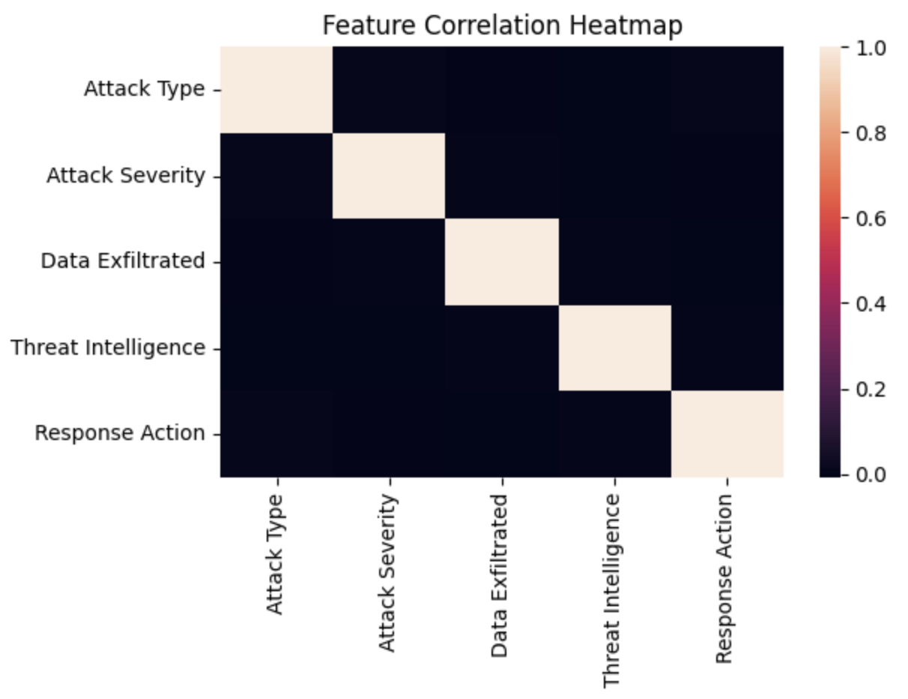
Visualization and Analysis
Fig. 2 Distribution of Cyber Attack Types
Fig. 3Feature Correlation Heatmap

Slide 9
Results
Model Performance
Logistic Regression Accuracy: ~19%
Random Forest Accuracy: ~20%
Random Forest showed slightly better performance due to its ability to handle complex feature relationships.
Key Observations
Weak feature correlations affected prediction accuracy.
Some attack categories were frequently misclassified.
Dataset quality significantly impacted model performance.
Overall Outcome
Machine Learning models were successfully implemented for cyber attack detection.
The project demonstrated the importance of preprocessing and feature engineering in cybersecurity systems.

Slide 10
Conclusion and Future Scope
Conclusion
Implemented Machine Learning techniques for cyber attack detection using cybersecurity event data.
Random Forest slightly outperformed Logistic Regression with ~20% accuracy.
Weak feature relationships and limited predictive patterns affected overall model performance.
The project demonstrated the importance of preprocessing, feature selection, and dataset quality in cybersecurity applications.
Future Scope
Use advanced Machine Learning and Deep Learning models.
Improve feature engineering and dataset quality.
Develop real-time cyber attack detection systems.
Integrate automated threat monitoring and response mechanisms.

Slide 11
References
W. Stallings, Network Security Essentials, Pearson, 2017.
S. Dua and X. Du, Data Mining and Machine Learning in Cybersecurity, CRC Press, 2016.
N. Moustafa and J. Slay, “The UNSW-NB15 dataset for network intrusion detection systems,” IEEE MilCIS, 2015.
M. Alazab et al., “Cybercrime: The case of obfuscated malware,” 2011.
I. Goodfellow, Y. Bengio, and A. Courville, Deep Learning, MIT Press, 2016.
T. M. Mitchell, Machine Learning, McGraw-Hill, 1997.
Scikit-learn Developers, “Scikit-learn: Machine Learning in Python.”

Slide 12
Thank You

