Slide 1
visualization tool for electric vehicle
File created on: 04-05-2023 18:56:41

Slide 2
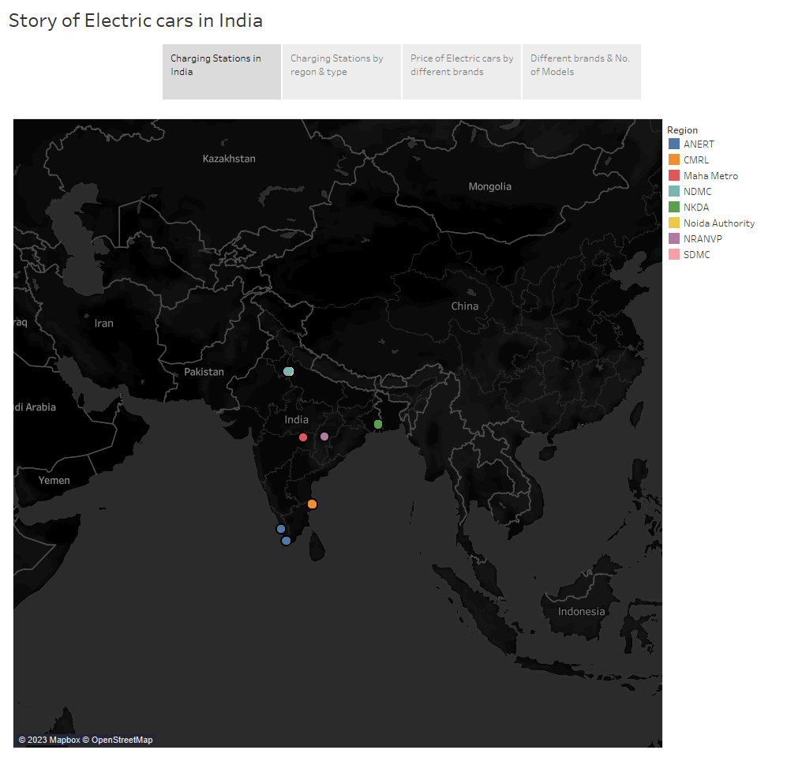

Slide 3
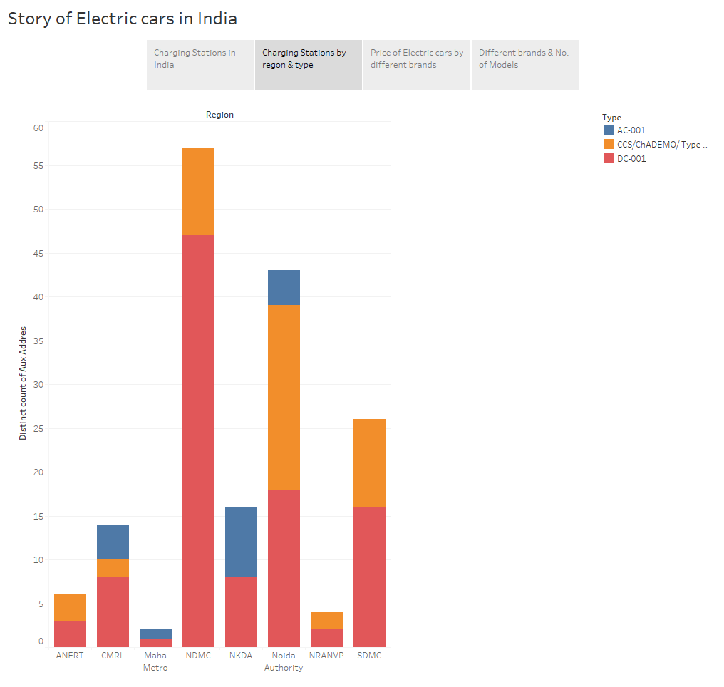

Slide 4
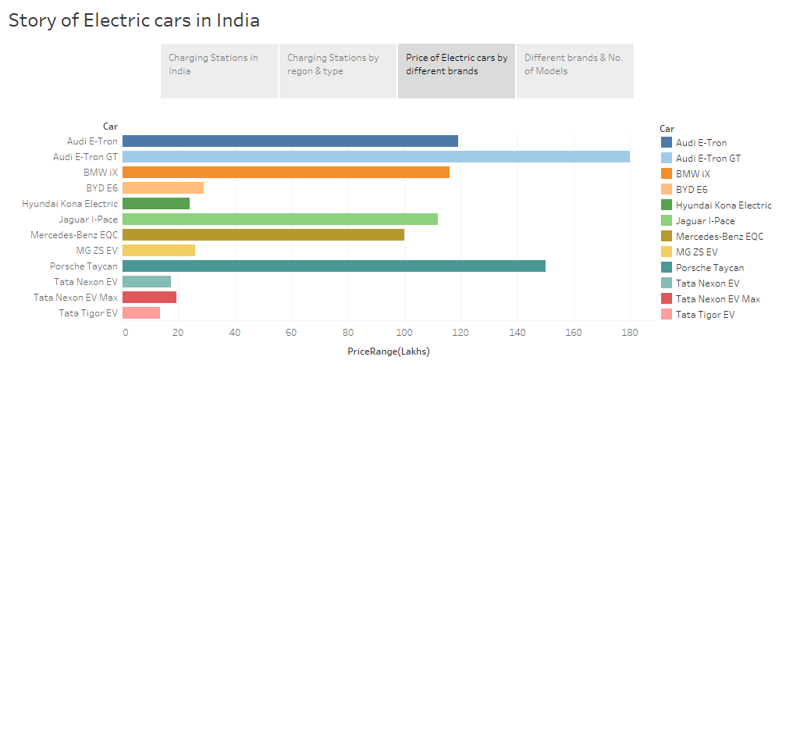

Slide 5
