Slide 1
Command Name: MExport
Give Naming to Amenities
Create _LandLord_Sub Layer
Use “MCPL” to create layer copy
Use “CLAYER” Command to create all layers
Use “MExportHELP” to open help document
1 | _SurveyNo
2 | _IndivSubPlot
3 | _MortgageArea
4 | _Amenity
5 | _DocNo
6 | _LandLord
7 | _InternalRoad
8 | _Plot
9 | _OrganizedOpenSpace
10 | _UtilityArea
11 | _LeftoverOwnersLand
12 | _SideBoundary
13 | _MainRoad
14 | _Splay
15 | _RoadWidening
16 | _GreenBufferZone
17 | _LandLord_Sub
18 | _FreeSpace

Slide 2
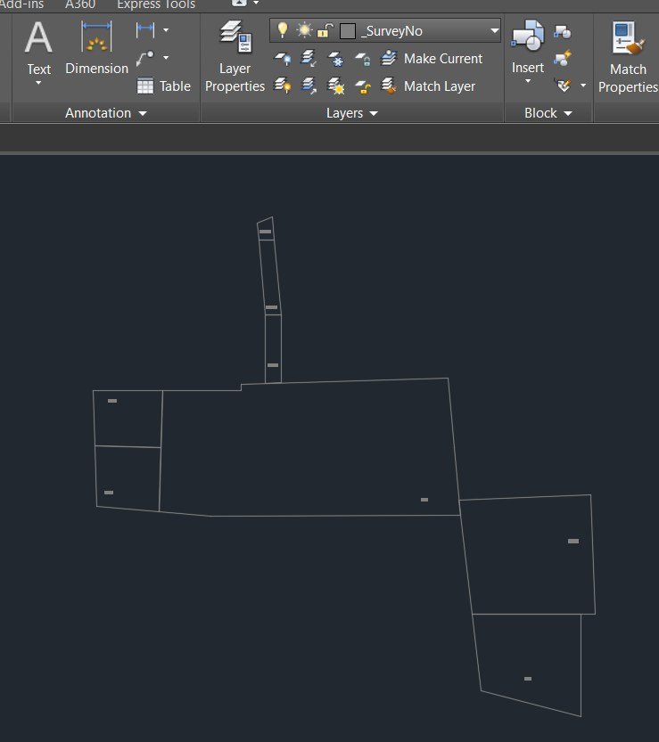
1 | _SurveyNo
2 | _IndivSubPlot
3 | _MortgageArea
4 | _Amenity
5 | _DocNo
6 | _LandLord
7 | _InternalRoad
8 | _Plot
9 | _OrganizedOpenSpace
10 | _UtilityArea
11 | _LeftoverOwnersLand
12 | _SideBoundary
13 | _MainRoad
14 | _Splay
15 | _RoadWidening
16 | _GreenBufferZone

Slide 3
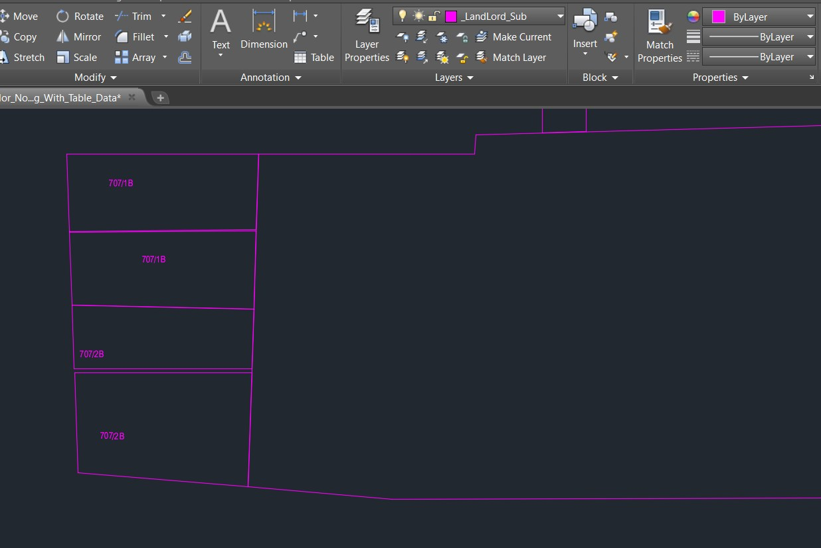
1 | _SurveyNo
2 | _IndivSubPlot
3 | _MortgageArea
4 | _Amenity
5 | _DocNo
6 | _LandLord
7 | _InternalRoad
8 | _Plot
9 | _OrganizedOpenSpace
10 | _UtilityArea
11 | _LeftoverOwnersLand
12 | _SideBoundary
13 | _MainRoad
14 | _Splay
15 | _RoadWidening
16 | _GreenBufferZone
17 | _LandLord_Sub
18 | _FreeSpace

Slide 4
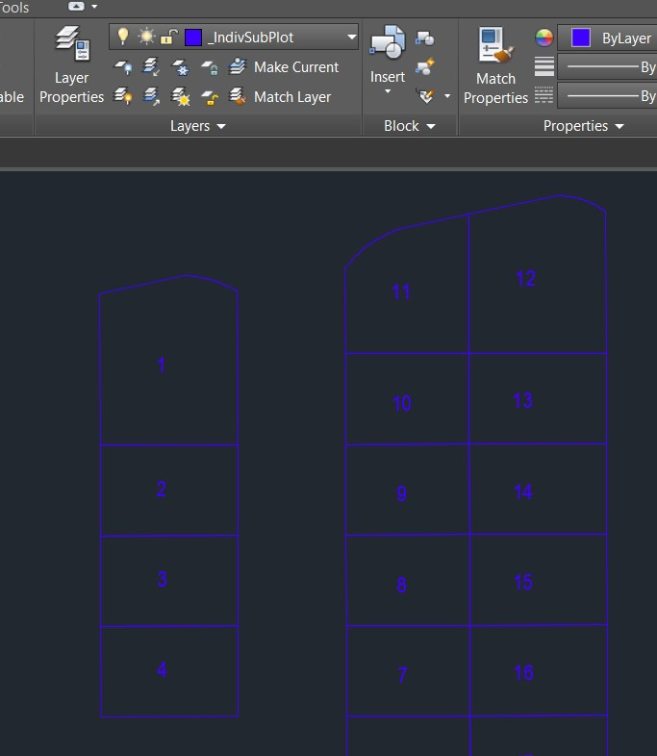
1 | _SurveyNo
2 | _IndivSubPlot
3 | _MortgageArea
4 | _Amenity
5 | _DocNo
6 | _LandLord
7 | _InternalRoad
8 | _Plot
9 | _OrganizedOpenSpace
10 | _UtilityArea
11 | _LeftoverOwnersLand
12 | _SideBoundary
13 | _MainRoad
14 | _Splay
15 | _RoadWidening
16 | _GreenBufferZone

Slide 5
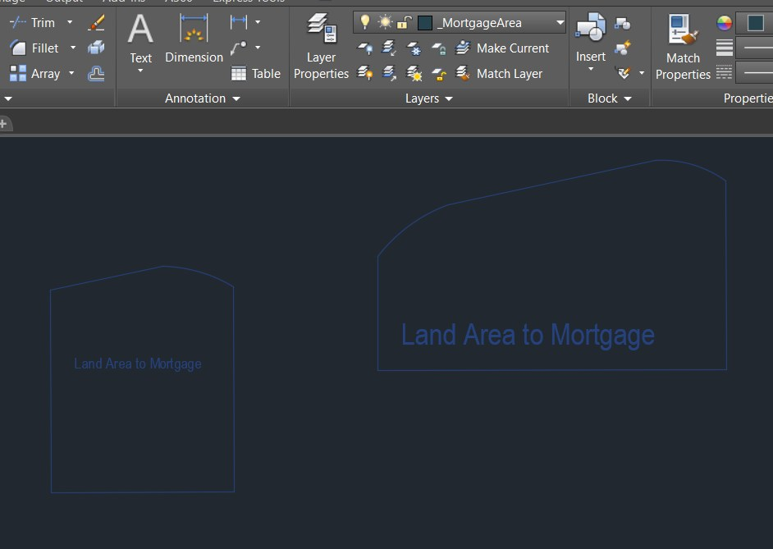
1 | _SurveyNo
2 | _IndivSubPlot
3 | _MortgageArea
4 | _Amenity
5 | _DocNo
6 | _LandLord
7 | _InternalRoad
8 | _Plot
9 | _OrganizedOpenSpace
10 | _UtilityArea
11 | _LeftoverOwnersLand
12 | _SideBoundary
13 | _MainRoad
14 | _Splay
15 | _RoadWidening
16 | _GreenBufferZone

Slide 6
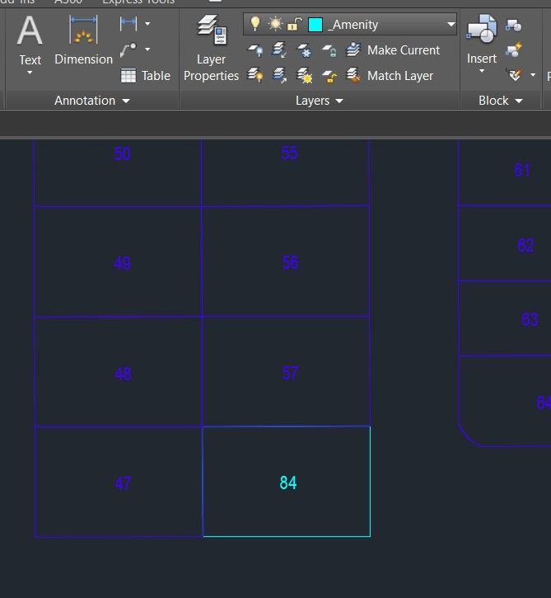
1 | _SurveyNo
2 | _IndivSubPlot
3 | _MortgageArea
4 | _Amenity
5 | _DocNo
6 | _LandLord
7 | _InternalRoad
8 | _Plot
9 | _OrganizedOpenSpace
10 | _UtilityArea
11 | _LeftoverOwnersLand
12 | _SideBoundary
13 | _MainRoad
14 | _Splay
15 | _RoadWidening
16 | _GreenBufferZone

Slide 7
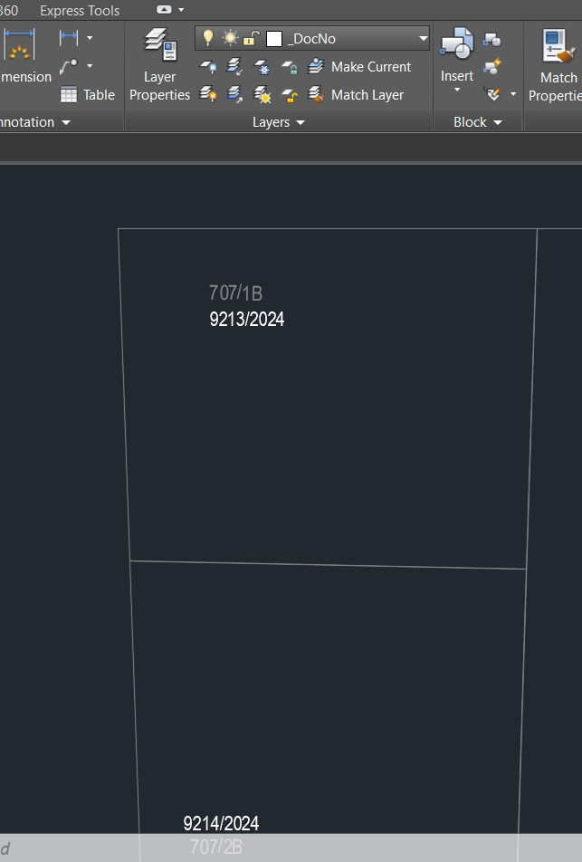
1 | _SurveyNo
2 | _IndivSubPlot
3 | _MortgageArea
4 | _Amenity
5 | _DocNo
6 | _LandLord
7 | _InternalRoad
8 | _Plot
9 | _OrganizedOpenSpace
10 | _UtilityArea
11 | _LeftoverOwnersLand
12 | _SideBoundary
13 | _MainRoad
14 | _Splay
15 | _RoadWidening
16 | _GreenBufferZone

Slide 8
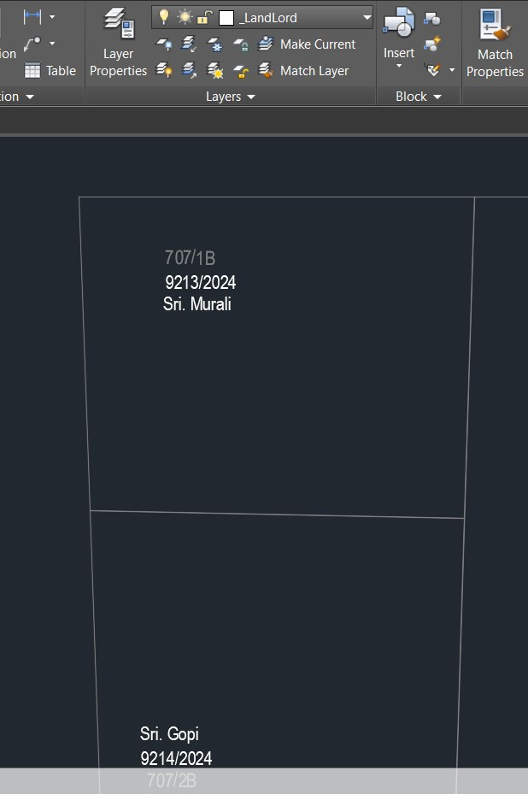
1 | _SurveyNo
2 | _IndivSubPlot
3 | _MortgageArea
4 | _Amenity
5 | _DocNo
6 | _LandLord
7 | _InternalRoad
8 | _Plot
9 | _OrganizedOpenSpace
10 | _UtilityArea
11 | _LeftoverOwnersLand
12 | _SideBoundary
13 | _MainRoad
14 | _Splay
15 | _RoadWidening
16 | _GreenBufferZone

Slide 9
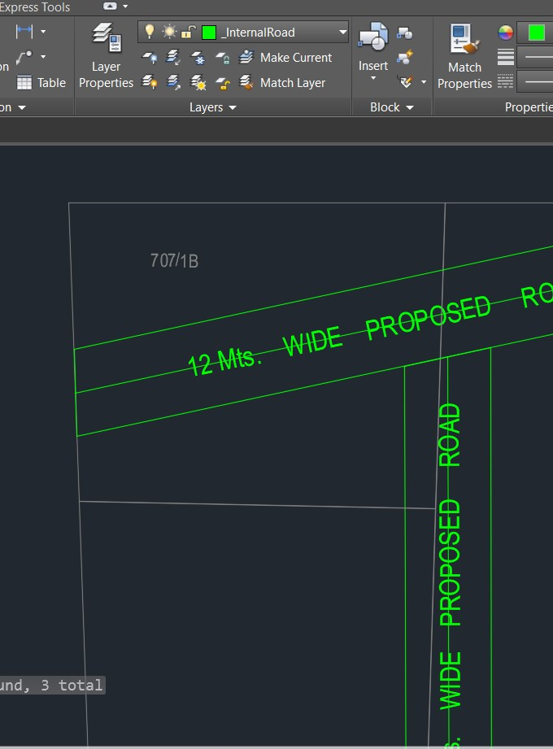
1 | _SurveyNo
2 | _IndivSubPlot
3 | _MortgageArea
4 | _Amenity
5 | _DocNo
6 | _LandLord
7 | _InternalRoad
8 | _Plot
9 | _OrganizedOpenSpace
10 | _UtilityArea
11 | _LeftoverOwnersLand
12 | _SideBoundary
13 | _MainRoad
14 | _Splay
15 | _RoadWidening
16 | _GreenBufferZone

Slide 10
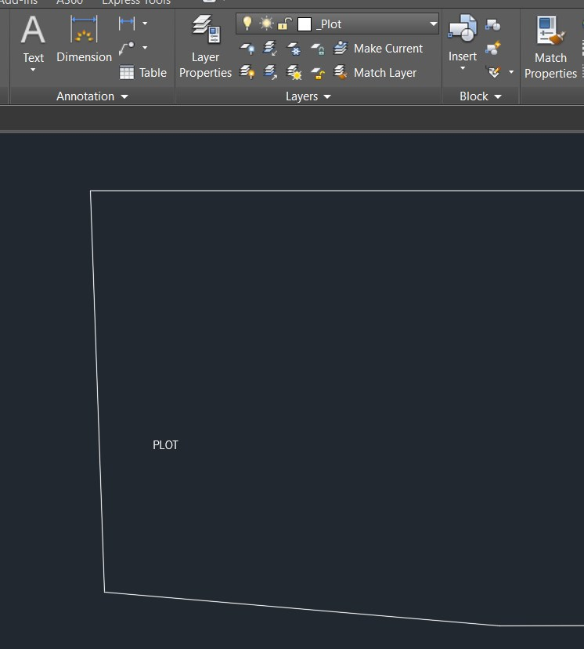
1 | _SurveyNo
2 | _IndivSubPlot
3 | _MortgageArea
4 | _Amenity
5 | _DocNo
6 | _LandLord
7 | _InternalRoad
8 | _Plot
9 | _OrganizedOpenSpace
10 | _UtilityArea
11 | _LeftoverOwnersLand
12 | _SideBoundary
13 | _MainRoad
14 | _Splay
15 | _RoadWidening
16 | _GreenBufferZone

Slide 11
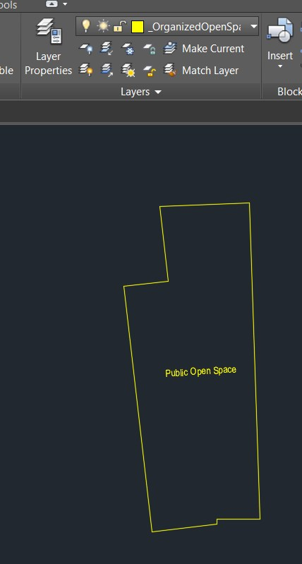
1 | _SurveyNo
2 | _IndivSubPlot
3 | _MortgageArea
4 | _Amenity
5 | _DocNo
6 | _LandLord
7 | _InternalRoad
8 | _Plot
9 | _OrganizedOpenSpace
10 | _UtilityArea
11 | _LeftoverOwnersLand
12 | _SideBoundary
13 | _MainRoad
14 | _Splay
15 | _RoadWidening
16 | _GreenBufferZone

Slide 12

1 | _SurveyNo
2 | _IndivSubPlot
3 | _MortgageArea
4 | _Amenity
5 | _DocNo
6 | _LandLord
7 | _InternalRoad
8 | _Plot
9 | _OrganizedOpenSpace
10 | _UtilityArea
11 | _LeftoverOwnersLand
12 | _SideBoundary
13 | _MainRoad
14 | _Splay
15 | _RoadWidening
16 | _GreenBufferZone

Slide 13
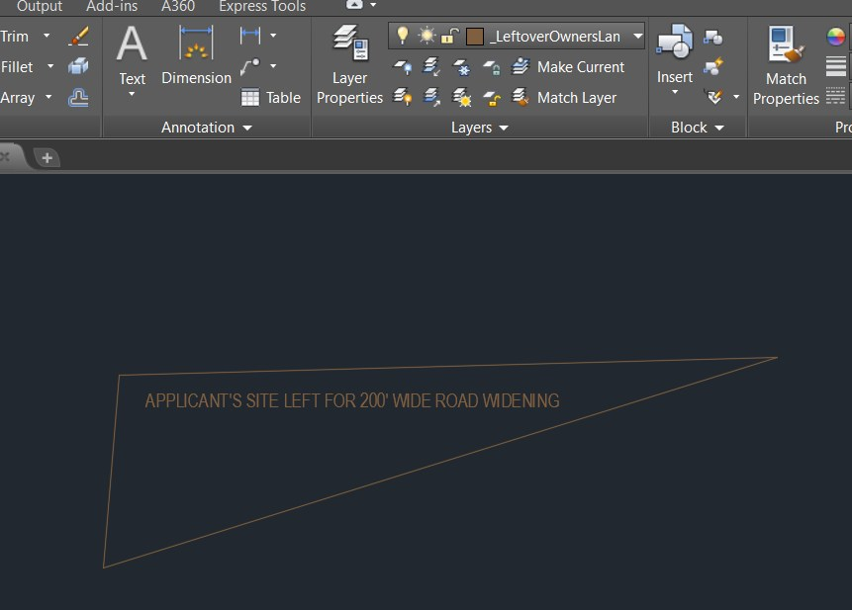
1 | _SurveyNo
2 | _IndivSubPlot
3 | _MortgageArea
4 | _Amenity
5 | _DocNo
6 | _LandLord
7 | _InternalRoad
8 | _Plot
9 | _OrganizedOpenSpace
10 | _UtilityArea
11 | _LeftoverOwnersLand
12 | _SideBoundary
13 | _MainRoad
14 | _Splay
15 | _RoadWidening
16 | _GreenBufferZone

Slide 14
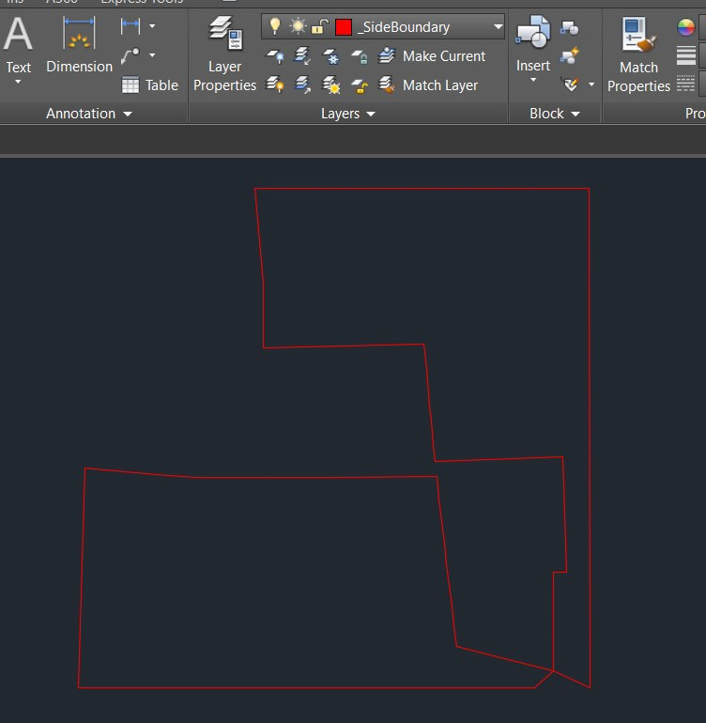
1 | _SurveyNo
2 | _IndivSubPlot
3 | _MortgageArea
4 | _Amenity
5 | _DocNo
6 | _LandLord
7 | _InternalRoad
8 | _Plot
9 | _OrganizedOpenSpace
10 | _UtilityArea
11 | _LeftoverOwnersLand
12 | _SideBoundary
13 | _MainRoad
14 | _Splay
15 | _RoadWidening
16 | _GreenBufferZone

Slide 15
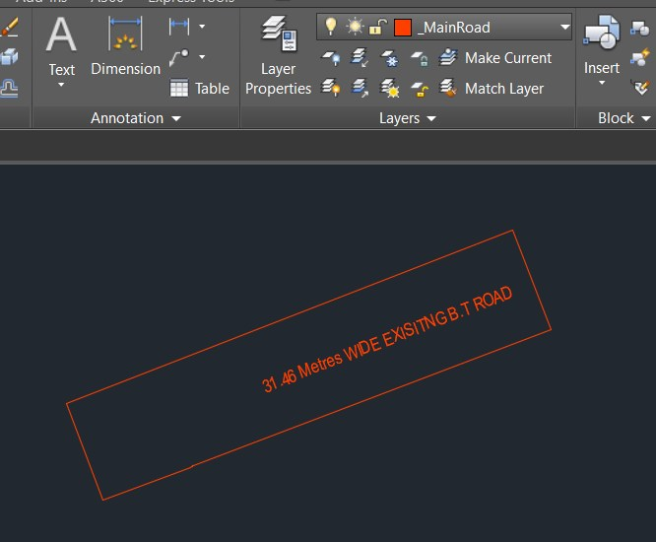
1 | _SurveyNo
2 | _IndivSubPlot
3 | _MortgageArea
4 | _Amenity
5 | _DocNo
6 | _LandLord
7 | _InternalRoad
8 | _Plot
9 | _OrganizedOpenSpace
10 | _UtilityArea
11 | _LeftoverOwnersLand
12 | _SideBoundary
13 | _MainRoad
14 | _Splay
15 | _RoadWidening
16 | _GreenBufferZone

Slide 16
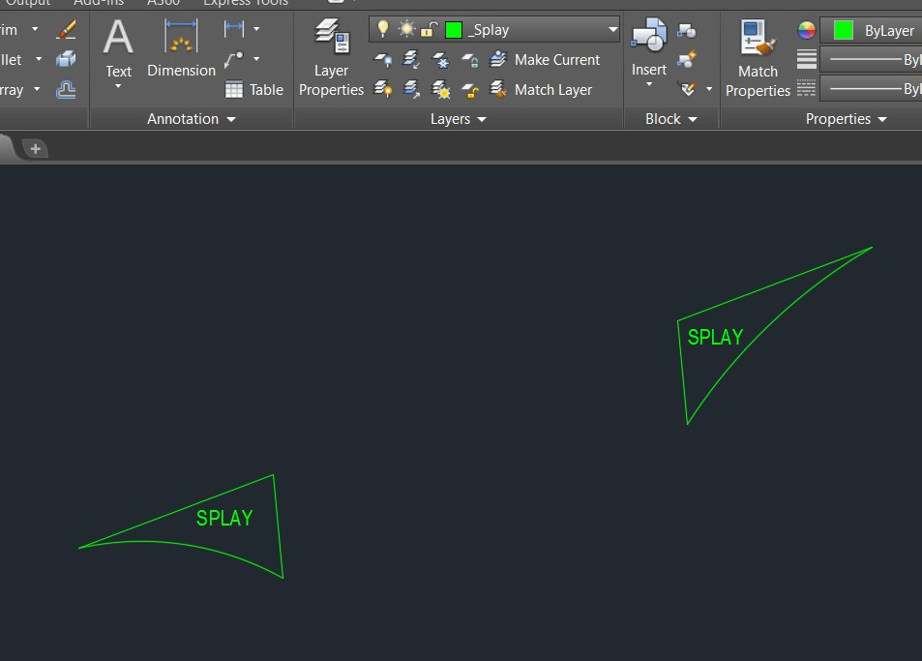
1 | _SurveyNo
2 | _IndivSubPlot
3 | _MortgageArea
4 | _Amenity
5 | _DocNo
6 | _LandLord
7 | _InternalRoad
8 | _Plot
9 | _OrganizedOpenSpace
10 | _UtilityArea
11 | _LeftoverOwnersLand
12 | _SideBoundary
13 | _MainRoad
14 | _Splay
15 | _RoadWidening
16 | _GreenBufferZone

Slide 17
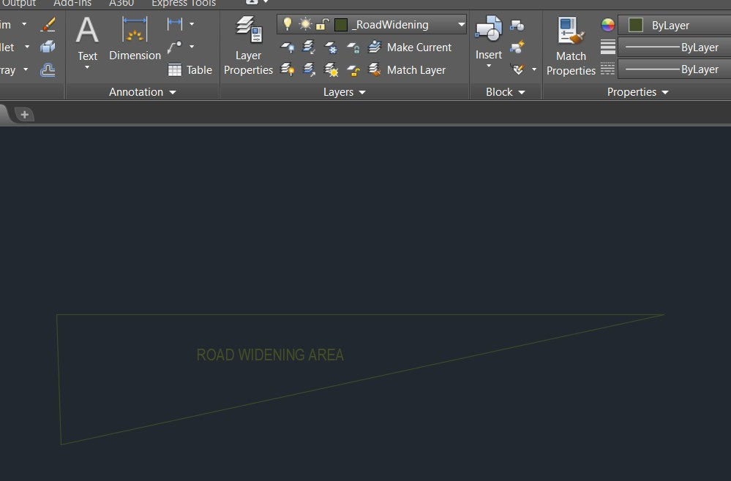
1 | _SurveyNo
2 | _IndivSubPlot
3 | _MortgageArea
4 | _Amenity
5 | _DocNo
6 | _LandLord
7 | _InternalRoad
8 | _Plot
9 | _OrganizedOpenSpace
10 | _UtilityArea
11 | _LeftoverOwnersLand
12 | _SideBoundary
13 | _MainRoad
14 | _Splay
15 | _RoadWidening
16 | _GreenBufferZone

Slide 18
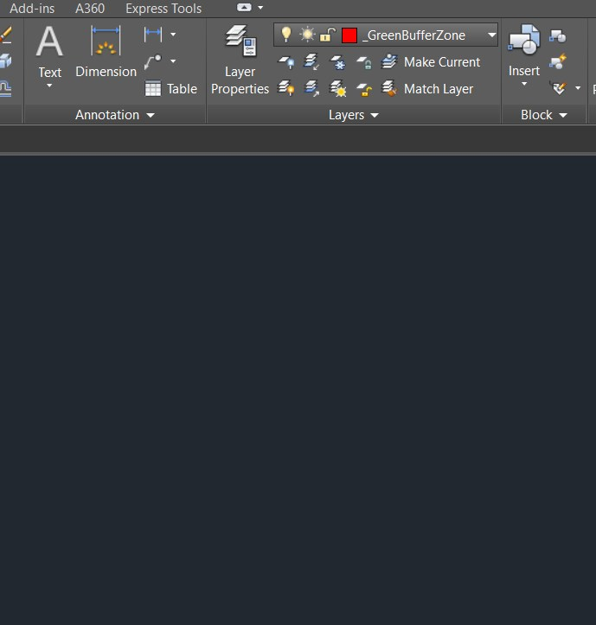
1 | _SurveyNo
2 | _IndivSubPlot
3 | _MortgageArea
4 | _Amenity
5 | _DocNo
6 | _LandLord
7 | _InternalRoad
8 | _Plot
9 | _OrganizedOpenSpace
10 | _UtilityArea
11 | _LeftoverOwnersLand
12 | _SideBoundary
13 | _MainRoad
14 | _Splay
15 | _RoadWidening
16 | _GreenBufferZone

Slide 19
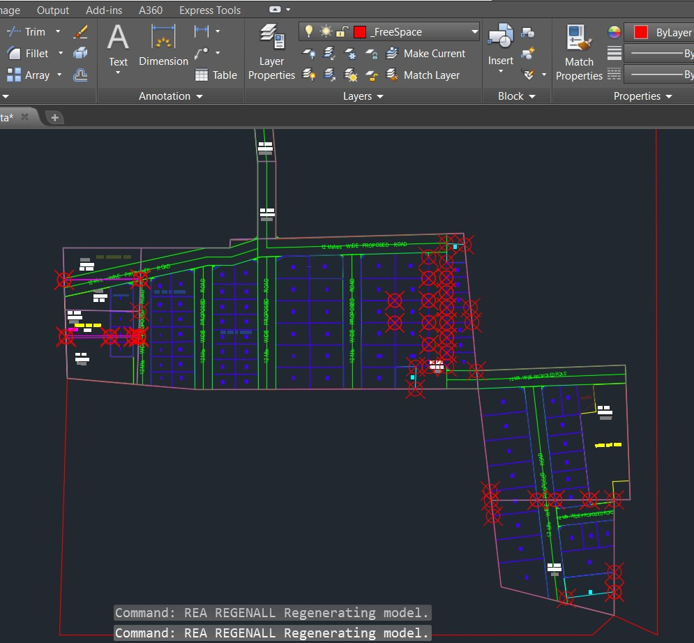
1 | _SurveyNo
2 | _IndivSubPlot
3 | _MortgageArea
4 | _Amenity
5 | _DocNo
6 | _LandLord
7 | _InternalRoad
8 | _Plot
9 | _OrganizedOpenSpace
10 | _UtilityArea
11 | _LeftoverOwnersLand
12 | _SideBoundary
13 | _MainRoad
14 | _Splay
15 | _RoadWidening
16 | _GreenBufferZone
17 | _LandLord_Sub
18 | _FreeSpace

