Slide 1
Command Name: MExport
Give Naming to Amenities
Add _DocNo layer
Add _LandLord layer
1 | _SurveyNo
2 | _IndivSubPlot
3 | _IndivSubPlot_DIMENSION
4 | _MortgageArea
5 | _Amenity
6 | _Amenity_DIMENSION
7 | _DocNo
8 | _LandLord
9 | _InternalRoad

Slide 2
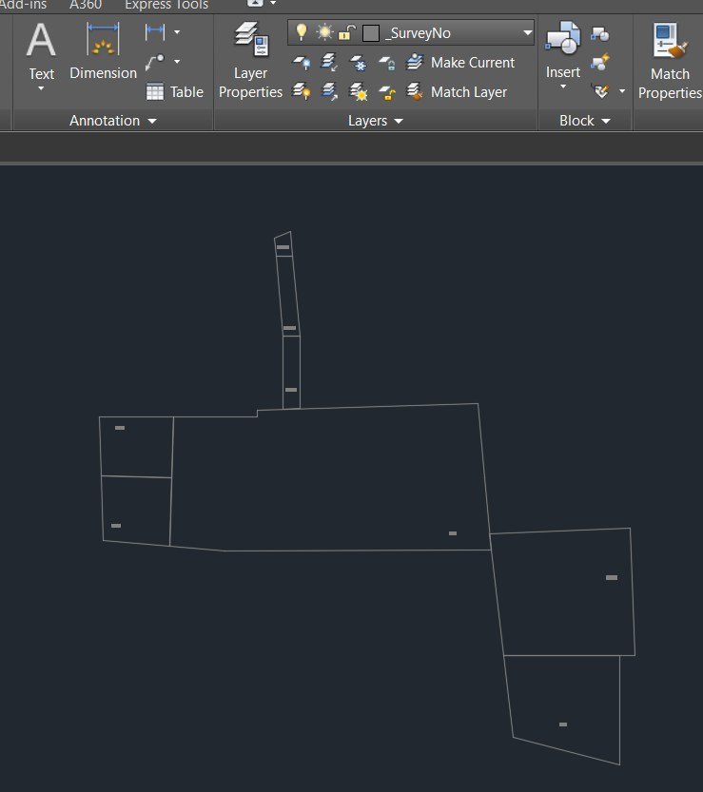
1 | _SurveyNo
2 | _IndivSubPlot
3 | _IndivSubPlot_DIMENSION
4 | _MortgageArea
5 | _Amenity
6 | _Amenity_DIMENSION
7 | _DocNo
8 | _LandLord
9 | _InternalRoad

Slide 3
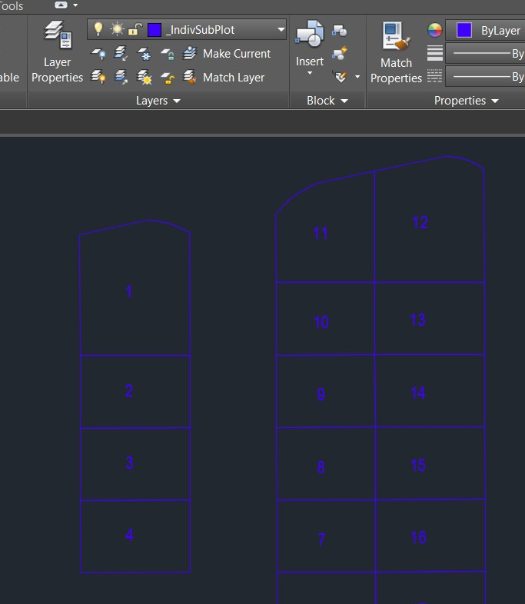
1 | _SurveyNo
2 | _IndivSubPlot
3 | _IndivSubPlot_DIMENSION
4 | _MortgageArea
5 | _Amenity
6 | _Amenity_DIMENSION
7 | _DocNo
8 | _LandLord
9 | _InternalRoad

Slide 4
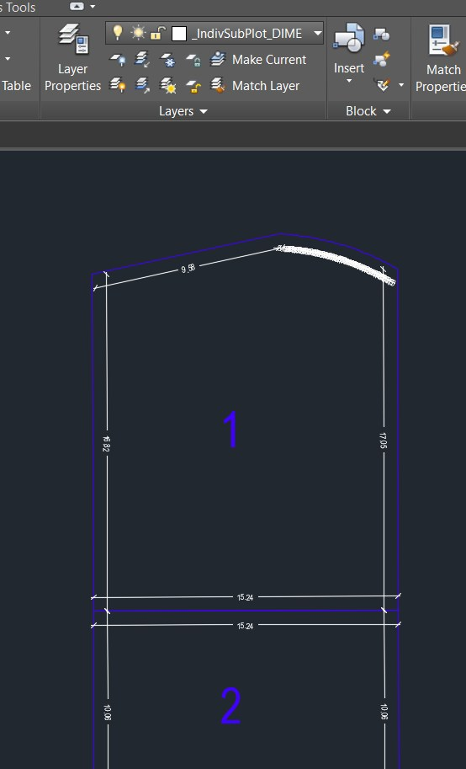
1 | _SurveyNo
2 | _IndivSubPlot
3 | _IndivSubPlot_DIMENSION
4 | _MortgageArea
5 | _Amenity
6 | _Amenity_DIMENSION
7 | _DocNo
8 | _LandLord
9 | _InternalRoad

Slide 5
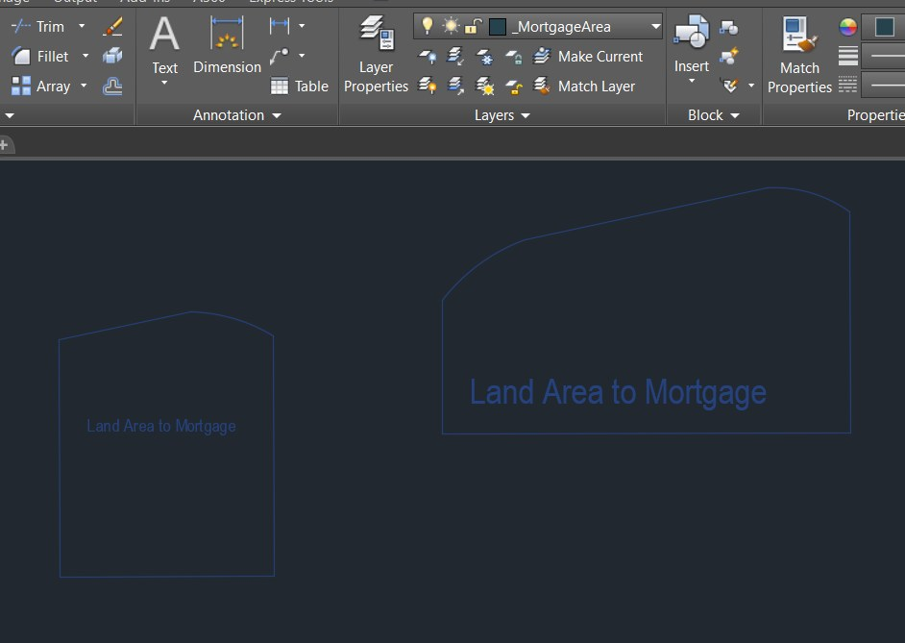
1 | _SurveyNo
2 | _IndivSubPlot
3 | _IndivSubPlot_DIMENSION
4 | _MortgageArea
5 | _Amenity
6 | _Amenity_DIMENSION
7 | _DocNo
8 | _LandLord
9 | _InternalRoad

Slide 6
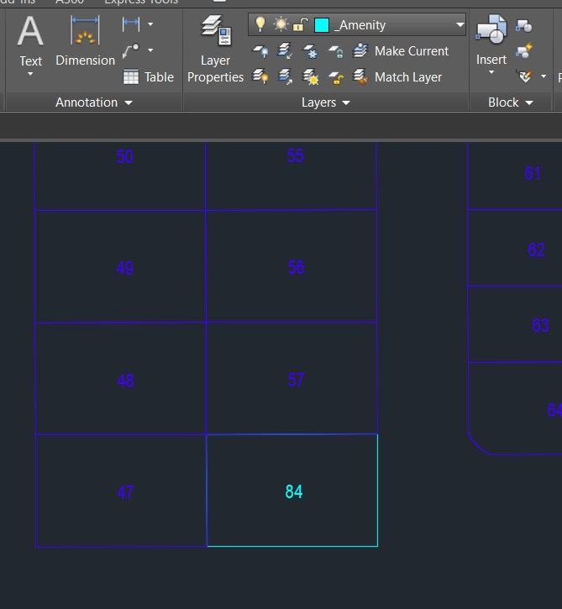
1 | _SurveyNo
2 | _IndivSubPlot
3 | _IndivSubPlot_DIMENSION
4 | _MortgageArea
5 | _Amenity
6 | _Amenity_DIMENSION
7 | _DocNo
8 | _LandLord
9 | _InternalRoad

Slide 7
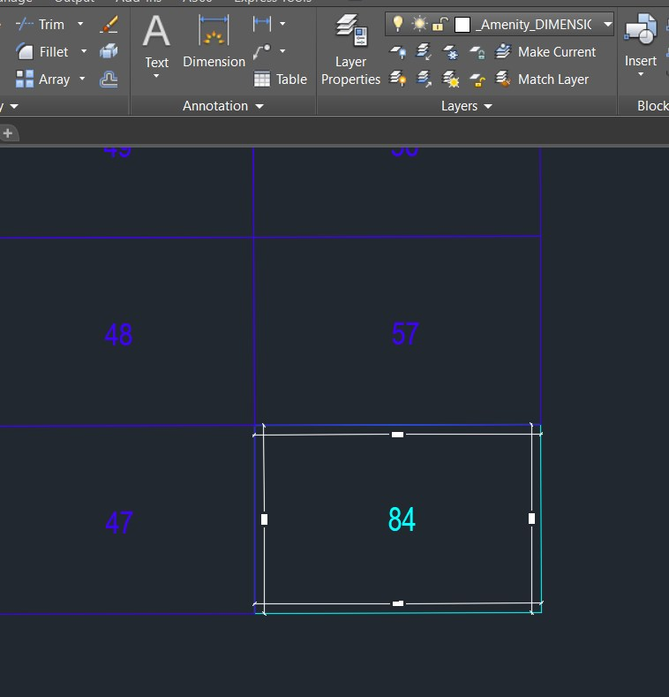
1 | _SurveyNo
2 | _IndivSubPlot
3 | _IndivSubPlot_DIMENSION
4 | _MortgageArea
5 | _Amenity
6 | _Amenity_DIMENSION
7 | _DocNo
8 | _LandLord
9 | _InternalRoad

Slide 8
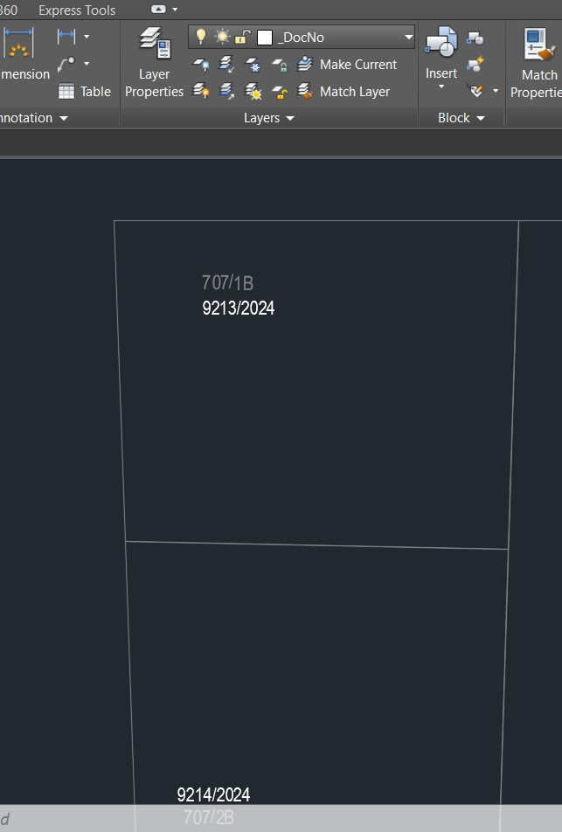
1 | _SurveyNo
2 | _IndivSubPlot
3 | _IndivSubPlot_DIMENSION
4 | _MortgageArea
5 | _Amenity
6 | _Amenity_DIMENSION
7 | _DocNo
8 | _LandLord
9 | _InternalRoad

Slide 9
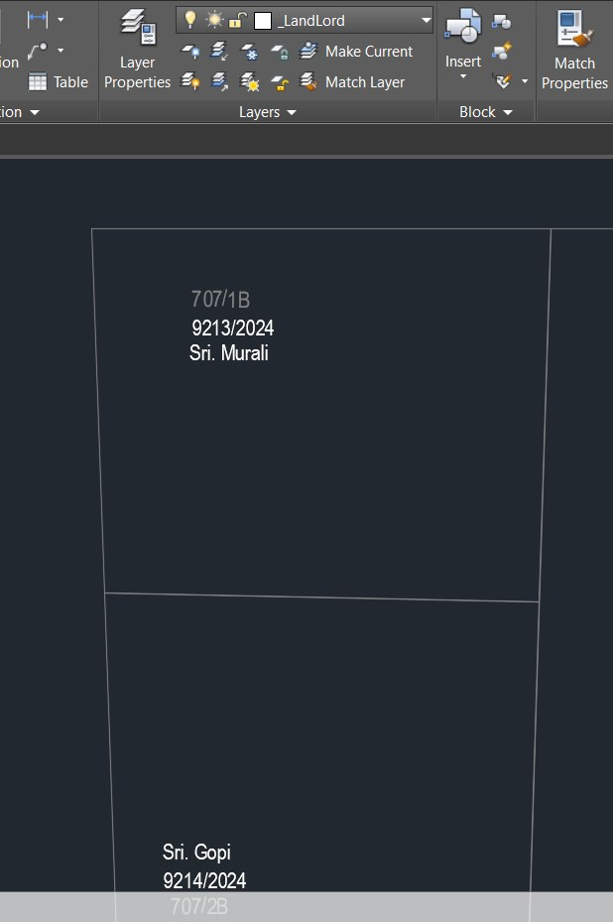
1 | _SurveyNo
2 | _IndivSubPlot
3 | _IndivSubPlot_DIMENSION
4 | _MortgageArea
5 | _Amenity
6 | _Amenity_DIMENSION
7 | _DocNo
8 | _LandLord
9 | _InternalRoad

Slide 10
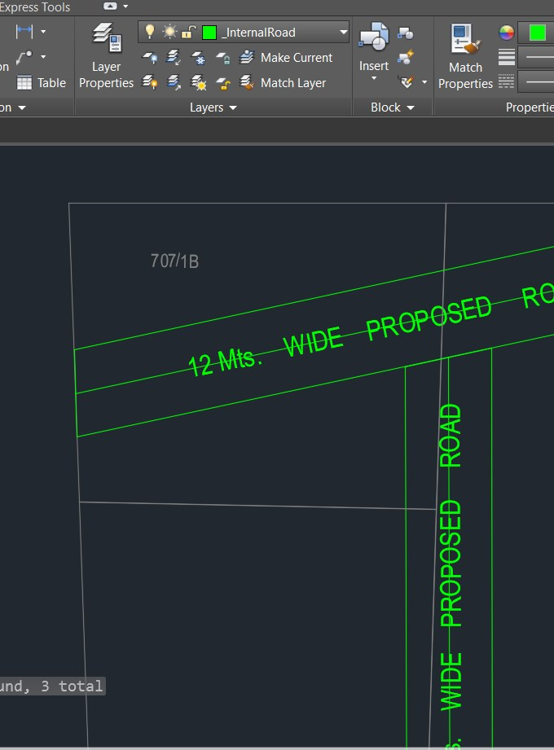
1 | _SurveyNo
2 | _IndivSubPlot
3 | _IndivSubPlot_DIMENSION
4 | _MortgageArea
5 | _Amenity
6 | _Amenity_DIMENSION
7 | _DocNo
8 | _LandLord
9 | _InternalRoad

Slide 11
