Slide 1
Early Detection of Coffee Leaf Rust Through Convolutional Neural Networks Trained on Low-Resolution Images Authors: Shrikanth Narayanan(USC) Angelly Cabrera(USC) Kleanthis Avramidis(USC)

Slide 2
Agenda
Motivation 1
Problem statement 2
Objectives 3
Contributions 4
Results 5 ---------------------------------------------- Critical Analysis 6 ---------------------------------------------- References 7

Slide 3

1.Motivation
Coffee leaf rust, a disease caused by the fungus Hemileia vastatrix, threatens coffee production
Climate change exacerbates this issue, shortening the latency period between infection and visible symptoms, leading to severe epidemics.
Early detection is critical to manage this disease effectively and prevent economic losses and agricultural job displacement.
It is affecting more than 70 countries

Slide 4
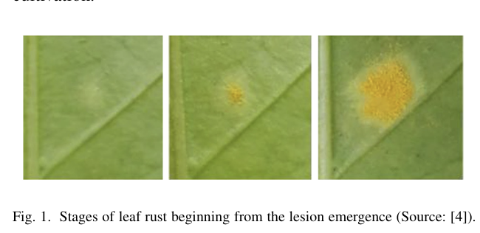

Slide 5
2.Problem statement
Existing methods for detecting coffee leaf rust are inadequate for early detection due to the requirement of high resolution images and the lack of resources in affected regions.
Hence, There is a need for a method that can detect early-stage leaf rust using low-resolution images and minimal computational power.

Slide 6
3.Objectives
Develop a deep learning model capable of detecting early-stage coffee leaf rust using low-resolution images.
Improve the model's performance through image preprocessing techniques.
Ensure that the method is resource-efficient, making it accessible to farmers in resource-limited environments.

Slide 7
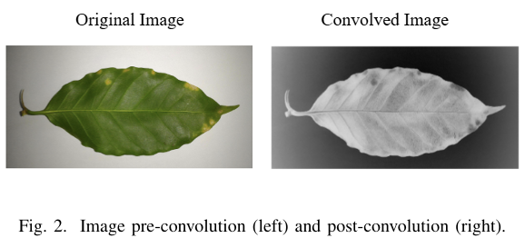
4.Contributions
Proposed a preprocessing technique using a high-pass filter to enhance lesion-leaf contrast.
Images are first convolved with a high-pass kernel to aid feature extraction, followed by image downsizing.
Trained a Convolutional Neural Network (CNN) on the processed images.
Achieved strong performance metrics (over 90% precision, recall, F1-score, and Dice coefficient)
Note: high-pass filter during preprocessing enhances the contrast between rust lesions and edges

Slide 8
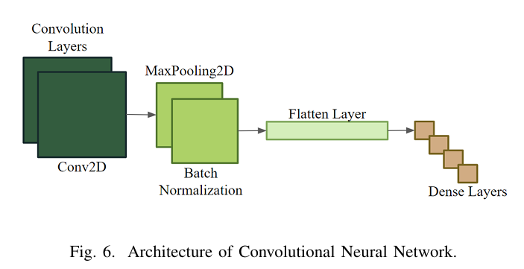
Architecture of CNN
-CNN comprises nine layers
beginning with two convolution layers
then a max pooling, batch normaliza tion, flattening layer,
finishing with four dense layers to integrate features from preceding layers and make final predictions

Slide 9
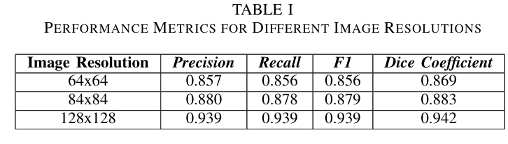
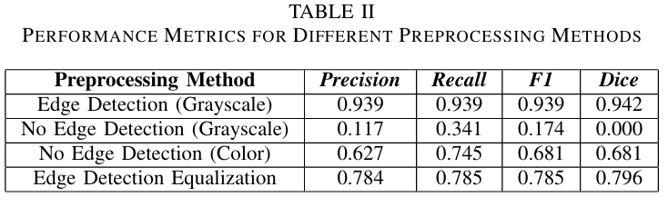
5. Results
The CNN demonstrated robust performance across various resolutions, with the best results at 128x128 pixels.
Edge detection preprocessing significantly improved the model's performance compared to using unaltered images

Slide 10

6. Critical Analysis
The high-pass filtering technique effectively highlighted early rust lesions, making the model efficient with low-resolution images
The method reduced the need for high-quality, large datasets, addressing a major limitation in resource-limited settings.
Future research could explore unsupervised labeling, such as k-nearest neighbors (KNNs), for scoring the severity of leaf rust.

Slide 11
7. REFERENCES
[1] A. Koutouleas, D. B. Collinge, and E. Boa, “The coffee leaf rust pan demic: An ever-present danger to coffee production,” Plant pathology, vol. 73, no. 3, pp. 522–534, 2024, doi: 10.1111/ppa.13846.
[2] J. Avelino et al., “The coffee rust crises in Colombia and Central Amer ica (2008–2013): impacts, plausible causes and proposed solutions,” Food security, vol. 7, no. 2, pp. 303–321, 2015, doi: 10.1007/s12571 015-0446-9.
[3] A. P. Marcos, N. L. Silva Rodovalho and A. R. Backes, ”Coffee Leaf Rust Detection Using Convolutional Neural Network,” 2019 XV Workshop de Visao Computacional (WVC), Sao Bernardo do Campo, Brazil, 2019, pp. 38-42, doi: 10.1109/WVC.2019.8876931.
[4] I. Merle, P. Tixier, E. de M. Virginio Filho, C. Cilas, and J. Avelino, “Forecast models of coffee leaf rust symptoms and signs based on identified microclimatic combinations in coffee-based agroforestry sys tems in Costa Rica,” Crop protection, vol. 130, pp. 105046-, 2020, doi: 10.1016/j.cropro.2019.105046.
[5] G. Dutta, ”Coffee Leaf Diseases,” Kaggle, Dataset, May 2023. [Online]. Available: https://www.kaggle.com/datasets/gauravduttakiit/ coffee-leaf-diseases.
[6] D. Vel´asquez, A. S´anchez, S. Sarmiento, M. Toro, M. Maiza, and B. Sierra, “A method for detecting coffee leaf rust through wireless sensor networks, remote sensing, and deep learning: Case study of the Caturra variety in Colombia,” Applied sciences, vol. 10, no. 2, pp. 697-, 2020, doi: 10.3390/app10020697.
[7] F. G. Waldamichael, T. G. Debelee, and Y. M. Ayano, “Coffee disease detection using a robust HSV color-based segmentation and transfer learning for use on smartphones,” International journal of intelligent systems, vol. 37, no. 8, pp. 4967–4993, 2022, doi: 10.1002/int.22747.
[8] D. Novtahaning, H. A. Shah, and J. M. Kang, “Deep Learning Ensemble Based Automated and High-Performing Recognition of Coffee Leaf Disease,” Agriculture (Basel), vol. 12, no. 11, pp. 1909-, 2022, doi: 10.3390/agriculture12111909.
[9] H. Xiong et al., “DiffuCNN: Tobacco Disease Identification and Grad ing Model in Low-Resolution Complex Agricultural Scenes,” Agri culture (Basel), vol. 14, no. 2, pp. 318-, 2024, doi: 10.3390/agricul ture14020318.

Slide 12
References(cont…)
[10] J. I. Chen, H. Wang, K.-L. Du, and V. Suma, “Deep-CNN for Plant Dis ease Diagnosis Using Low Resolution Leaf Images,” in Machine Learn ing and Autonomous Systems, vol. 269, Singapore: Springer Singapore Pte. Limited, 2022, pp. 459–469. doi: 10.1007/978-981-16-7996-4 33.
[11] Alvaro Leandro Cavalcante Carneiro, L. de Brito Silva, and Marisa Silveira Almeida Renaud Faulin, “Artificial intelligence for detection and quantification of rust and leaf miner in coffee crop,” arXiv.org, 2021, doi: 10.48550/arxiv.2103.11241.
[12] A. Krizhevsky, I. Sutskever, and G. Hinton, ImageNet classification with deep convolutional neural networks, vol. 60, no. 6. NEW YORK: ACM, 2017, pp. 84–90. doi: 10.1145/3065386.
[13] T. C. Pham, V. D. Nguyen, C. H. Le, M. Packianather, and V. D. Hoang, “Artificial intelligence-based solutions for coffee leaf disease classifica tion,” IOP Conference Series: Earth and Environmental Science, vol. 1278, no. 1, pp. 12004-, 2023, doi: 10.1088/1755-1315/1278/1/012004.

Slide 13
thank you
Gopinadh K
700763819

