Slide 1

DEPARTMENT OF INFORMATION TECHNOLOGY
IRRIGATION SYSTEM FOR SMART FARMING
DOMAIN: INTERNET OF THINGS
ZEROTH REVIEW.
Presented by-Batch No.03
GUIDE NAME:
Mrs.ESWARI ME..,
ASSISTANT PROFESSOR,
DEPARTMENT OF IT.
1.HARISH R (1133202050301)
2.THANGAMANI A (113320205005)
3.GOPINATH S (113320205035)

Slide 2
AIM
►To minimize human labor used in irrigation,
save the time of the owner for the large fields
And To provide convenience in accessing the system from anywhere at any time.

Slide 3
ABSTRACT
► Agriculture is the primary occupation in our country. India’s major income source is depending on agriculture therefore the development of agriculture is important.
►In today also most of the irrigation system are operated manually. The available traditional techniques are like drip irrigation ,sprinkler irrigation etc.
►IoT helps to access information and make major decision-making process by getting different values from sensors like soil moisture, water level sensors, water quality etc.
►This paper focuses primarily on reducing the wastage of water and minimizing the manual labor on field for irrigation so that you can saving time, cash and power of the
farmer. And also Automate the Distribution System for Canal Irrigation System.

Slide 4
MOTIVATION FOR THE PROJECT
►According to statistics, agriculture uses 85% of available freshwater resources worldwide, and this percentage will continue to be dominant in water consumption because of population growth and increased food demand.
►There is an urgent need to create strategies based on science and technology for sustainable use of water, including technical, agronomic, managerial, and institutional improvements
►Agricultural irrigation based on Internet technology is based on crop water requirement rules.
►By using Internet technology and sensor network technology to control water saving irrigation of farmland and to maximize the scientific use of water, not only can greatly improve the utilization of water, and can increase water productivity

Slide 5
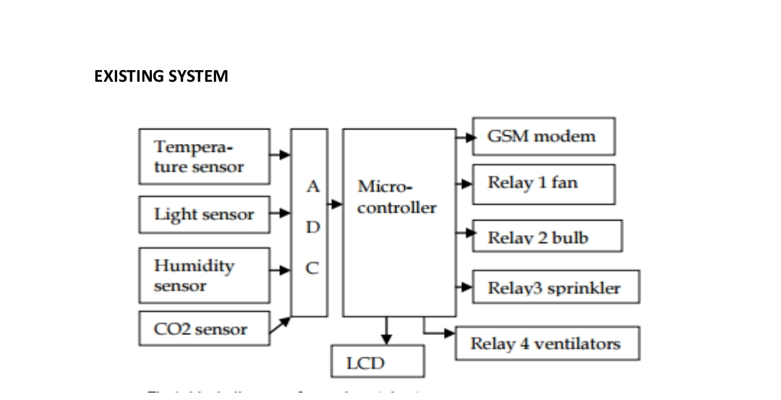
EXISTING SYSTEM

Slide 6
DRAWBACKS
►System response is slow.
►Micro controller operating frequency is very low.
►Needs additional interfaces

Slide 7
PROPOSED SYSTEM
►The Proposed soil Moisture Controlled irrigation system has been designed and tested successfully
► It has been developed by integrated features of all the hardware components used. The system has been tested to function automatically.
►The moisture sensors measure the moisture level (water content) of the different plants
►If the moisture level goes below the desired and limited level, the moisture sensor sends the signal to the Arduino board which triggers the Water Pump to turn ON and supply the water to respective plant.
►Thus, the functionality of the entire system has been tested thoroughly and it is said to function successfully

Slide 8
ADVANTAGES
►Easy to implement.
► Simple and efficient
► Accurate sensing
► Low maintenance cost
► Acknowledging user about the field

Slide 9
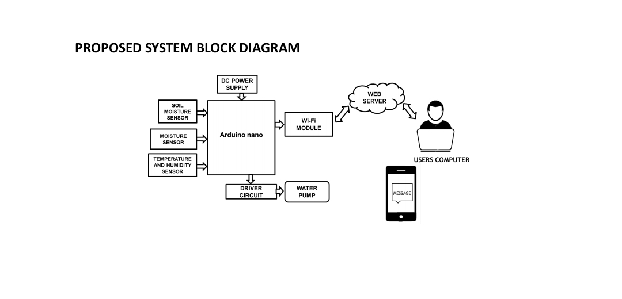

Slide 10
SOFTWARE AND HARDWARE REQUIREMENTS
1.Software Requirements:
► Arduino Software (IDE)
►Programming Language: C++
2.Hardware Requirements:
►ARDUINO nano MICROCONTROLLER
►DH11 SENSOR (Temperature Sensor)
►MOISTURE SENSOR
►ESP8266 Wi-Fi Module

Slide 11
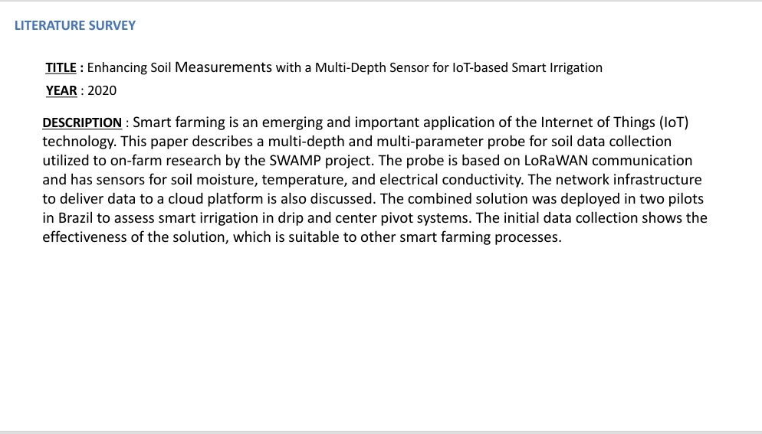

Slide 12
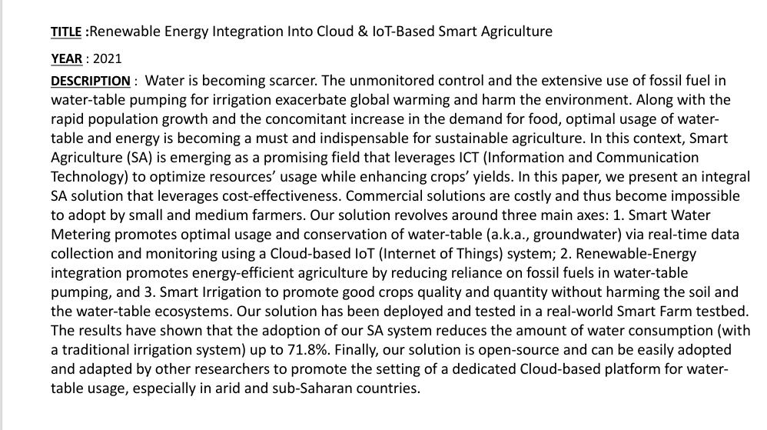

Slide 13
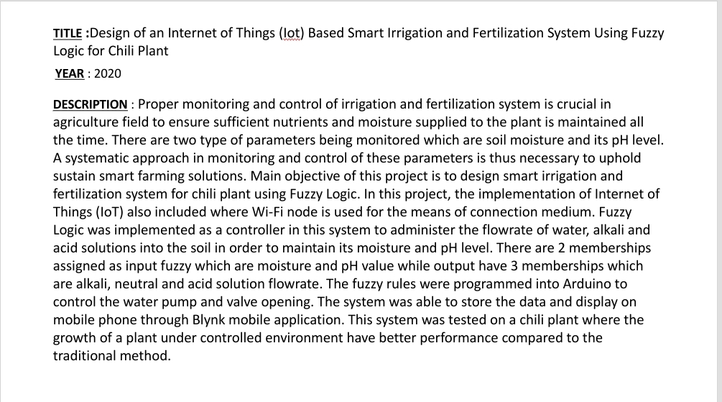

Slide 14
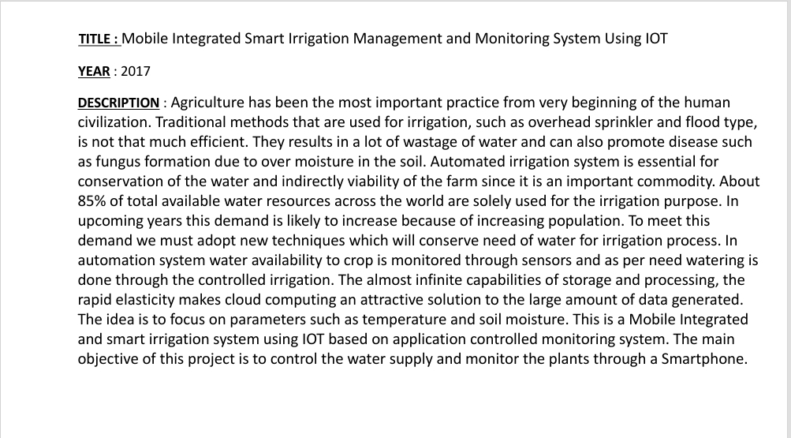

Slide 15
