Slide 1


Positioning Navigation and Timing Internship
IIT Tirupati Navavishkar I-Hub Foundation &
Siddhartha Academy of Higher Education (Deemed to be University), India
“HANUMA”(HAZARD ANALYSIS NAVIGATION UNIT FOR MINE ASSISTANCE)
Date : September 18th 2025
Mentor
Dr. Shaik Fayaz Ahmed
Siddhartha Academy of Higher Education
(Deemed to be University)
Team
B. Venkat Gopi Nayak
M. Bindu Madhavi
Siddhartha Academy of Higher Education
(Deemed to be University)

Slide 2




The Critical Need for Automation in Hazardous Environments
Human Risk: Traditional manual inspection in underground mines exposes workers to fatal risks.
Environmental Dangers: Threats include toxic gas leaks (Nitrogen DiOxide, Carbon Dioxide), structural instability, and fire hazards from temperature spikes.
Data Gap: Safety teams lack real-time visual and sensory feedback from deep within tunnels before human entry.

Slide 3
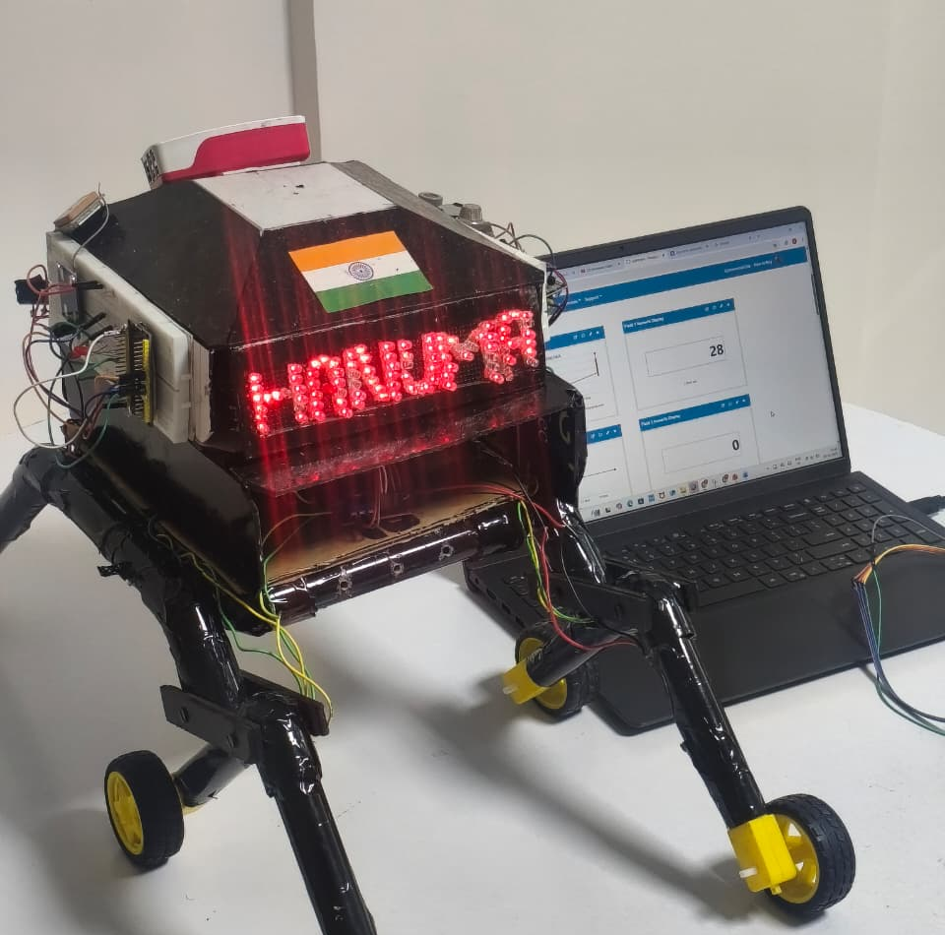
Our Solution: A Robotic First Responder
An autonomous rover designed to enter hazardous zones, stream real-time environmental data, and provide a live visual feed to a safe control center, ensuring areas are clear before human entry.

Slide 4




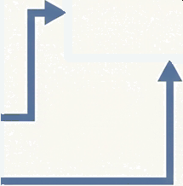


System Architecture
Environmental Sensor Suite
NO₂ Gas SensOr
CO₂ Gas Sensor
Temperature Sensor
Control & Sensing Core: ESP32
Video Processing & Streaming: Raspberry Pi 5
Operator Interface
Vibration & Tilt Sensors
Webcam (Live Feed)
Navigation B Movement
_{((})} Wi-Fi Data
Stream
GPS Module
(NEO-6M)
Rotary Encoder
(for speed detection)
Motor Control System

Slide 5




The Build, Part 1: From Raw Signals to Reliable Senses
Challenges Solutions
Gas Sensor Noise: Initial readings from NO₂ and
CO₂ sensors were unstable and fluctuating.
Data Filtering Implemented analog filtering and code-based smoothing algorithms to stabilize sensor output.
Rotary Encoder Bounce: Mechanical bouncing generated multiple false pulses, corrupting speed detection.
Signal Debouncing: Developed and optimized an Interrupt Service Routine (ISR) with debouncing logic to ensure accurate pulse detection from the encoder.

Slide 6
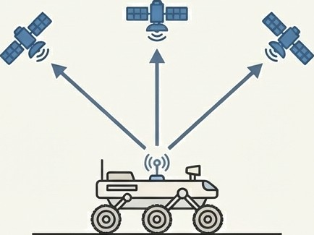
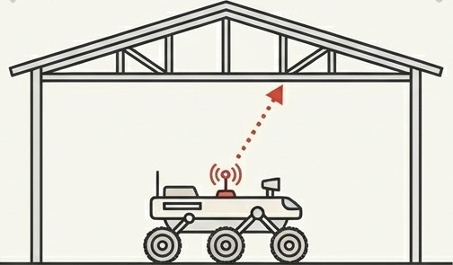
The Build, Part 2: Achieving Positional Awareness
Challenge Solution
Satellite Acquisition: The NEO-6M GPS module experienced significant delays in achieving a satellite lock, hindering real-time location location tracking.
Protocol & Placement: Diagnosed the issue as a signal problem. Improved satellite acquisition speed by strategically placing the antenna and establishing an outdoor testing protocol with a clear sky view.
This also validated the use of the TinyGPS+ + library for parsing NMEA data via UART.

Slide 7
The Build, Part
Integrating a Unified System
Solutions
Challenges
Processing Latency: Running multiple processes simultaneously (sensing, movement, communication) caused slight but noticeable delays in rover response.
Code Optimization: Refactored the code to remove blocking delays and improve process handling, increasing responsiveness.
Signal Interference: The GPS and Wi-Fi modules interfered with each other, causing instability in both location data and the data stream.
Hardware Isolation: Physically separated the wiring paths and optimized the placement of the RF modules on the chassis to reduce signal interference.

Slide 8
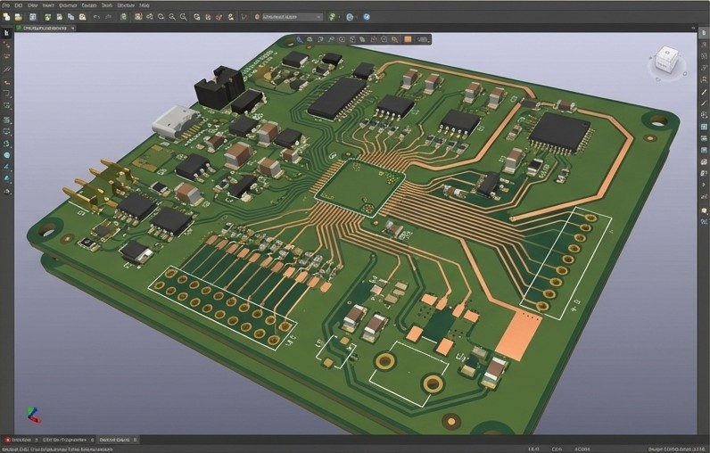
The Build, Part 4: A Foundation for Reliability
Objective: To create a robust, reliable motor-control subsystem, we designed a custom Printed Circuit Board (PCB).
Benefits:
Ensures stable performance
under vibration.
O
Reduces complex point-to-
point wiring.
Improves overall system
reliability.
O
Status: Component placement is complete, routing is in progress.

Slide 9
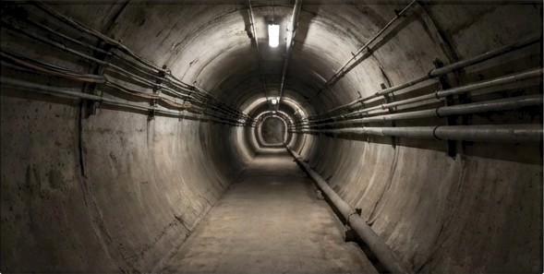



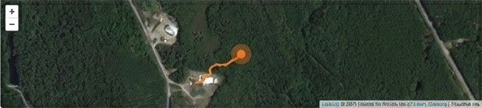




The Result: Real-Time Situational Awareness
= Mission Control
Tn
Live Video
oata
CO
HO,
Map
Live HD Video Streaming
Continuous Environmental Monitoring
Precise GPS Location Tracking
Remote Rover
Control

Slide 10



Key Learnings and Competencies
Hardware Integration
Mastered sensor calibration, power management, and UART serial communication between modules.
Embedded Programming
Gained proficiency in handling real-time inputs, interrupts, and multi-process optimization on the ESP32.
Systematic Troubleshooting
Developed a rigorous methodology for diagnosing and solving complex hardware/software conflicts, from signal noise to RF interference.

Slide 11
Project Status and Future Trajectory
Immediate Next Steps
Final Validation: Perform final, comprehensive testing of the fully integrated rover to verify reliable, simultaneous operation of all modules.
Documentation: Complete and submit all project
documentation, including schematics, code
repositories, and final reports.
Future Vision
Implement basic autonomy with on-board
obstacle avoidance.
Design a more robust, environmentally-sealed
chassis for real-world deployment.

Slide 12


Acknowledgements
We extend our sincere gratitude for the invaluable guidance and support provided by:
Faculty Mentor
Dr. Ravi Raja
Dr. Shaik Fayaz Ahamed
Supporting Institution
Geospatial Intelligence and Applications Laboratory
Associate Professor, Siddhartha Academy of Higher Education.
IIT Tirupati Navavishkar I-Hub Foundation
IIT Tirupati
I-Hu b Foundation

Slide 13


