Slide 1
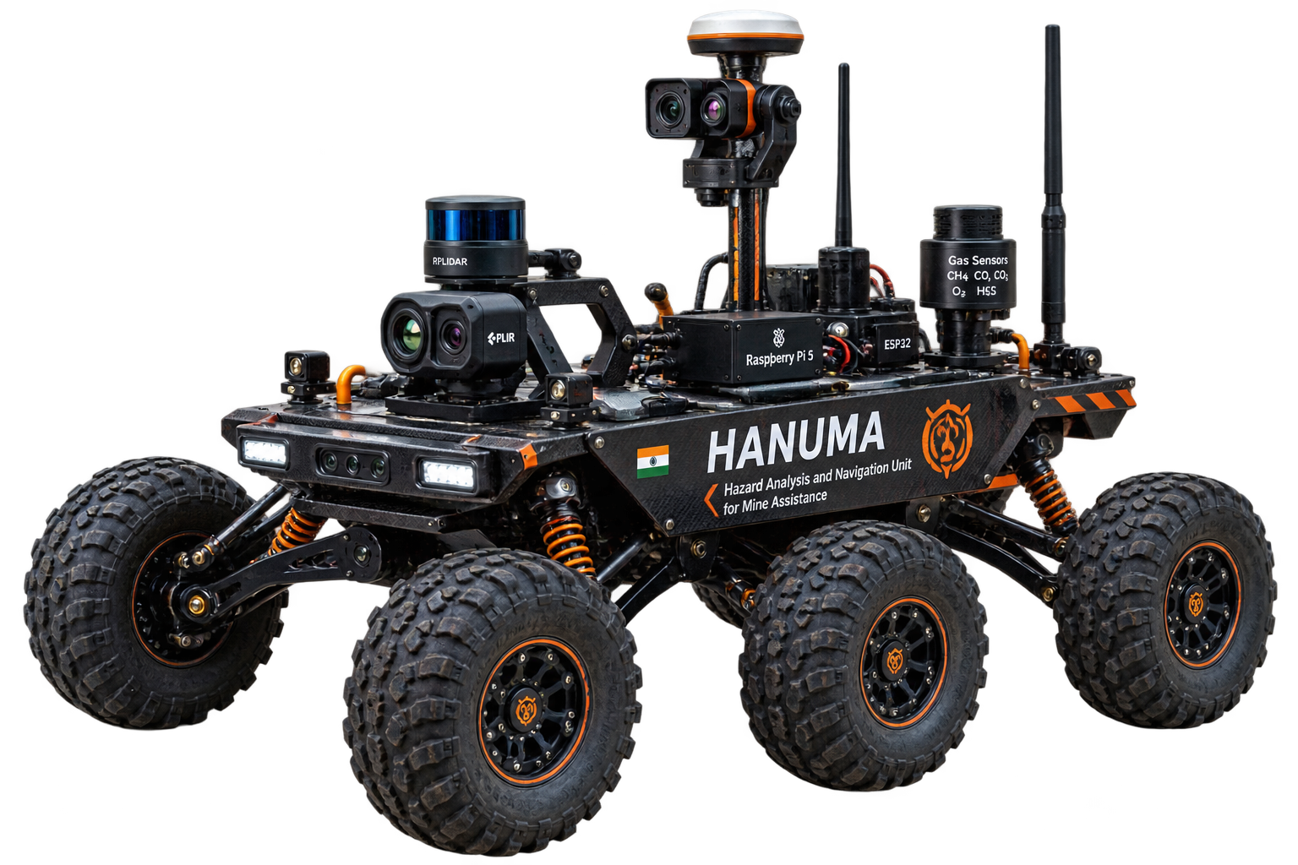

SMART INDIA HACKATHON 2026
Problem Statement ID – SIH26039
Problem Statement Title- Al-Powered Underground Mine Safety, Monitoring and Rescue System
Theme- SMART AUTOMATION
PS Category- HARDWARE
Team ID-
Team Name- SAR SQUADS

Slide 2
HANUMA – HAZARD ANALYSIS & NAVIGATION UNIT FOR MINE ASSISTANCE
SAR
SQUADS
"HANUMA translates advanced subterranean robotics into a modular, low-cost inspection architecture combining multimodal sensing, resilient communication, and edge intelligence.“
SUBTERRANEAN HAZARDS: 1. HIGH-RISK ENVIRONMENT
Underground mines present severe risks including toxic gases, oxygen deficiency, dust, unstable terrain, and communication shadow zones.
THE SOLUTION: HANUMA ROVER
A rugged six-wheel rocker-bogie rover that transforms human-first inspection into a remote, safe, and multimodal sensing operation, designed specifically to traverse and map extreme underground spaces.
CORE INNOVATIONS
GPS-DENIED LOCALIZATION
Fusing 2D LiDAR, IMU, and wheel odometry.
2. MULTIMODAL HAZARD INTELLIGENCE
Integrating gas, thermal, vision, and environmental sensors.
3. RESILIENT COMMUNICATION
LoRa-based breadcrumb relay concept.
4. EDGE-AI ASSISTANCE
Local processing for rapid artifact interpretation.
5. FAILSAFE AUTONOMY
Proposed return-to-comms behavior to prevent rover abandonment.

Slide 3
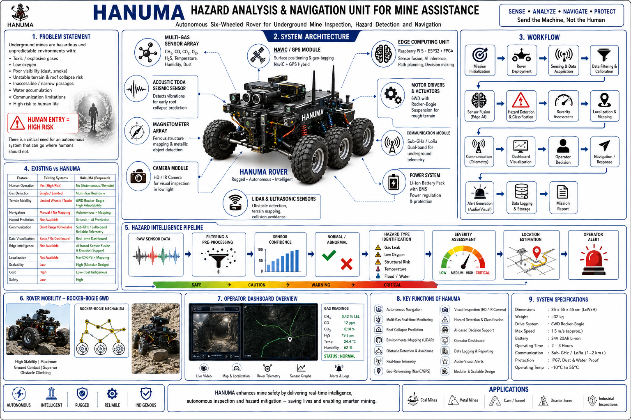

Slide 4
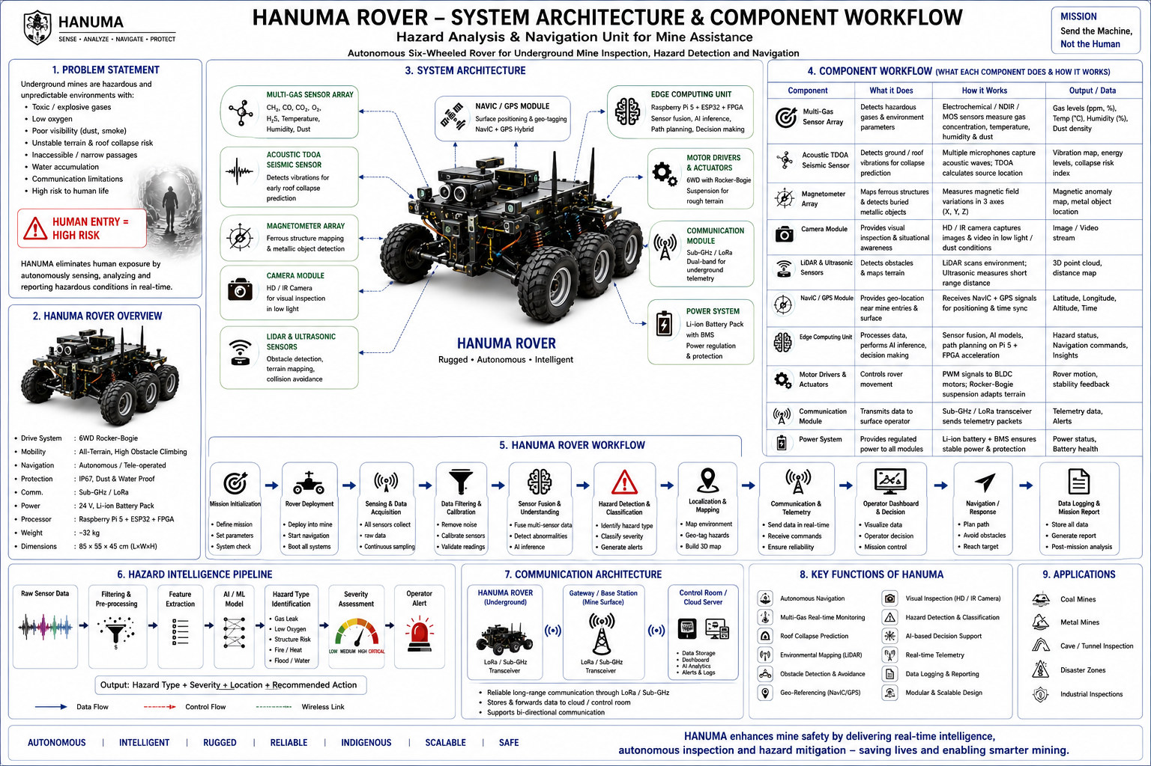
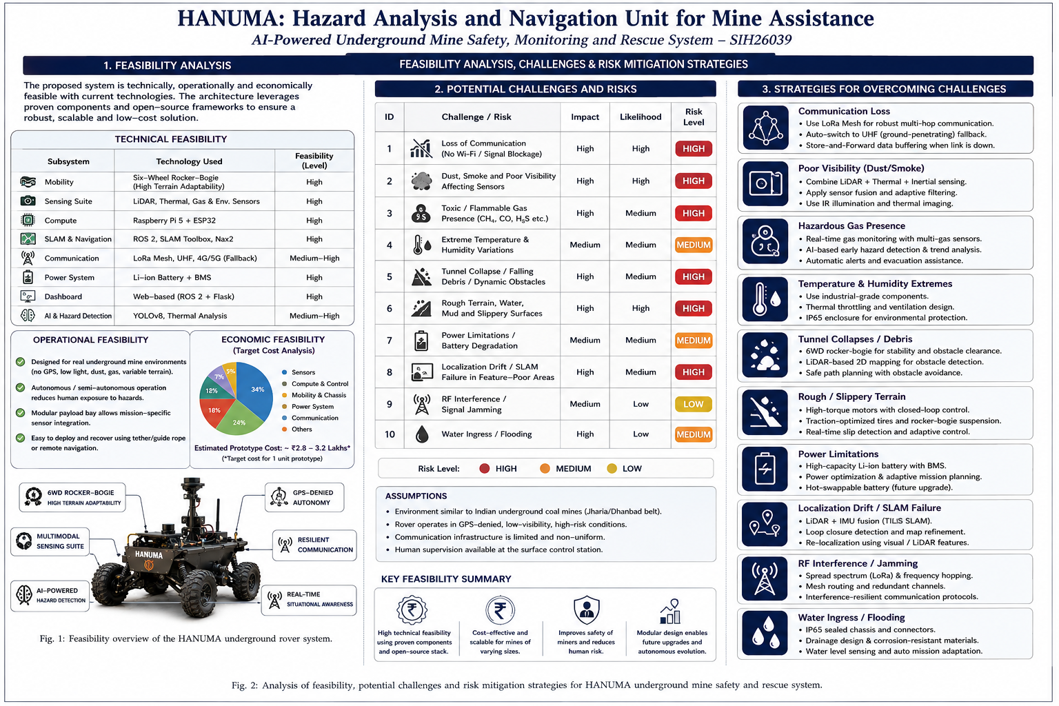
FEASIBILITY AND VIABILITY
SAR
SQUADS

Slide 5
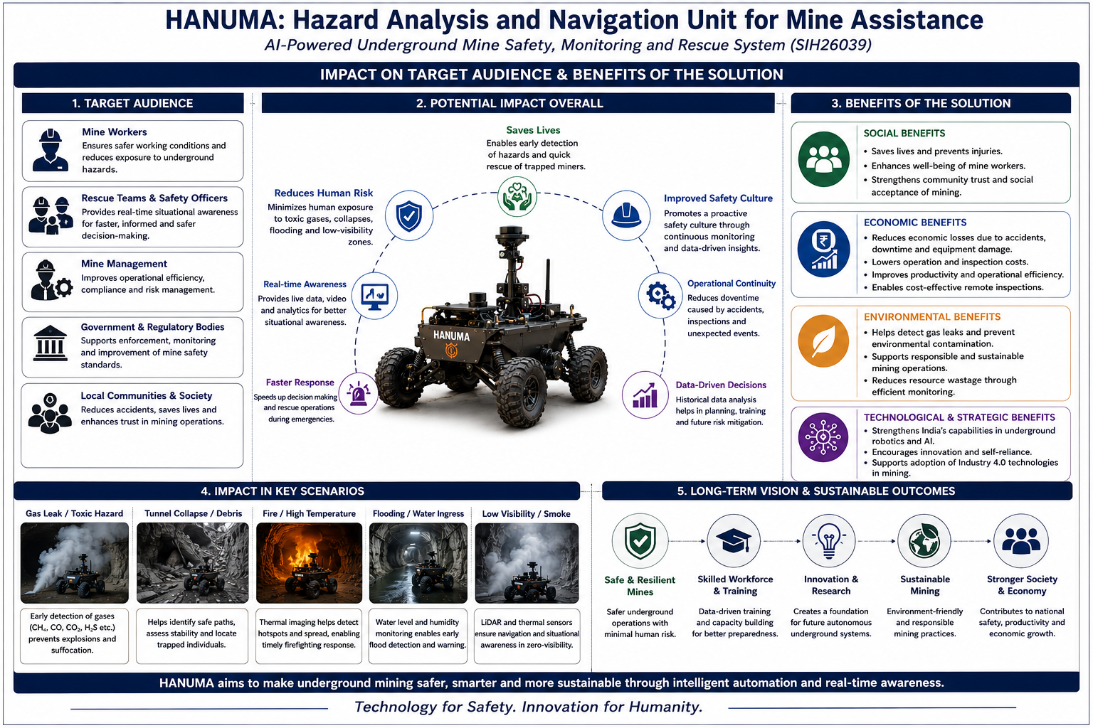
IMPACT AND BENEFITS
SAR
SQUADS

Slide 6
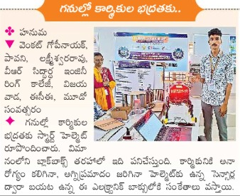
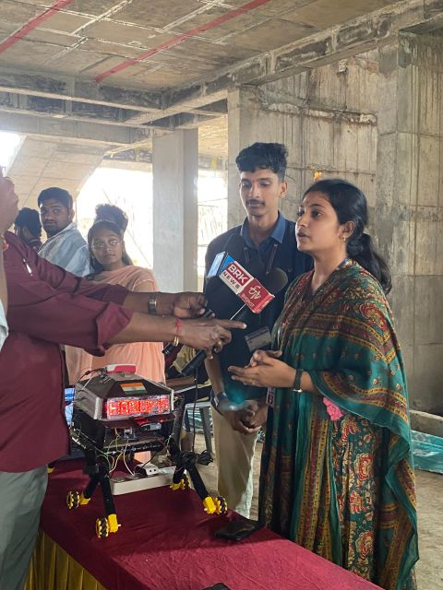
RESEARCH AND REFERENCES
CERBERUS in the DARPA Subterranean Challenge (Science Robotics, 2022):
https://www.science.org/doi/10.1126/scirobotics.abp9742
DARPA Subterranean (SubT) Challenge Official Overview:
https://www.darpa.mil/program/darpa-subterranean-challenge
Directorate General of Mines Safety (DGMS) - Official Statistics & Circulars:
https://dgms.gov.in/
ROS 2 Navigation2 (Nav2) Official Documentation:
https://navigation.ros.org/
OUTPUTS:- https://drive.google.com/drive/folders/1AN-MhGUkb1pW22zvBqY6sv8BgVrvYtHC?usp=sharing
“”The above given link contains the outputs obtained from the testing of our original model/prototype.””
GITHUB:- https://github.com/Gopinayak02/HANUMA_Weekly_Report
The Pipelines, we went through our model processing, and we also add the training .pth files to avail the trained weights directly.
NOTE:- The model weights are under re-enhancing stage which will be released on and before i.e., 27/10/2026.
YOUTUBE LINK:- https://youtube.com/shorts/cCB2XQQ_4Ew?si=7JsAbaE7Y5XlR80W

