Slide 1

Minor Project Presentation on Cricket Data Analytics
Core branch:
Artificial Intelligence & Data Science (I1)
J Monesh - 160121771039
Md Mushtaq - 160121771050 M Gopi Prashanth Raju - 160121771051
Mentor: Smt. T Satya Kiranmai Designation: Assistant Professor

Slide 2

Table of Contents
S. No. | Content
1 | Abstract
2 | Introduction
3 | Literature Survey
4 | Methodology
5 | Results
6 | Conclusion
7 | Future Scope
8 | Bibliography

Slide 3
Abstract
Cricket is transforming with data analytics, moving beyond intuition to advanced statistical methods. This project analyzes key metrics like strike rate and dismissal patterns to optimize team selection and training. Statistical models predict player performance, aiding strategic decisions and in-match adjustments. Machine learning analyzes vast datasets, identifying patterns in data. Using India vs Australia match data, the project provides specific insights. Data visualization through charts and dashboards empowers real-time analysis and decision-making. This approach exemplifies how analytics enhances player performance, team strategies, and fosters a data-driven cricket management evolution.

Slide 4
Introduction
Overview
Data analytics is revolutionizing cricket by moving beyond intuition to data-driven decision-making. This project analyzes strike rate, economy rate, and dismissal patterns to optimize team selection and player performance. Insights from statistical analysis enable tailored training programs and predictive models to adjust strategies for a competitive edge. Data visualization transforms complex data into actionable insights through charts and interactive dashboards, empowering informed decisions for winning performances. This project exemplifies how data can enhance player performance and team strategies, marking a new era in cricket.

Slide 5
Introduction
Problem Statement
Cricket has traditionally relied on intuition and conventional metrics, but this approach falls short in optimizing player performance and team strategies. This project addresses this gap by developing a comprehensive framework for analyzing cricket data using advanced statistical methods. By moving beyond traditional averages, it aims to uncover deeper insights into player strengths and weaknesses and broader team dynamics. The goal is to democratize access to actionable insights through advanced statistical models and data visualization, revolutionizing cricket strategies. This initiative aspires to enhance performance and competitiveness, driving informed decision-making and elevated standards of play.

Slide 6
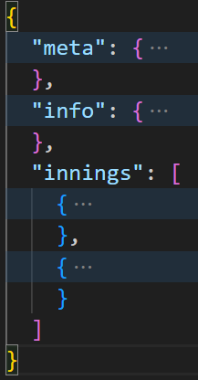
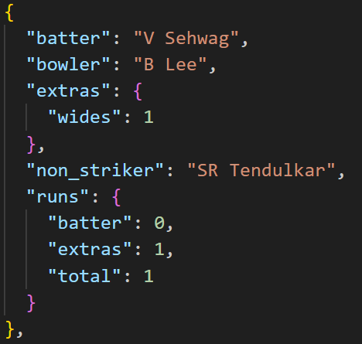
Introduction
Introduction to Data
Figure-1
Figure-2
Figure-1 contains the structure of the json file and Figure-2 contains the structure of a ball data.

Slide 7
Literature Survey
Paper Title | Predicting the Outcome of ODI Cricket Matches: A Team Composition Based Approach
Year Of Publication | 2016
Conference details | IEEE
Dataset used | Source: ESPN Cricinfo [reference 13] Timeframe: 2010-2014 ODI matches (excluding rain-interrupted/tied matches)
Tasks | Predicting the winner of an ODI cricket match

Slide 8
Literature Survey
Paper Title | Analysing the performance of the Indian Cricket Team using Weighted Association Rule Mining
Year Of Publication | 2018
Conference details | 2018 International Conference on Computing, Power and Communication Technologies (GUCON)
Dataset used | ODI cricket matches played by India against Sri Lanka and South Africa from 2008 to 2017
Tasks | Identify frequent patterns between match attributes and outcome.

Slide 9
Methodology
1. Data Collection and Preprocessing
Acquire cricket match data from official database of cricksheet.org.
Preprocess data to ensure consistency, handle missing values, and format data for analysis.
2. Feature Engineering
Identify and engineer relevant features to enhance predictive power.
Calculate key metrics like batting averages, strike rates, and economy rates.
3. Data Visualization and Interpretation
Visualize insights with plots, charts, and dashboards for stakeholder comprehension.
Provide interactive tools for deeper data exploration and actionable insights.

Slide 10
Methodology
4. Model Development
Develop predictive models using statistical and machine learning techniques.
Select appropriate algorithms (regression for continuous, classification for categorical outcomes).
Train and validate models with historical data using cross-validation.
5. Validation and Testing
Validate models using appropriate metrics and testing methodologies.
Conduct sensitivity analysis to ensure model robustness and refine based on results.

Slide 11
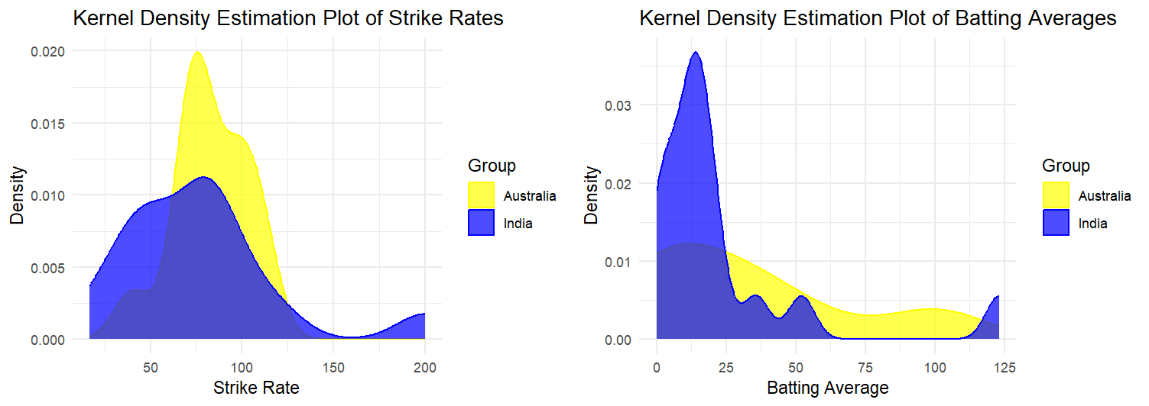
Results & Discussion
Analysis of IND vs AUS stats
Comparison of Strike Rates and Batting Averages

Slide 12
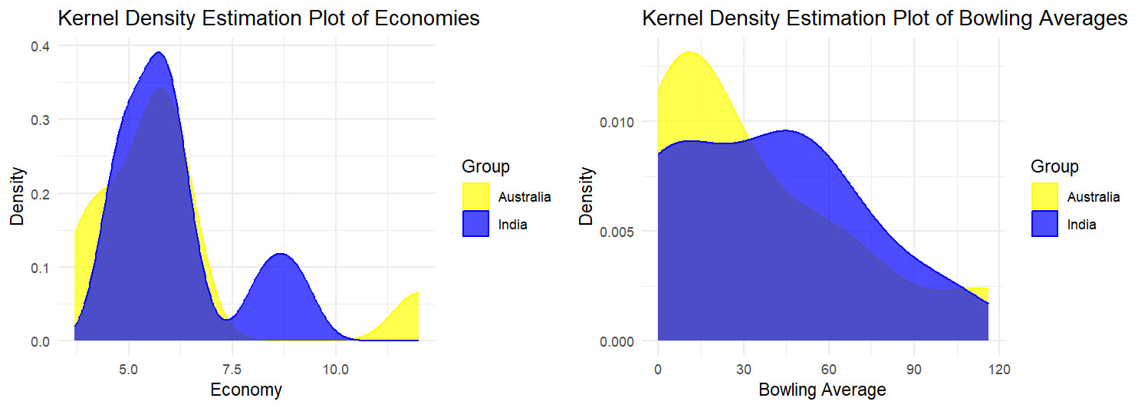
Results & Discussion
Analysis of IND vs AUS stats
Comparison of Economies and Bowling Averages

Slide 13
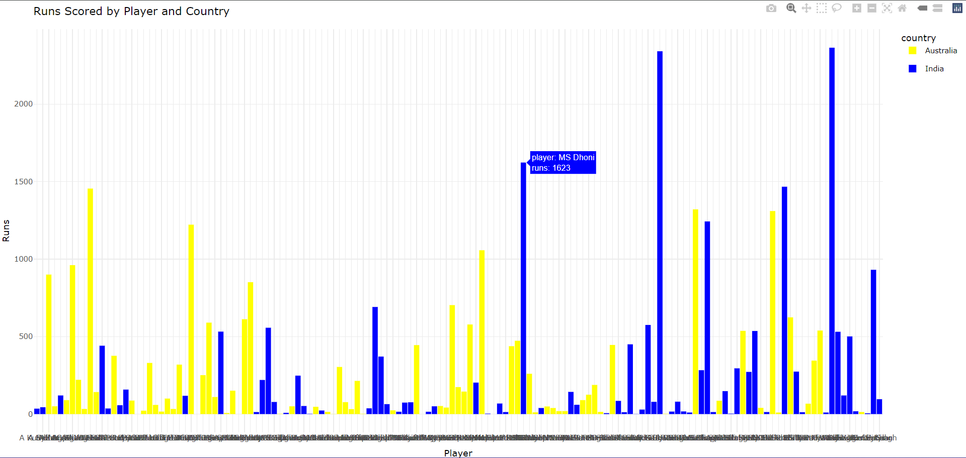
Results & Discussion
Analysis of IND vs AUS stats
Comparison of Total Runs Scored

Slide 14
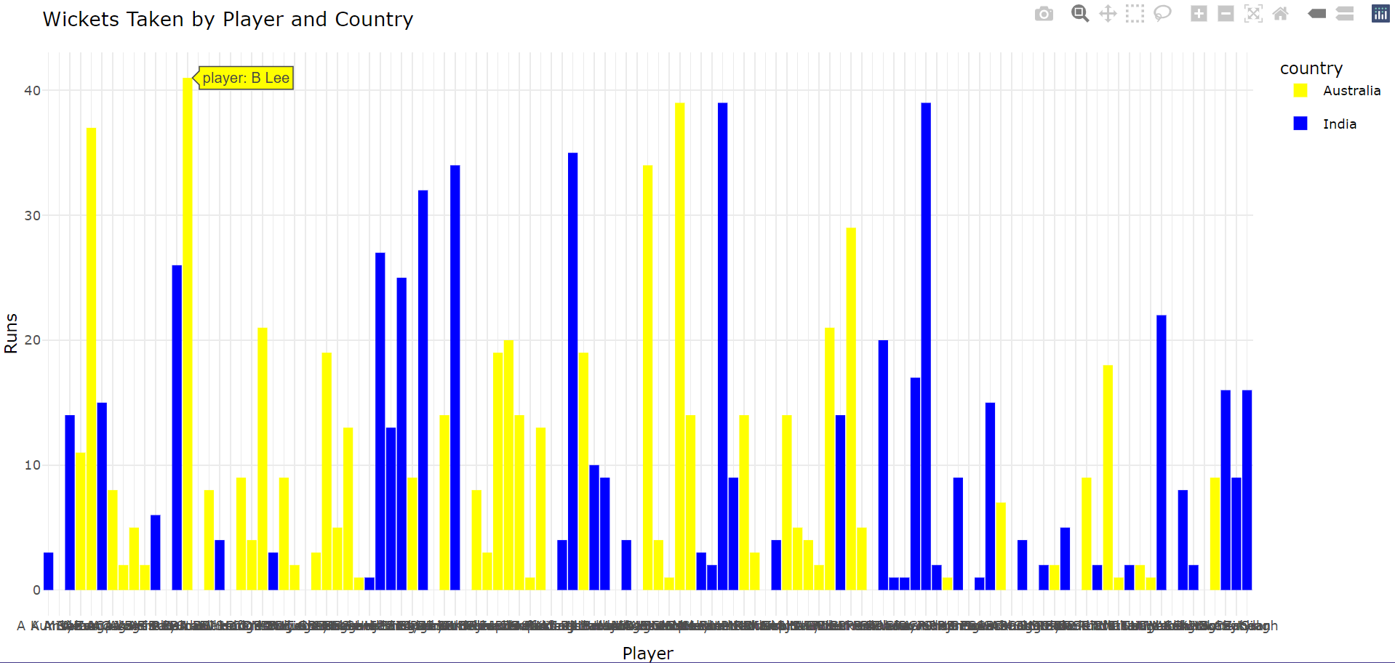
Results & Discussion
Analysis of IND vs AUS stats
Comparison of Wickets Taken

Slide 15
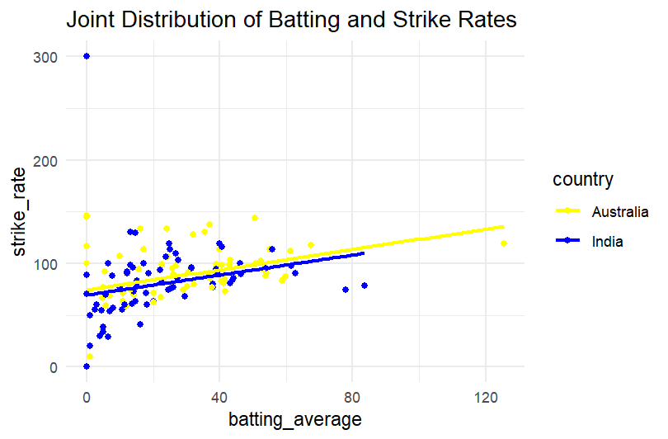
Results & Discussion
Analysis of IND vs AUS stats

Slide 16
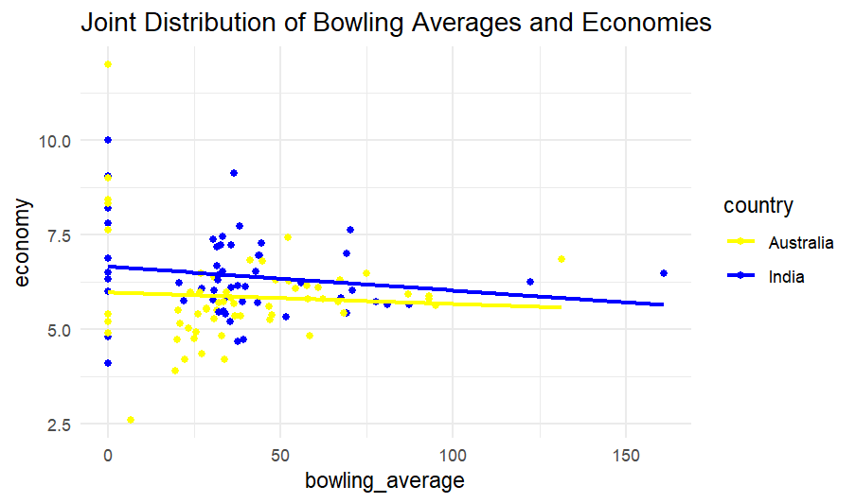
Results & Discussion
Analysis of IND vs AUS stats

Slide 17
Results & Discussion
Model – 1 : Wicket Analysis
Comparison of Models :
• Linear Regression Model: The scatter plot shows a significant deviation from the ideal line, indicating that the linear regression model does not capture the relationship between the variables well.
• Random Forest Model: The scatter plot for the Random Forest model shows a slightly better alignment with the ideal line compared to the Linear Regression model. However, there are still notable deviations, suggesting limitations in its predictive power.
• XGBoost Model: The scatter plot for the XGBoost model also shows significant deviations from the ideal line. While it exhibits some clustering of predicted values, it does not perform substantially better than the other models.

Slide 18
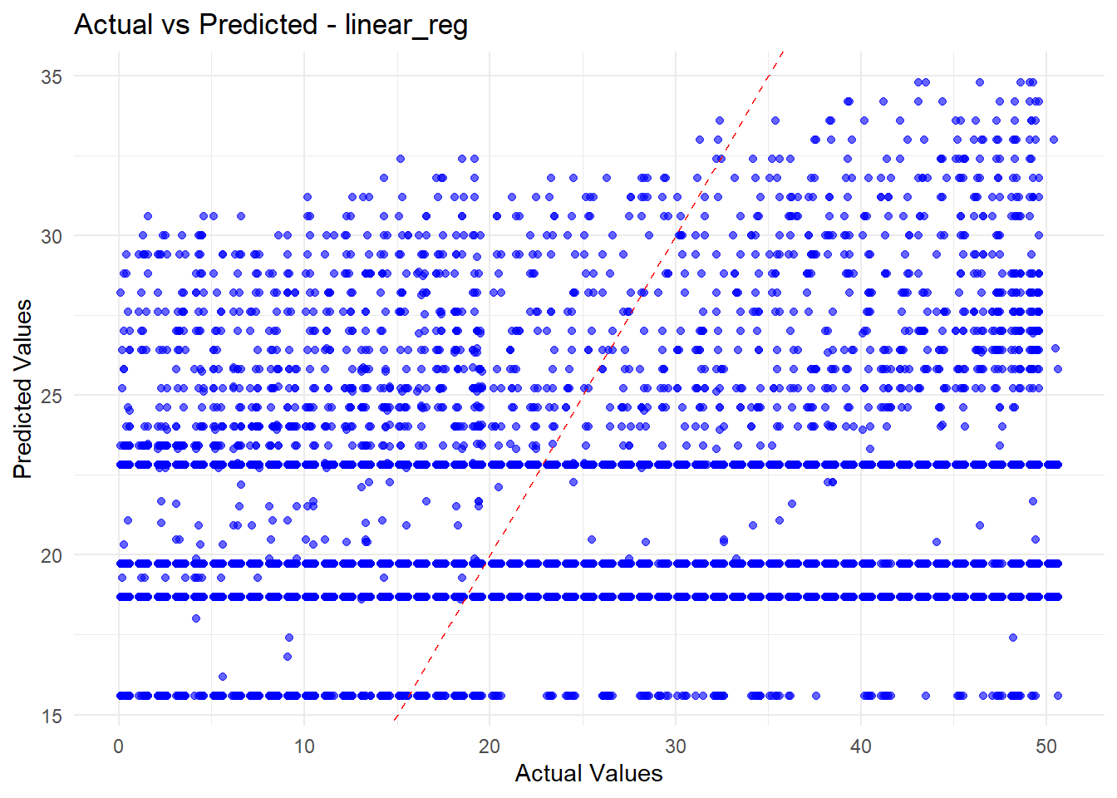
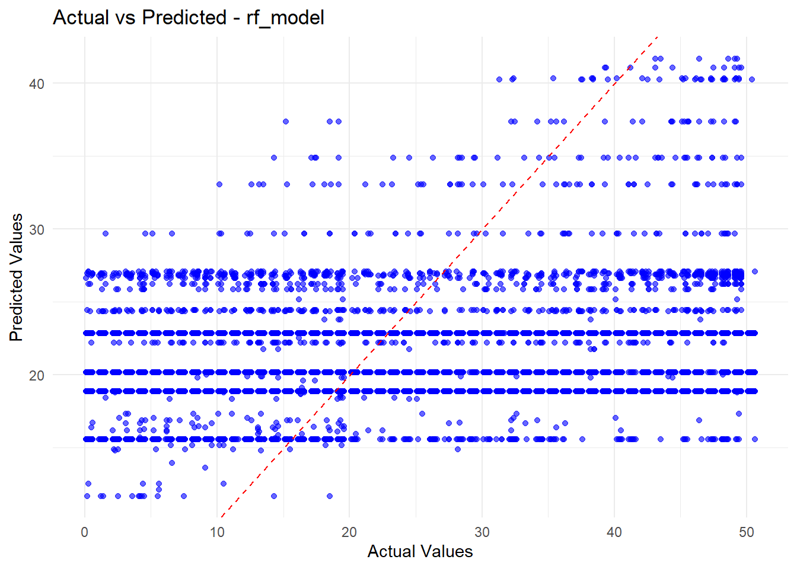
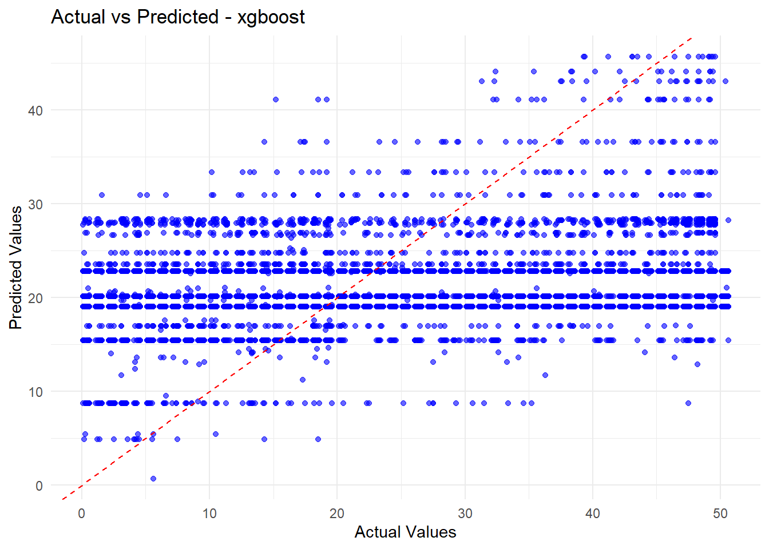
Results & Discussion
Plot: Actual vs Predicted Values

Slide 19
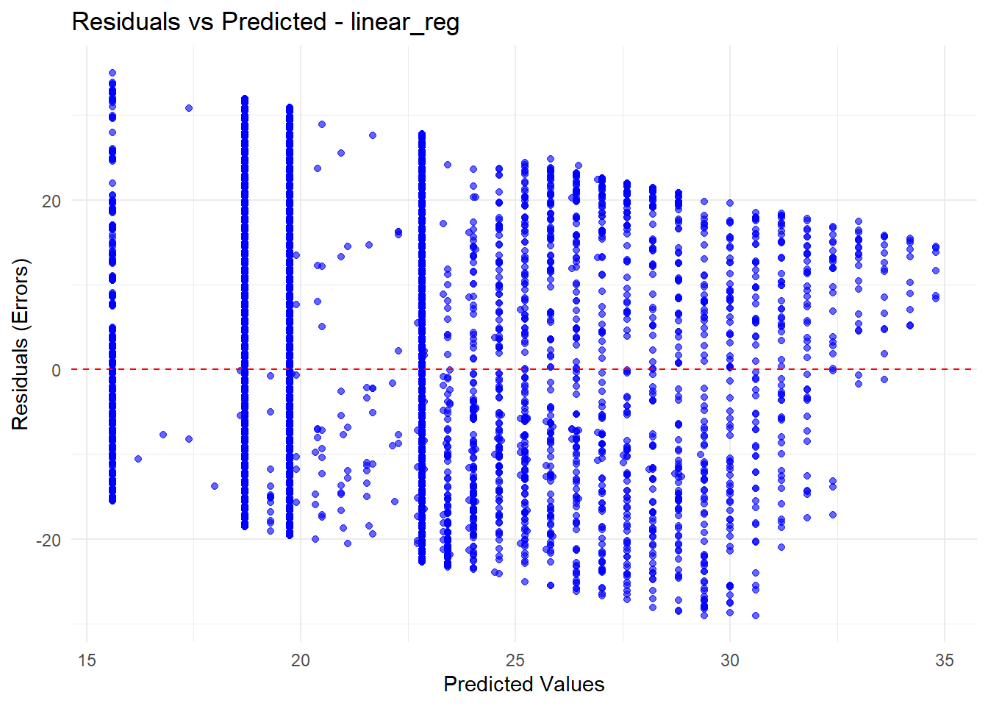
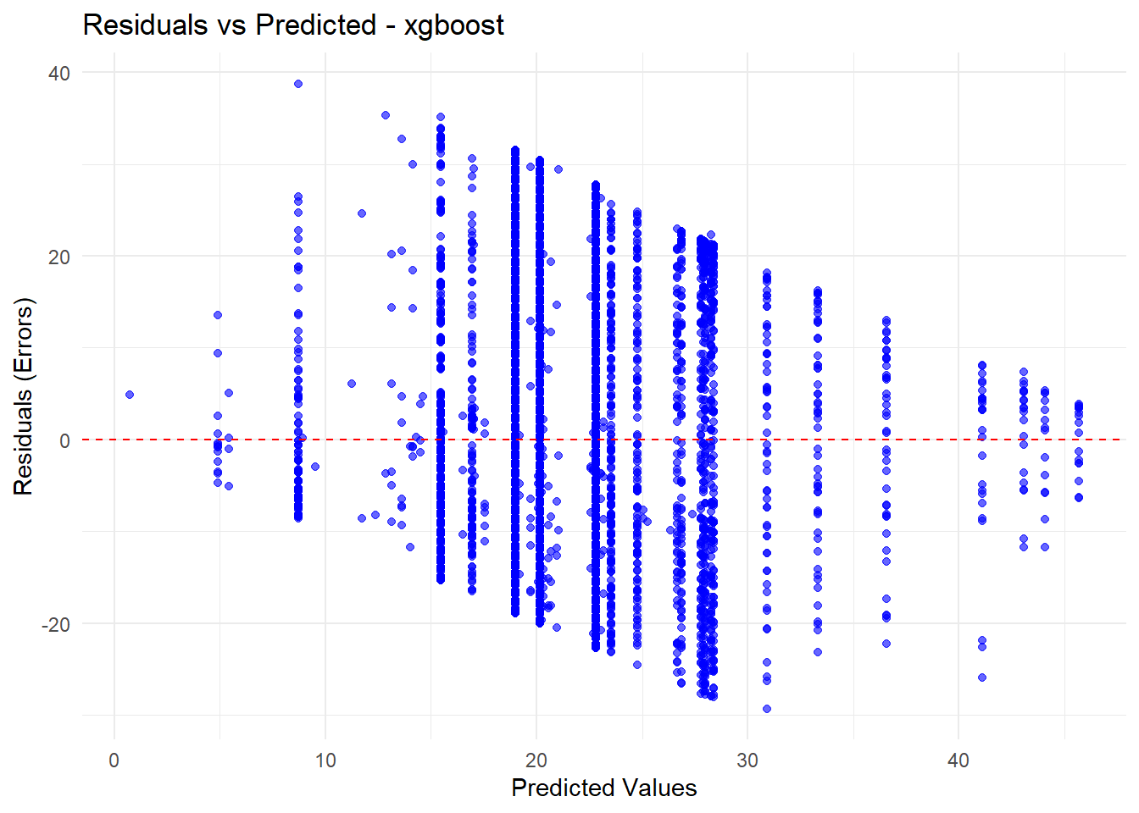
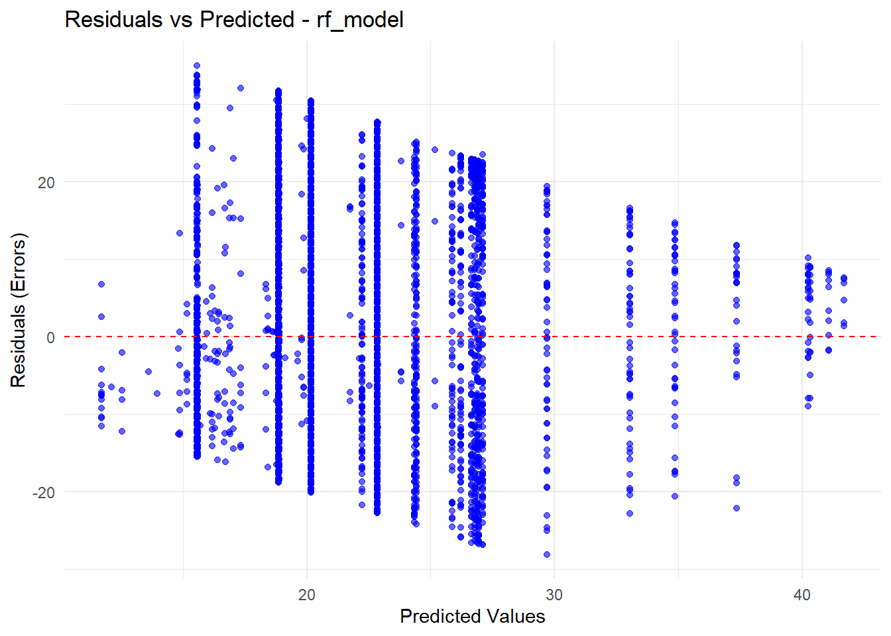
Results & Discussion
Plot: Residuals vs Predicted Values

Slide 20
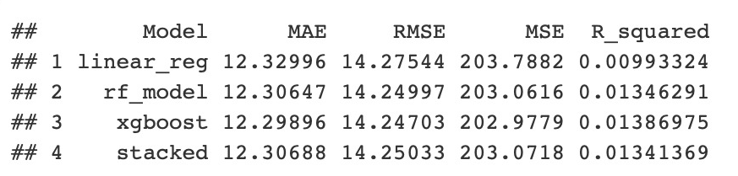
Results & Discussion
Model - 1 metrics

Slide 21
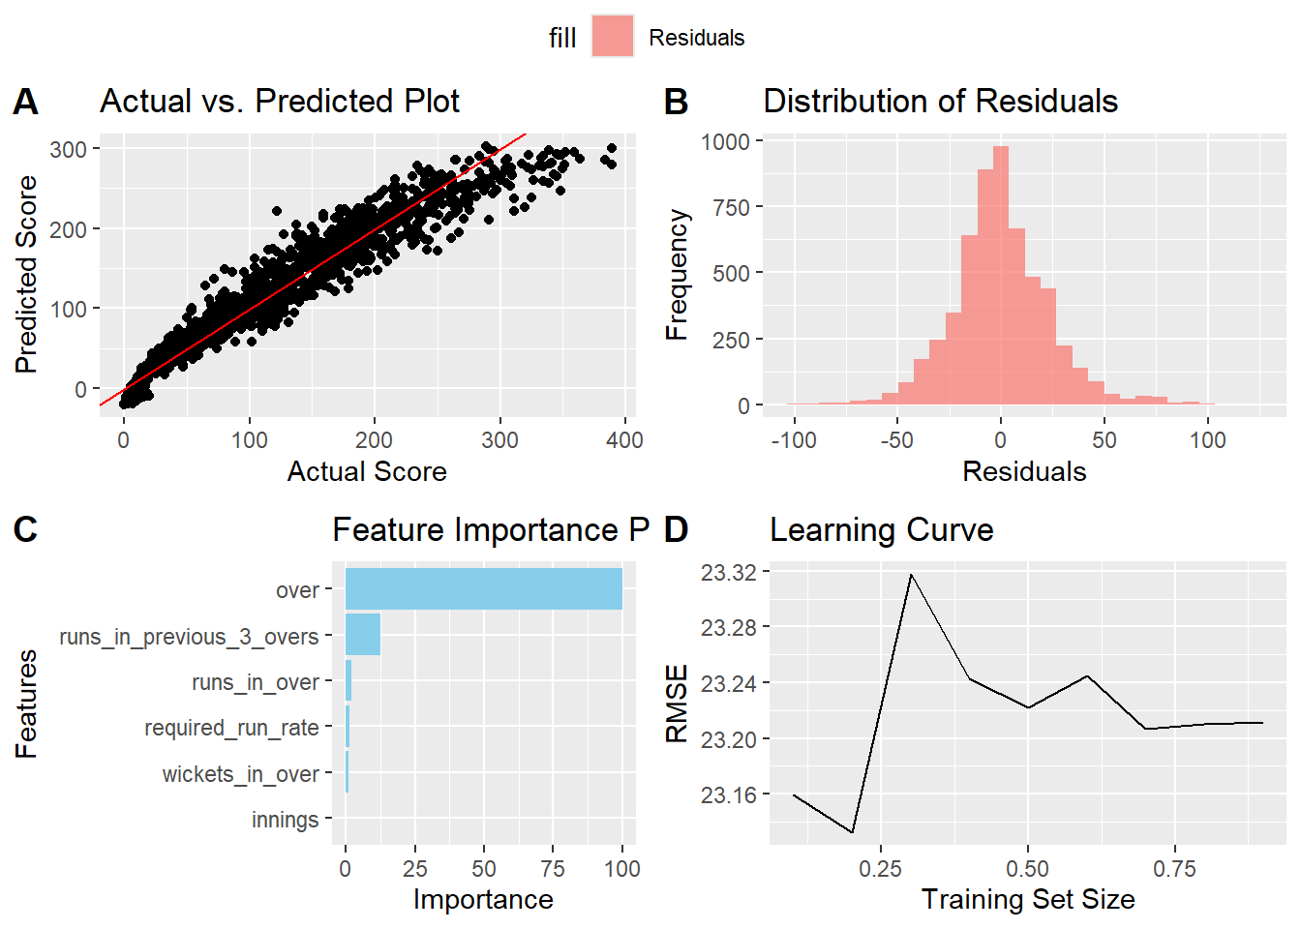
Results & Discussion
Model – 2 : Score Prediction based on match conditions

Slide 22
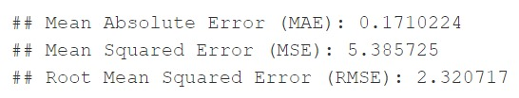
Results & Discussion
Model – 2 : Score Prediction based on match conditions
Model - 2 metrics

Slide 23
Predicted Team for T20
Results & Discussion
A PowerBI report on

Slide 24
Conclusion
The Cricket Data Analytics project has demonstrated the power of data science in cricket by analysing historical match data and player statistics to inform strategic decisions. Utilizing machine learning models for predicting outcomes and player performances, the project offers valuable insights to teams, analysts, and fans. Our comprehensive approach, including robust data preprocessing, model training, and advanced visualizations, ensures that insights are accessible and actionable. This project lays a strong foundation for future advancements in cricket analytics, highlighting the importance of data-driven decision-making in enhancing strategies and performance.

Slide 25
Future Scope
The future scope of this cricket data analytics project includes expanding data sources to cover diverse formats like Test matches and T20s, integrating real-time data for live analytics, and applying advanced machine learning techniques for player performance and match outcome predictions. Additionally, incorporating NLP for analyzing commentary and social media sentiments will enhance strategic insights. Enhancing visualization with interactive dashboards and developing a web-based or mobile platform will make the insights more accessible and user-friendly, fostering a more connected and informed cricket community.

Slide 26
Bibliography
[1] James, G., Witten, D., Hastie, T., & Tibshirani, R. (2013). An Introduction to Statistical Learning with Applications in R. Springer.
[2] Kuhn, M., & Johnson, K. (2013). Applied Predictive Modeling. Springer.
[3] Swartz, T. B., & Gill, P. S. (2010). An analysis of cricket performance using Duckworth/Lewis. European Journal of Operational Research, 200(3), 775-784.
[4] Bailey, M. J., & Clarke, S. R. (2006). Predicting the match outcome in one day international cricket matches, while the game is in progress. Journal of Sports Science and Medicine, 5(4), 480.
[5] Jain, S., & Shah, K. (2021). Predictive Analysis of Cricket Players’ Performance Using Machine Learning Techniques. International Journal of Computer Applications, 174(15), 23-28.

Slide 27
Thank You

Slide 28
Any Queries?....

