Slide 1
Employee Data Analysis using Excel
STUDENT NAME: G GOPISH
REGISTER NO: 312201027, CBF1C42E9779FCDBE164A5739FCE3A1A
DEPARTMENT: B.COM ACCOUNTING FINANCE
COLLEGE: DRBCCC HINDU COLLEGE

Slide 2
PROJECT TITLE
Employee Performance Analysis using Excel

Slide 3


AGENDA
Problem Statement
Project Overview
End Users
Our Solution and Proposition
Dataset Description
Modelling Approach
Results and Discussion
Conclusion
3/21/2024 Annual Review

Slide 4

PROBLEM STATEMENT
It helps to pinpoint the strength and areas for improvement for each employee, allowing for targeted development and training
It helps in making decision on promotions, raises, and bonuses by providing objective data on an employees contribution
Performance analysis helps in identifying potential leaders within the organization in effective succession planning
Regular feedback through performance analysis can increase employees engagement by making them feel valued and supported in their role

Slide 5

PROJECT OVERVIEW
.Employee performance analysis is the process of evaluating an individual employee’s job performance over a specific period. It involves systematically assessing how well employees perform their job duties, meet their goals, and contribute to the organization’s success. It is based on a combination of quantitative merits like sales number, project completion rate, feedback from supervisors, and peers.

Slide 6





WHO ARE THE END USERS?
Managers and supervisors
Human resources profession
Training and development team
Employees
Senior leadership/executives
Compensation and benefit teams
Legal and compliance department

Slide 7

OUR SOLUTION AND ITS VALUE PROPOSITION
Conditional formatting: to find blank values
Filter: to remove blank values
Text to columns: to split the info into two columns
Wrap text: to move the invisible letters to the next line of the same cell
Formula: to find the performance
Pivot: to get a summary
Graph: data visualization

Slide 8
Dataset Description
Employee dataset : naan mudhalvan dash board
Features available : 9 features
Selected features : 7 features
Employee ID- number
First name- text
Last name- text
Gender- male/female
Department- text
Employee rating- number
Performance- very high, high, medium, low

Slide 9

THE "WOW" IN OUR SOLUTION
Employee rating =RANDBETWEEN(1,5)
Employee performance =IFS(L3=5,"very high",L3>3,"high",L3>2,"medium",TRUE,"low")
3/21/2024 Annual Review
9

Slide 10
MODELLING
Data collection
Enter naan mudhalvan portal
Select employee dataset from the options
The dataset will download
Features collection
Select the required features.
Employee ID-number
Name-text
Gender-male/female
Employee type
Department-text
Data cleaning
Finding blank values by using the following steps
Select conditional formatting
Choose highlight cell rules
Select more rules
Choose format only cells that contain and choose blank from the rule discription
10

Slide 11
e) Select the format and click ok to mark the blank cells
Remove the blank space by using the filter option
Select the column with marked blank cells
Select filter and choose filter by color to remove the empty cells
Employee rating and performance
Select an empty column and use the formula =IFS(L5=5,"very high",L5>3,"high",L5>2,"medium",TRUE,"low") to set up the performance generator and drag it down to the required row
Select the column mentioned in the formula and enter =RANDBETWEEN(1,5) to generate random numbers between 1-5 and drag it down to the required row
Doing this will automatically fill the performance column
summary
Select the features to be used from the dataset ( employee ID, name, gender, department, employee rating, employee performance)
In the pivot table enter the department in the rows section, employees performance in the columns, gender in filter, and name in value

Slide 12
3) Add a slicer from the insert option and place employee type to get a clear view of the type of employee working in the company
Data visualization
Select the pivot table and insert a chart
It provides a clear view of the performance of employees in the company
It show how employees from each department perform
It provides a lot of insight on how the company is going to develop and help make decision on the steps to be taken by the company if the employees performance is not good

Slide 13
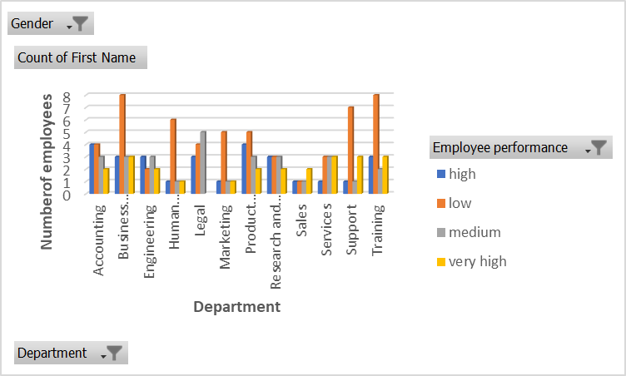
RESULTS
EMPLOYEE PERFORMANCE ANALYSIS
13

Slide 14
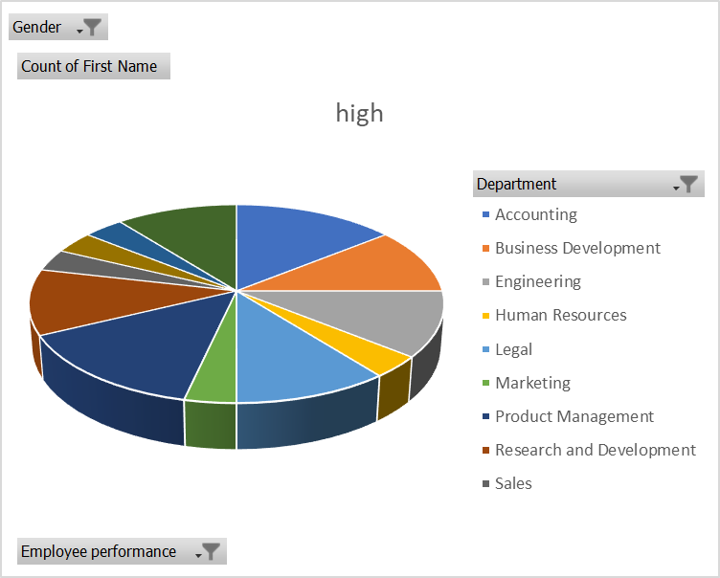
High performance

Slide 15
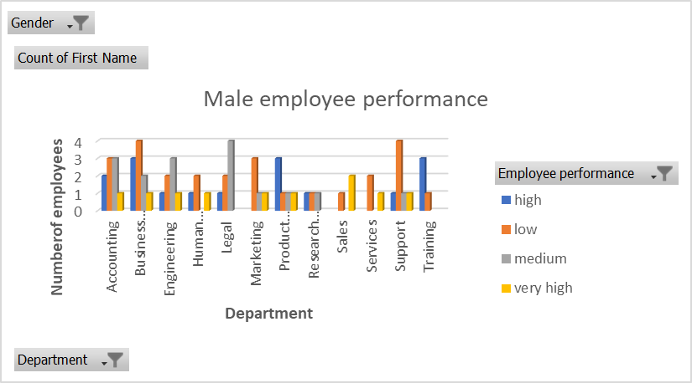

Slide 16
conclusion
From the chart we can conclude that employees from other than accounting, product management, and legal; all other department employees are not performing well.
Of the three department with the highest performance product management is the highest contributor.
The remaining department needs to perform well to meet the companies goals.

