Slide 1
Encrypted Regression Model with CKKS
Team: [Your Names]
Course: CTML – Homework 6 Presentation
Date: [Add Date]

Slide 2
Problem Statement
- Apply regression on encrypted data using CKKS
- Compare predicted vs. expected output
- Optimize for performance while maintaining data security

Slide 3
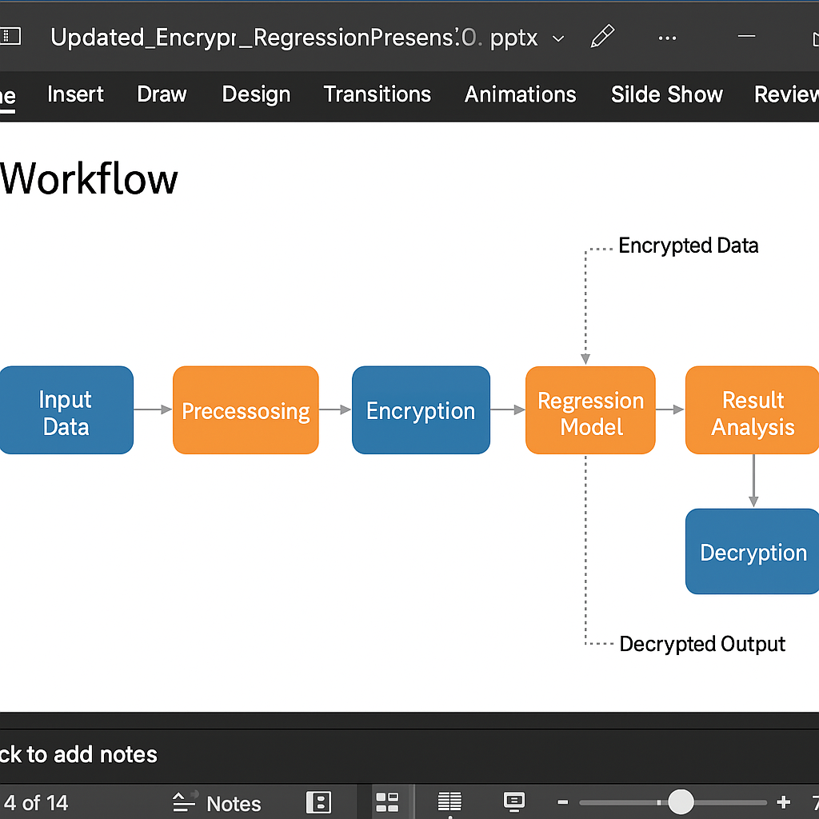
Workflow

Slide 4
Technology Stack
- C++ with OpenFHE for encrypted regression
- Python (scikit-learn) for baseline
- JSON for I/O
- CMake for build automation

Slide 5
Code Architecture
- main.cpp: workflow controller
- yourSolution.cpp: encrypted regression logic
- Regression_model.py: reference regression
- result.json: result output and evaluation

Slide 6
CKKS Methodology
- Encode vectors using CKKS
- Encrypt inputs, weights, and bias
- Perform homomorphic operations: Enc(w)*Enc(x) + Enc(b)
- Decrypt and decode result
- Vectorized slots for potential batching

Slide 7
Optimization Techniques
- Reduced multiplicative depth
- Tuned scale and modulus chain
- Packed vector slots for parallel computation
- Removed redundant encoding steps

Slide 8
Experimental Setup
- 1 sample tested
- Expected: 91,100.00
- Predicted: 186,315.51
- Time: 5.52 seconds

Slide 9
Results & Analysis
Predicted vs. Expected:
- Expected: 91,100.00
- Predicted: 186,315.51
- Accuracy Gap: Needs tuning
- Performance: Efficient execution (~5.5s)

Slide 10
Challenges & Improvements
- Approximate arithmetic caused deviations
- Tuning CKKS parameters is complex
- Plan: normalize inputs, improve rescaling, test batch inputs

Slide 11
Conclusion & Future Work
- Successfully built encrypted regression system
- CKKS-enabled computation without decryption
- Future: support batching, optimize accuracy, expand dataset

