Slide 1
Ni/Metglas/PVDF Based ME Antenna for near field communication

Slide 2
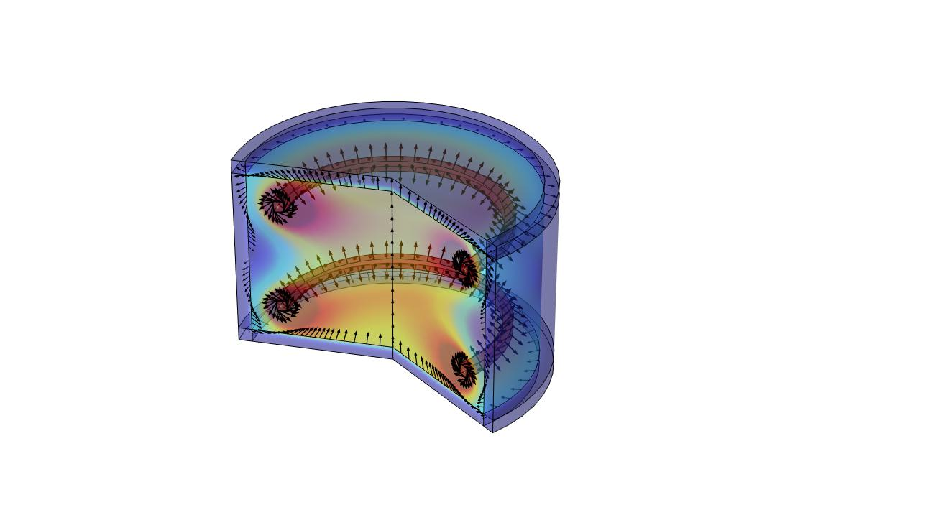

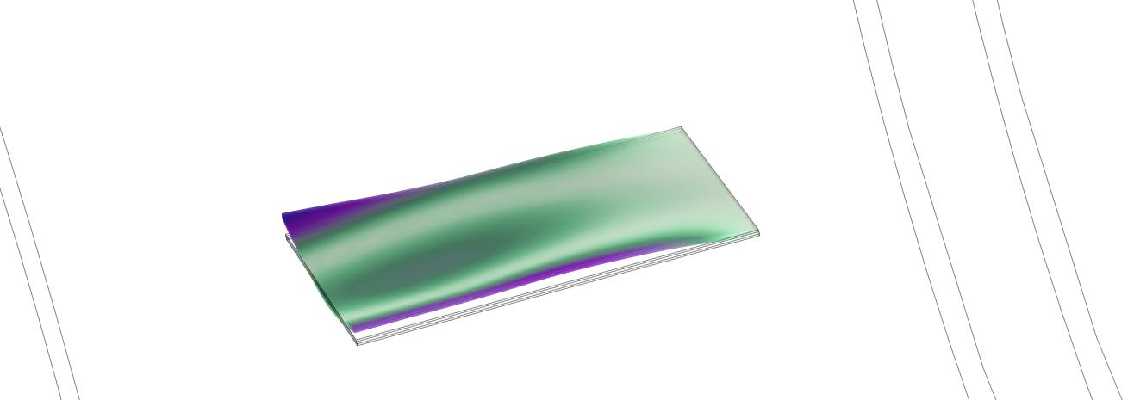
Softwares
We started on the last week of may learning basics of Antennas
Then we learned simulation softwares like COMSOL, Matlab and simulated
Dipole Antenna
Helmoltz Coil
Magnetoelectric antenna (shape change on applying magnetic field)

Slide 3
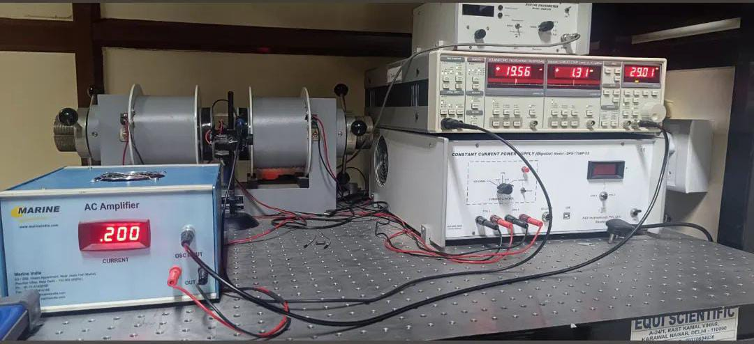
Frequency Analysis Of ME antenna
For the first time we worked on hardware level. For different values of Frequency of input magnetic field we calculated the output voltage and tried to match it with our simulation
we took 185 different values of frequency (20KHz to 70KHz) and made graph in Excel and Origin softwares
Function Generator
Helmoltz Coil
ME reciever

Slide 4
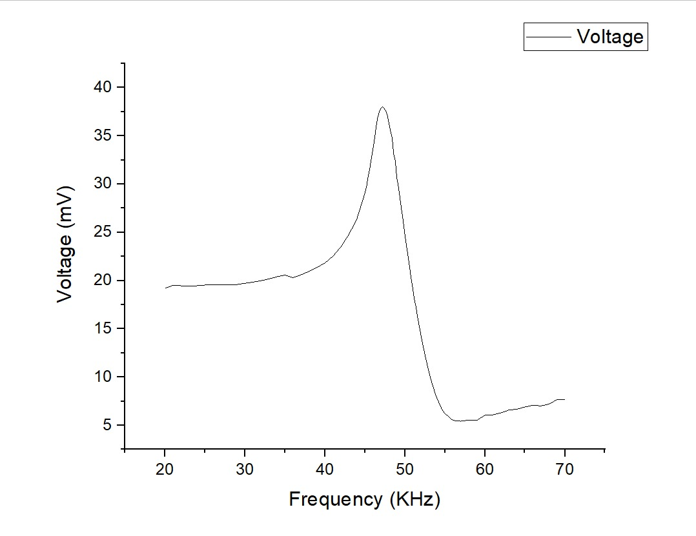
Simulation in Matlab
Plotting Observation data in Origin

Slide 5
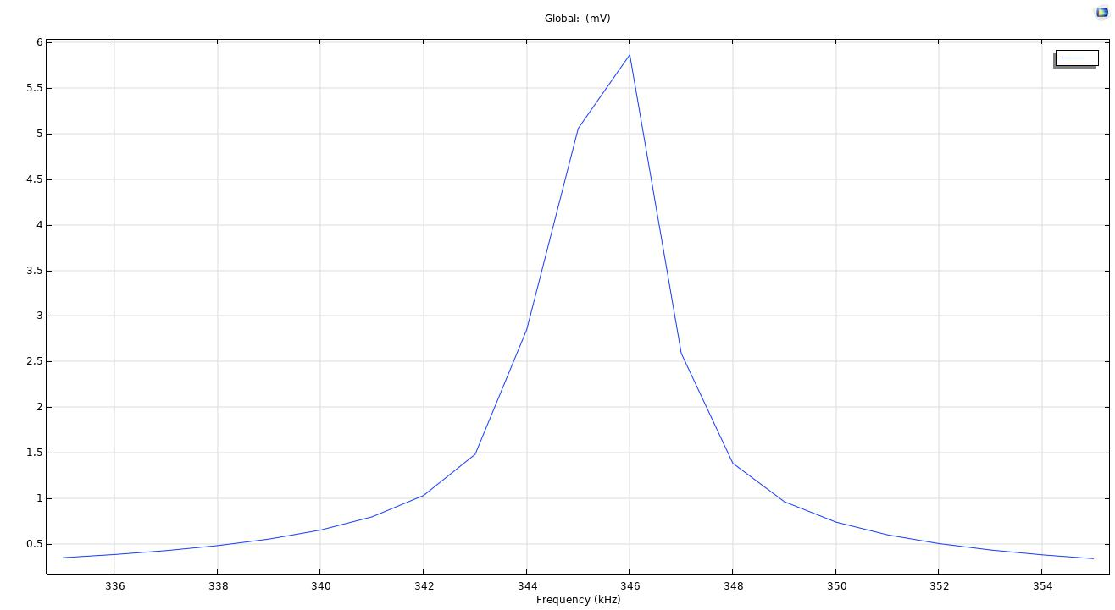
Some COMSOL Simulations
Frequency Sweep
Shape Change Due to Applied Magnetic Field

Slide 6
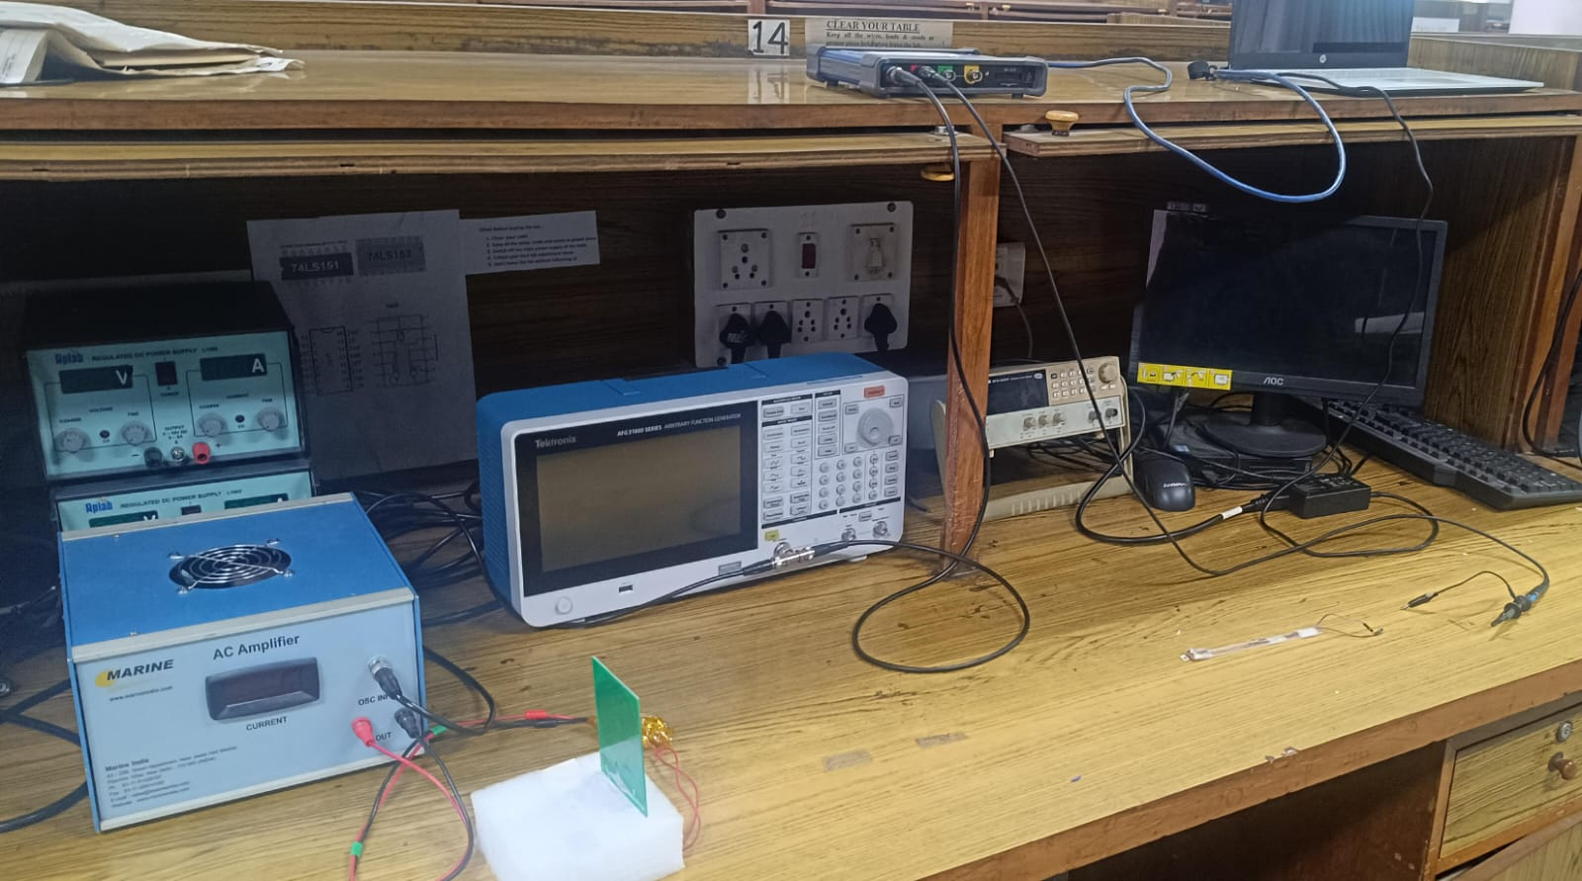
Testing as reciever
After Frequency analysis we are currently testing the ME chip as a receiver and will be simulating it later
We established below setup to check the waveform of input and output signal
Laptop
Function Generator
Picoscope
Lockin Amplifier
ME chip (reciever)
Transmitter

Slide 7
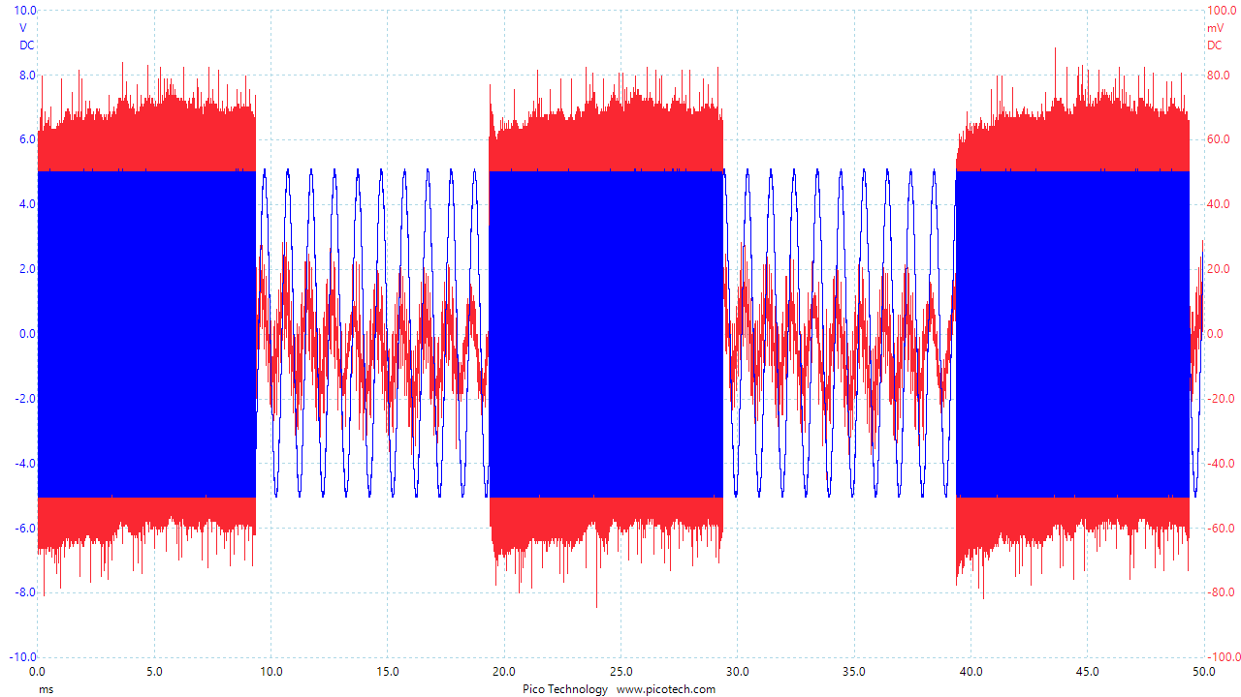

Slide 8
