Slide 1
Flagging client portfolio concentration risk before it becomes a loss
CAP182 CAPSTONE · POSTGRADUATE DIPLOMA IN DATA SCIENCE
From a public proxy dataset to the STADIOEquities client extract
Gopolang Mmutlwane
Client: STADIOEquities
Notes:
TIMING: 0:30. ON CAMERA. Show your face here. Say your name, the module and the client in one breath, then go straight to the problem. The study guide suggests a short, punchy opener, so consider a 10-second teaser clip before this slide: for example, show the one-line result "2 of 2 flagged clients caught on unseen data" and then cut to you. Suggested words (put them in your own voice): "Hello, I'm Gopolang Mmutlwane. This is my CAP182 capstone for STADIOEquities, a digital investment platform. I'll show you how we can spot clients who are dangerously concentrated in one stock, before they lose money." Business: keep it warm and plain. Expert: no jargon needed yet.

Slide 2
Clients learn they were over-concentrated only after they lose money
INTRODUCTION · THE REAL-WORLD PROBLEM
01
02
03
04
Concentrated
Price falls
Loss
Complaint
Most of a client's balance sits in one volatile stock.
One bad move hits the whole portfolio.
The client loses money they did not expect to lose.
STADIOEquities hears about it only now.
Our objective: flag these clients early, so the team can guide them before a loss.
Risk Concentration Flagging · STADIOEquities · CAP182
2 / 13
Notes:
TIMING: 0:55. Section: Introduction. Start with the real-world problem, not the data or the algorithm (study guide tip). Say, in your own words: today STADIOEquities usually finds out a client was over-concentrated when the client has already lost money and complained. The project asks: can we spot those clients earlier? Walk the four steps quickly, about 10 seconds each. Pause on the gold bar and read the objective. Business: this is the "why it matters" slide. The company protects clients from themselves, and a complaint is a late signal. Expert: the formal problem statement is how to model concentration-amplified loss risk, using measures such as the Herfindahl-Hirschman Index (HHI), top-holding percentage, number of holdings and sector exposure.

Slide 3
Can concentration risk be flagged early? How we found out
INTRODUCTION · HOW WE TACKLED IT
Step 1 · SS1
Step 2 · SS2
Step 3 · SS3
Frame the problem
Test it on public data
Apply it to client data
Framed the problem with STADIOEquities
Specified the client data we would need
Chose concentration measures such as HHI
SEC Form 13F holdings as a proxy
Compared Logistic Regression with XGBoost
Recommended XGBoost
STADIOEquities extract of 418 clients
Retrained and tested XGBoost
Results, limits and next steps
Risk Concentration Flagging · STADIOEquities · CAP182
3 / 13
Notes:
TIMING: 0:40. Tell this as a story, not as a list of assignment parts: the problem, the test on public data, and the application to the client. The small SS tags on the cards only let a marker match the steps to the brief; do not say them aloud. Talking points: first we framed the problem with the client and the data we would need. Then, before we had client data, we tested the idea on public SEC holdings data and chose a model. Finally we applied that model to the STADIOEquities client extract. Do not linger. The detail comes on the next slides. Business: you are showing a clear, step-by-step piece of work. Expert: the public-data comparison used a time-based split, and the client-data step retrains the same model family with different hyperparameters.

Slide 4
Two datasets: a public proxy first, then the client extract
DATA OVERVIEW
Public data · SEC Form 13F (stand-in for client data)
Client data · STADIOEquities extract
20,244
418
institution-quarter rows across 10 quarters, 2015 to 2017
clients, from four tables: accounts, holdings, transactions, complaints
846 labelled high-risk (4.2%)
17 flagged (4.07%)
Key variables: HHI, top-holding %, number of holdings, sector HHI, total value. The client data adds the share of value in auto-invest.
Limits: 13F covers institutions, not retail clients. The client extract is synthetic and small.
Risk Concentration Flagging · STADIOEquities · CAP182
4 / 13
Notes:
TIMING: 0:45. Section: Data overview. Keep it high level. Talking points: first we used public SEC Form 13F holdings as a stand-in for client data: about 20 thousand institution-quarter rows, of which 846 were labelled high-risk. Then we received a synthetic extract for 418 STADIOEquities clients across four tables. 17 clients are flagged by our rule. Name the key variables once. Then state the limits plainly: 13F describes institutions, not individual retail clients, and the client extract is synthetic and small. Saying this early builds trust with the expert audience. Facts to have ready: The public-data test set is 5,093 rows with 114 positives. The client split is stratified 70/15/15 into 292, 63 and 63 clients, with 12, 3 and 2 flagged clients.

Slide 5
What we cleaned, and why it matters
DATA PREPARATION
Public data · holdings
Client data · extract
Filled gaps in holdings
Built six features per client
Filings record a value only in the month they appear, so values were carried forward.
Concentration (HHI), top holding, number of holdings, sector concentration, value, auto-invest share.
Matched securities to tickers
Defined the flag
About two-thirds of identifiers could not be matched, most likely delisted or acquired securities.
Stated risk appetite is Low and concentration is in the top quarter (HHI above 0.25).
Checked price history
Protected client privacy
42.5% of matched tickers had no usable prices: a survivorship-bias risk.
Client IDs were kept out of anything displayed.
Risk Concentration Flagging · STADIOEquities · CAP182
5 / 13
Notes:
TIMING: 0:50. Section: Data preparation. Say what was done and why it matters, not the code. Public data talking points: raw 13F files only show a value in the month a filing appeared, so values were carried forward to build a continuous history. Securities were matched to tickers to get prices; about two-thirds could not be matched, most likely because they were delisted or acquired. And 42.5% of matched tickers had no usable price history. That matters: the securities most likely to fail are also the ones most likely to cause losses, so the results may understate risk. Client data talking points: six features per client, the flag definition, and client IDs kept out of anything displayed. Expert: the flag is stated risk appetite = Low AND HHI above the 75th percentile (0.250). Forward-fill treats zeros as missing, so a genuine exit to zero cannot be recorded. Mention this only if asked, or on the limitations slide.

Slide 6
The maths behind the flag, in three lines
MATHEMATICAL FRAMEWORK
01
02
03
Concentration (HHI)
Why two features overlap
The public-data label
H = Σ wᵢ²
Excess return = Σ wᵢ (rᵢ − market)
High risk if below −5%
(largest weight)² ≤ H ≤ largest weight
wᵢ is each holding's share of the portfolio. H is 1 for a single holding. 1/H is the effective number of holdings: H = 0.25 acts like four equal stocks.
When one holding dominates, both bounds meet, so HHI and top-holding weight are almost the same signal (correlation 0.96). That unsettles Logistic Regression but not XGBoost.
A fall counts in proportion to its weight: 40% down costs an 80% holding 32 points, but a 2% holding under 1 point. Returns start 45 days after quarter-end.
Client flag: stated risk appetite Low and HHI above 0.25. We checked it against the complaint records and found no link (p = 0.74), so it stays a business-defined rule.
Risk Concentration Flagging · STADIOEquities · CAP182
6 / 13
Notes:
TIMING: 0:55. Section: Mathematical framework (a short version of Section 4 of your report). Aimed at the data science audience, but say each line in plain words so business viewers keep up. Do not derive anything; point at each formula and say what it means. Card 1, concentration: HHI is the sum of the squared portfolio weights. A weight is the share of the portfolio in one holding. 1 means everything is in one stock. The reciprocal 1/HHI is the effective number of holdings: an HHI of 0.25 behaves like four equally weighted stocks. Card 2, why two features overlap: the largest weight squared is never more than HHI, and HHI is never more than the largest weight. When one holding dominates, both bounds meet, so HHI and top-holding weight carry almost the same signal (correlation 0.96 in the public data). That makes the individual Logistic Regression weights unstable, which is why a strong penalty was needed, but it does not trouble tree models like XGBoost. Do not over-read how importance splits between the two. Card 3, the public-data label: the excess return is each holding's return minus the S&P 500 return, weighted by the holding's share. A portfolio is labelled high risk if that excess return is below minus 5 percent. Because it is weighted, concentration matters mechanically: a 40 percent fall costs a portfolio with an 80 percent holding 32 points, but one with a 2 percent holding less than 1 point. Returns start 45 days after quarter-end, when filings become public, to avoid look-ahead. The threshold of minus 5 percent was chosen empirically: minus 15 percent flagged only 0.6 percent of portfolios, too few to train on, and minus 5 percent gives the 846 positives (4.2 percent). Bottom bar: the client flag is defined directly from stated appetite and HHI. We checked the flag against the complaint records and found no relationship with concentration (Mann-Whitney p = 0.738 for HHI), so it stays a business-defined rule.

Slide 7
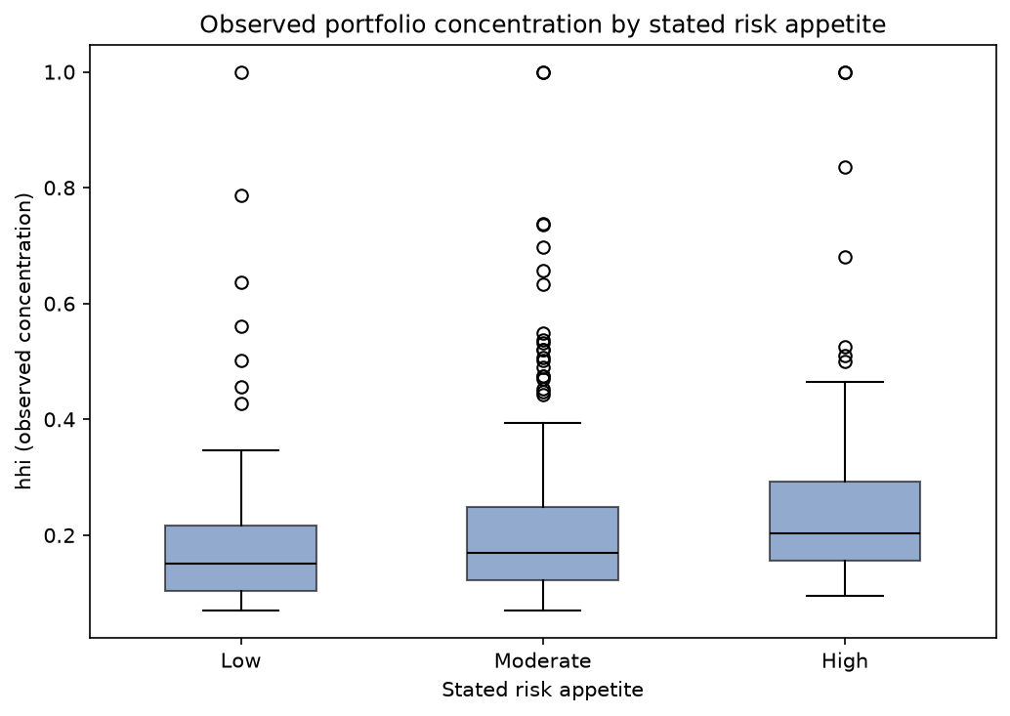
Who gets flagged, and what the data does not show
EXPLORATORY ANALYSIS · KEY INSIGHTS
Appetite and behaviour differ
Most Low-appetite clients are not very concentrated, but a few hold portfolios with HHI near 1.0. These mismatches are the clients we flag.
17 of 418 clients flagged
Low stated risk appetite (106 clients) and HHI above 0.25: 4.07%.
No complaint link
Clients who complained were not measurably more concentrated (p = 0.74), so the flag is a business rule.
Risk Concentration Flagging · STADIOEquities · CAP182
7 / 13
Notes:
TIMING: 1:15. Section: Exploratory analysis and key insights. Graph 1 of 3 (your own notebook chart, hhi_by_risk_appetite.png from SS3_PartB/charts). The study guide asks for 2 to 3 key graphs in the whole talk. How to read the chart: each box is the spread of portfolio concentration (HHI) for clients who state a Low, Moderate or High risk appetite. The middle line is the median. Median concentration rises only slightly from Low to High, and the dots are unusually concentrated clients. Some Low-appetite clients sit at HHI near 1.0, which means a single holding. Talking points: 106 of the 418 clients state a Low risk appetite. 17 of those are also in the most concentrated quarter of clients (HHI above 0.25), so 17 clients, 4.07%, are flagged: people who say they want low risk but hold very concentrated portfolios. We also checked whether clients who complained were more concentrated. They were not, measurably (Mann-Whitney p = 0.74 for HHI, 0.84 for top holding), so the flag is a business rule, not a model of complaints. Expert extra: in the public data, HHI and top holding together carry about 77% of XGBoost's importance (model2_feature_importance.png), but they are correlated at 0.96 and the split between them depends on the column-sampling setting, so do not over-read the individual shares. In the client model, num_holdings ranks first, then HHI and top holding.

Slide 8
Two models, compared on the same time-based test
MODEL OR METHOD
Model 1
Model 2
Logistic Regression
XGBoost
Adds up weighted evidence from each feature into a risk score. Easy to explain, but correlated features made its HHI weight unstable until it was strongly constrained.
Builds many small decision trees, each one correcting the mistakes of the last. It copes with correlated features and picks up non-linear patterns.
Both were trained on the 2015 to 2016 quarters and tested on the 2017 quarters, so the test looks like the future.
We chose XGBoost: missing an at-risk client costs more than a false alarm.
Risk Concentration Flagging · STADIOEquities · CAP182
8 / 13
Notes:
TIMING: 0:55. Section: Model or method. Plain language, no equations. Talking points: - Same data, same time-based split: train on earlier quarters, test on later ones. - Logistic Regression is a weighted scorecard: simple and explainable. - XGBoost builds many small decision trees, each correcting the last. - Why XGBoost: in this problem, missing a truly at-risk client is worse than a false alarm that costs a conversation. Expert: Model 1 used C = 0.001 for a correctly-signed HHI coefficient, with class_weight balanced. Model 2 final settings: learning rate 0.01, 50 estimators, depth 3, subsample 0.7, column sample 0.7, scale_pos_weight for the imbalance. Hyperparameters were tuned with TimeSeriesSplit cross-validation; the folds follow row order (institution then quarter), so they are not strictly chronological. Say so if asked.

Slide 9
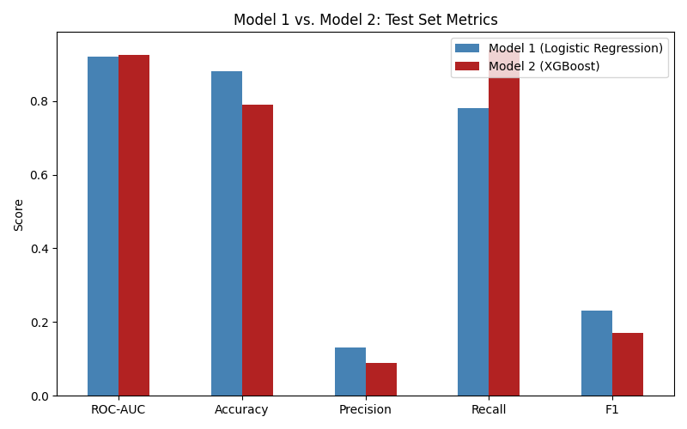
XGBoost caught 107 of 114 at-risk portfolios; Logistic Regression caught 89
RESULTS · TESTED ON PUBLIC DATA
Recall 0.94 vs 0.78
XGBoost found 107 of 114 truly at-risk portfolios; Logistic Regression found 89.
Cost: more false alarms
1,044 for XGBoost against 586, and precision 0.09 against 0.13.
Ranking skill is a tie
ROC-AUC 0.926 vs 0.921, not significant (DeLong p = 0.21).
Risk Concentration Flagging · STADIOEquities · CAP182
9 / 13
Notes:
About 1:00. Section: Results and interpretation (public data). This is graph 2 of the 3 key graphs. Business talking points: - On later quarters the models had not seen, XGBoost caught 107 of the 114 truly at-risk portfolios; Logistic Regression caught 89. - The cost is more false alarms, 1,044 against 586. An uncaught at-risk client is the bigger problem, so we recommended XGBoost. Expert talking points: - Ranking skill (ROC-AUC) is statistically a tie: 0.921 versus 0.926, DeLong p = 0.21. - McNemar's test is significant, but the disagreements are lopsided in Model 1's favour: Model 1 right and Model 2 wrong on 460 rows, the reverse on 20. That reflects Model 2's extra false positives. McNemar compares overall correctness, so it says nothing about recall; the recall advantage (0.94 versus 0.78) is a separate result. - Accuracy was 0.88 (Model 1) and 0.79 (Model 2). XGBoost trades precision for recall; say so plainly. Test set: 5,093 institution-quarter rows with 114 positives. Chart: your own model_comparison.png from reports/charts.

Slide 10
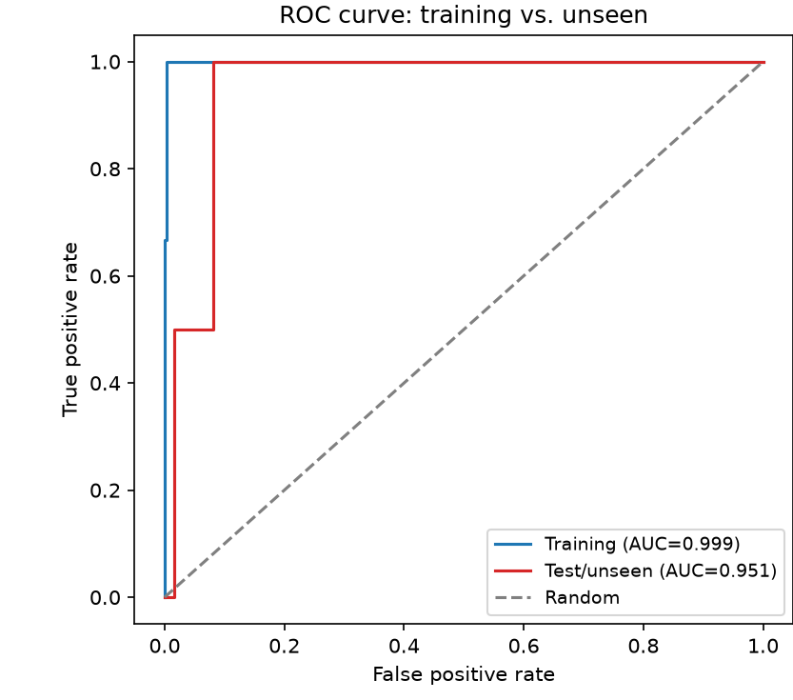
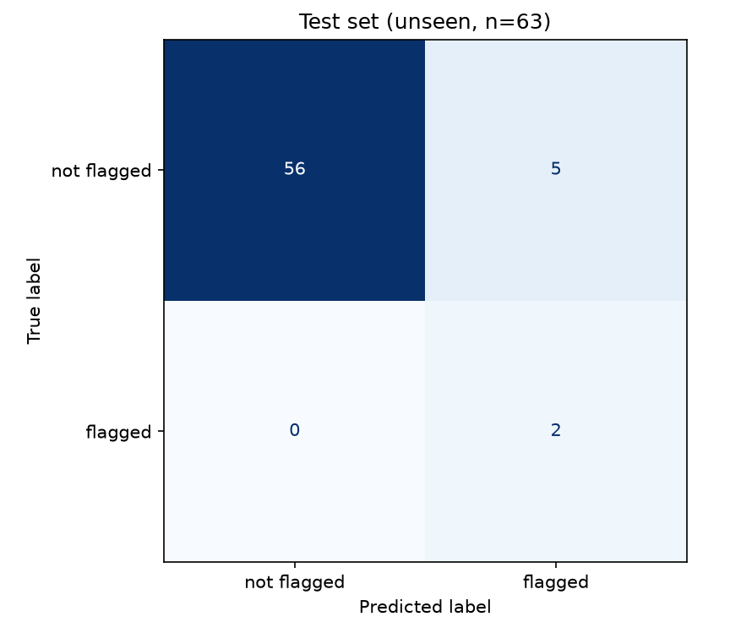
The model caught 2 of 2 flagged clients, but a simple HHI rule does as well
RESULTS · APPLIED TO CLIENT DATA
Test: 2 of 2 caught
ROC-AUC 0.951, with 5 false alarms among 61 other clients.
Validation: 1 of 3
ROC-AUC 0.856. With only 3 and 2 flagged clients, treat these as early signals.
A simple HHI rule does as well. Across all 418 clients, cross-validated ROC-AUC is 0.887 for the model and 0.895 for HHI alone.
Risk Concentration Flagging · STADIOEquities · CAP182
10 / 13
Notes:
About 1:30. Section: Results and interpretation (client data). This is graph 3 of the 3 key graphs. Charts: your own ROC curves and test confusion matrix from SS3_PartB/charts (results_evaluation.png). Business talking points: - XGBoost applied to the 418 clients. On clients it had never seen, it caught both flagged clients in the test set, with five false alarms among the 61 others. In validation it caught one of three. Expert talking points: - ROC-AUC 0.856 on validation and 0.951 on test, against 0.999 on training. Precision 0.17 on validation and 0.29 on test. - Validation and test hold only 3 and 2 flagged clients, so one client changes the picture. - Structural reason for modest precision: HHI is both a feature and half of the flag definition, and the model does not see stated risk appetite, so it ranks clients by concentration rather than by the full flag. Be ready for a question about the missed client: client 174 holds a single stock (HHI 1.0) and was not flagged. The cause was not tested, so say so. Split: 292 training clients (12 flagged), 63 validation (3), 63 test (2), stratified 70/15/15. Optional: show your own results_evaluation chart from SS3_PartB/charts instead. Rule comparison (added after the notebook baseline): flagging every client above the HHI threshold (105 of 418) catches all 17 flagged clients by construction, with precision 0.16. In validation the rule caught 3 of 3 with 17 clients flagged, against 1 of 3 with 6 flagged for the model. In test both caught 2 of 2, with 16 flagged for the rule and 7 for the model. Repeated stratified 5-fold cross-validation (5 repeats) on all 418 clients: mean ROC-AUC 0.887 for the model and 0.895 for HHI alone; at a 0.5 cut-off the model caught 46% of positives (precision 0.19) against 100% for the rule (precision 0.16). Say it plainly: on this label the model does not beat the rule, because the label is built from HHI and stated appetite and the model cannot see appetite. The differences are within noise, so do not claim HHI is better, only that they are indistinguishable.

Slide 11
Start with a simple rule, and use the model as a second opinion
RECOMMENDATIONS
01
02
Start with a simple rule
Model as a second opinion
Review clients above the HHI threshold. It catches every flagged client and is easy to explain.
Use the model only to rank clients within that group, never as an automatic decision.
03
04
Collect real outcomes
Guide before a loss
Replace the business-defined label with losses or complaints, where a model can add value.
Offer a diversification prompt or a call, and agree thresholds with the business.
Risk Concentration Flagging · STADIOEquities · CAP182
11 / 13
Notes:
TIMING: 1:00. Section: Recommendations and conclusion. THESE ARE A DRAFT: change them to your own judgement before recording. Talking points: - Start with the simple rule: flag clients above the HHI threshold. It catches every flagged client, is transparent and easy to explain to the client service team. - Use the model only as a second opinion to rank clients within that group. On this label it did no better than HHI alone (ROC-AUC 0.887 against 0.895), so it should never be an automatic decision. - Collect real outcomes: the label is a business definition and complaints did not validate it (p = 0.74). A model is only likely to add value once the label reflects losses or complaints. - Guide before a loss, for example a diversification prompt or a call, and agree the thresholds with the business and track results. Expert: this follows from Section 8.5 of the report. HHI is both a feature and half of the label, so the model re-learns the rule. The next steps are an outcome-based label and a larger sample.

Slide 12
What the results can and cannot tell us
LIMITATIONS
Data
Method
The client extract is synthetic and small: 3 and 2 flagged clients in validation and test.
SEC 13F data describes institutions, not retail clients.
42.5% of matched tickers had no price history.
HHI is both a feature and half of the client flag, so a high ROC-AUC partly reflects how the flag is built.
Complaints did not validate the flag, so it is a business rule.
Public-data cross-validation folds were not chronological, and the test set informed some choices.
Risk Concentration Flagging · STADIOEquities · CAP182
12 / 13
Notes:
TIMING: 0:50. Section: Recommendations and conclusion (limitations and possible improvements). Aimed at the data science expert audience. Stating limits honestly is a strength, and the study guide's advice for hard questions is to acknowledge limits and suggest improvements. Talking points: - Data: the client extract is synthetic and small; SEC data is institutions, not retail clients; some securities had no price history. - Method: HHI is both a feature and half of the flag; complaints did not validate the flag; public-data cross-validation was not chronological and the test set informed some modelling choices, so reported test metrics may be somewhat optimistic. - Possible improvements: more flagged clients and real outcomes, chronological cross-validation, a test set used only once, and validating the flag against actual losses. These limits are also recorded in the repository README under Known Limitations.

Slide 13
What this study adds
CONCLUSION
A problem framed with the client
A model chosen on evidence from public data
An early, honest test on client data, with its limits stated
Thank you. Questions welcome.
Code and documentation: github.com/GopolangMmutlwaneCaptone/Risk-Concentration-Flagging
Risk Concentration Flagging · STADIOEquities · CAP182
13 / 13
Notes:
ON CAMERA. About 0:30. Talking points (use your own words): - One-breath summary: framed the problem with STADIOEquities, chose XGBoost on evidence from public data, applied it to the client extract, where a simple HHI rule turned out to be as good a screen as the model, so a model will only add value once there are real outcomes to learn from. - What it adds: a reproducible path from public data to a client flagging model, with its limits stated openly. - Point to the repository and thank the viewer. Total talk time across all slides is about 11:35. Practise with a timer; the brief requires 10 to 12 minutes, so leave slack at both ends.

