Slide 1

Basic Details of the Team
Problem Statement
Organization Name:
Ministry of AYUSH
PS Code:
SIH1344
Problem Statement:
Al-based tool for preliminary diagnosis of Dermatological manifestations
Team Name:
Team Alpha
Team Leader Name:
Syed Masood S
Institute Code (AISHE) : 8138
Institute Name : Saranathan College of Engineering
Theme Name : MedTech / BioTech / HealthTech

Slide 2
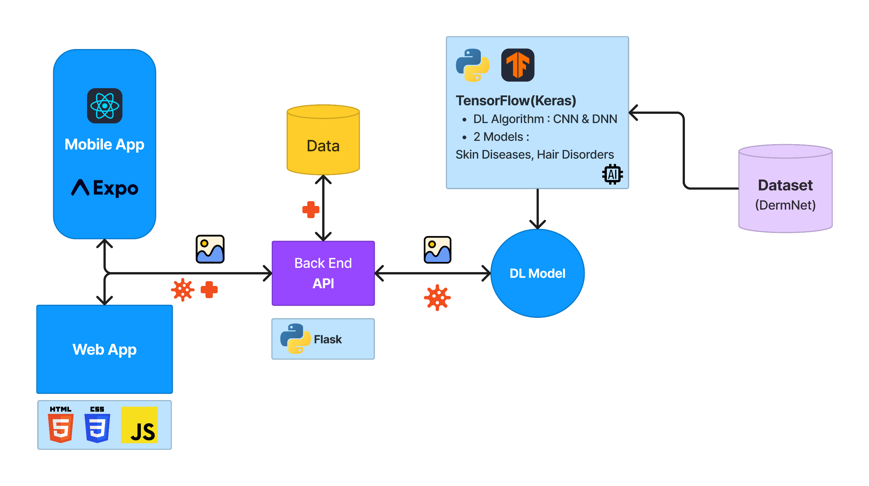
Work Flow Diagram:

Slide 3
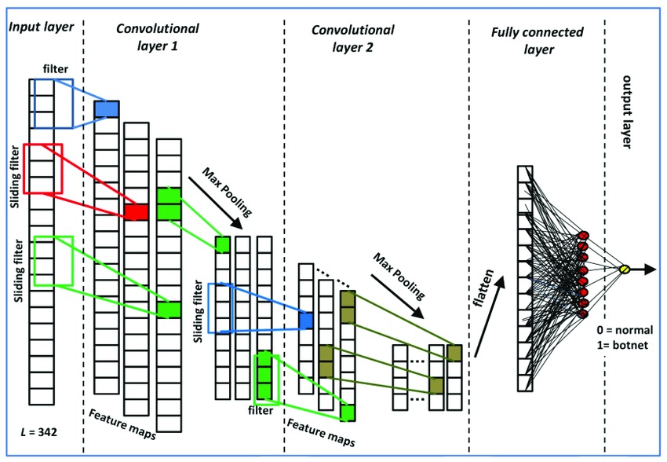
DL Algorithm: CNN-DNN Image Classifier
The model is a two-part architecture, consisting of a CNN and a DNN.
The CNN extracts features from the input image, and the DNN classifies the features into one of the 7 classes.
The CNN consists of a series of convolutional and pooling layers. The convolutional layers learn to extract features from the input image, and the pooling layers reduce the size of the feature maps while preserving the most important information.
The DNN consists of a series of fully connected layers. The fully connected layers learn to classify the extracted features into one of the 7 classes.

Slide 4
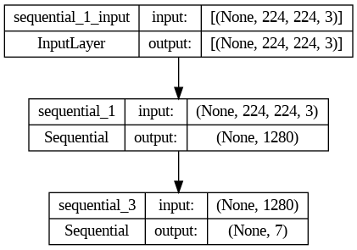
CNN
DNN

Slide 5
Key Features:
Easy Access
Tips to Control
Get Doctor
Suggestion
Diet Suggestion
Available as a Mobile App and Web App
Get some tips to Control and Recover
Know what food to take/not to take for a cure
Get a List of Specialists for the Skin condition

Slide 6
Team Members:
Mentor
Mr.Rethina Kumar B
Assistant Professor, CSE
Syed Masood S
B.E. CSE, III year
Suryaa D
B.E. CSE, III year
GoppyKrishna M
B.E. CSE, III year
Velvizhi V V
B.E. CSE, III year
Vishwa N
B.E. CSE, III year
Sai Charan P
B.E. CSE, III year

Slide 7
Thank You!

