Slide 1

Basic Details of the Team and Problem Statement
Organization Name : Ministry of AYUSH
PS Code: SIH1344
Problem Statement Title: Al-based tool for preliminary diagnosis of Dermatological manifestations
Team Name: Alpha
Team Leader Name: S.Syed Masood
Institute Code (AISHE): C-25006
Institute Name: Saranathan College of Engineering
Theme Name: MedTech / BioTech / HealthTech

Slide 2
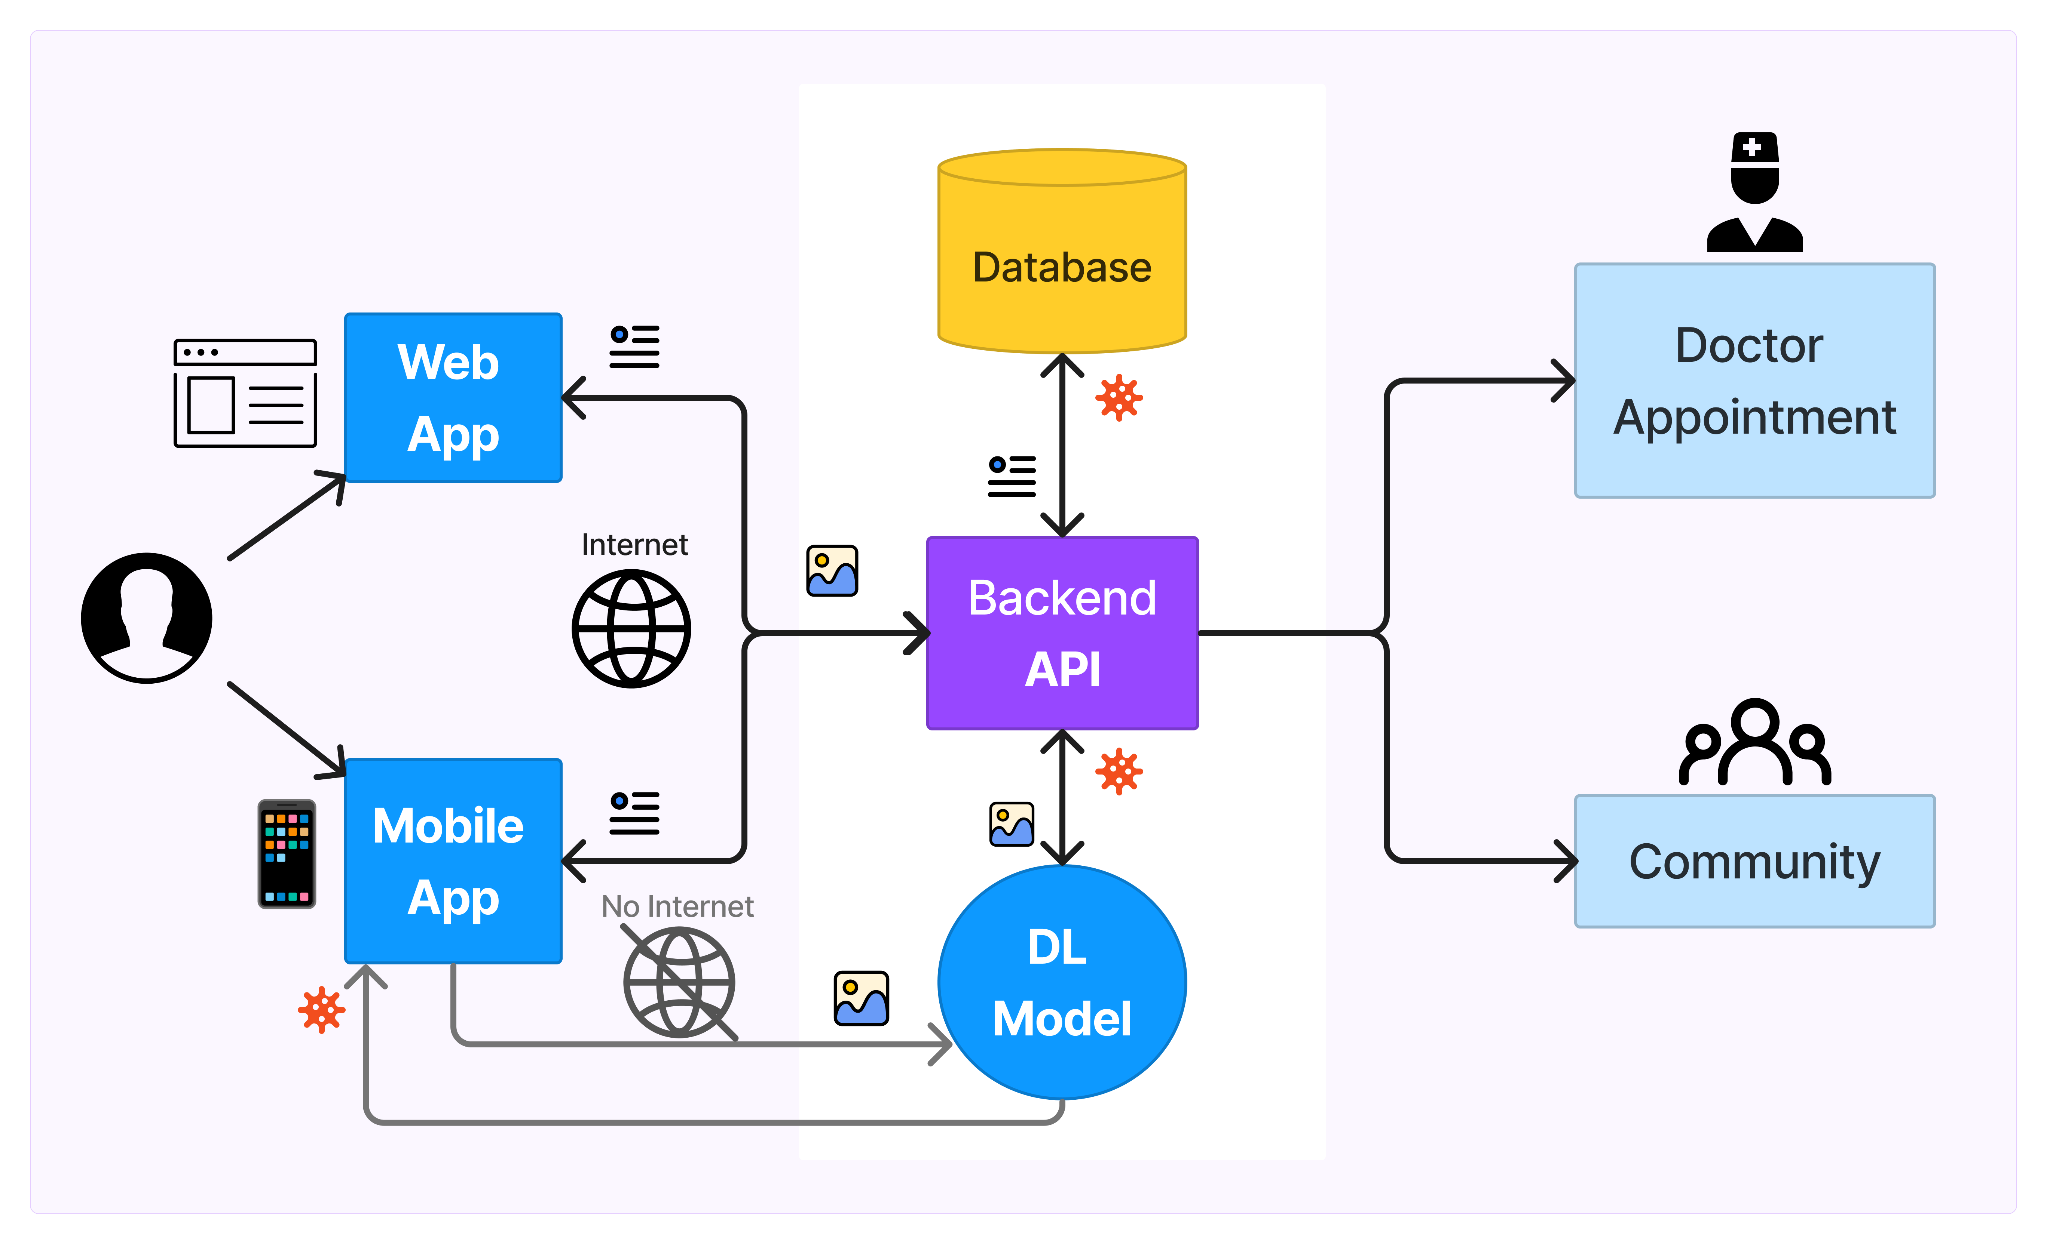
Idea/Approach Details
Architecture
Solution :
We propose an AI-powered Mobile and Web application to identify dermatological diseases as a solution.
Using the app, users can upload/snap a picture of the area that they suspect to be affected by a Dermatological Disease.
The app analyses the image and provides information on the disease, dietary recommendations, and a list of expert doctors.
The Deep Learning Model comprises :
Convolutional Neural Network (CNN) for Image Feature Extraction
Dense Neural Network (DNN) for Identifying the Dermatological Disease
Technology Stack :
TensorFlow, Keras - Deep Learning Framework
Flask - Web Framework
React Native(Expo) - Mobile App Framework
SQLite - Database
OpenCV, PIL - Image Processing
spaCy - Natural Language Processing
GeoPy - Geolocation

Slide 3
Idea/Approach Details
Show Stoppers :
Use Cases:
Dermatological Disease Identification
Identify the Dermatological disease with an Image of
the Disease
Doctor Recommendation and Consultation
Get a list of Expert Dermatologists nearby and an
option to book a consultation session
Diet Recommendation
Get a list of Food items to take and not to take for a
quick recovery
Get Useful Tips
Get useful Tips to Recover from the Disease and to
Prevent the Spreading of the Disease
Community Forum
Join the Community for support and spread Awareness
Multilingual Support
Supports Major Languages across India and the World
Cross Platform Support
Works on Android, iOS and all the Web Browsers
Early detection and Treatment : The App helps users to quickly know about the disease, so they can take Remedial actions or consult doctor for serious cases.
Awareness about the Disease : The App helps to create awareness among the public, especially in rural areas.
Useful in Remote Areas : The Mobile App can be used in remote areas with no internet connection to get basic information.

Slide 4
Team Members Details
Team Leader Name: S. Syed Masood
Branch : B.E Stream : CSE Year : III
Team Member 1 Name: D. Suryaa
Branch : B.E Stream : CSE Year : III
Team Member 2 Name: M. GoppyKrishna
Branch : B.E Stream : CSE Year : III
Team Member 3 Name: VV. Velvizhi
Branch : B.E Stream : CSE Year : III
Team Member 4 Name: P. Sai Charan
Branch : B.E Stream : CSE Year : III
Team Member 5 Name: N. Vishwa
Branch : B.E Stream : CSE Year : III
Team Mentor 1 Name: B. Rethina Kumar
Category : Assistant professor, CSE, SCE Expertise : AI/ML Domain Experience : 21 years

