Slide 1



Feasibility proof from completed drone-video runs
SIH26158
01
INPUT CAPTURE
02
OUTPUT PRODUCTS
604,982
COLOURED POINTS
361,510
MESH FACES
GLB, LAS and GeoTIFF
4.19-minute flight 253 keyframes 2,525 telemetry samples
EPSG:32610 DSM 0.5 m
03
RUNTIME PROOF
04
QUALITY EVIDENCE
15 min
PASS
capture screen
Processing mode
reduced frames
target achieved
0.458 px
reprojection
28.81 min
81.82%
all 253 frames
registered
Runtime (minutes)
Accuracy proof pending
Independent checkpoint RMSE has not been evaluated. GPS camera RMSE cannot prove the one-metre surface target.
Notes:
Sources: optimized_v1/run_report.json; optimized_v1/verification_report.json; optimized_v1/preflight.json; optimized_v1/capture_quality.json.
Input image: SIH26158_HF_Drone_Full253_AB_Colab (1).ipynb, cell 5.
DSM image: the same notebook, cell 8. Geometry diagnostics: the same notebook, cell 7.
Runtime evidence: the archived run_report.json records 28.81 minutes for all 253 frames. The project team reports a 15-minute run after reducing the processed frame count. Historical baseline: 80.75 minutes.
The archive reports no surveyed checkpoints or independent reference surface, so the one-metre surface target remains unevaluated.

Slide 2
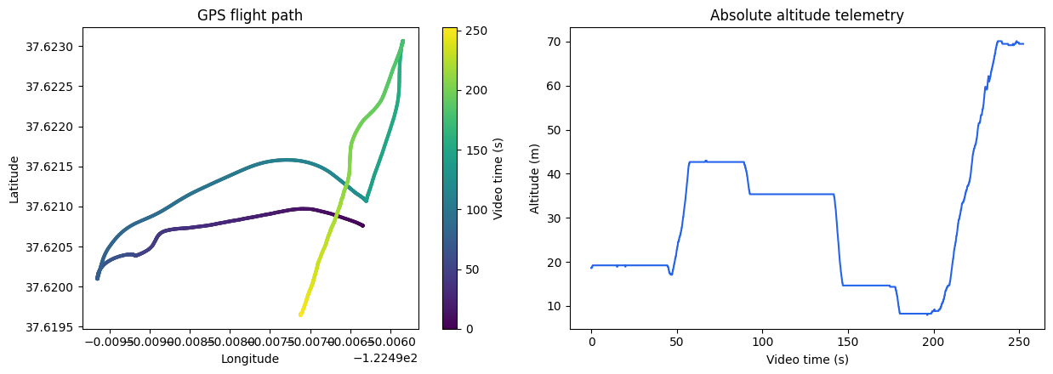
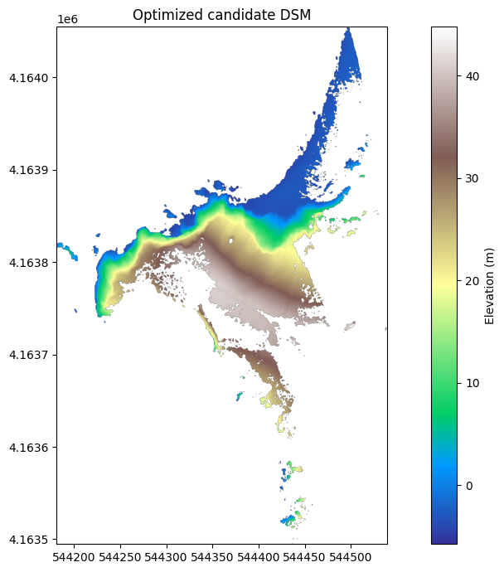
Benefits and field impact
SIH26158
01
CAPTURE ONCE
02
CHOOSE THE RUNTIME
03
USE THE OUTPUT
15 min
reduced frames
rapid assessment
28.81 min
Standard drone video and telemetry
all 253 frames
full-detail run
Single flight over complex terrain
GLB, LAS and GeoTIFF
GIS and 3D workflows
FIELD IMPACT
Less field exposure
Earlier site decisions
Reusable GIS data
Notes:
The slide communicates deployment viability through existing drone inputs, two demonstrated runtime modes and standard output formats.
Flight-path image: SIH26158_HF_Drone_Full253_AB_Colab.ipynb, telemetry audit output.
DSM image: SIH26158_HF_Drone_Optimization_1088_Colab.ipynb, optimized candidate DSM output.
The archived run_report.json records 28.81 minutes for all 253 frames. The project team reports a 15-minute run after reducing the processed frame count.
Field-impact statements are qualitative benefits of remote capture, faster turnaround and interoperable outputs. They are not measured cost or response-time claims.

