Slide 1

SIH26158
Feasibility
evidence
Single-pass drone video to georeferenced 3D and GIS products
Verified run: 4.2-minute video, 253 selected frames, CUDA on Tesla T4
Evidence date 14 September 2026
Notes:
Open with the evidence boundary: the repository demonstrates end-to-end technical feasibility.
Do not claim the 15-minute target or one-metre surface accuracy from this archived run.
Source image: SIH26158_HF_Drone_Full253_AB_Colab (1).ipynb, cell 5 output.

Slide 2
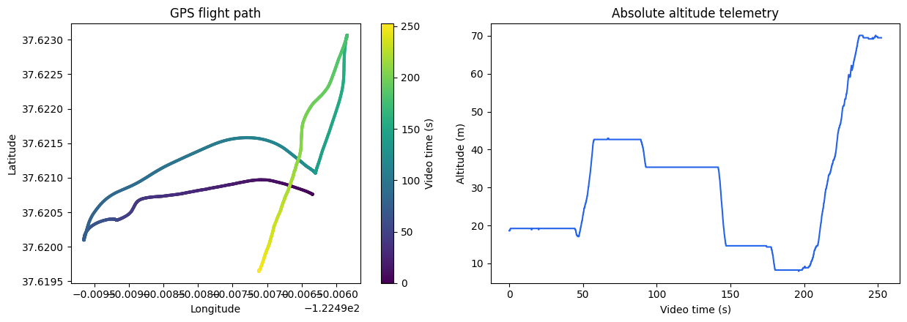
One continuous flight produced a reproducible metric input set
02
4.19 min
video duration
7,538
source frames at 1920 x 1080
2,525
telemetry samples covering the video
253 geometry-aware keyframes
Preflight ready
Selected at about 1 frame per second with 5.73 m median GPS baseline and 97.5% median tracked features.
COLMAP 4.2 with CUDA, NVIDIA T4 visible, telemetry valid, no timestamp reversals, gaps, or probable position jumps.
Sources: input_summary.json, preflight.json, frames.selection.json
Notes:
This slide proves that the reconstruction used one continuous video with synchronized telemetry.
The telemetry plot and flight frames come from the controlled full-253-frame experiment notebook.
Sources: SIH26158/evidence_20260914_080536/input_summary.json; preflight.json; frames.selection.json.

Slide 3

The completed run exported valid 3D and GIS products
03
604,982
filtered coloured points
181,314 vertices
361,510 faces across 3 retained components
Verified deliverables
model.glb valid, textured, 1 mesh
point_cloud.las valid, EPSG:32610
dsm.tif valid, EPSG:32610, 0.5 m pixels
model.obj and mesh.ply present and valid
The DSM contains 111,476 valid cells. Its 13.84% coverage misses the current 75% production gate, so present it as output proof rather than complete-site coverage.
Sources: verification_report.json and run_report.json; DSM image from Full253 notebook output
Notes:
Use the DSM image as visible evidence that the pipeline exported a georeferenced raster.
The verification report validates the GLB header and JSON chunk, LAS point count and CRS, GeoTIFF dimensions and CRS, and mesh structure.
Source: SIH26158/evidence_20260914_080536/verification_report.json and run_report.json.

Slide 4
Runtime fell 64%, while the 15-minute target remains open
04
2.80x
speedup versus the 80.75-minute historical run
28.81 min
latest archived wall-clock result
A further 47.9% reduction, or 1.92x speedup, is required to reach 15 minutes on this measured result.
Sources: Full253 and Frontend Sparse A/B notebook outputs; evidence run_report.json
Notes:
The bars combine documented experiment outputs and the latest archived evidence run.
Do not imply that every historical bar is an identical configuration. Use the chart as optimization history.
The latest evidence package reports 1,728.47 seconds wall clock and 1,522.40 seconds across reconstruction stages.
Sources: SIH26158_HF_Drone_Full253_AB_Colab (1).ipynb cell 7; SIH26158_HF_Drone_Frontend_Sparse_AB_Colab.ipynb cell 17; SIH26158/evidence_20260914_080536/run_report.json.

Slide 5

Capture checks passed, while reconstruction quality remains mixed
05
Capture screen
READY
Passed all configured capture gates
0% blurred, 0% poor exposure, no telemetry gaps
Reprojection
0.458 px
PASS against the 2 px gate
Sparse model geometry is internally consistent
Registration
81.82%
FAIL against the 90% gate
207 of 253 selected images registered
AI masking
SKIPPED
Capability exists but this run did not test it
A masked versus unmasked proof image still needs a rerun
Sources: run_report.json, verification_report.json, reusable_run_assessment.json
Notes:
The capture-quality gate is a risk screen, not an accuracy certificate.
Geometry-aware selection improved the median baseline and parallax in the controlled comparison, but the archived run registered only 81.82% of selected images.
Dynamic masking code exists in the repository. The evidence run explicitly records ai_dynamic_masking as skipped.

Slide 6
One-metre surface accuracy remains unevaluated
06
1.835 m
Evidence required for the final claim
01
Survey holdout points
GPS camera-alignment RMSE
Use at least three independent checkpoints for the project gate. Thirty points only satisfies the repository's checkpoint-count status.
Diagnostic only. It compares reconstructed camera positions with flight GPS. It does not measure surface accuracy.
02
Measure them in the reconstruction
Record reconstructed and surveyed XYZ in checkpoint_measurements.csv.
03
Run the existing validator
Checkpoint RMSE
python -m sih_drone_pipeline validate-checkpoints --output <run> --checkpoints <csv>
NOT EVALUATED
04
Show the numerical result
No independent checkpoint set or reference surface is included in the evidence bundle.
Present checkpoint 3D RMSE below 1.0 m, with the CSV and report retained as evidence.
Sources: verification_report.json and README accuracy-evidence protocol
Notes:
This is the most important credibility slide.
The report leaves one_metre_accuracy and checkpoint_rmse_3d_m null. State that directly.
The repository already implements the required validator. The missing work is independent field evidence, not software plumbing.

Slide 7
Final judging evidence pack
Use these artifacts to convert technical feasibility into judge-ready proof
01
3D model and scale
READY
The archive includes model.glb and viewer_metadata.json. Add your viewer capture and demonstrate Shift-click measurement live.
02
Independent <1 m accuracy
MISSING
Collect holdout checkpoints, run validate-checkpoints, and show the 3D RMSE from the generated report.
03
Runtime improvement
READY
Use the editable runtime chart. State 28.81 minutes for the latest local evidence and 15 minutes as the remaining target.
04
Dynamic-object robustness
MISSING
Rerun with AI masking enabled and save one matched before-and-after frame plus its masked reconstruction result.
05
GIS interoperability
VERIFIED
Show dsm.tif in QGIS and point_cloud.las in CloudCompare. Both formats and EPSG:32610 metadata passed structural checks.
Current conclusion
End-to-end output generation is feasible. The speed and one-metre acceptance targets still require stronger evidence.
Notes:
End with a precise evidence plan instead of a broad claim.
The supplied archive contains the GLB, LAS, GeoTIFF, point cloud, mesh, reports, and logs. It does not contain an independent checkpoint CSV.
Production_ready is false in verification_report.json.

