Slide 1



Feasibility proof from completed drone-video runs
SIH26158
01
INPUT CAPTURE
02
OUTPUT PRODUCTS
604,982
COLOURED POINTS
361,510
MESH FACES
GLB, LAS and GeoTIFF
4.19-minute flight 253 keyframes 2,525 telemetry samples
EPSG:32610 DSM 0.5 m
03
RUNTIME PROOF
04
QUALITY EVIDENCE
15 min
PASS
capture screen
Processing mode
reduced frames
target achieved
0.458 px
reprojection
28.81 min
81.82%
all 253 frames
registered
Runtime (minutes)
Accuracy proof pending
Independent checkpoint RMSE has not been evaluated. GPS camera RMSE cannot prove the one-metre surface target.
Notes:
Sources: optimized_v1/run_report.json; optimized_v1/verification_report.json; optimized_v1/preflight.json; optimized_v1/capture_quality.json.
Input image: SIH26158_HF_Drone_Full253_AB_Colab (1).ipynb, cell 5.
DSM image: the same notebook, cell 8. Geometry diagnostics: the same notebook, cell 7.
Runtime evidence: the archived run_report.json records 28.81 minutes for all 253 frames. The project team reports a 15-minute run after reducing the processed frame count. Historical baseline: 80.75 minutes.
The archive reports no surveyed checkpoints or independent reference surface, so the one-metre surface target remains unevaluated.

Slide 2
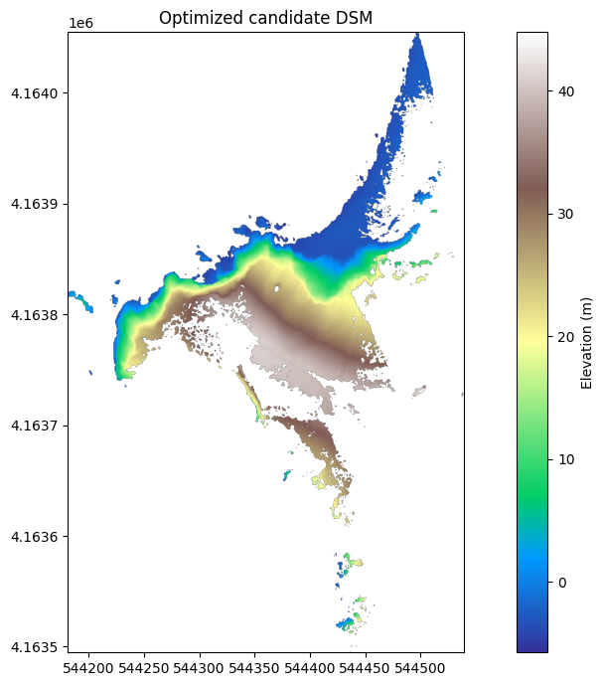
Benefits and impact
SIH26158
DIRECT IMPACT ON TARGET USERS
ECONOMIC AND OPERATIONAL BENEFITS
Survey and GIS teams
Lower survey overhead
3D model and DSM from one drone flight.
Reuse existing drone video and telemetry.
Infrastructure teams
Faster turnaround
Inspect difficult terrain before field deployment.
15 min rapid mode, 28.81 min full run.
Emergency response teams
Reduced tool lock-in
15-minute mode supports rapid site assessment.
GLB, LAS and GeoTIFF remain portable.
STRATEGIC IMPACT
REUSABLE GIS OUTPUT
Local geospatial capability
Open pipeline, reports and standard outputs.
DSM 0.5 m
Shared operational picture
EPSG:32610
GIS, 3D and browser-ready data.
Ready for GIS
Scales with each mission
Rapid mode or full 253-frame reconstruction.
Notes:
The slide follows the supplied impact-slide structure while retaining the project's navy and teal visual system.
DSM image: SIH26158_HF_Drone_Optimization_1088_Colab.ipynb, optimized candidate DSM output.
The archived run_report.json records 28.81 minutes for all 253 frames. The project team reports a 15-minute run after reducing the processed frame count.
Target-user and impact statements describe intended operational use. They are not measured cost savings, response-time improvements or deployment outcomes.

