Slide 1
Huffman Coding Project
TOR 3 project
Gregor Antonaz, Miha Sivka
20.5.2025
Git repo: https://github.com/GorGre14/hauffman_code

Slide 2
Project description
Restrict your alphabet to 6 letters {a, b, c, d, e, f} and construct the sequence of 300 symbols e.g. abacefddcabbdedacffaeebdfcabeafbdcab
using the following probability distribution : Pb(a)=0.05, Pb(b)=0.1, Pb(c)=0.15, Pb(d)=0.18, Pb(e)=0.22, Pb(f)=0.3
Huffman coding assigns shorter codewords to more frequent symbols and longer ones to less frequent symbols, thereby minimizing the expected codeword length
In this project we show Huffman coding and decoding of the stream and compute the average length of codewords
And what happens if the probability is changed so that Pb(a)=0.3 and P(f)=0.05

Slide 3
Code explanation
Node class - defines nodes in the huffman tree
Huffman_code – buildes a Huffman code for the given dictionary and probabilities
Encoding – encodes the sequence with Huffman codebook
Decoding – decodes the string back to its original form
Expected_length – calculates the expected codeword length
Averaged_realised_length – computes the empirical average codeword length
Compression_ratio – estimates the compression ratio

Slide 4
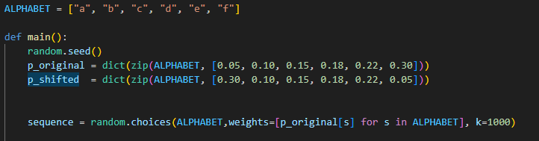
Defining the probabilities and generating the sequence

Slide 5
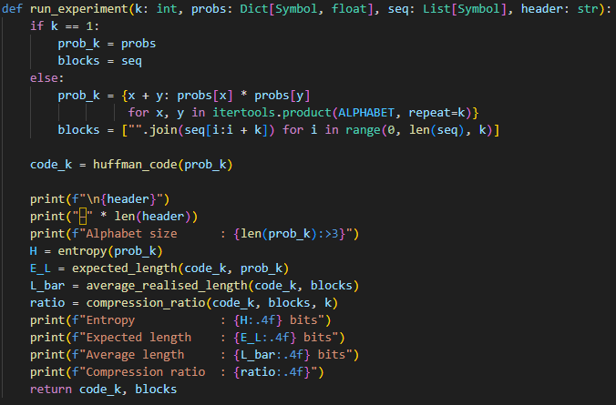
Constructing the codebook and calculating its stats

Slide 6
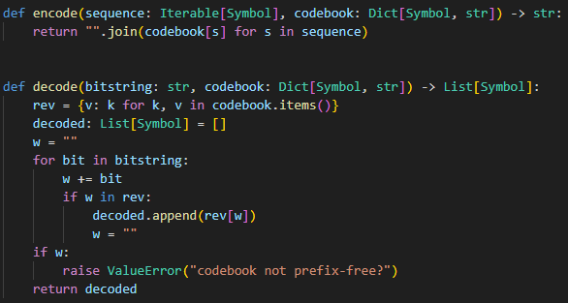
Encoding and decoding

Slide 7
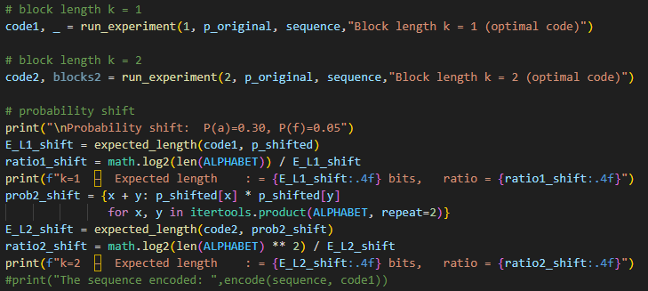
Defining the block size and probability shift and running everything

Slide 8
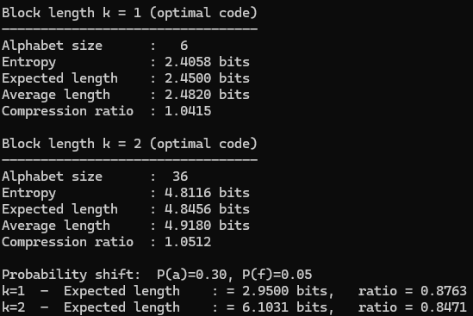
Output

Slide 9
Discussion
When the symbol probabilities are suddenly changed so that P(a) = 0.30 and P(f) = 0.05, but you continue using the original Huffman code (which was optimized for P(a) = 0.05 and P(f) = 0.30), the compression ratio drops significantly
Huffman coding is optimal only when the code matches the source distribution
The compression ratio drops to ~ 0.87, meaning the method becomes inefficient and counterproductive

