Slide 1

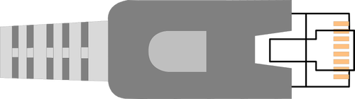
Naked Coroutines
LIVE
CppCon 2017
live with Networking
Gor Nishanov • Visual C++ Team • Microsoft
Notes:
Hi, my name is Gor Nishanov. I am a developer in Visual C++ team and I work on design and standardization of C++ Coroutines.

Slide 2
Design Principles
Scalable (to billions of concurrent coroutines)
Efficient (resume and suspend operations comparable in cost to a function call overhead)
Seamless interaction with existing facilities with no overhead
Open ended coroutine machinery allowing library designers to develop coroutine libraries exposing various high-level semantics, such as generators, tasks, async streams and more.
Usable in environments where exceptions are forbidden or not available

Slide 3
Coroutines
Subroutine A
Coroutine C
Subroutine A
Subroutine B
…
…
C start
B start
Introduced in 1958 by Melvin Conway
Donald Knuth, 1968: “generalization of subroutine”
call C
call B
suspend
end
resume C
B start
suspend
 | subroutines | coroutines
call | Allocate frame, pass parameters | Allocate frame, pass parameters
return | Free frame, return result | Free frame, return eventual result
suspend | x | yes
resume | x | yes
call B
resume C
end
end
…
…

Slide 4
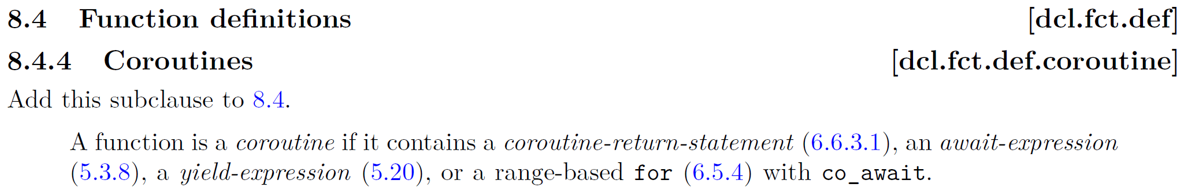
generator<char> hello() {
for (char ch: "Hello, world\n") co_yield ch;
}
int main() { for (char ch : hello())
cout << ch;
}
future<void> sleepy() { cout << “Going to sleep…\n";
co_await sleep_for(1ms);
cout << “Woke up\n";
co_return 42;
}
int main() { cout << sleepy.get();
}
Notes:
What is a coroutine? Let’s consult with the dry language of the standard.

Slide 5
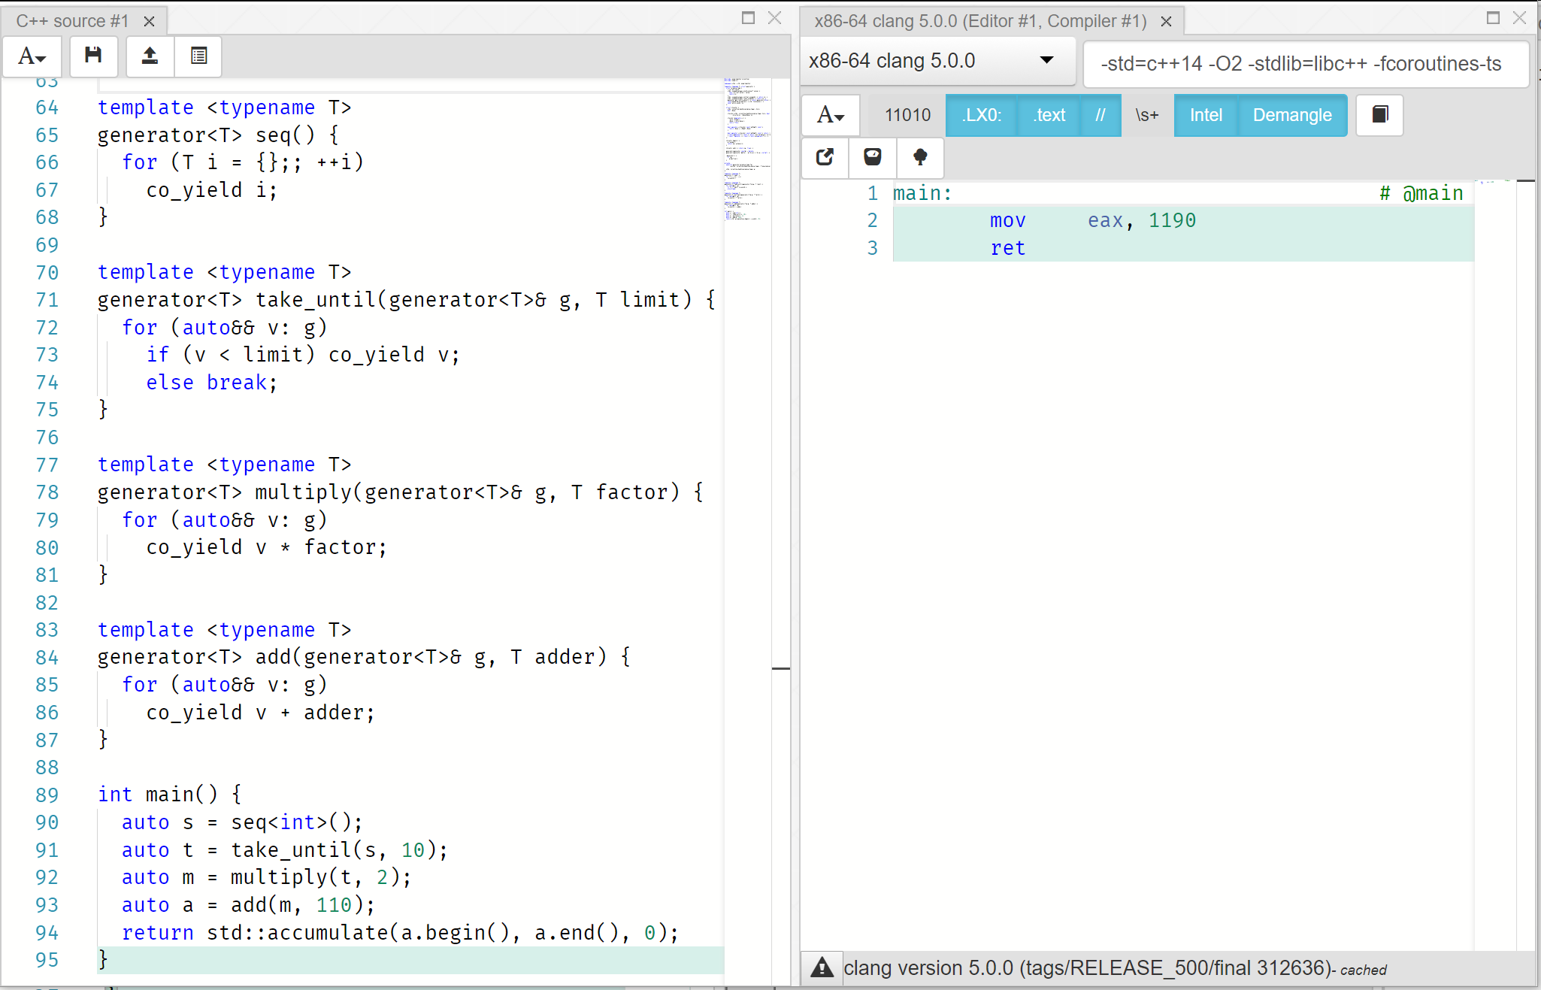
https://godbolt.org/g/26viuZ

Slide 6

Gifts from Toronto 2017
Coroutine TS
Networking TS
Notes:
This summer we had a standardization meeting in Toronto which brought us many great gifts.

Slide 7

Opening the Networking TS box!
io_context
+ and more nifty things
executors
timers
tcp::endpoint
tcp::socket
tcp::acceptor
udp::endpoint
tcp::resolver
udp::socket
tcp::iostream
udp::resolver
Notes:
Let’s start unpacking the first gift. What is in the networking box?

Slide 8
Networking TS – io_context
ASYNC SOURCES
EXECUTION POLICY
post
defer
thread 1
io_context::run()
executor
dispatch
thread 2
io_context::run()
async_accept
io_context
socket
async_connect
…
thread N
io_context::run()
async_read/write
timer
async_wait
io_context::stop()
io_context::poll()
…
… (more async sources)
Notes:
This is

Slide 9
Simple timer example
int main() {
io_context io;
system_timer slow_timer(io, hours(15));
slow_timer.async_wait([](auto) {
puts("Timer fired");
});
system_timer fast_timer(io, seconds(1));
fast_timer.async_wait([&io](auto) {
io.stop();
});
io.run();
}

Slide 10
Beautiful tcp server
struct session {
session(net::io_context &ioc, net::ip::tcp::socket s, size_t block_size)
: io_context_(ioc), socket_(std::move(s)), block_size_(block_size),
buf_(block_size), read_data_length_(0)
{}
void start() {
std::error_code set_option_err;
net::ip::tcp::no_delay no_delay(true);
socket_.set_option(no_delay, set_option_err);
if (!set_option_err) {
socket_.async_read_some( net::buffer(buf_.data(), block_size_),
make_custom_alloc_handler( allocator_,
[this](auto ec, auto n) { handle_read(ec, n); }));
return;
}
net::post(io_context_, [this] { destroy(this); });
}
void handle_read(const std::error_code &err, size_t length) {
if (!err) {
read_data_length_ = length;
async_write(socket_, net::buffer(buf_.data(), read_data_length_),
make_custom_alloc_handler( allocator_,
[this](auto ec, auto) { handle_write(ec); }));
return;
}
net::post(io_context_, [this] { destroy(this); });
}
void handle_write(const std::error_code &err) {
if (!err) {
socket_.async_read_some(net::buffer(buf_.data(), block_size_),
make_custom_alloc_handler( allocator_,
[this](auto ec, auto n) { handle_read(ec, n); }));
return;
}
net::post(io_context_, [this] { destroy(this); });
}
static void destroy(session *s) { delete s; }
private:
net::io_context &io_context_;
net::ip::tcp::socket socket_;
size_t block_size_;
std::vector<char> buf_;
size_t read_data_length_;
handler_allocator allocator_;
};
struct server {
server(net::io_context &ioc, const net::ip::tcp::endpoint &endpoint,
size_t block_size)
: io_context_(ioc), acceptor_(ioc, endpoint), block_size_(block_size)
{
acceptor_.listen();
start_accept();
}
void start_accept()
{
acceptor_.async_accept(
[this](auto ec, auto s) { handle_accept(ec, std::move(s)); });
}
void handle_accept(std::error_code err, net::ip::tcp::socket s)
{
if (!err) {
session *new_session = new session(io_context_, std::move(s), block_size_);
new_session->start();
}
start_accept();
}
private:
net::io_context &io_context_;
net::ip::tcp::acceptor acceptor_;
size_t block_size_;
};

Slide 11
Unboxing the Coroutines
and that is all you get!
suspend_never
co_await
suspend_always
co_yield
coroutine_handle
co_return
coroutine_traits

Slide 12
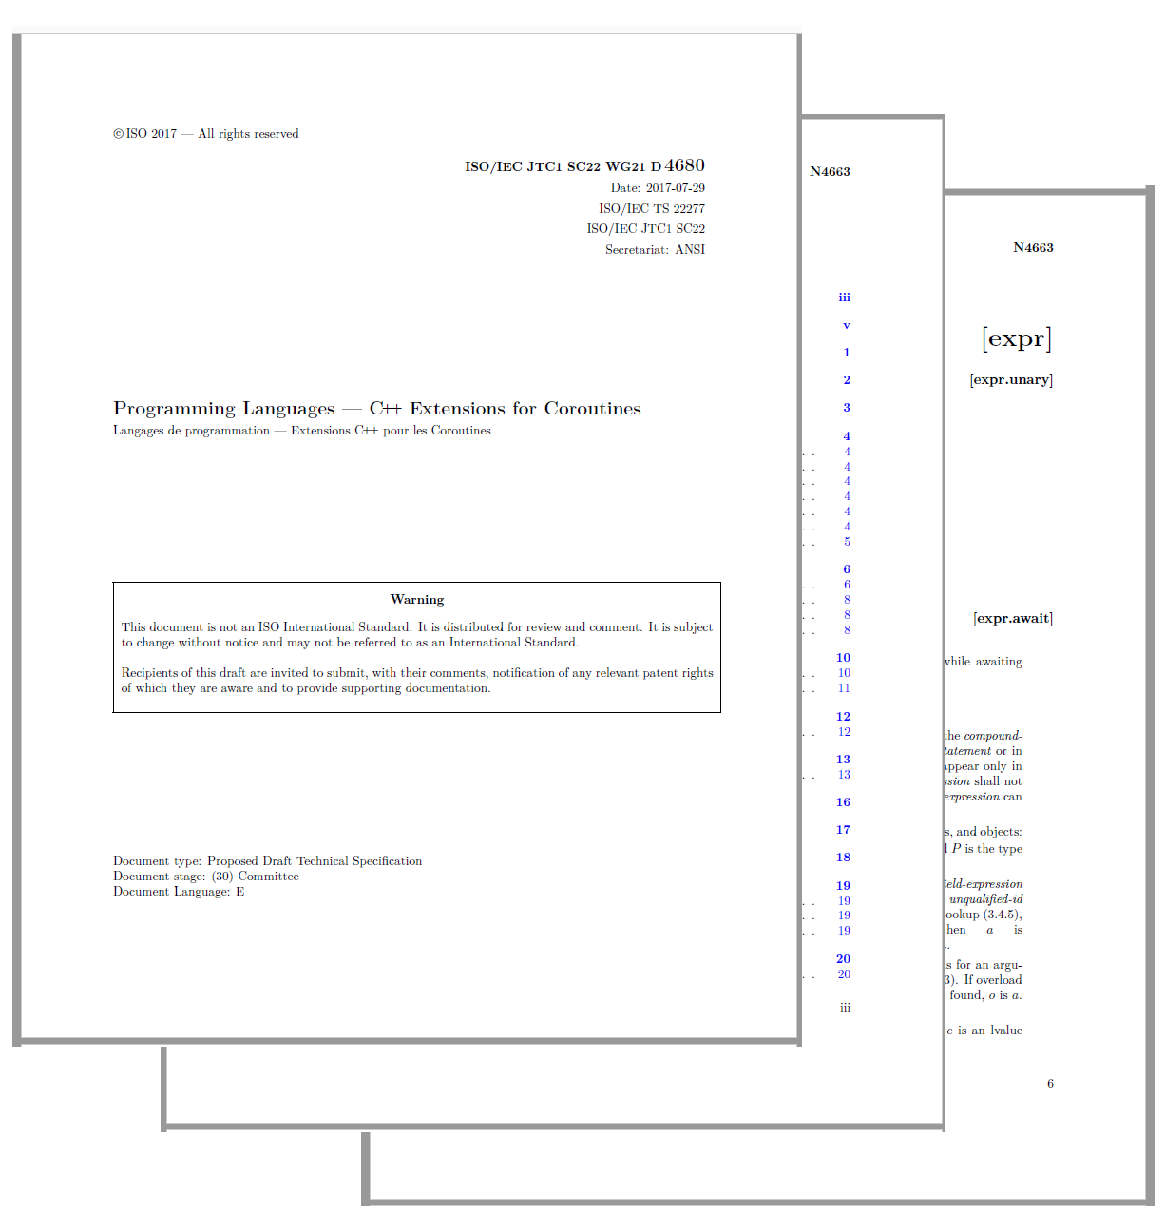
Read the manual?

Slide 13
LIVE

Slide 14
The Easy Way

Slide 15
Async Initiating Function
template <typename BufferSequence, typename CompletionToken>
auto async_xyz(BufferSequence const& buffers, CompletionToken handler)
{
async_completion<CompletionToken, void(std::error_code, std::size_t)> init(handler);
impl.real_async_xyz(buffers, init.completion_handler); return init.result.get();
}
What to return
What to pass as a callback to real implementation
What executor to complete on
What allocator to use
CompletionToken

Slide 16
Trait Specialization for use_boost_future
template <>
struct async_result<use_boost_future_t, void(std::error_code, size_t)> {
using return_type = boost::future<size_t>;
struct completion_handler_type {
boost::promise<size_t> p;
completion_handler_type(use_boost_future_t const&) {}
void operator() (std::error_code const& ec, size_t n) {
if (ec) p.set_exception(std::system_error(ec));
else p.set_value(n);
}
};
explicit async_result(completion_handler_type &h) : fut(h.p.get_future()) {}
auto get() { return std::move(fut); }
private:
boost::future<size_t> fut;
};

Slide 17
LIVE

Slide 18
Beautiful tcp server
struct session {
session(net::io_context &ioc, net::ip::tcp::socket s, size_t block_size)
: io_context_(ioc), socket_(std::move(s)), block_size_(block_size),
buf_(block_size), read_data_length_(0)
{}
void start() {
std::error_code set_option_err;
net::ip::tcp::no_delay no_delay(true);
socket_.set_option(no_delay, set_option_err);
if (!set_option_err) {
socket_.async_read_some( net::buffer(buf_.data(), block_size_),
make_custom_alloc_handler( allocator_,
[this](auto ec, auto n) { handle_read(ec, n); }));
return;
}
net::post(io_context_, [this] { destroy(this); });
}
void handle_read(const std::error_code &err, size_t length) {
if (!err) {
read_data_length_ = length;
async_write(socket_, net::buffer(buf_.data(), read_data_length_),
make_custom_alloc_handler( allocator_,
[this](auto ec, auto) { handle_write(ec); }));
return;
}
net::post(io_context_, [this] { destroy(this); });
}
void handle_write(const std::error_code &err) {
if (!err) {
socket_.async_read_some(net::buffer(buf_.data(), block_size_),
make_custom_alloc_handler( allocator_,
[this](auto ec, auto n) { handle_read(ec, n); }));
return;
}
net::post(io_context_, [this] { destroy(this); });
}
static void destroy(session *s) { delete s; }
private:
net::io_context &io_context_;
net::ip::tcp::socket socket_;
size_t block_size_;
std::vector<char> buf_;
size_t read_data_length_;
handler_allocator allocator_;
};
struct server {
server(net::io_context &ioc, const net::ip::tcp::endpoint &endpoint,
size_t block_size)
: io_context_(ioc), acceptor_(ioc, endpoint), block_size_(block_size)
{
acceptor_.listen();
start_accept();
}
void start_accept()
{
acceptor_.async_accept(
[this](auto ec, auto s) { handle_accept(ec, std::move(s)); });
}
void handle_accept(std::error_code err, net::ip::tcp::socket s)
{
if (!err) {
session *new_session = new session(io_context_, std::move(s), block_size_);
new_session->start();
}
start_accept();
}
private:
net::io_context &io_context_;
net::ip::tcp::acceptor acceptor_;
size_t block_size_;
};

Slide 19

SAME Beautiful tcp server but now with a bigger font
std::future<void> session(tcp::socket s, size_t block_size)
{
s.set_option(tcp::no_delay(true));
std::vector<char> buf(block_size);
for(;;) {
size_t n = co_await async_read_some(s, buffer(buf.data(), block_size));
n = co_await async_write(s, buffer(buf.data(), n));
}
}
std::future<void> server(io_context &io, tcp::endpoint const &endpoint,
size_t block_size)
{
tcp::acceptor acceptor(io, endpoint);
acceptor.listen();
for (;;)
session(co_await async_accept(acceptor), block_size);
}

Slide 20
std::future<T> and std::promise<T>
Memory Allocation
Atomic operations
Mutex + Condition_Variable
Scheduler interaction in set_value / set_exception
shared_state<T>
atomic<long> refCnt;
mutex lock;
variant<empty, T, exception_ptr> value;
condition_variable ready;
promise<T>
future<T>
intrusive_ptr<shared_state<T>>
set_value(T)
set_exception(exception_ptr)
intrusive_ptr<shared_state<T>>
wait()
T get()
then(F) // Concurrency TS

Slide 21
Complications
Cancellation and allocation

Slide 22
LIVE

Slide 23
Beyond the TS
Two possible additions to C++ Coroutines

Slide 24
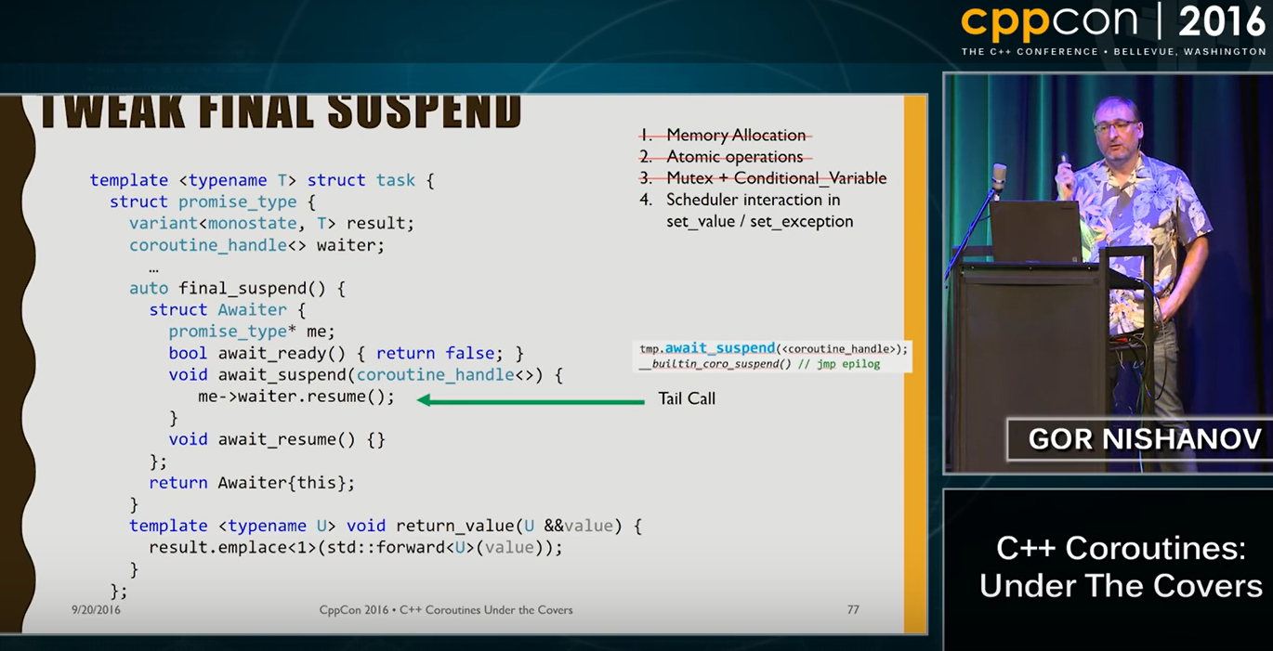
Symmetric Control Transfer
Available only in clang trunk
Not in MSVC or clang 5
Not part of the TS (yet)
coroutine_handle<> await_suspend(coroutine_handle<>) {
return me->waiter;
}

Slide 25
Peeking at coroutine arguments from promise
// Coroutine object returned in an usual place
HRESULT f(X x, Y y, Z z, SomeSmartPtr<MyCoro>* p);
// Would like have access to executor in initial_suspend
void g(executor& e);
// Would like to check whether we are cancelled at every
// suspend point
void h(cancellation_token& c);

Slide 26
Not Very Good Workaround
struct promise_type {
template <typename... Args>
void* operator new(size_t size, Args const&... args) {
// stash what you need into a thread_local
}
promise_type() {
// get what you wanted out of a thread_local
}
...
};

Slide 27
Let promise constructor peek at args!
struct promise_type {
template <typename... Args>
promise_type(Args const&... args) {
// get what you want
}
...
};
Opt-in feature. Empty construct will work fine
Will observe stable parameters (parameter copies)
Implicit object parameter passed as a first argument
Not part of the TS
Not available in any compiler

Slide 28
Conclusion
Networking and Coroutine TS are great together
At the moment, for the best performance use “the hard way”
Hopefully can be addressed before C++20 ships
Coroutines are available in
MSVC 2017 (/await)
clang 5.0 (-fcoroutines-ts –stdlib=libc++)
Networking TS implementation:
https://github.com/chriskohlhoff/networking-ts-impl
Look at good open source coroutine libraries: Example: https://github.com/lewissbaker/cppcoro
Snippets we used during the live part will be available at: https://github.com/GorNishanov/await/tree/master/2017_CppCon

Slide 29
Questions?

Slide 30
BACKUP

Slide 31
C++ Coroutines
SNEAK PEEK
at the bright future
Common pattern for Async and sync i/o
async
future<int> tcp_reader(int total)
{
char buf[64 * 1024];
auto conn = co_await Tcp::Connect("127.0.0.1", 1337);
for (;;)
{
auto bytesRead = co_await conn.read(buf, sizeof(buf));
total -= bytesRead;
if (total <= 0 || bytesRead == 0) co_return total;
}
}
sync
expected<int> tcp_reader(int total)
{
char buf[64 * 1024];
auto conn = co_await Tcp::Connect("127.0.0.1", 1337, block);
for (;;)
{
auto bytesRead = co_await conn.read(buf, sizeof(buf), block);
total -= bytesRead;
if (total <= 0 || bytesRead == 0) co_return total;
}
}
e-mail: gorn with answers, complaints, corrections, suggestions and new material

Slide 32
C++ Coroutines
Reactive streams meEt coroutines
Source
async_stream<int> Ticks()
{
for (int tick = 0;; ++tick)
{
co_yield tick;
co_await sleep_for(1ms);
}
}
SNEAK PEEK
at the bright future
Produces 0.1.2.3…
each 1ms
Transformer
template<class T>
auto AddTimestamp(AsyncStream<T>& S)
{
for await(auto&& v: S) co_yield make_pair(v,system_clock::now());
}
Transforms stream of v₁.v₂.v₃…
into a stream of
(v₁,t₁).(v₂,t₂).(v₃,t₃)…
where t_{i} is a timestamp of when
v_{i} was received
future<int> Sum(AsyncStream<int>& input)
{
int sum = 0;
for co_await(v: input)
sum += v;
co_return sum;
}
Sink
Reduces an asynchronous stream to a sum of its values
e-mail: gorn with answers, complaints, corrections, suggestions and new material

Slide 33
N4134: resumable functions v2
Generators and iterables and aggregate initialization
generators
generator<char> hello() {
for (ch: "Hello, world\n") yield ch;
}
int main() { for (ch : hello()) cout << ch;
}
SNEAK PEEK
(more later)
Not in N4134
constexpr
generators
int a[] = { []{ for(int x = 0; x < 10; ++x) yield x*x; } };
Equivalent to
int a[] = { 0,1,4,9,16,25,36,49,64,81 };
Recursive
Generators
auto flatten(node* n) -> generator<decltype(n->value)> {
if (n != nullptr) { yield flatten(n->left);
yield n->value;
yield flatten(n->right);
}
}
bool same_fringe(node* tree1, node* tree2)
{
auto seq1 = flatten(tree1);
auto seq2 = flatten(tree2);
return equal(begin(seq1), end(seq1),
begin(seq2), end(seq2));
}
Checks if in-order depth first traversal of two trees yields the same sequence of values
e-mail: gorn with answers, complaints, corrections, suggestions and new material

Slide 34
WARNING: Do not do this!
template <typename R>
auto operator co_await(std::future<R>&& f) {
struct Awaiter {
std::future<R>&& f;
bool await_ready() {
return f.wait_for(0s) != future_status::ready();
} void await_suspend(std::experimental::coroutine_handle<> h) {
std::thread([&]() mutable {f.wait(); h.resume();}).detach();
}
auto await_resume() { return f.get(); }
};
return Awaiter{ std::forward<std::future<R>>(f) };
}

Slide 35
With use_future, behaves as if it were
template <typename BufferSequence>
auto async_xyz(BufferSequence const& buffers, use_future_t)
{
std::promise<size_t> p;
auto result = p.get_future();
impl.real_async_xyz(buffers, [p = std::move(p)](auto ec, auto n) {
if (ec) p.set_exception(std::system_error(ec));
else (p.
}); return result;
}
Implementation:
https://github.com/chriskohlhoff/networking-ts-impl/blob/master/include/experimental/__net_ts/impl/use_future.hpp

