Slide 2
About me
Goran Šiška
Adacta-Fintech
Technical Lead of Quality Engineering Team
.Net and various technologies (+15y)
TDD (+10y)
Sustainable development
https://github.com/GoranSiska

Slide 3
WebGl

Slide 4
What is WebGl?
Javascript API for rendering (2011)
Almost Native Graphics Layer Engine
Low-level access to GPU
Required knowledge of js, glsl and math

Slide 5
WebGl pipeline
Vertex data
Vertex shader
Rasterization
Fragment shader
Framebuffer

Slide 6
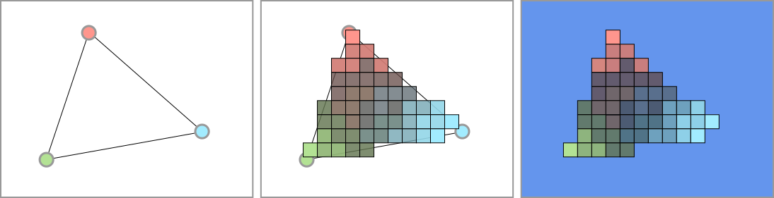
Vertices, rasterization and framebuffer

Slide 7
Demos

Slide 8
Visualization
Hello World
Wave World

Slide 9
Visual Computation
Conway‘s World
  https://en.wikipedia.org/wiki/Conway%27s_Game_of_Life
Wire World
  https://en.wikipedia.org/wiki/Wireworld
  https://www.quinapalus.com/wi-index.html

Slide 10
Annexation

Slide 11
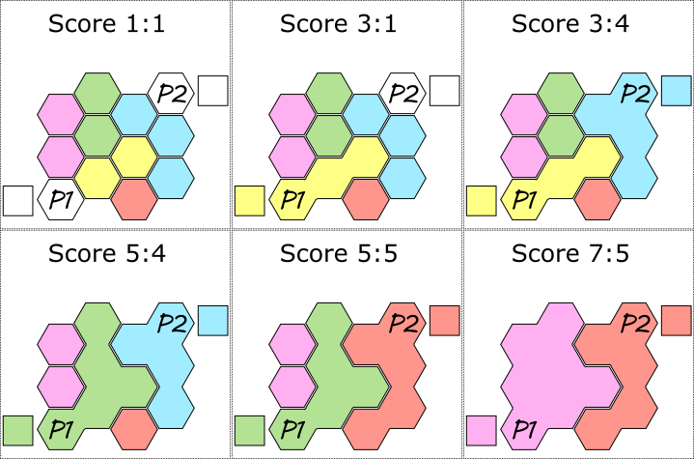
Filler rules

Slide 12
Filler AI
Use MCTS
Perform Random Playouts on GPU
  Encode position and state in a texture
  Calculate next state based on player to move and color chosen (in parallel)
  Perform n moves to reach end-state
  Extract win/lose ratio from state texture

Slide 13
Monte Carlo Tree Search
Heuristic search algorithm
Asymmetric game-tree exploration
Generic heuristic through random playouts

Slide 14
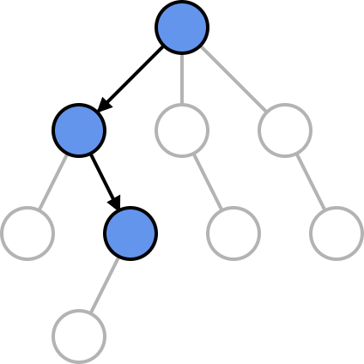
Selection
Traverse tree by UCB-1

Slide 15
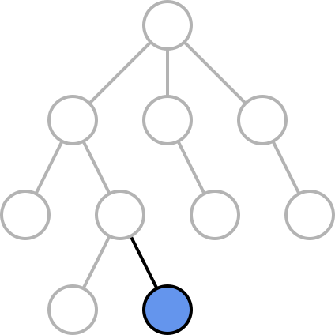
Expansion
Add new node

Slide 16
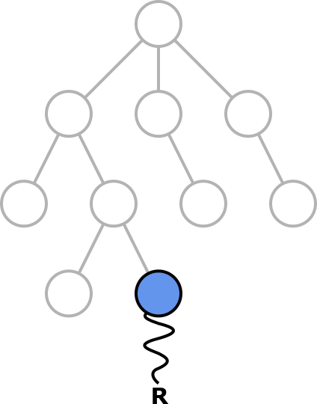
Simulation
Apply heuristic

Slide 17
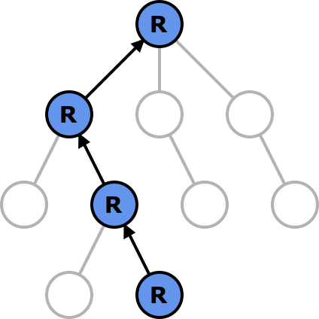
(Back)Propagation
Propagate result to root

Slide 18
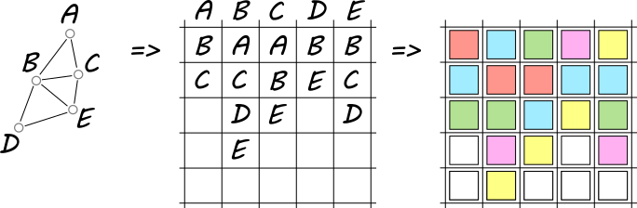
Board encoding

Slide 19
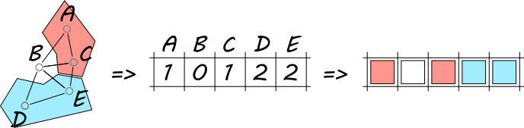
State encoding

Slide 20
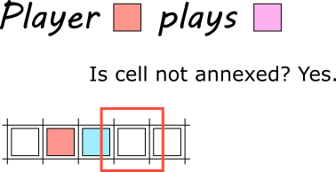

Slide 21
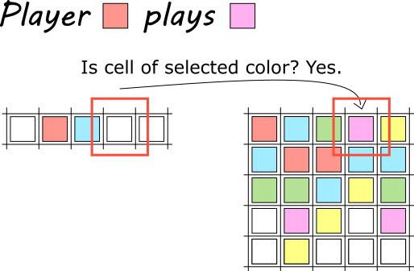

Slide 22
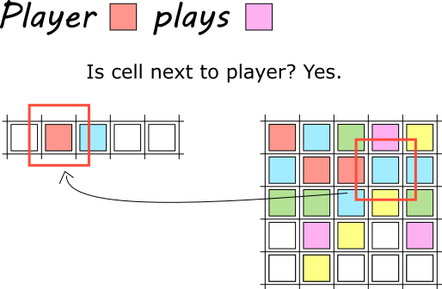

Slide 23
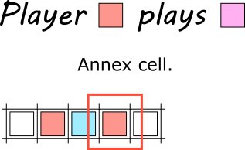

Slide 24
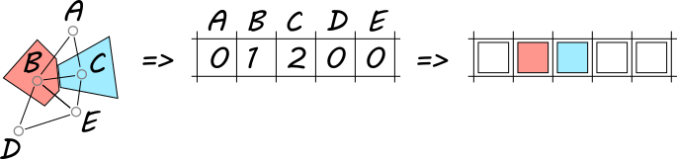
Multi-state encoding

Slide 25
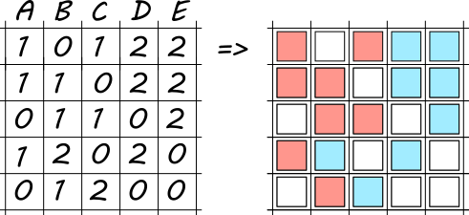
State texture

Slide 26
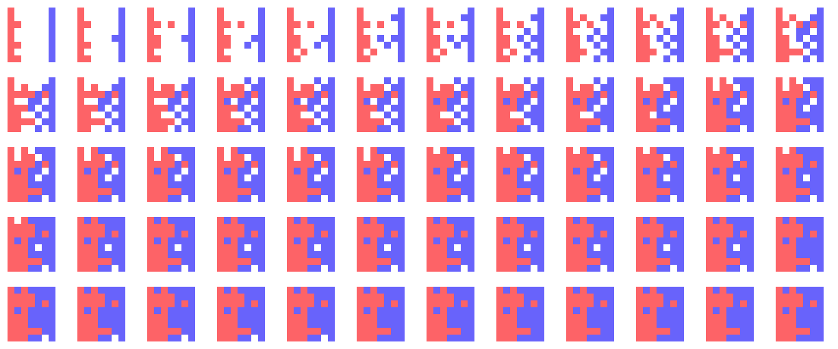
Playouts frames

Slide 27
Conclusions

Slide 28
WebGl usage
Visualizations (maps and charts, marketing, data visualization)
Calculations (simulations, neural networks, data processing)
UI (2d/3d controls, AR/VR)
Games (games, game engines)

Slide 29
Why?
Desktop 500 - 4000+ shader processors (mobile 0 – 1000)
Single Instruction Multiple Data
Monte Carlo, Numerical Integration, Rendering, Physical Simulations…
Cross-platform (Cordova/PhoneGap, Capacitor…)
Ubiquitous Web (Brower)

Slide 30
Why not?
Based on OpenGl ES
WebGl / WebGl2
Various levels of conformance (see IOS)
Performance
Synchronous API
Testing

Slide 31


