Slide 2
NTK Invaders
Goran Šiška

Slide 3
Godot
General purpose game engine
Editors
GDScript
Exporters
Key concepts
Scenes
Nodes
Signals
Themes
Tweens and Animations

Slide 4
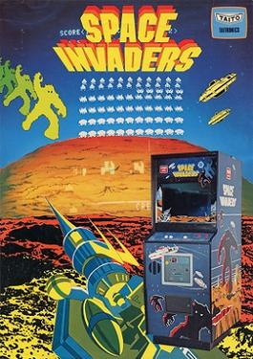
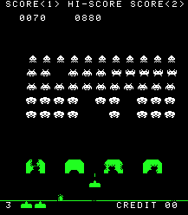
Space Invaders

Slide 5
Demo

Slide 6
Key Points
Call down, signal up
Go for Fast Feedback
Think components
Favor composition over inheritance

