Slide 2
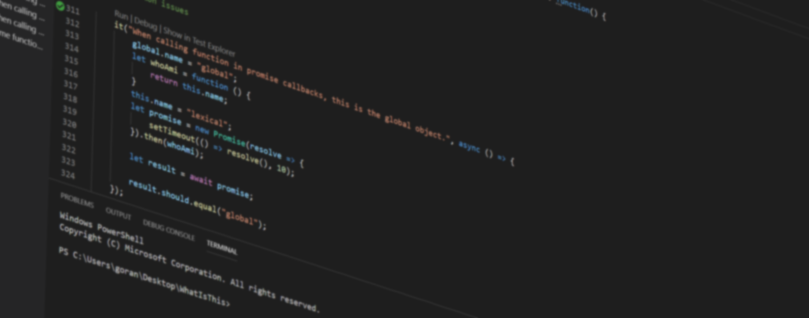
Visual Studio Code Extensions

Slide 3
“Visual Studio Code combines the simplicity of a source code editor with powerful developer tooling, like IntelliSense code completion and debugging.”
Microsoft

Slide 4
Contribution points
Common
Theming
Debugging
Language
Workbench

Slide 5
Theming
Dark|Light
TextMate

Slide 6
Debugging
VS Code debug protocol
Languages

Slide 7
Language
Hovers
CodeLens
Intellisense
Formatting
…

Slide 8
Common
Command
Configuration
Dialogs
Key bindings, context menus
Output channels,…

Slide 9
Workbench
Activity bar
Side bar
Status bar
Panel
Editor (WebView)

Slide 10
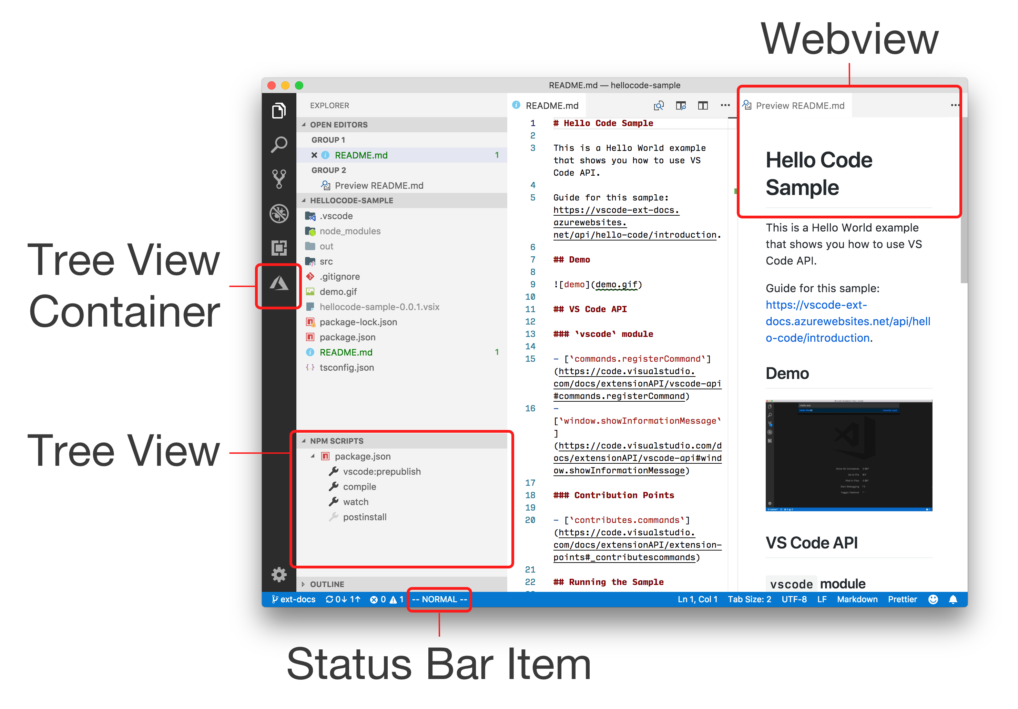

Slide 11
Getting started
Yeoman
npm install –g yo
npm install –g yo generator-code
yo code

Slide 12
Extension manifest
Name, description, version...
Contributes
Activation events
package.json
https://code.visualstudio.com/api/references/extension-manifest

Slide 13
Contribution points
Common
Activity, side, status bar
Panel
Editor (WebView)
https://code.visualstudio.com/api/references/contribution-points

Slide 14
Activation events
onLanguage
onCommand
workspaceContains
*
...
https://code.visualstudio.com/api/references/activation-events

Slide 15

DEMO

Slide 16
Testing
Running extension
Running extension tests
.vscodeignore

Slide 17
Publishing
Visual Studio Code Extensions
npm install –g vsce
vsce package
vsce publish

Slide 18
What now?
Read the docs
Check the samples
Check the marketplace
Profit!
https://code.visualstudio.com/api

Slide 19


Slide 20
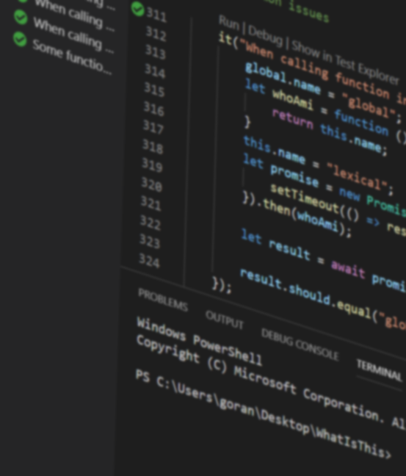
https://twitter.com/GoranSiska
https://medium.com/@GoranSiska
https://github.com/GoranSiska
Ntk2019_VSCodeExtensions

