Slide 2
Understanding Test Isolation
Goran Šiška

Slide 3
Test FIRST
Fast
Isolated
Repeatable
Self-validating
Timely/Thorough

Slide 4





Interactions
 | Query | Command
Incoming
Internal
Outgoing

Slide 5
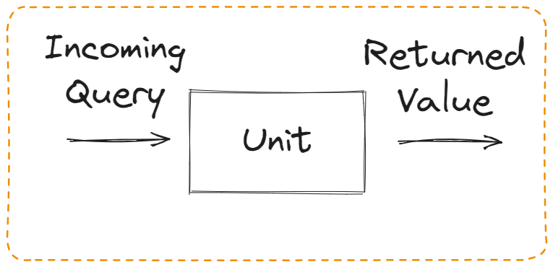
Incoming Query

Slide 6
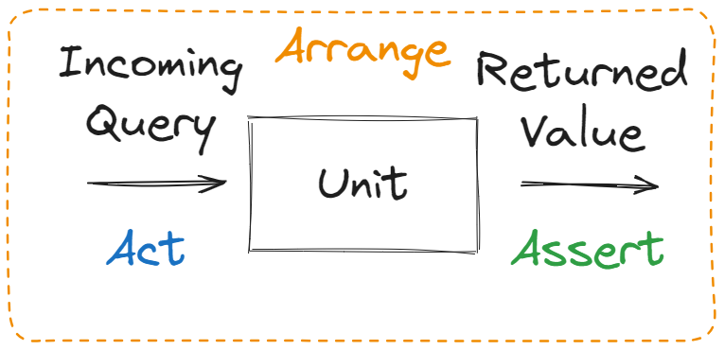
Incoming Query Test

Slide 7
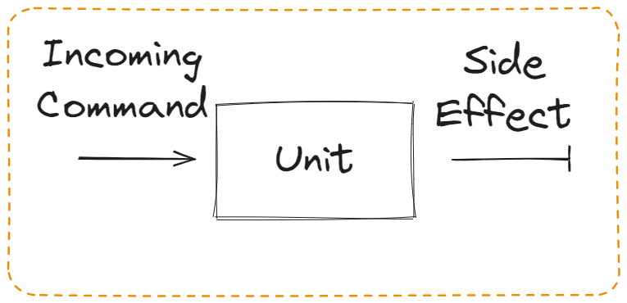
Incoming Command

Slide 8
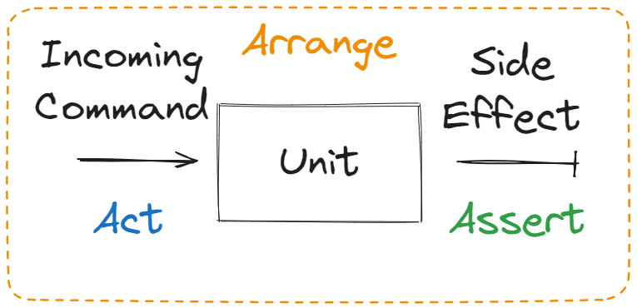
Incoming Command Test

Slide 9
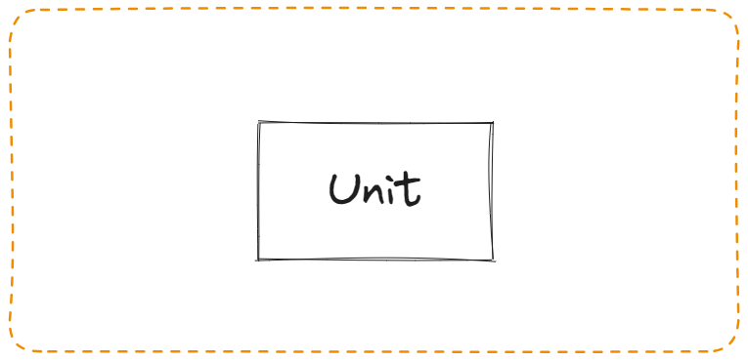
Internal Query / Command

Slide 10
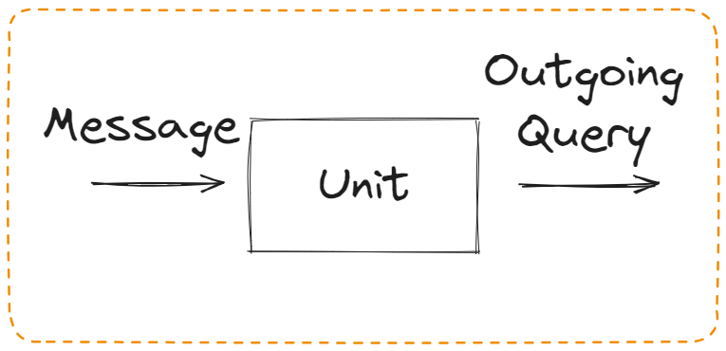
Outgoing Query

Slide 11
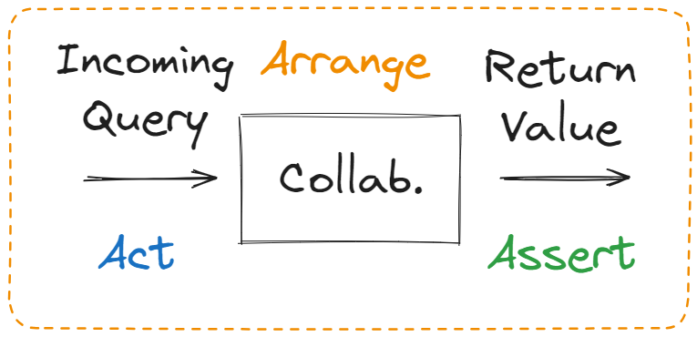
Outgoing Query Test

Slide 12
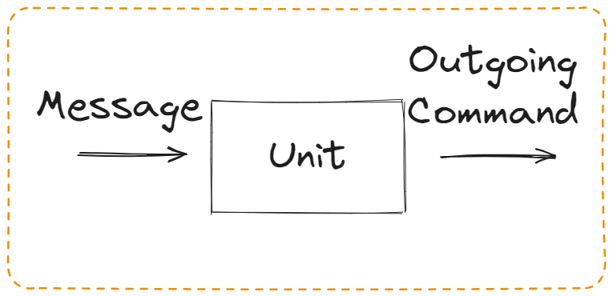
Outgoing Command

Slide 13
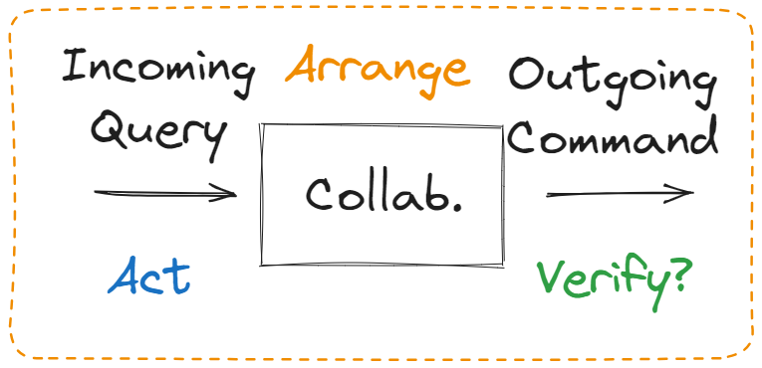
Outgoing Command Test

Slide 14
Interactions tests
 | Query | Command
Incoming | Assert return result | Assert immediate public side-effect
Internal | / | /
Outgoing | / | Do nothing (verify call)

Slide 15
What’s wrong with mocks?
Mocks achieve technical isolation, not material isolation
Mocks introduce alternate realities
Mocks test interactions not behavior
Mocks result in implementation ossification

Slide 16
Implementation ossification
Things in your test must exist in your code
Things in your code don’t need to exist in your tests

Slide 17
Demo

Slide 18
Orchestrator and Logic classes
Orchestrator classes
Logic classes
Many dependencies
Few branches
Few dependecies
Many branches

Slide 19
Integration Tests and Unit Tests
Integration Tests
Unit Tests
Easier to test behavior
Slow, expensive, inconclusive
Hate edge conditions
Harder not to test implementation
Fast, cheap, conclusive
Love edge conditions

Slide 20
Key Points
Test Business Logic using Unit Test
Test Orchestration Logic using Integration tests
Always focus on Behavior
Consider what is visible to the System

Slide 21
Source
https://github.com/GoranSiska/OnTestIsolation/

