Slide 1
Yet Another Traversal
Data Structures Week 9
In BFS, vertices not reachable from s are never listed.
So the entire graph may not be visited at all.
We will study yet another traversal mechanism for graphs.
This is called Depth First Search (DFS) and has important applications.
Several graph algorithms use DFS as a subroutine.

Slide 2
Yet Another Traversal
Data Structures Week 9
One way to think of the new traversal is to consider using a stack instead of a queue in BFS.
Let us understand by an example.

Slide 3
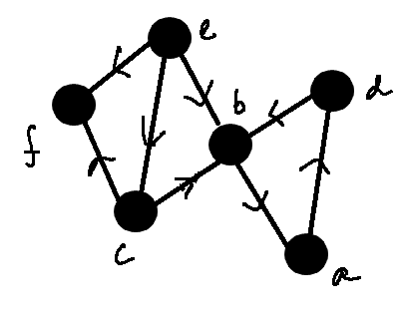
DFS
Data Structures Week 9
Let us start from vertex e.

Slide 4
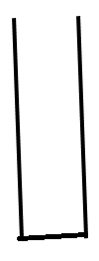
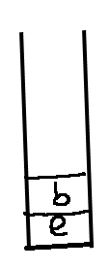
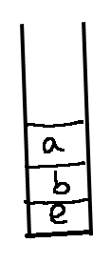
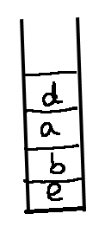
DFS
Data Structures Week 9
Π(e) = nil
Π(b) = e
Π(a) = b
Π(d) = a

Slide 5
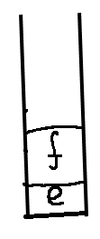
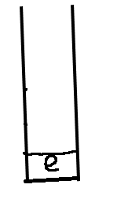
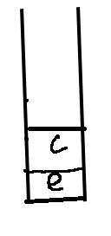
DFS
Data Structures Week 9
Π(c) = e
Π(f) = e

Slide 6
Depth First Search
Data Structures Week 9
The idea of DFS is as follows.
Start from a specified start vertex, say s.
Explore from s as deep as possible. This suggests that we go from s, to one of its neighbors x, to a neighbor of x, ...
When to stop? When there are no new neighbors to explore from a given point.

Slide 7
DFS
Data Structures Week 9
Further, when the stack is empty, and there are still vertices that are not visited, pick another start vertex.
Repeat until all vertices are visited.
A big departure from BFS, but the goals are different.
  In DFS, we aim to understand the structure of the graphs. To be done via several auxiliary information recorded during DFS.
  In BFS, the idea is to find shortest paths.

Slide 8
Depth First Search
Data Structures Week 9
Alike BFS, have to keep track of a the state of a vertex.
A vertex can be in three states: VISITED, NOT_VISITED, IN_STACK
Normal to associate colors to these states such as
  VISITED – GREEN
  NOT_VISITED – RED
  IN_STACK – ORANGE
Why the third state? Same reason as BFS.

Slide 9
DFS
Data Structures Week 9
In a programmatic sense, can use recursion to manage the stack.
So, the modified program looks as below.

Slide 10
DFS
Data Structures Week 9
Procedure DFS(G)
Begin
for each vertex v do
color(v) = RED
P(v) = NIL;
end-for
for each vertex v do
if v is colored RED then
color(v) = ORANGE
VisitDFS(v)
end-if
end-for
End.
Procedure VisitDFS(v)
Begin
for each neighbor w of v do
if w is colored RED then
P(w) = v;
Color(w) = ORANGE
VisitDFS(w)
end-if
end-for
color(v) = GREEN;
End.

Slide 11
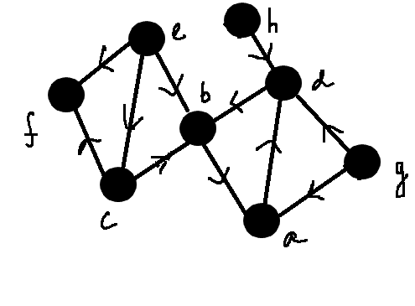
DFS – An Example
Data Structures Week 9

Slide 12
Discovery and Finish Times
Data Structures Week 9
With every vertex, can also associate start and finish times.
Start with time = 0 at the beginning.
Increment time for the following events
  A new vertex is discovered
  A discovered vertex finishes processing.

Slide 13
Discovery and Finish Times
Data Structures Week 9
The first time a vertex v changes state from NOT_VISITED to IN_STACK, the current time is recorded as the discovery time of v,
  denoted d(v)‏
The time at which vertex v changes state from IN_STACK to VISITED is recorded as the finish time of v
  denoted f(v)‏

Slide 14
Data Structures Week 9
Data Structures Week 9
DFS
Procedure DFS(G)
Begin
for each vertex v do
color(v) = RED
P(v) = NIL;
end-for
time = 0
for each vertex v do
if v is colored RED then
color(v) = ORANGE
VisitDFS(v)
end-if
end-for
End.
Procedure VisitDFS(v)
Begin
d(v) = ++time;
for each neighbor w of v do
if w is colored RED then
P(w) = v;
Color(w) = ORANGE
VisitDFS(v)
end-if
end-for
color(v) = GREEN;
f(v) = ++time;
End.

Slide 15
Discovery and Finish Times
Data Structures Week 9
Several graph properties can be observed using the d() and the f() times.
Interesting algorithms can be designed relying mostly on d() and f() times.
We will see at least one such example later.

Slide 16
Discovery and Finish Times – Example
Data Structures Week 9

Slide 17
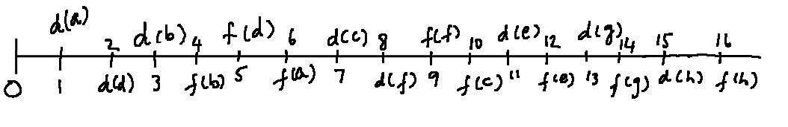
DFS – Complete Example
Data Structures Week 9
Vertex | Discovery Time | Finish Time
a | 1 | 6
b | 3 | 4
c | 7 | 10
d | 2 | 5
e | 11 | 12
f | 8 | 9
g | 13 | 14
h | 15 | 16

Slide 18
Classifying Edges
Data Structures Week 9
The edges of E_{π} are also called as tree edges.
The edges of E_{N} := E \ E _{π} are called as non-tree edges.
These edges can be further classified as follows.

Slide 19
Classifying Edges
Data Structures Week 9
Back Edges
  An edge (u, v) ∈ E_{N} is called as a back edge if v is an ancestor of u in the tree.
  In other words, u can be reached from v using tree edges, but there an edge from u to v also.
Forward Edge
  Edges (u, v) which connect a vertex u to a descendant of u in the DFS tree. (v is a descendant of u)
  In other words, v can be reached from u using tree edges, but there an edge from u to v also.

Slide 20
Classifying Edges
Data Structures Week 9
Cross Edges : Edges (u, v) where u and v do not share any ancestor/descendant relationship.
Depending on the type of the edge, certain relations between d() and f() values of the endpoints hold.
If (u,v) is a cross edge then the intervals [d(u), f(u)] and [d(v], f(v)] do not overlap.
Find other such relations.

Slide 21
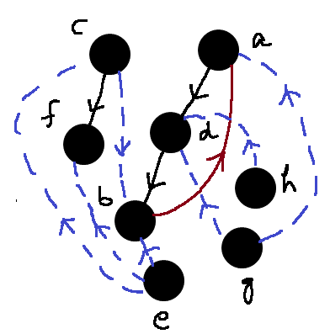

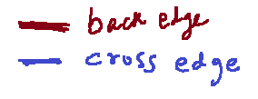
Example
Data Structures Week 9
Vertex | Discovery Time | Finish Time
a | 1 | 6
b | 3 | 4
c | 7 | 10
d | 2 | 5
e | 11 | 12
f | 8 | 9
g | 13 | 14
h | 15 | 16

Slide 22
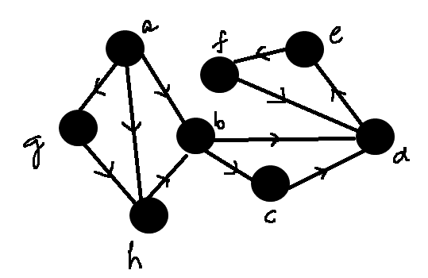
DFS Example
Data Structures Week 9

Slide 23
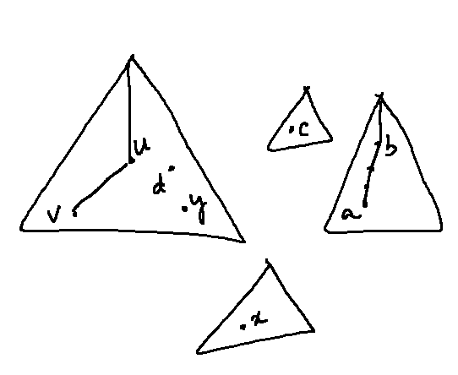
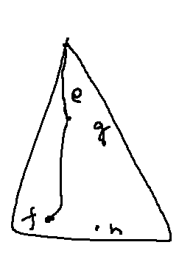
Edge Classification
Data Structures Week 9
Another attempt to explain edge classification according to DFS.
Consider the following DFS forest.

Slide 24

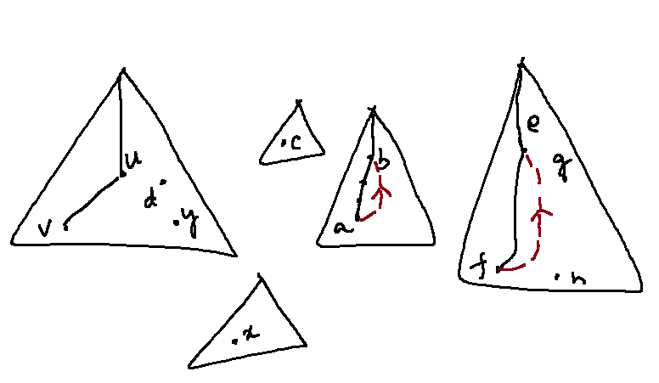
Back Edges
Data Structures Week 9

Slide 25
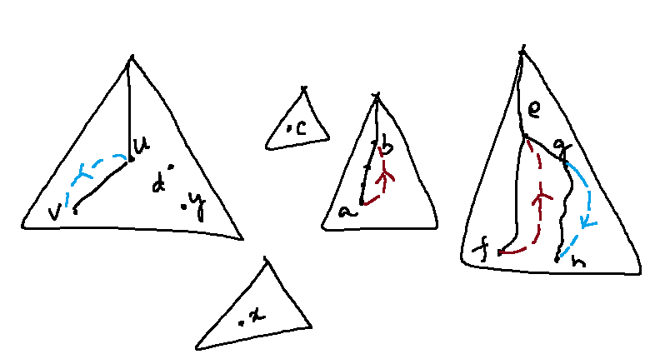
Forward Edges
Data Structures Week 9

Slide 26
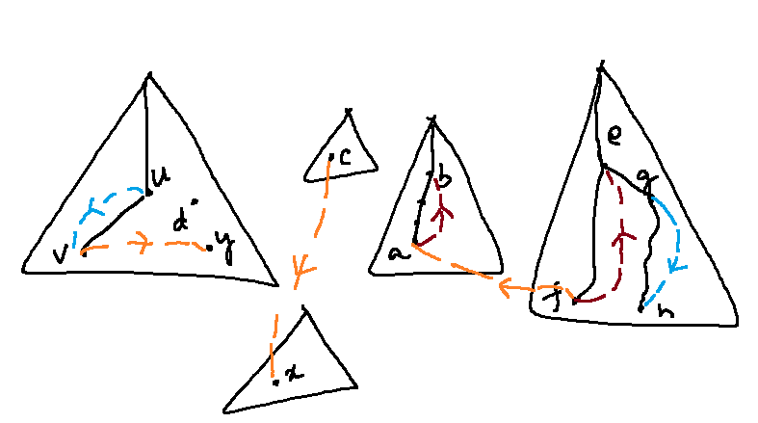
Cross Edges
Data Structures Week 9

Slide 27
Application of DFS - I
Data Structures Week 9
Consider the UG curriculum here.
Some courses have pre-requisites.
A small picture illustrates this idea.

Slide 28
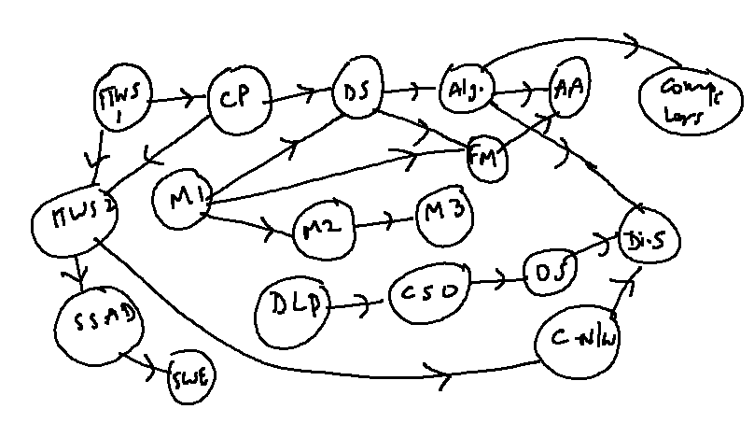
Example
Data Structures Week 9

Slide 29
Some Questions
Data Structures Week 9
How long do you really need to complete the program if you are allowed to do as many courses as possible each semester?

Slide 30
Some Questions
Data Structures Week 9
How long do you really need to complete the program if you are allowed to do as many courses as possible each semester?
How soon can you take some course, by finishing all its prerequisites.

Slide 31
Some Questions
Data Structures Week 9
How long do you really need to complete the program if you are allowed to do as many courses as possible each semester?
How soon can you take some course, by finishing all its prerequisites.
What is an order of the courses?

Slide 32
The Graph Based Solution
Data Structures Week 9
The last question indicates some ordering on the vertices of the graph.
The graph we have in this case is a directed graph.
Additionally, there cannot be cycles in the graph.
Such a graph is called as a directed acyclic graph, DAG for short.

Slide 33
The Graph Based Solution
Data Structures Week 9
We will use just DFS to arrive at our solution as follows.
Consider performing DFS on the graph G.
Let (u,v) be an edge in G.
If G is a DAG, then it holds that f(u) > f(v).

Slide 34

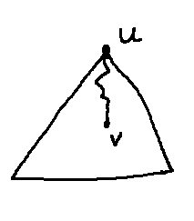
f(u) > f(v)
Data Structures Week 9
If G is a DAG, then it holds that f(u) > f(v).
Can be proved as follows. Let d(u) < d(v). Then the case is clear. The DFS procedure from u would definitely reach v, finishes at v, then returns to u.
In this case, (u,v) is either a tree edge or a forward edge.

Slide 35
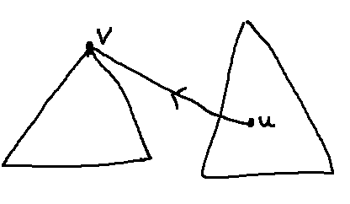
f(u) > f(v)
Data Structures Week 9
On the other hand, if d(v) < d(u), then the DFS procedure at v cannot visit u. Why? So, in this case, also f(u) > f(v).
The edge (u,v) appears as a cross edge.

Slide 36
The Solution
Data Structures Week 9
We need an ordering of vertices such that:
  If (u,v) is an edge, then u appears before v in the order.
The simple solution to produce such an ordering of the vertices is to therefore perform a DFS and produces vertices in the decreasing order of their finish times.

Slide 37
Example
Data Structures Week 9
Vertex | F(v)
DS | 12
ITW1 | 32
ITW2 | 27
SSAD | 24
CP | 31
SWE | 2
Alg | 11
FM | 5
Aalg | 4
CSO | 35
DLP | 36
OS | 30
CN | 26
DiS. | 8
Compilers | 10
M1 | 18
M2 | 17
M3 | 16
Sorted order
DLP, CSO, ITW1, CP, OS, ITW2, CN. SSAD, SWE, M1, M2, M3, DS, Alg, Comp., DiSy, FM, AAlg

Slide 38
Application of DFS – II
Data Structures Week 9
Consider the bridges problem.
Suppose one day all the roads in the city are made directional.
  like one-way roads.
Directions decided arbitrarily.
Can we go from one point to another point, and also come back respecting the directions?

Slide 39
Applications of DFS – II
Data Structures Week 9
The general problem is as follows.
Given a directed graph G = (V, E) and two vertices U and v, is there a path between u to v and vice-versa.
Does the above hold for every pair of vertices u, v?

Slide 40
Applications of DFS – II
Data Structures Week 9
The second question is more general than the first. Can be solved also.
Problem: Given a directed graph G, partition V into maximal subsets so that each pair of vertices in each subset have a path between them.
  u, v in V_{i}, u is reachable form v and v is reachable from u.
Each such set is called a strongly connected component.

Slide 41
Applications of DFS – II
Data Structures Week 9
Can use DFS to find the strongly connected components of a given directed graph.
Requires a few thought questions.

Slide 42
Applications of DFS – II
Data Structures Week 9
C
v
C'
u
x
y
Let C, C' be two (distinct) strongly connected components of G.
Let u in C, and v in C' be such that (u,v) in an edge.
There cannot be an edge from some y in C' to an x in C.

Slide 43
Applications of DFS – II
Data Structures Week 9
C
v
C'
u
x
y
If such an edge (y,x) exists, then C and C' are not maximal.

Slide 44
Applications of DFS – II
Data Structures Week 9
C
v
C'
u
Given such C and C' and u, v such that (u,v) is an edge, in any DFS of G, C finishes after C'.
  Set f(C) = max_{v in C} f(v) for a component C.

Slide 45
Applications of DFS – II
Data Structures Week 9
C
v
C'
u
Given such C and C' and u, v such that (u,v) is an edge, in any DFS of G, C finishes after C'.
  Set f(C) = max_{v in C} f(v) for a component C.
Proof: Consider the case that d(u) < d(v).
Then, DFS from u clearly enters C' via (u,v) or some other edge.

Slide 46
Applications of DFS – II
Data Structures Week 9
C
v
C'
u
d(u)‏
d(v)‏
f(C')‏
f(C)‏
Thus, v would be a descendant of u.
Once DFS enters C', all vertices of C' would be visited before backtracking to a vertex in C.
Thus, C' finishes before C.

Slide 47
Applications of DFS – II
Data Structures Week 9
C
v
C'
u
d(v)‏
d(u)‏
f(C')‏
f(C)‏
Similar observations hold also if d(u) > d(v).
In this case, DFS from v has to finish C' and cannot enter C.
So, f(C) is also larger than f(C')‏

Slide 48
Applications of DFS – II
Data Structures Week 9
C
v
C'
u
Define the graph G^{T} as follows
  V(G^{T}) = V(G)‏
  E(G^{T}) = { (v,w) | (w,v) in E(G)}
In essence, invert the directions of edges in G to get G^{T}.
The SCCs of G and G^{T} are identical.

Slide 49
Applications of DFS – II
Data Structures Week 9
C
v
C'
u
Why is that important?
Consider setting up a DFS in G' so that
  the DFS will visit only vertices in each component.
How to set this up?

Slide 50
Applications of DFS – II
Data Structures Week 9
C
v
C'
u
Notice that in G^{T}, the edge (u,v) in G appears as (v,u).
Also, a DFS in G^{T} that starts in C cannot enter C'.
Why?

Slide 51
Applications of DFS – II
Data Structures Week 9
C
v
C'
u
How to do DFS in G^{T} such that it visits only vertices in one component before having to start again.
If in a DFS in G, C finishes later than C', then there is some vertex in C whose finish time is more than the finish time of all vertices in C'.
So, can start with such a vertex.

Slide 52
Applications of DFS – II
Data Structures Week 9
C
v
C'
u
Suggests that we should pick the start vertex for DFS in G^{T} such that it has the largest finish time among all vertices according to DFS in G.
Indeed, that is the algorithm for finding SCCs also.

Slide 53
Algorithm for SCC
Data Structures Week 9
Algorithm SCC(G)‏
begin
  perform a DFS in G and record the d() and f() times of all vertices.
  construct the graph G^{T} from G.
  Perform DFS in G picking vertices in decreasing order of finish time according to DFS in G
end

Slide 54
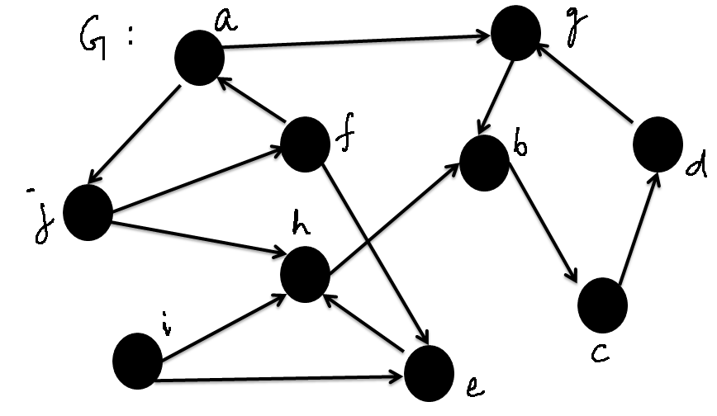
Example SCC
Data Structures Week 9

Slide 55
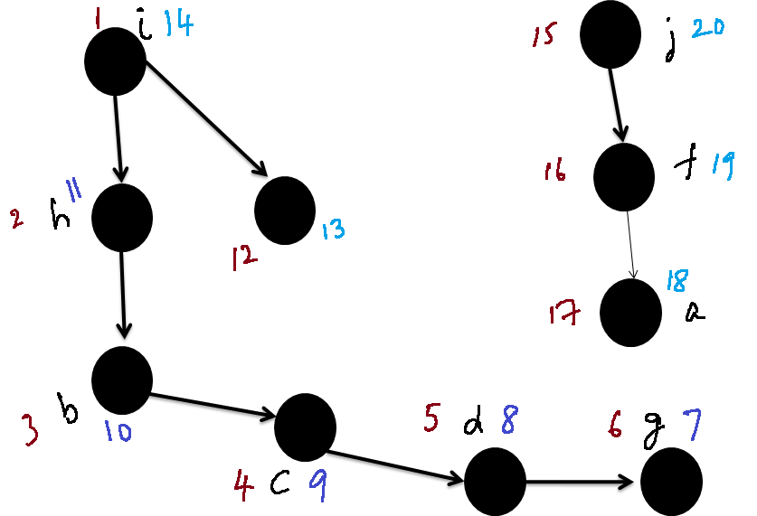

Example SCC: DFS on G
Data Structures Week 9

Slide 56
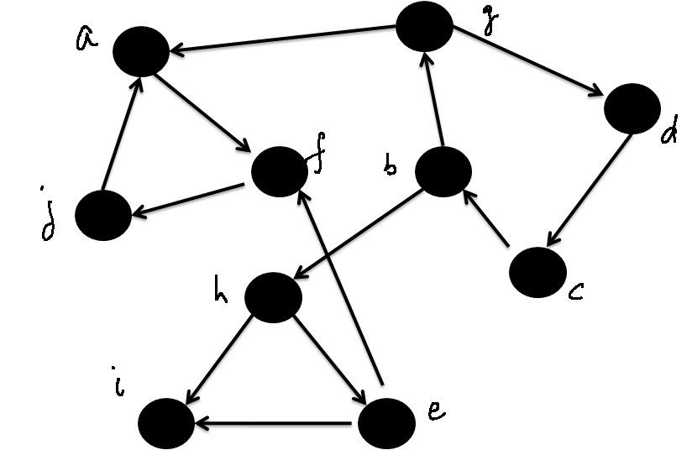
The Graph G^{T}
Data Structures Week 9

Slide 57
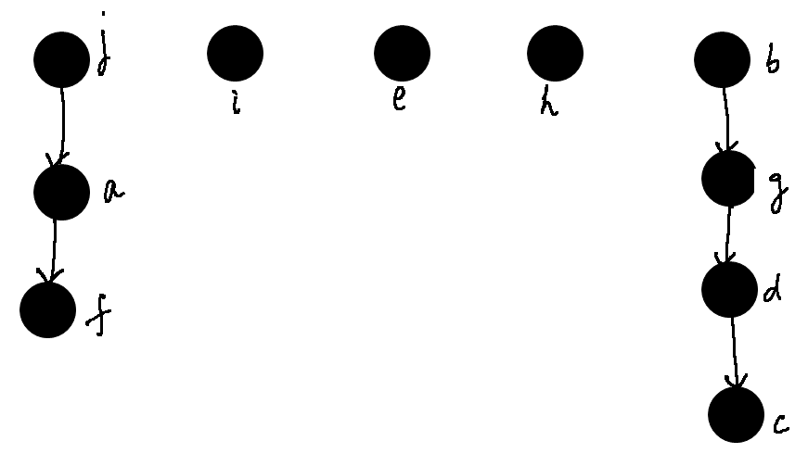
DFS on G^{T} With Specific Start Vertices
Data Structures Week 9

