Slide 1
Advanced Data Structures
Data Structures Week 9
An abstract problem:
Given n elements, grouped into a collection of disjoint sets S₁, S₂, …, S_{k}, design a data structure to:
  Find the set to which an element belongs
  Combine two sets
The abstract problem finds applications in several settings:
  Spanning tree algorithm of Kruskal
  Graph connected components
  Least common ancestors
  …

Slide 2
Some Notation
Data Structures Week 9
Imagine a collection S = {S₁, S₂, …, S_{k}} of sets.
Each set has a representative element
  Some member of the set, typically.
  Depending on application, can be
    The smallest numbered element
    A number
    Or other
Typical operations
  MakeSet(x)
  Union(x, y)
  FindSet(x)

Slide 3
Some Notations
Data Structures Week 9
Two parameters
  n : The number of MakeSet operations.
  m : The total number of MaketSet, Union, and Find operations.
Some observations
  Each Union operation reduces the number of sets by 1.
  When starting with n elements, at most n-1 Union operations.
  Also, m >= n.
Assume that the n MakeSet operations are the first n operations.

Slide 4
How to Implement the Operations?
Data Structures Week 9
Option 1 : Use linked lists.
For every set, there is a linked list.
The representative of a set is the head of the list.
Every element also stores a pointer to the representative.
There is a tail pointer indicating where to append.

Slide 5
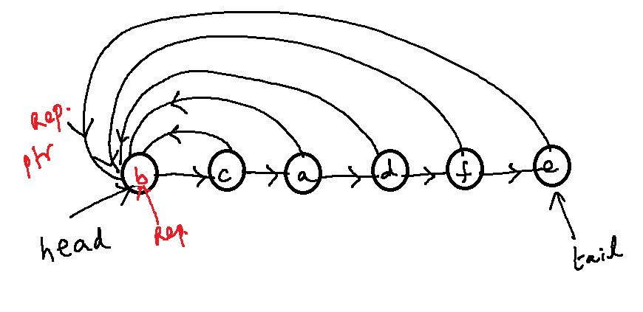
Example
Data Structures Week 9

Slide 6
Operations
Data Structures Week 9
MakeSet(x): Create a new linked list.
FindSet(x) : Can be answered via the direct pointer
Union(x, y) : Can append the list of x to the list of y.
But have to update the pointer for each element in the list of x.

Slide 7
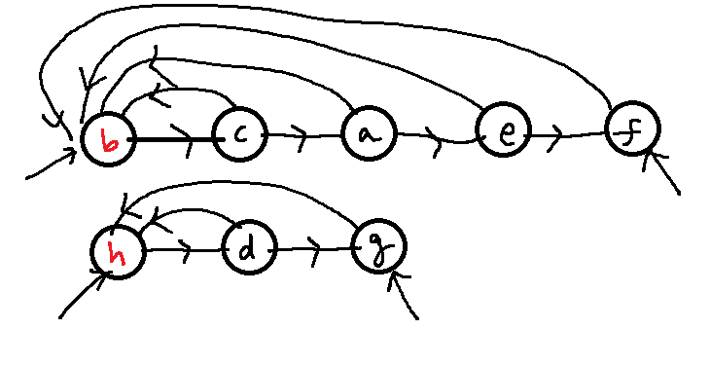
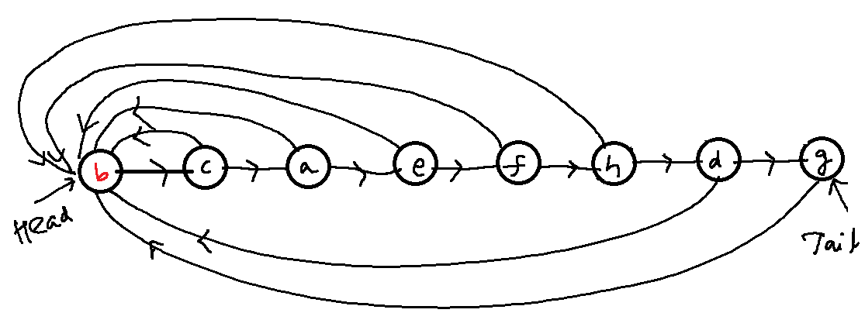
Data Structures Week 9

Slide 8
Application to Connected Components
Data Structures Week 9
Problem: Given an undirected graph G = (V, E), partition V into disjoint sets V₁, V₂, …, V_{k}, so that two vertices u and v are in the same partition if and only if there is a path between u and v.
Several ways to solve this problem
  This may not be the best way!
Example follows.

Slide 9
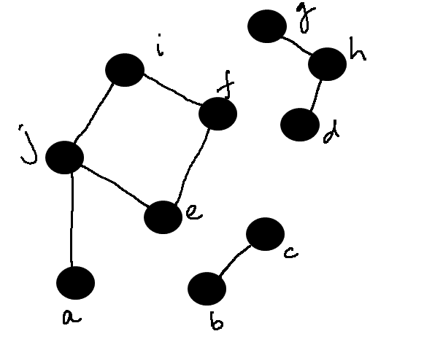
Example
Data Structures Week 9
Algorithm:
  For each vertex v
    MakeSet(v)
  For each edge vw
    Union(v,w)

Slide 10
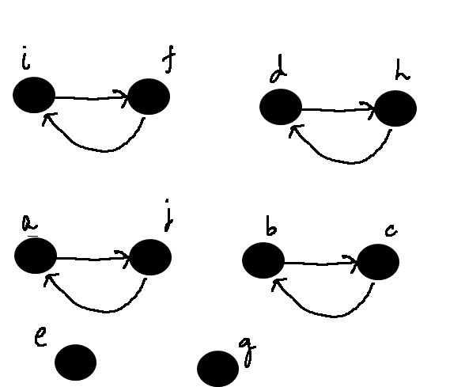
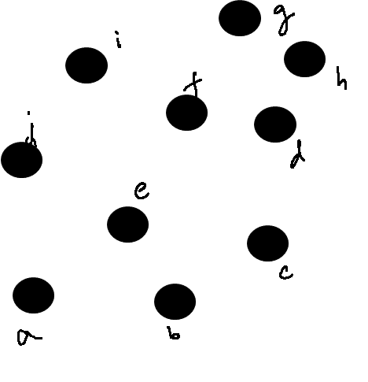
Example
Data Structures Week 9

Slide 11
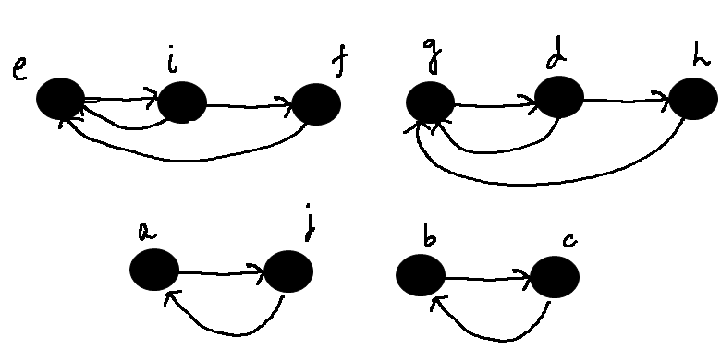
Example
Data Structures Week 9

Slide 12
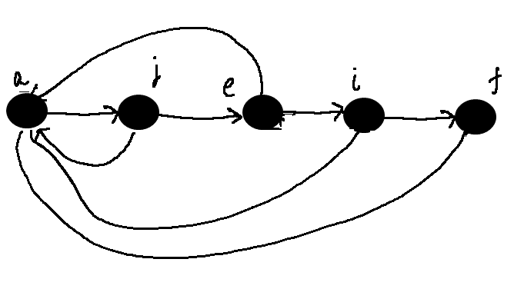
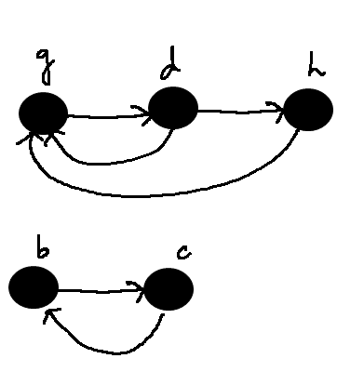
Example
Data Structures Week 9

Slide 13
Operations
Data Structures Week 9
How difficult is it to append the lists?
Claim: There exists a sequence of m operations on n objects so that the total time required for the entire sequence of operations is O(n²).

Slide 14
Operations
Data Structures Week 9
How difficult is it to append the lists?
Claim: There exists a sequence of m operations on n objects so that the total time required for the entire sequence of operations is O(n²).
After the first n MakeSet operations, call Union(x1,x2), Union(x2, x3), Union(x3, x4), …, Union(x_{n-1}, x_{n}).
The kth union call takes time proportional to k.
Total time is therefore O(n²).
The average time per operation is also O(n).

Slide 15
Application to Kruskal’s Algorithm
Data Structures Week 9
An average time of O(n) is not helpful for Kruskal’s algorithm.
We have several Union calls and several FindSet calls.

Slide 16
Better Solution
Data Structures Week 9
Most of the time spent is in the Union operation.
Can we modify the operation slightly?
Intuitively, it is easier to append a smaller list to a larger list.
  Requires fewer updates.
  Will the overall time decrease?
We will show that indeed it does.

Slide 17
The Weighted Union Heuristic
Data Structures Week 9
Maintain the length of each list. Corresponds to the size of the set.
To perform Union(x, y):
  Append the list of x to the list of y if len(x) < len(y)
  Append the list of y to the list of x otherwise.
A single Union operation can still take lot of time.
  Union of two large lists, say of size n/10 each.
But, a sequence of operations may be not so expensive.
  Hopefully.

Slide 18
Analysis
Data Structures Week 9
How many times can an element change its representative?
Consider any element x.
If in an Union operation, the representative of x changes, then x is in the smaller list.
  Why?

Slide 19
Analysis
Data Structures Week 9
How many times can an element change its representative?
Consider any element x.
If in an Union operation, the representative of x changes, then x is in the smaller list.
  Why?
The first time this happens, the resulting list has at least 2 elements.

Slide 20
Analysis
Data Structures Week 9
How many times can an element change its representative?
Consider any element x.
If in an Union operation, the representative of x changes, then x is in the smaller list.
  Why?
The first time this happens, the resulting list has at least 2 elements.
Next time, the resulting list has at least 4 elements.

Slide 21
Analysis
Data Structures Week 9
In general, if the representative of x changes k times, then the resulting list has size at least 2^{k}.
The largest set can have a size of n.
Therefore, the representative of x cannot change more than log n times, over all the Union operations.
This applies to every element.
Therefore, over all Union operations, the total time spent is O(n log n).

Slide 22
Analysis
Data Structures Week 9
Now, consider a sequence of m operations.
MakeSet and Find are O(1) time operations.
Therefore, the total time is O(m + nlog n).
The average time per operation is O(log n).

Slide 23
Application to Kruskal’s Algorithm
Data Structures Week 9
How does the above apply?

Slide 24
Application to Kruskal’s Algorithm
Data Structures Week 9
Do n MakeSet operations indicating that each vertex is in its own tree/set.
To check if e = uv creates a cycle, check if FindSet(u) = FindSet(v).
If not, add e to the current tree. Perform Union(u, v) to merge the trees of u and v.
There are at most m FindSet operations.
Overall time is therefore bound by O(m+nlog n).

