Slide 1
Further Data Structures
Data Structures Wk.11
Time for some advanced data structures
Last week we studied
  Study how to adjust the size of arrays according to usage.
  A new way to analyze such data structures
This class
  We will see how to store a set of strings such as the list of contacts in a mobile phone

Slide 2
The Problem
Data Structures Wk.11
Recall one of the first problems we talked about.
Each of us have a mobile phone, and we also store contacts along with their numbers for later use.
The operations we are interested on the list of contacts are:
  Insert : insert a new contact
  Search : search for a contact
  Delete : Remove an existing contact

Slide 3
The Problem
Data Structures Wk.11
In essence, this is the standard dictionary set of operations.(insert, find, delete)
But, we know that as we use the list of contacts, we may not be using binary search, or binary search trees.
What are the differences that we feel?
  We are able to jump directly to names starting with any alphabet.
  Can generalize the above. We are able to jump directly to names starting with any prefix. Example: all names starting with sr.
Need a data structure for this purpose.

Slide 4
The Problem
Data Structures Wk.11
Other applications of the same kind include:
  Command filling in the Linux shell environment.
  Storing census data according to the UID

Slide 5
The Solution
Data Structures Wk.11
The data structure that we use is called as a trie.
  Name comes from retrieval.
An extension of a tree in many ways.
Let us start with an example, and then see how to perform insert/delete/find.
We will take the following Linux commands
  cat, cp, echo, dump, dvips, du, cal, chown, chmod

Slide 6
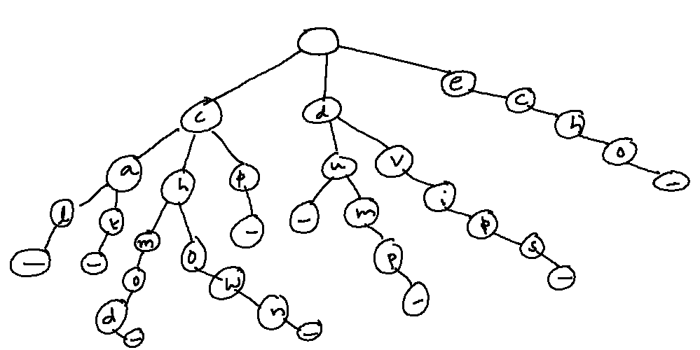
The Trie
Data Structures Wk.11

Slide 7
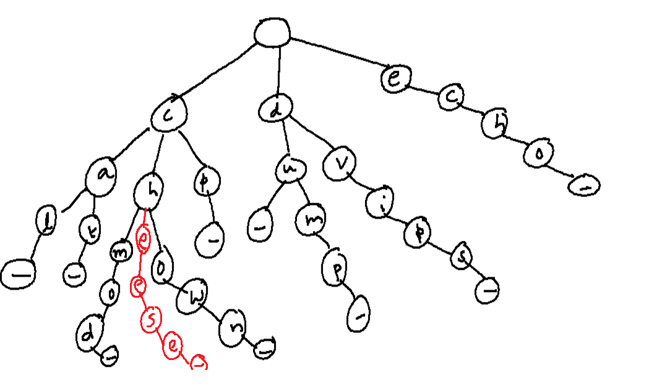

Data Structures Wk.11

Slide 8
A Trie
Data Structures Wk.11
The root of the trie corresponds to the null string, or the empty string.
Each of the sub-tries, which are children of the root, represent a trie of string that start with a common letter.
A _ character could be used to create strings that are prefix free. (du and dump)
In general
  Each node has at most 27 children. (including the _).
  Each node corresponds to one letter.
  Leaf nodes correspond to the string obtained by concatenating the letters on the root to the leaf path

Slide 9
How to Insert?
Data Structures Wk.11
Let us insert the command env into our trie.
The procedure is rather straightforward now.
Start traversing from the root.
If the root has a child labeled ‘e’, insert the rest of the string ‘nv’ in that subtrie, recursively.
Otherwise, create a subtrie labeled ‘e’ and insert the string ‘nv’ in the new subtrie, recursivley.

Slide 10
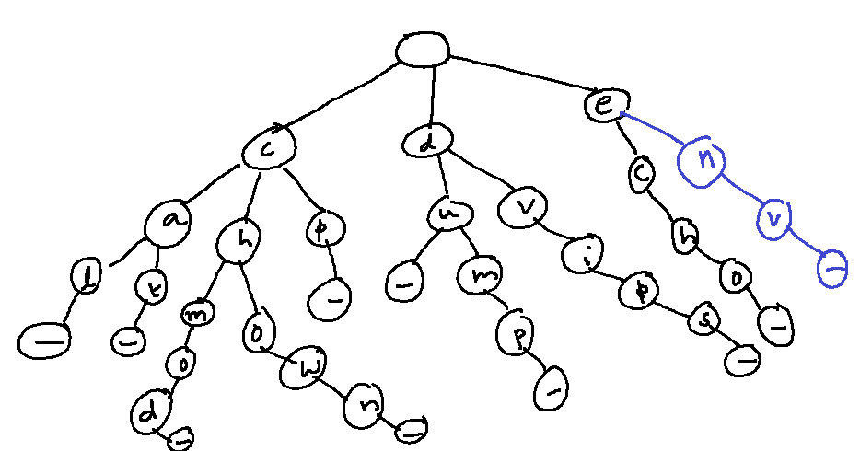
After Inserting env.
Data Structures Wk.11

Slide 11
How to Insert
Data Structures Wk.11
The time taken is proportional to the length of the string.
Each level of the trie accounts for one of the characters.
A few thoughts:
  A binary search tree has height independent of the length of the strings. Depends only on the number of strings.
  But the advantage of a trie shows in better searching, especially at the large scale.

Slide 12
Why Trie Instead of a BST?
Data Structures Wk.11
Use a trie to store the census data.
At 1 Billion records, the height of the BST can be no less than 30.
A trie on the other hand has only 10 levels.
  If the UID is 10 digits (can store 10¹⁰ records with 10 digits.)
Another advantage is the added search ability.
  BST cannot show quickly all the strings with a given prefix.

Slide 13
The Find Operation
Data Structures Wk.11
No need to explain.
Just follow from the root till you reach the correct leaf node, or declare that the element is not in the trie.

Slide 14
The Delete Operation
Data Structures Wk.11
Can be done similarly.
The only additional care to be taken is to delete entirely subtries that become empty.
For instance, deleting dvips in our trie will reduce the number of children of ‘d’ to 1.

Slide 15
Further Improvements
Data Structures Wk.11
Should we have each node correspond to a single letter?
Look at our trie and the string chmod.
After branching out on ‘m’, there are no other strings with the prefix ‘chm’ except ‘chmod’ in the present trie.
Can we therefore store a string instead of a letter?
YES. Called a compressed trie.

Slide 16
Compressed Trie
Data Structures Wk.11
A compressed trie has internal nodes of degree at least two.
Can be obtained from standard trie by compressing chains of nodes of degree 1.

Slide 17
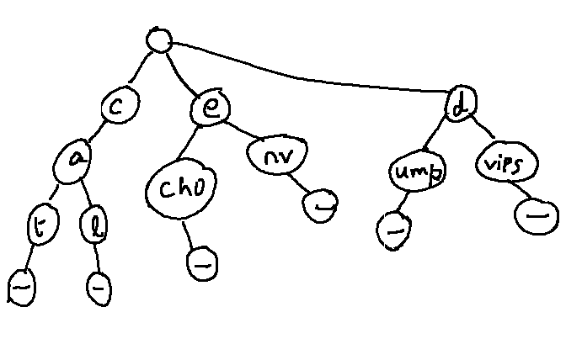
The Compressed Trie
Data Structures Wk.11

Slide 18
Operations
Data Structures Wk.11
To insert, may have to decompress some subtrie as need.
To find, can simply use the operation from the standard trie.
For delete, look for chances to compress.
A compressed trie may have:
  fewer levels,
  fewer nodes, and
  hence faster in practice.

Slide 19
Other Uses of the Trie
Data Structures Wk.11
Can track all occurrences of a given word in a text.
  Very useful in editors (Think of find, find&replace)
Add all (unique) words in the text into a trie.
At each leaf node, store the starting indices of the corresponding word.
Example follows.

Slide 20
Example
Data Structures Wk.11
Consider the following (indexed) text and the corresponding trie.
The tree has ten nodes. Three nodes have degree two. One has degree three.
1
4
9
13
17
24
30
36
41
48
53
57
61
68

Slide 21
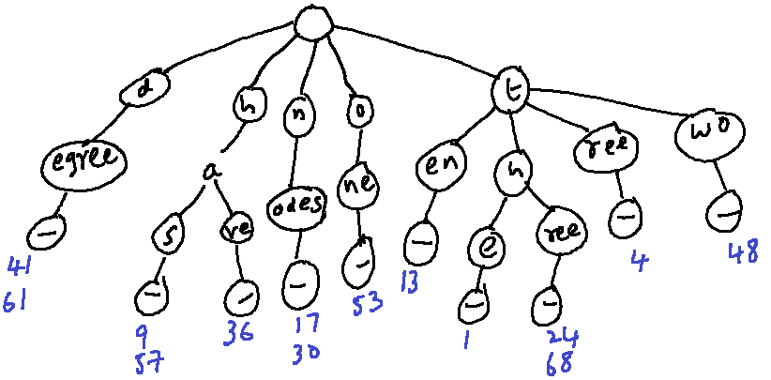
Example
Data Structures Wk.11
1
4
9
13
17
24
30
36
41
The tree has ten nodes. Three nodes have degree two. One has degree three.
48
53
57
61
68

Slide 22
Summary
Data Structures Wk.11
Trie is useful in some cases, especially for string based data.
Can also have other features such as:
  List elements with a given prefix. Recall our mobile phone’s contact lists again.
  No need to balance the tree with respect to height.
Other ways to represent the trie using less space also exist.

