Slide 1

A Java Framework for Game Development & Graphics

Slide 2
What is ?
Cross-platform Java Framework for game development
Runs on Desktop, Mobile and Web
Open source
Supports 2D and 3D graphics

Slide 3
Why use ?
Performance: Optimized for real-time rendering
Easy to Learn: Simple API for Java developers
Rich Features:
Model Loading
Lightning & shadows
Camera controls
Physics
Active Community: Many tutorials & plugins

Slide 4
Core Components
ApplicationAdapter: Base class for game loop
ModelBatch: Renders 3D models efficiently
Model: Contains mesh data (vertices, textures)
ModelInstance: Position/rotation of a model in the world
Camera: Controls the view
Environment: Lightning & fog settings

Slide 5
3D Rendering Pipeline
Setup: Load models, set up camera & lights
Update: Handle input, update positions
Render: Clear screen → Draw models → Swap buffers

Slide 6
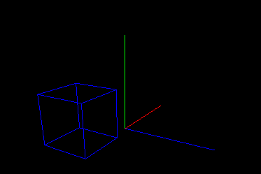
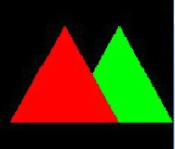
Camera System
PerspectiveCamera: 3D view (depth perception)
OrthographicCamera: 2D view (no perspective)

Slide 7
Light Types
DirectionalLigth (Sun-like)
PointLike (Bulb-like)
SpotLight (Flashlight)

Slide 8
Material Attributes
ColorAttribute (Diffuse, Ambient, Emissive)
TextureAttribute (Images on models)
FloatAttribute (Shininess, Opacity)

