Slide 1
Predicting Standard and Poor's 500 Equity Index ($SPY/NYSE)
3/6/24 - Tyler Gorczycki, Blake Zurman, Charlie Diaz, Nathaniel Sablan, Hunter Gotwalt, Nicholas Azzi

Slide 2
- Mission Statement
Using SKlearn we are concerned with writing a predictive model that attempts to quote the daily closing prices for the $SPY index.
We used the Alphavantage® API to receive the historical daily close price and daily volume of the $SPY Index, as well as the historical daily close price of the $VIX volatility index for fiscal year 2023. These were given as CSV’s to parse.

Slide 3
- Implementation/Libraries
Made usage of Principal Component Analysis method to allow for simplification of data points, as well as Long Short-term Memory Neural Network for prediction.
Pandas
Numpy
Sklearn
Keras
Matplotlib

Slide 4
Blake’s LSTM
With LSTM approach, Trained 100 epochs to receive:
Train loss: 0.0027
Test Loss: 0.0032

Slide 5
Cont.
Train Predictions:
[395.95715]
[396.85263]
[396.50003]
[396.26282]
[396.87833]
Test Predictions:
[431.5172]
[428.293 ]
[426.2334]
[424.0384]
[421.2292]

Slide 6
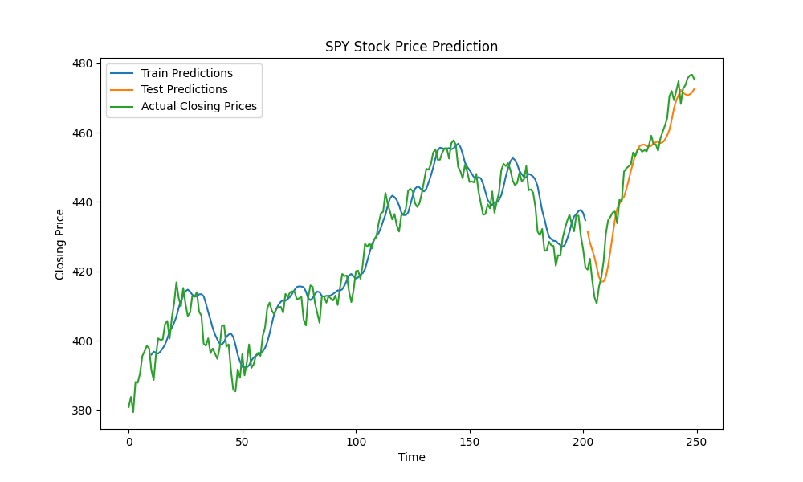
Cont.

Slide 7
Hunter’s PCA--->LSTM
Used:
from sklearn.decomposition import PCA
from sklearn.preprocessing import MinMaxScaler
As well as PCA to receive corresponding eigenvalues and eigenvectors

Slide 8
Cont.
Mean [[4.27367201e+02 8.19238916e+07 1.68700400e+01]
Cov. Matrix: [ 5.30200000e+02 -1.51951808e+08 -6.42200000e+01]
[-1.51951808e+08 4.65531026e+14 3.17021911e+07]
[-6.42200000e+01 3.17021911e+07 9.85000000e+00]]
Eigen vectors [[-3.26405329e-07 9.93734064e-01 1.11770347e-01]
[ 1.00000000e+00 3.31971541e-07 -3.11898458e-08]
[ 6.80989866e-08 -1.11770347e-01 9.93734064e-01]]
Eigen values [4.65531026e+14 4.86661406e+02 1.63182731e+00]

Slide 9
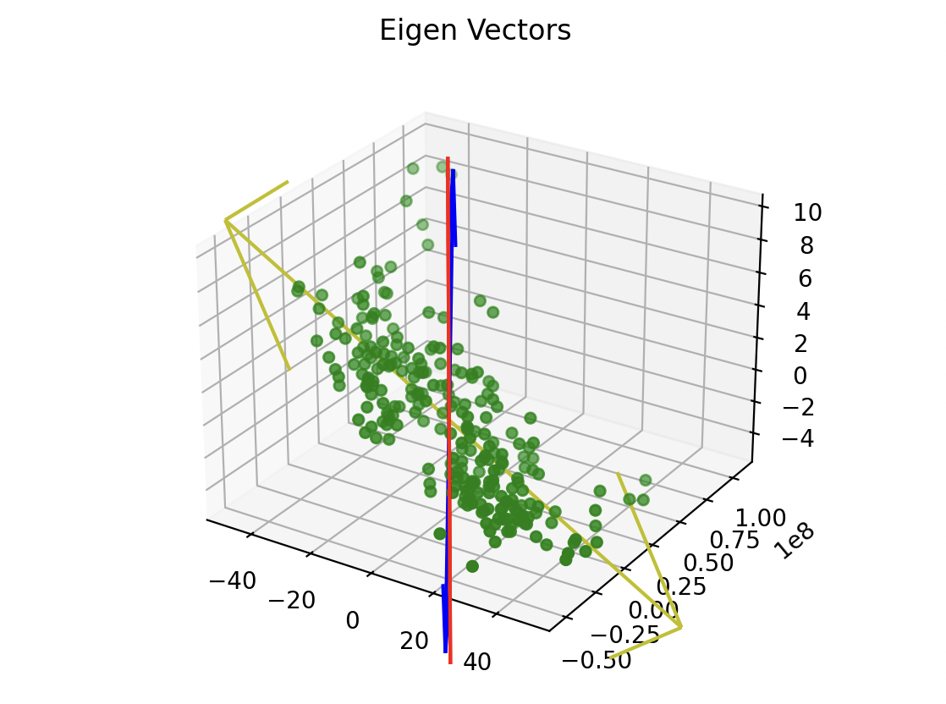
Eigen Vectors

Slide 10
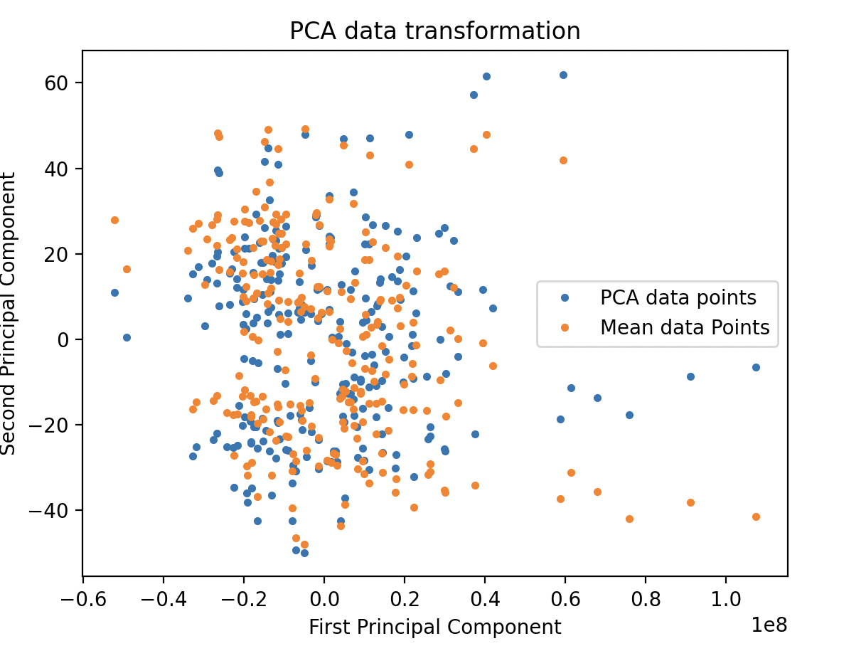
PCA transformation

Slide 11
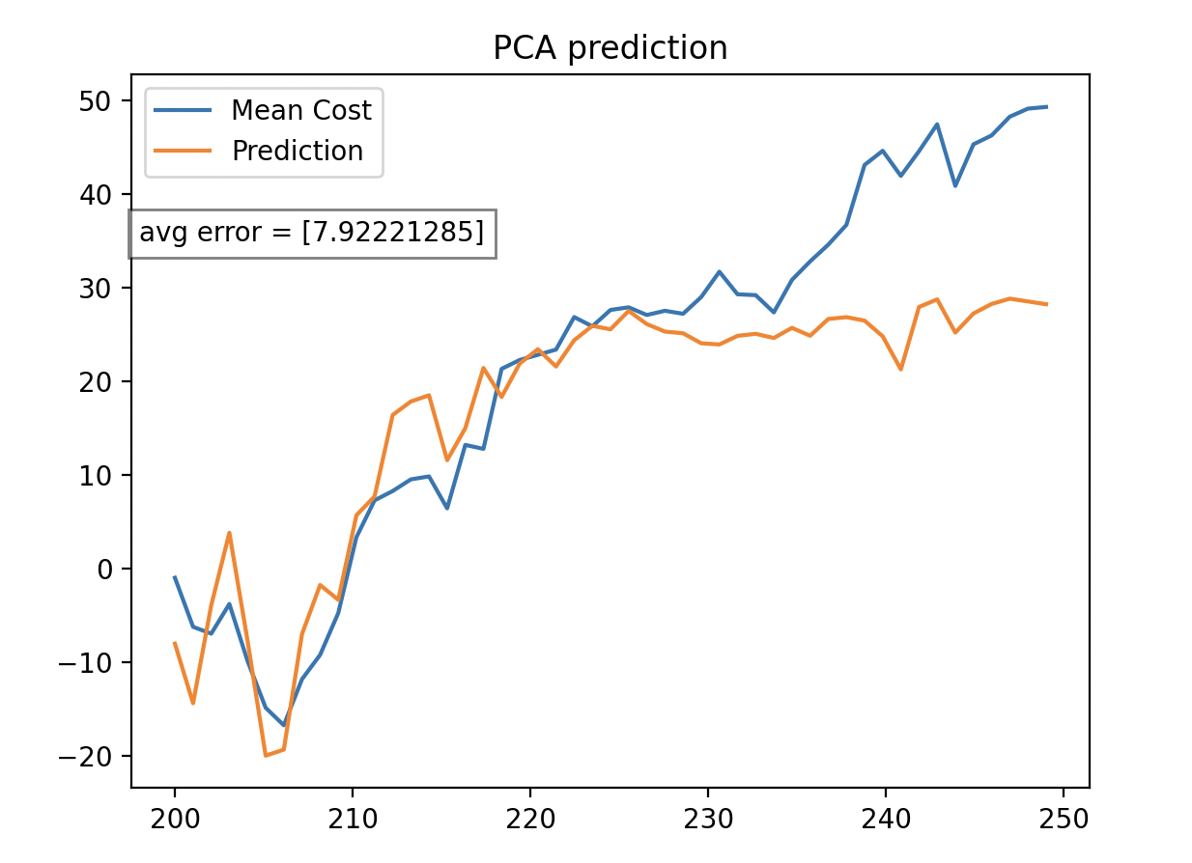
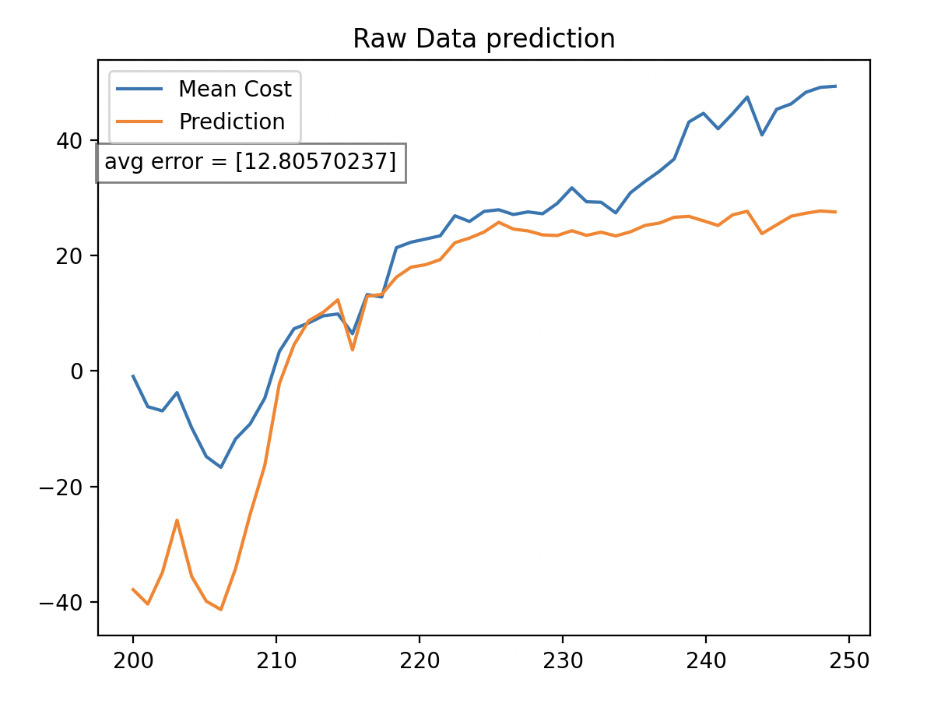
Hunter’s Outcome(normalized)

