Slide 1

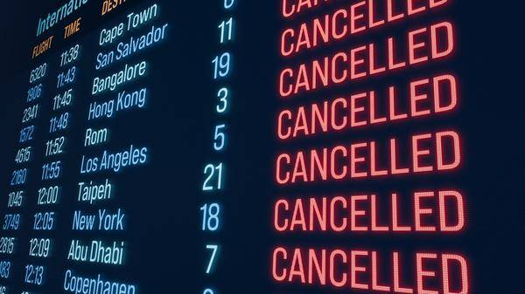
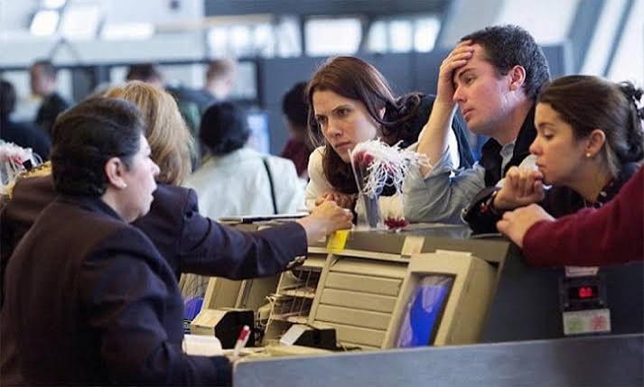
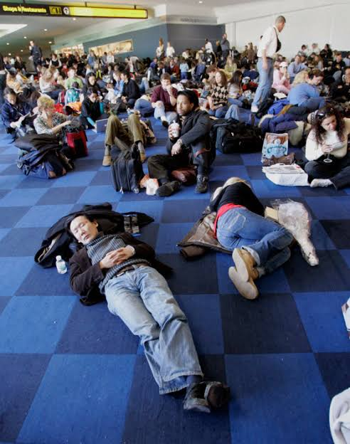
The night the flight cancels
IRONHACK AI CONSULTING
Decision support for airline disruption care. Three working n8n workflows that cost the night, source the rooms, and capture what was agreed.
Gordan Skopljak | September 2026
Synthetic and public data only. No real passenger data was used.
Notes:
At 19:40 a flight cancels and one person has to solve it
"Hands up if you have ever had a flight cancelled on you." (most hands)
"Keep them up if you were put in a hotel that night." (fewer)
"Keep them up if you know what that hotel cost the airline."

Slide 2
THE PROBLEM
One person, three hours, no numbers
19:40
23:30
07:00
Flight cancels
Hotels stop check in
Next departure
195 passengers, 18 crew, nobody has costed anything yet.
Rooms must be found, priced and approved before this.
Whatever rest is left after coaches out and back.
The station duty manager works from memory and a phone list.
  He over books rooms, because nothing tells him which passengers started their journey here and are simply going home.
  The decision stalls, because authority to commit the spend sits above the station and the case for it is not in front of anyone.
Notes:
Two failures: over booking and stalling. Both come from missing information, not from bad people.
2

Slide 3
THE LEGAL FLOOR
Compensation is conditional. Care is not.
Article 7 Compensation
Article 9 Duty of care
Can be zero
Always owed, no ceiling
  Owed only when the cause is within the airline's control
  Extraordinary circumstances remove it entirely
  Never a station decision
  Rooms, meals and transport, whatever the cause
  Survives extraordinary circumstances
  CJEU McDonagh v Ryanair: no financial cap
Care is the bill the airline always pays. That is the cost this system attacks.
The system does not reduce statutory care or compensation. Both are legal obligations and no saving is claimed against either.
Notes:
If she asks whether you are cutting EU261 costs: no. Anyone pitching that is either wrong or planning to under provide care, which is unlawful. You recover over spend, not statutory cost.
3

Slide 4
THE OPPORTUNITY
9.2M USD
The money is in rooms nobody needed
Where it comes from
3,305 overnight care events out of 10,919 real cancellations. American Airlines 2015, US DOT.
Why it happens
The station cannot see which passengers began their journey here, so everyone is costed a room.
a year of over provisioning, the ceiling of the addressable saving
What changes
Trip origin from the reservation record turns a guess into a counted number.
Sourcing time falls from about 2h40 to under 40 minutes.
Figures are illustrative, modelled on the American Airlines 2015 analog with unverified unit costs. A real engagement re runs the model on the carrier's own invoices.
Notes:
One number only. If asked why not more precise: the ceiling is what the data supports, capture rate is the assumption, and that is exactly what the pilot measures.
4

Slide 5
THE SOLUTION
Three workflows, one night
1
2
3
Cancellation exposure
→
Accommodation sourcing
→
Hotel call intelligence
Reads the manifest, destroys the names, costs the night, and says who is allowed to approve it.
Triages the partner hotels on rest before the morning flight and hands the manager a ranked shortlist.
Turns the closing phone call into structured terms with a confidence score on every one.
The system proposes, ranks and explains. A human commits.
Nothing is booked. Nothing is confirmed. No hotel is ever given a payment guarantee by the system.
Notes:
Say the sentence in the green box out loud. It is the answer to half the questions you will get.
5

Slide 6
WORKFLOW 1
Cancellation exposure
1
Manifest in as CSV or PNL teletype
Demo run
2
Names read and destroyed, booking reference replaced by a per run salted hash
Passengers
195 in 125 parties
Crew
6
3
Parties grouped, trip origin identifies who could go home
Rooms required
89, of which 4 accessible
4
Rooms, meals, transport and EU261 liability costed as low, expected and high
Care ceiling
23,498 EUR
5
Authorisation gate routes to station or carrier operations centre
Station limit
25,000 EUR
Inside the station mandate. The station may commit without carrier authorisation.
The model never sees a passenger. It receives counts and money only, and a privacy guard throws an error if any identifier reaches the payload.
Notes:
The result page shows the exact payload the model received. Offer to open it if she pushes on transparency. Confirm the demo numbers against your own run before you present.
6

Slide 7
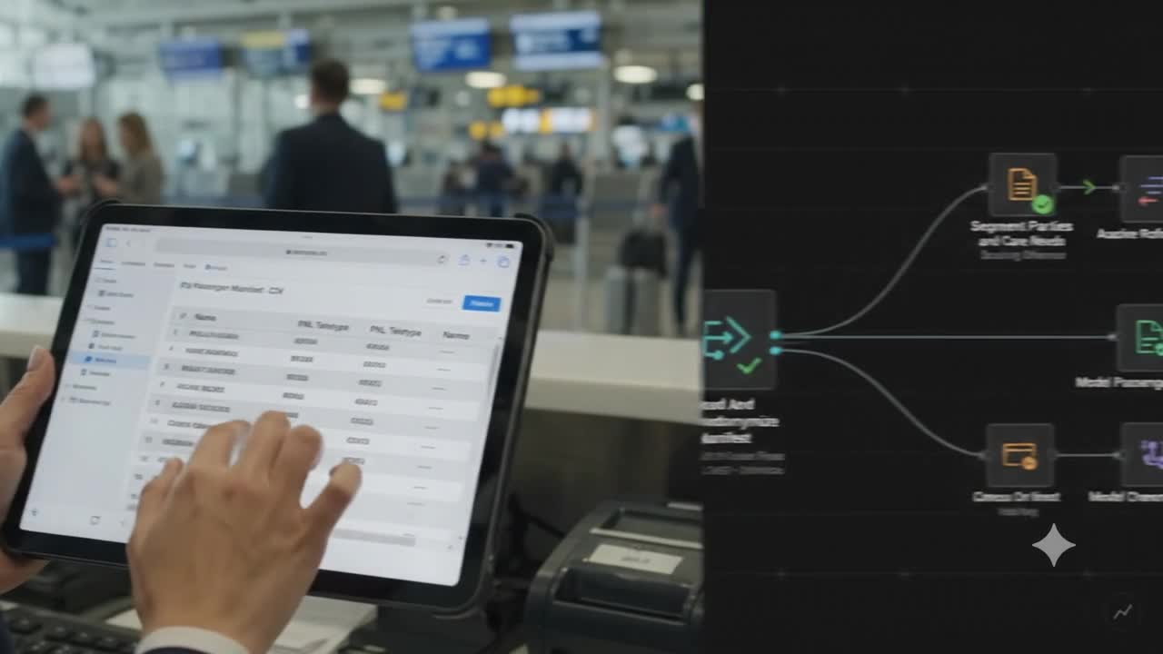

Slide 8
WORKFLOW 2
Accommodation sourcing
Hotels are ranked on the constraint that actually decides the night: how much sleep is left before the morning departure, not the room rate.
Hotel | Distance | Rest before 07:00 | Rooms held | Verdict
Airport Inn (partner) | 0.5 km | 6h16 | 160 | call first
Skyport Hotel (partner) | 7 km | 6h05 | 120 | call first
Terminal Lodge (partner) | 5 km | 6h13 | 70 | partial, 89 rooms needed
Lakeside Hotel (nearby) | 12 km | 5h29 | 95 | skip, no coach parking
Ranking is arithmetic in code
It suggests, it does not send
The same inputs always produce the same winner. No model judgement decides money.
Room counts are nominal from the partner list, not live availability. The manager confirms with the hotel.
Notes:
If asked why not book automatically: an enquiry commits nothing, a booking commits money, and the second one needs a person. That is also what keeps the AI Act classification out of high risk.
7

Slide 9
WORKFLOW 3
Hotel call intelligence
Recorded call
Whisper transcript
Terms extracted with per section confidence
Deterministic re check in code
Manager approval email
→
→
→
→
The workflow stops and asks for a human when any of these fire
Critical field missing
Confidence below 0.75
Total above threshold
Rooms, rate, currency or cancellation terms not stated on the call.
Any section the model is not sure it heard correctly.
High value arrangements never pass on confidence alone.
The agent negotiated it. The manager approves it. The model only writes down what was already said.
Notes:
This is the workflow that breaks the privacy design. Do not hide it. Slide 9 handles it head on.
8

Slide 10
COMPLIANCE
Where the design defence holds, and where it does not
Workflows 1 and 2
Workflow 3
The model sees no personal data
The model does see personal data
  Names discarded at ingestion, references hashed per run
  Payload built field by field from an allow list
  Fail closed privacy guard throws on any identifier
  No Chapter V transfer engaged for the model call
  Data subjects are the ops agent and the hotel staff, never a passenger
  Real transfer to the United States under standard contractual clauses
  Notification at the start of the call, all party consent as the ceiling
  Works council agreement required in Germany before go live
Not high risk under the AI Act, and the reason is design, not low stakes: no automated decision has legal effect on anyone. The moment it books, pays or scores an employee, the classification is rewritten.
Notes:
Concede the fact instantly, then show you knew the boundary. Article 6(3) narrow task exemption plus the human authorisation gate. Annex III high risk duties are deferred to December 2027 anyway, but that is not the argument you lead with.
9

Slide 11
WHAT IT COSTS TO RUN
The technology is a rounding error
Measured per incident
140 USD
Workflow | Tokens | Cost, cents
1 Cancellation exposure | 896 | 0.18
2 Accommodation sourcing | 1,510 | 0.30
3 Hotel call intelligence | 3,355 | 0.67
One complete incident | 5,761 | 1.15
a year, everything, across 3,305 care events
Whisper costs more
Transcribing a five minute call is about 3 cents, roughly three times the models it feeds.
Language model only. Worst case, every token priced at the output rate.
A year of AI costs about the same as one hotel room. The spend is integration, not compute.
Token counts measured from live workflow runs. gpt-5-mini and Whisper at published list prices, September 2026.
Notes:
The model is not the cost. The data feed is.
READING THE TABLE
Token counts are measured from live runs, not estimated. Workflow 3 is the biggest because the transcript itself goes into the extraction prompt, so the input is long.
gpt-5-mini lists at 0.25 dollars per million input tokens and 2.00 dollars per million output tokens.
The cents column prices every token at the output rate, which is the worst case and cannot happen in practice. On a realistic input and output split the true figure is roughly half of what is shown. The number is deliberately pessimistic.
5,761 tokens times 3,305 care events is about 38 dollars a year for all language model calls combined.
WHY WHISPER IS THE BIGGER LINE
Whisper is about 0.006 dollars per minute. A five minute hotel call is 3 cents, roughly three times the language model cost of that same incident. Across the year that is close to 99 dollars, so total AI spend is around 140 dollars.
If asked: the ratio moves with call length. Longer calls make Whisper dominate further, shorter calls shift it back. The total stays trivial either way. The five minutes is an assumption, not a measurement, so do not defend it as one.
IF SHE ASKS WHY THE ROI DOCUMENT SAYS UNDER 3,000 EUR
Say it straight. That was an assumption written before the workflows were instrumented, and the measured figure is roughly twenty times lower. Conservative is the safe direction to be wrong in, and the measured number now replaces it.
IF SHE ASKS WHAT THE REAL COST IS
The one time integration to the reservation and departure control system for the trip origin feed. That single line dominates the business case, which is exactly why the recommendation is a three station pilot rather than a full build.
WHAT NOT TO CLAIM
Do not say the system is free to run. There is a 0.5 FTE owner, hosting, observability and change management. The claim is narrower and stronger: the AI itself is not what you are buying.
1

Slide 12
WHERE THIS STANDS
What is not built, and what I would fund
Not built
The ask
  No live hotel availability. Room counts are nominal from the partner list.
  No outbound sending. Workflow 2 suggests, it does not contact hotels.
  One incident reference across all three workflows is designed, not yet wired.
  No integration to a reservation system. Trip origin is synthetic.
Fund a pilot, not the integration
Three stations where a trip origin feed already exists. Eight to twelve weeks. One job: measure the real capture rate against the assumption.
Everything else in the model barely moves the answer. This one number decides it.
The software is cheap and the return is large, but both depend on one feed of data you already own and do not yet use at the station.
Notes:
Close on the pilot, not on the 9.2M. Asking for a small, measurable step is what a consultant does. Asking for the full build on an unproven assumption is what a vendor does.
10

Slide 13
