Slide 1
只看一小角，你猜得中嗎？
Can you guess from just one corner?
老師藏起一件物件，只露出一小角
The teacher hides an object and shows just one corner
是筆？擦膠？還是……猜錯也沒關係！
A pen? An eraser? A wrong guess is welcome!
你用了甚麼線索：顏色、邊緣、形狀？
Which clues helped: colour, edges or shape?
1
Notes:
8-minute introductory game. Teacher holds a pen or eraser partly behind paper; show a little more after guesses. Physical objects, no model yet. Ask what visual clues helped: colour, edge, shape. Do not say a model sees/understands as humans do.

Slide 2
換個背景，還認得到嗎？
A new background: still recognisable?
同一支筆，換背景、轉角度、拉遠一點
The same pen: change its background, angle or distance
你仍認得，但模型的預測會一樣嗎？
You still recognise it. Will the model give the same prediction?
先寫下你的猜測，稍後來「考考」模型
Write your guess. We will challenge the model later
2
Notes:
Continue warm-up. Show the same object against two backgrounds or at two angles. Ask whether a computer trained only on one view might struggle. Students write a prediction before training.

Slide 3
今天教電腦認識三個類別
Today we teach three classes
筆、擦膠、空背景
Pen, eraser, empty background
用貼好標籤的相片，教模型分辨這三類
Teach these classes with labelled images
模型只會在我們設定的類別中作選擇
The model chooses among the classes we set
3
Notes:
Begin setup. Define the allowed classes: Pen, Eraser, Empty background. Empty means background only with no object present, not a universal unknown category.

Slide 4
回歸猜數值，分類猜類別
Regression predicts a number; classification predicts a class
上兩堂：每天溫習時間，預測考試成績
Previously: study time predicts an exam score
今堂：輸入一張圖片，預測「筆／擦膠／空背景」
Today: an image predicts pen, eraser or empty background
一個輸出是數值，另一個輸出是類別
One output is a number; the other is a class
4
Notes:
Link the first two workshops to the third. Do not derive either algorithm. A classification score is not a measured evaluation accuracy.

Slide 5
圖片也是數據
A picture is data too
數位圖片由很多小色點組成，稱為「像素」
A digital image contains tiny coloured pieces called pixels
你看見一支筆；電腦接收的是圖像數據
You see a pen; the computer receives image data
改角度或背景，收到的圖像數據也會改變
Change the angle or background, and the image data changes
5
Notes:
About one minute. Explain pixels as small coloured pieces. A digital image is represented numerically; the model does not receive the physical object. Teacher may zoom a photo on screen or use the webcam preview, without teaching pixel calculations.

Slide 6
CNN：從局部圖像學習模式
CNN: learning patterns from parts of an image
先看局部圖像，可能學到邊緣、紋理等模式
Local parts can reveal patterns such as edges and textures
把不同模式組合起來，幫助作分類
Combining patterns helps classify images
我們只需理解想法，不需計算像素或推導公式
Understand the idea. No pixel calculations or formulas needed
6
Notes:
CNN stands for convolutional neural network. Mention the name only once. It can learn local patterns and combine them across layers. Edges/textures are examples, not hand-coded rules for every CNN. No convolution arithmetic or architecture specification. Source: https://www.tensorflow.org/tutorials/images/cnn

Slide 7
借用一個已學過圖像的模型
Reuse a model that has already learned image features
Teachable Machine 借用已訓練的圖像模型
Teachable Machine reuses a trained image model
再用我們的相片，建立自己的分類部分
Our images teach the classifier our chosen classes
今天要花心思選好例子，不需從零編寫 CNN
Today we focus on good examples, without coding a CNN from scratch
7
Notes:
Introduce transfer learning in plain language. Current Teachable Machine image models build on pretrained MobileNet and train a classifier with the user’s labelled examples. Not building a full CNN from scratch. Sources: https://github.com/googlecreativelab/teachablemachine-community/tree/master/libraries/image and https://www.tensorflow.org/tutorials/images/transfer_learning

Slide 8
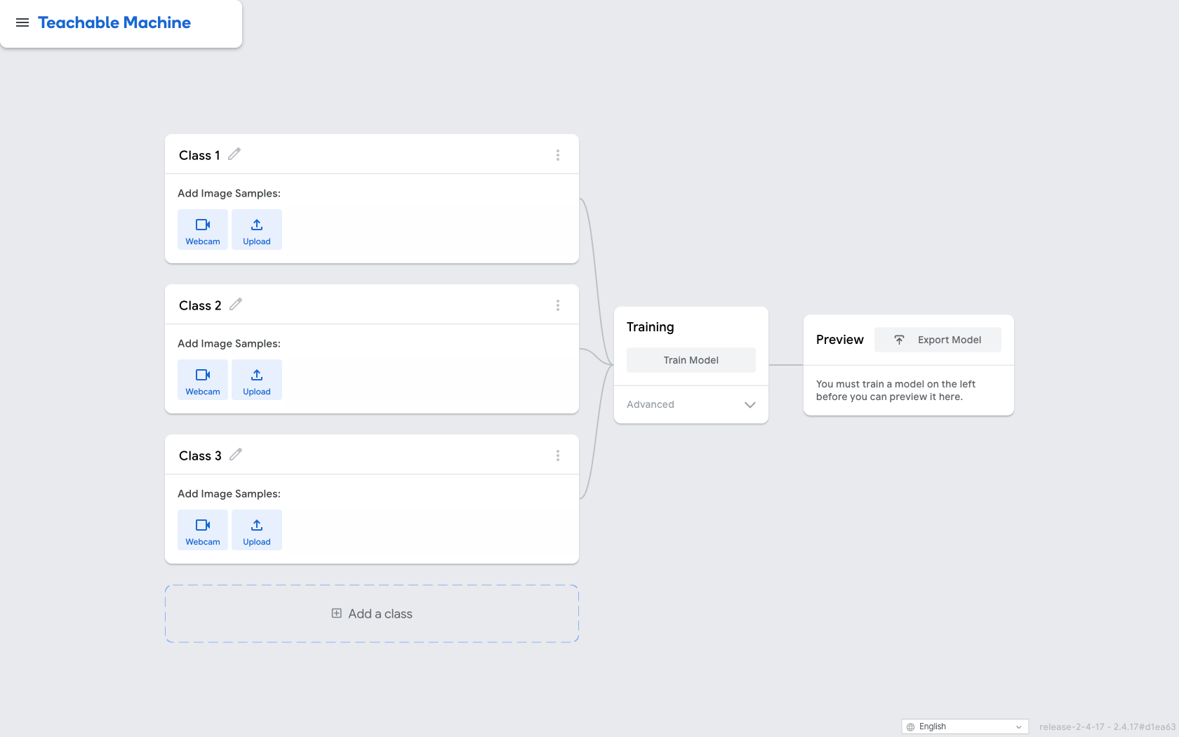
開啟你的圖像專案
Open your image project
三個類別
Three classes
加相片
Add images
訓練，再預覽
Train, then preview
網站 / Website: teachablemachine.withgoogle.com
8
Notes:
Use the official current UI screenshot as a locating aid, not a training result. Choose Image Project and Standard image model; rename classes and add a third. Webcam or Upload are alternatives. Use object pictures, not faces. Teacher checks camera permissions or prepares object photos. Source: https://teachablemachine.withgoogle.com/train/image

Slide 9
訓練相片的「食譜」
A recipe for training images
每類目標至少 20 張，數量大致相近
Aim for 20 or more per class, with similar counts
改角度、距離、背景；試不同的筆和擦膠
Vary angle, distance and background; try different pens and erasers
一直拍同一角度，可能只讓模型「背熟那一幕」
Repeated identical views may teach only that one scene
9
Notes:
15-minute gather/train block. Aim20+ varied images/class, similar counts. This is a classroom target, not a product minimum. Repeated adjacent video frames are not20 independent views; vary views deliberately. Both object classes should appear on multiple backgrounds.

Slide 10
按訓練之前，先留起測試圖片
Reserve test images before training
訓練圖片：給模型學習
Training images: examples for learning
老師備妥 A：每類 4 張，用來第一次檢查
Teacher prepares A: four new images per class
B：另留每類 4 張，改善後才用；兩批難度相近
B: another four per class, used after improvement; similar difficulty
10
Notes:
Use teacher-prepared sets A and B, each4 images/class=12, not added to training. Use similar conditions/difficulty in the two sets. TestA guides improvements. After those improvements, A is no longer independent evidence; test freshB. Teacher prepares and distributes clearly named A and B folders before class. Each contains four fresh images per class under matching conditions; B remains closed until the final check.

Slide 11
Train Model：開始學習你的類別
Train Model: learn your classes
先檢查三類是否都有相片，再按 Train Model
Check that every class has images, then select Train Model
完成後，用 Preview 試 A 的新圖片
After training, use Preview with the new images in set A
記錄真實類別及預測；若 A 全對，可寫「未見錯誤」
Record actual and predicted classes. If A is all correct, write “none found”
11
Notes:
After sufficient varied samples, click Train Model and wait until it finishes before using Preview. Do not change advanced settings for this beginner workshop. UI presence verified, no claim of classroom model training or webcam tests yet.

Slide 12
模型「很有信心」，也可能答錯
A confident-looking model can be wrong
實際拿的是擦膠！
It is actually an eraser!
90% 不是測試準確率
90% is not test accuracy
這是示例畫面；要用新圖片的實際結果來檢查 / Illustration: check against actual results on new images
12
Notes:
Illustrative percentages, not an actual run. Hold an eraser and imagine a displayed Pen90/Eraser7/Empty3. Highest output score means strongest model preference among its classes, not90% measured accuracy or a guarantee. Student compares with known actual class.

Slide 13
考完 A，改善，再考新的 B
Test A, improve, then try fresh B
看看 A 的錯誤：哪些角度、距離或背景較困難？
Inspect mistakes on A. Which views were difficult?
補充合適的訓練圖片，再訓練一次
Add useful training images, then train again
最後才使用 B，記每類答對多少張；不需計百分比
Use B last. Record correct counts per class; no percentages needed
13
Notes:
20-minute test/improve block. Use worksheet counts, not percentage arithmetic. A mistake may suggest poor examples, background clues or unseen views; do not assume a single cause without checking. Add varied training images, retrain, then evaluate unusedB. B was not used to make the model changes.

Slide 14
突擊小考：拿一件沒教過的物件
Surprise challenge: an object never taught
換成水樽或間尺，先猜模型會選哪一類
Try a bottle or ruler. Guess which class the model will choose
它只有三個選項，不能自動新增「水樽」這一類
It has three choices; it does not automatically create a bottle class
空背景只代表教過的背景例子，不是所有未知物件
Empty background means learned background examples, not every unknown object
14
Notes:
Try a bottle or ruler not used in training. The model still outputs only the chosen classes; high score does not create knowledge of a missing class. Empty background is learned background examples, not universal other/unknown. This is classification, not a general detector of everything.

Slide 15
你的偵探報告
Your detective report
你改了哪些訓練例子？模型有甚麼改變？
What training examples did you change? What happened?
為甚麼要用模型未見過的新圖片來測試？
Why test with new images the model has not seen?
模型猜得很有信心，還需要人檢查嗎？
If the model looks confident, do we still need to check?
15
Notes:
Final5 minutes. Students complete reflection without mathematical theory. Accept honest errors and explanations. Optional show another group one surprising failure; no public model upload is required. Save a teacher-approved local project if available; avoid promising a successful export unless observed.

