Slide 1
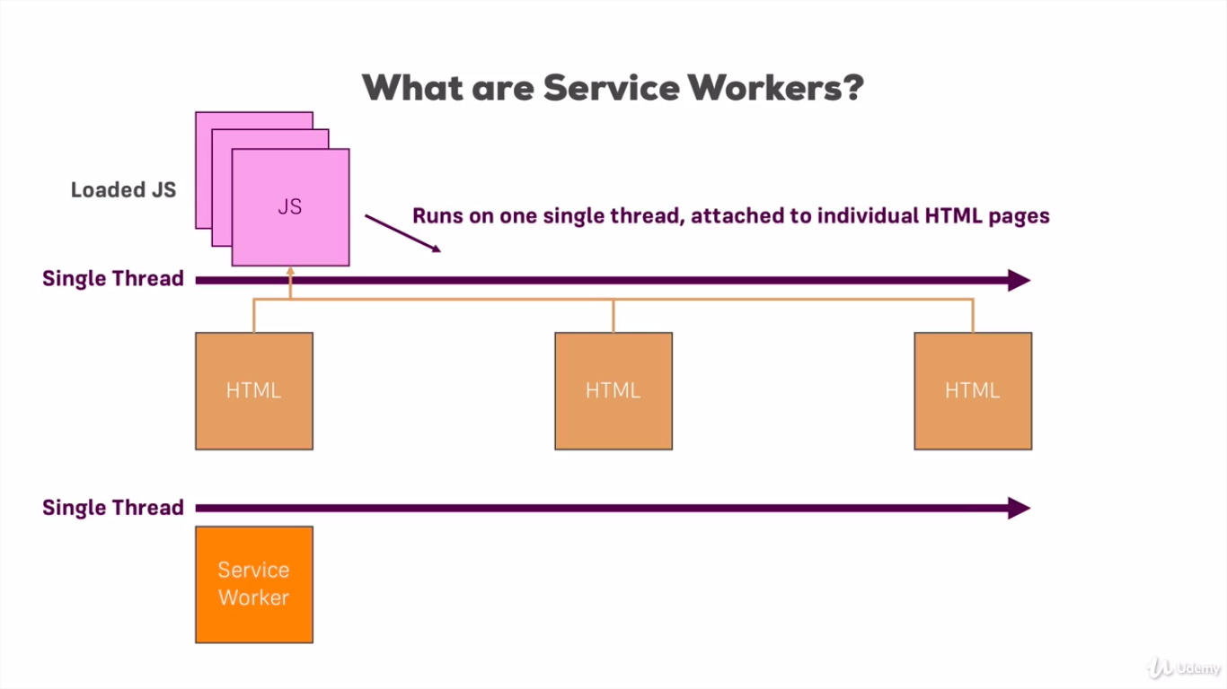
WEB
WORKER

Slide 2
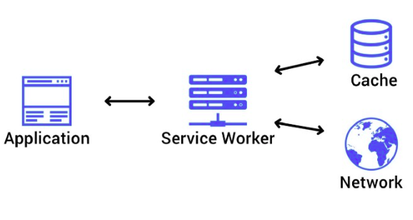
dedicated workers
shared workers
service workers
script.js
worker.js
script2.js
script1.js
worker.js
script3.js

Slide 3
COMMON FEATURES:
run in an isolated thread in the browser
‘self’ read-only property keeps reference to worker global scope
working with DOM and window object are not available
can create another workers
can import another .js scripts

Slide 4
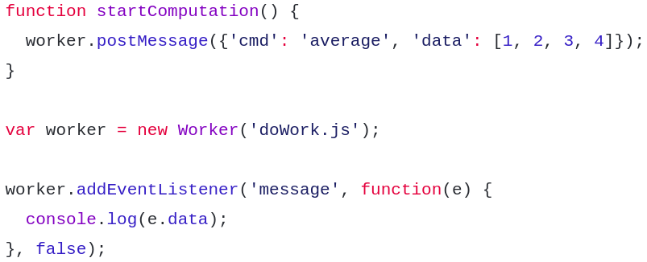
dedicated worker
In owner-script:

Slide 5
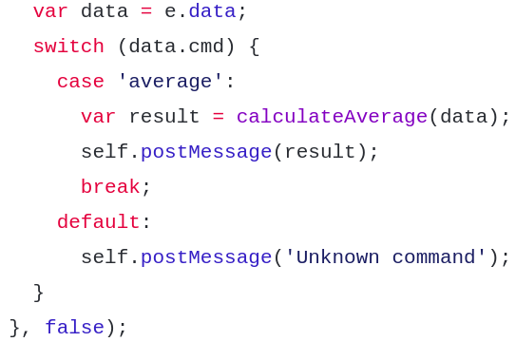
dedicated worker
In worker:

Slide 6
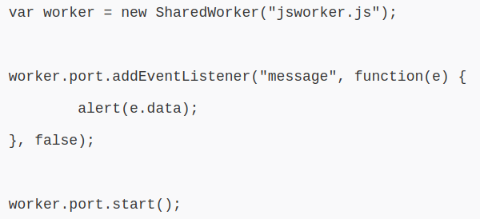
shared worker
In owner-script:

Slide 7
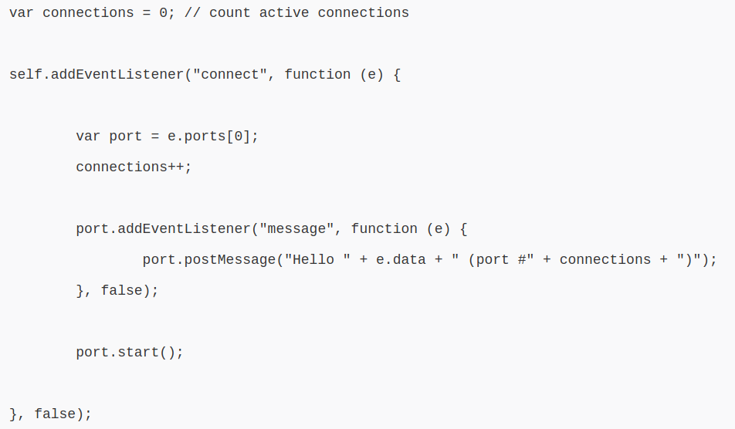
shared worker
In worker:

Slide 8
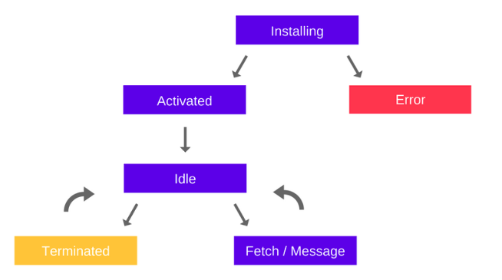
service worker
Life-cycle:

Slide 9
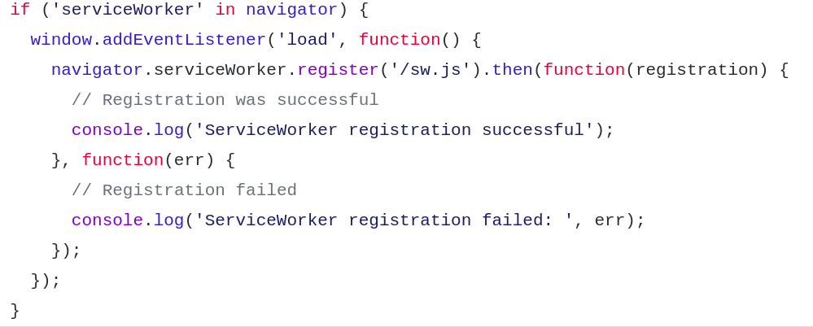
service worker
Registration:

Slide 10
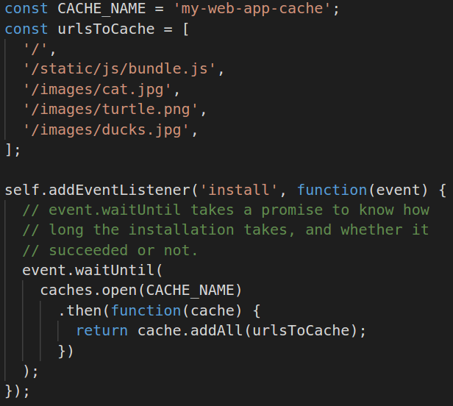
service worker
Installation:

Slide 11
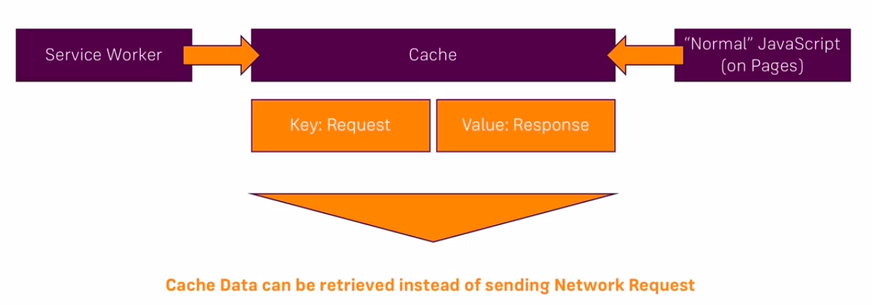
cache

Slide 12
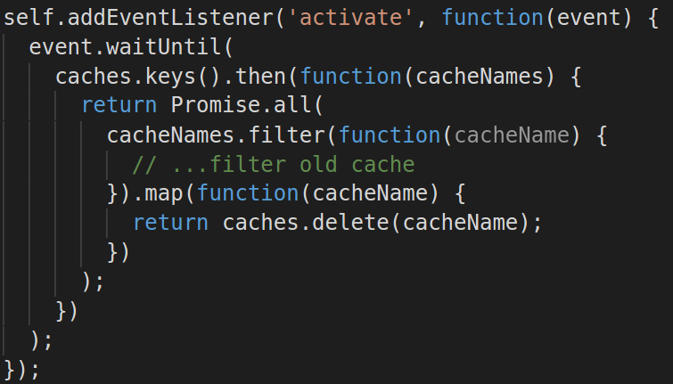
service worker
Activation:

Slide 13
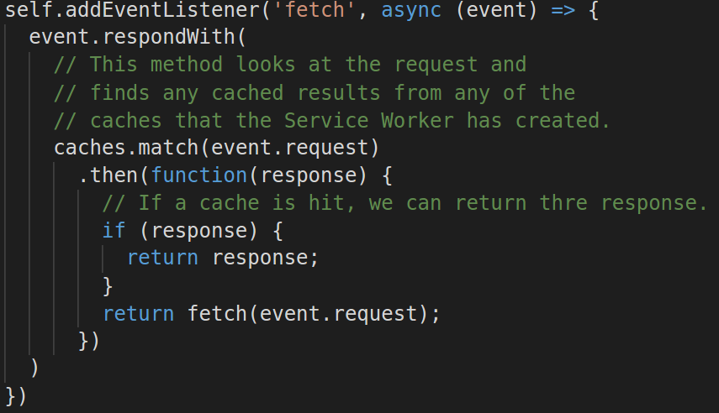
service worker
Fetching:

Slide 14
AVAILABLE FEATURES:
Push notifications — allow users to opt-in to timely updates from web apps.
Background sync — allows you to defer actions until the user has stable connectivity.
Periodic sync (future)
Geofencing (future)

