Slide 1


10:57 am
Smart Assistant
Look into Camera for Facial Recognition login
Enter Password
Start

Slide 2




10:57 am
Smart Assistant
Settings

Slide 3
10:57 am
Smart Assistant
Settings

Slide 4







Exercises
10:57 am
Tai Chi
Hand Grasping
Seated Rowing
Seated Cycling
5 minutes
9 minutes
6 minutes
22 minutes
Add
Notes:
Press Exercise button to do that exercise.
Press + button to add new exercises to list.
Press back button to go back to main page.

Slide 5








Add Exercises
10:57 am
Tai Chi
Golf Exercise
Bowling
Exercise Title
5 minutes
9 minutes
15 minutes
9 minutes
Tai Chi ,be mindful of your body’s movements as well as your breathing and the sensations that your body is experiencing. Try to move like water
Improve your swing
Improve your form in bowling.
Description
Add
Remove
Add
Remove
Add
Remove
Add
Remove
Notes:
Press tick box to add to personal exercise list.
Press exercise button do a run though of the exercise to see if suitable.
Back button takes you back to exercise page.

Slide 6
Add Exercises
10:57 am
Tai Chi
Golf Exercise
Bowling
Exercise Title
5 minutes
9 minutes
15 minutes
9 minutes
Tai Chi ,be mindful of your body’s movements as well as your breathing and the sensations that your body is experiencing. Try to move like water
Improve your swing
Improve your form in bowling.
Description
Add
Remove
Add
Remove
Add
Remove
Remove
Add
Remove
Add
Notes:
Press tick box to add to personal exercise list.
Press exercise button do a run though of the exercise to see if suitable.
Back button takes you back to exercise page.

Slide 7
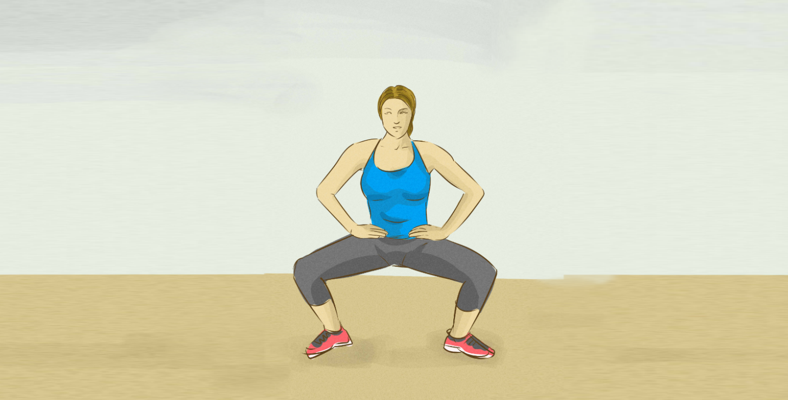


Tai Chi
10:57 am
Good Job!
Notes:
Has animation showing the exercise with voice over.
Can pause at any time by pressing the || button.
Can stop exercise by pressing back button.

Slide 8

Tai Chi
10:57 am
10
Notes:
Can have countdown. For example when a position should be held for a period of time.

Slide 9
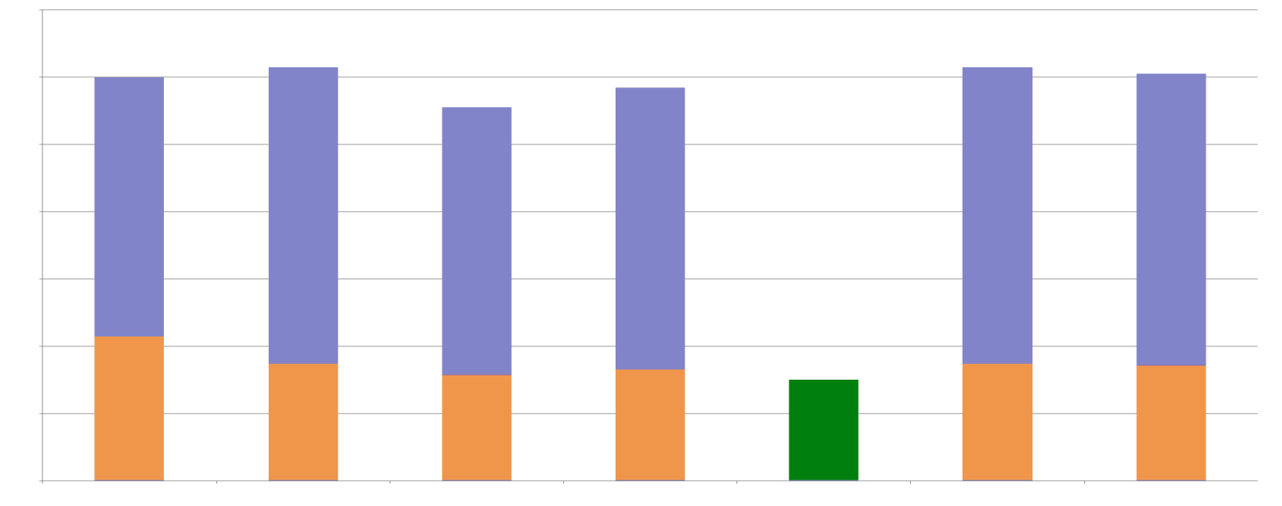

Energy
10:57 am
Energy Usage
Monday
Tuesday
Wednesday
Thursday
Friday
(Today)
Saturday
Sunday
Tip:
The Kitchen light has been left on for 6 hours.
Edit
Notes:
Shows basic layout of house with information on what lights/appliances are on.
Press + button to add/modify room/appliance.
Back take user to main menu

Slide 10
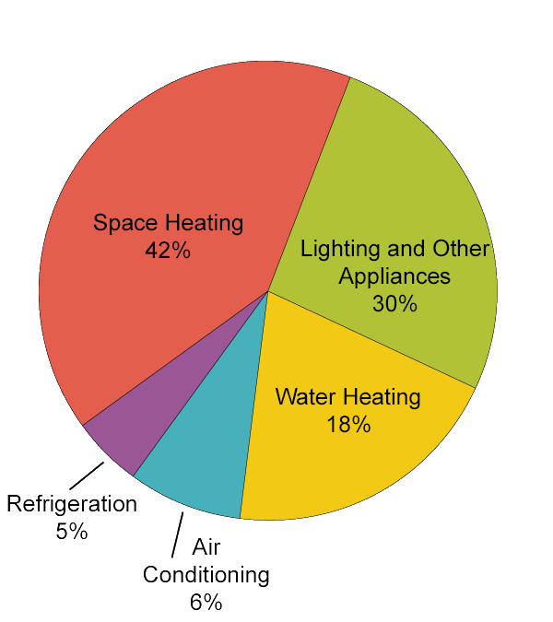
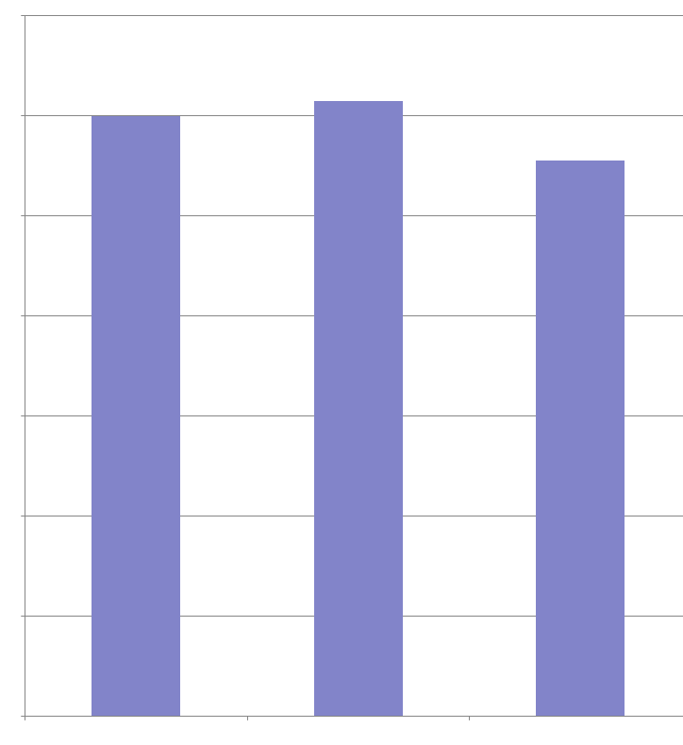
Friday
10:57 am
Breakdown of energy usage:
Past Friday Energy usage
Energy Usage
7th Jan
14th Jan
21st Jan
(this Week)

Slide 11

Energy
10:57 am
Smart Appliances Detected
Appliances in House
IOT Boch Water Heater
Smart Oven
Smart Ikea Light 10

Slide 12
Energy
10:57 am
Smart Appliances Detected
Appliances in House
Smart Oven
Smart Ikea Light 10
IOT Boch Water Heater

Slide 13


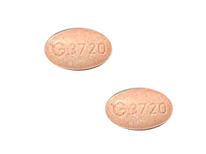
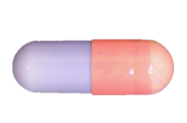
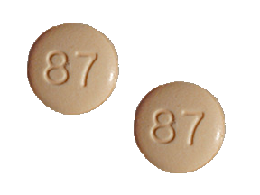






Medication
10:57 am
Monday
Tuesday
Wednesday
Thursday
Friday
Saturday
Sunday
Formohelidrine
Oxytocin
Tetracoloridine
8:00 am
11:00 am
6:00 pm
Change

Slide 14
Medication
10:57 am
Monday
Tuesday
Wednesday
Thursday
Friday
Saturday
Sunday
Formohelidrine
Oxytocin
Tetracoloridine
Warning
It is not yet 6:00pm.
This medication should not be taken until 6:00pm
If this medication has been taken outside of timetabled slot please seek medical advice.
8:00 am
11:00 am
6:00 pm
Change

Slide 15
Medication
10:57 am
Monday
Tuesday
Wednesday
Thursday
Friday
Saturday
Sunday
Formohelidrine
Oxytocin
Tetracoloridine
Warning
It is not yet 6:00pm.
This medication should not be taken until 6:00pm
If this medication has been taken outside of timetabled slot please seek medical advice.
8:00 am
11:00 am
6:00 pm
Change

Slide 16
Medication
10:57 am
Monday
Tuesday
Wednesday
Thursday
Friday
Saturday
Sunday
Formohelidrine
Oxytocin
Tetracoloridine
8:00 am
11:00 am
6:00 pm
Change

Slide 17

Add Medication
10:57 am
Enter Medication Name
Search
Results
Notes
Dose:
Add
Notes:
can search for drugs to add to list
To be used mostly by doctors

Slide 18
Add Medication
10:57 am
Formohelid
Search
Results
Notes
Dose:
Add
Notes:
can search for drugs to add to list
To be used mostly by doctors

Slide 19
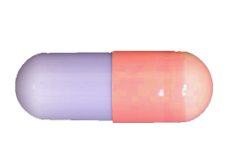
Add Medication
10:57 am
Formohelid
Search
Results:
Formohelidicas
Formohelidiel
Formohelidiate
Formohelidrine
Notes:
Formohelidrine:
Dose – 2x 50 mg tablets taken once in the morning before breakfast.
Tablets are oblong, red and purple capsules.
Do not take if pregnant or if you have fainted in the last three days.
Dose:
Add
Notes:
can search for drugs to add to list
To be used mostly by doctors

Slide 20
Medication
10:57 am
Tetracoloridine
x
2
Medication details
Dose – 2x 50 mg tablets taken once in the morning before breakfast.
Tablets are brown with the number 87 imprinted.
Do not take if pregnant or if you have fainted in the last three days.
To be taken at: 6:00pm
Dosage
2x 50 mg tablets taken once in the morning before breakfast.
Notes:
Detailed notes on medication

Slide 21
Medication
10:57 am
Formohelidrine
x
1
Medication details
Dose – 1x 10 mg tablets taken once in the morning before breakfast.
Tablets are brown oblong.
Do not take if pregnant or if you have fainted in the last three days.
To be taken at: 8:00am
Dosage
1x 10 mg tablets taken once in the morning before breakfast.
Notes:
Detailed notes on medication

Slide 22
Medication
10:57 am
Oxytocin
x
1
Medication details
Dose – 1x 50 mg tablets taken once in the morning before breakfast.
Tablets are oblong, red and purple capsules.
Do not take if pregnant or if you have fainted in the last three days.
To be taken at: 11:00am
Dosage
1x 50 mg tablets taken once in the morning before breakfast.
Notes:
Detailed notes on medication

Slide 23










Robot Assistant
10:57 am

Slide 24
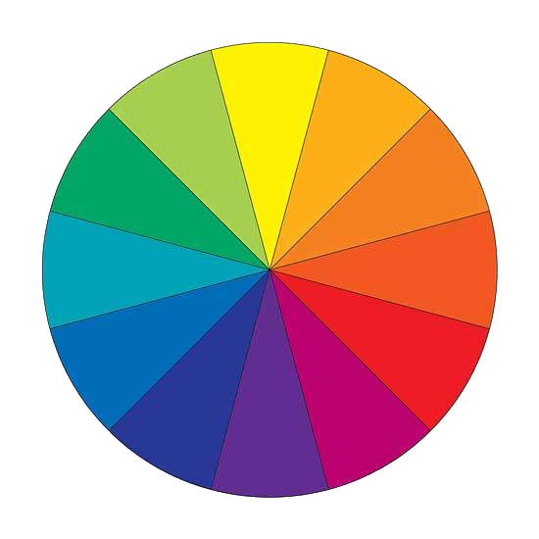






Settings
10:57 am
Change Colour Scheme
Select Colour
Reset
Notes:
Select which area user wants to change colour scheme and the select colour wanted.

