Slide 1





10:57 am
Smart Assistant
Settings

Slide 2







Exercises
10:57 am
Tai Chi
Exercise Title
Exercise Title
Exercise Title
5 minutes
9 minutes
6 minutes
22 minutes
Add
Notes:
Press Exercise button to do that exercise.
Press + button to add new exercises to list.
Press back button to go back to main page.

Slide 3








Add Exercises
10:57 am
Tai Chi
Exercise Title
Exercise Title
Exercise Title
5 minutes
9 minutes
15 minutes
9 minutes
Description
Description
Description
Description
Add
Remove
Add
Remove
Add
Remove
Add
Remove
Notes:
Press tick box to add to personal exercise list.
Press exercise button do a run though of the exercise to see if suitable.
Back button takes you back to exercise page.

Slide 4
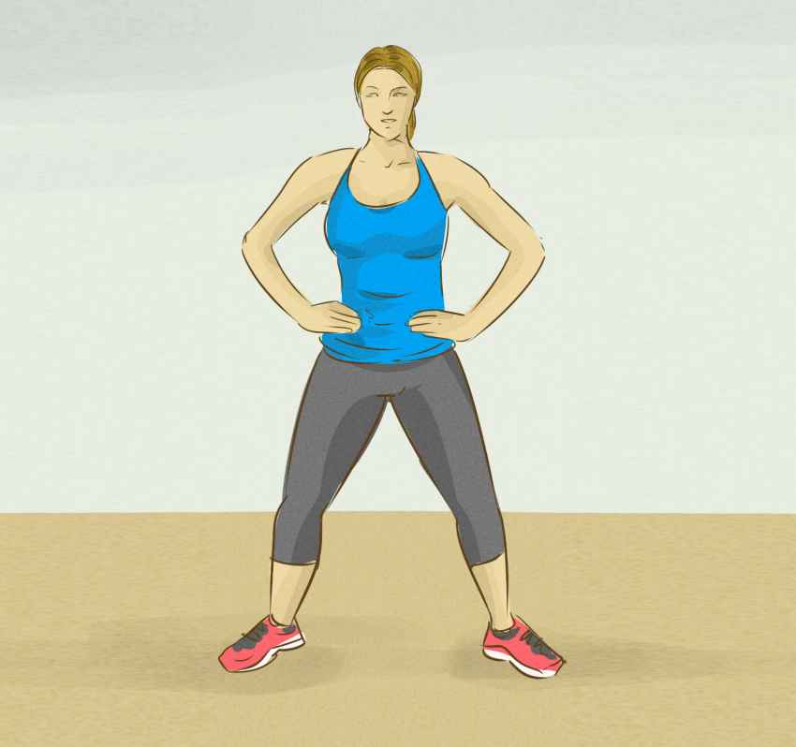

Tai Chi
10:57 am
Notes:
Has animation showing the exercise with voice over.
Can pause at any time by pressing the || button.
Can stop exercise by pressing back button.

Slide 5
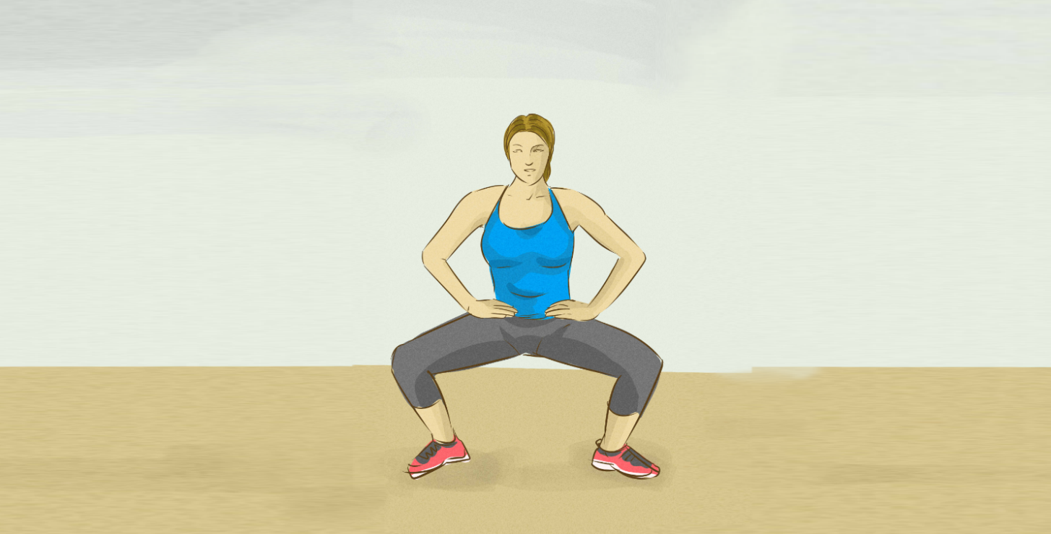

Tai Chi
10:57 am
10
Notes:
Can have countdown. For example when a position should be held for a period of time.

Slide 6


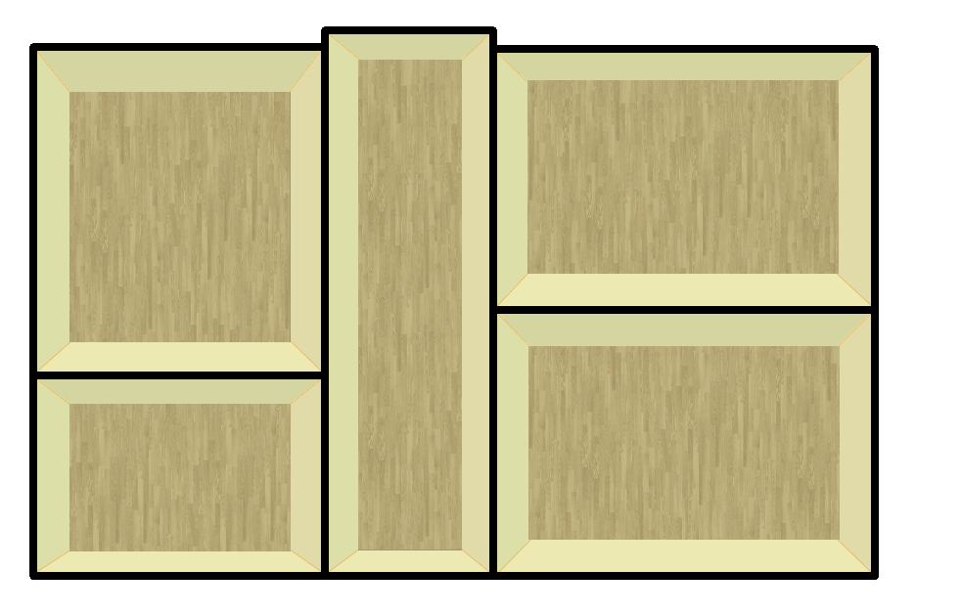



Energy
10:57 am
Ground Floor
1st Floor
Bedroom
Kitchen
Hall
Sitting Room
Bathroom
Edit
Notes:
Shows basic layout of house with information on what lights/appliances are on.
Press + button to add/modify room/appliance.
Back take user to main menu

Slide 7
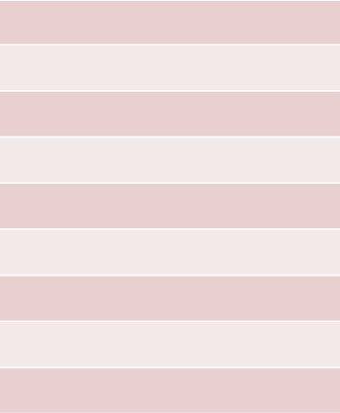



Energy
10:57 am
Ground Floor
+ Add Floor
Smart Appliances
Bedroom
Appliances in Room
Bedroom
Add Room
Delete

Slide 8

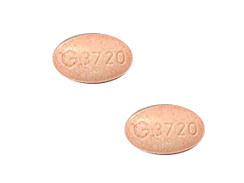
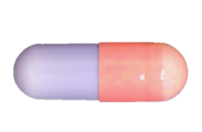
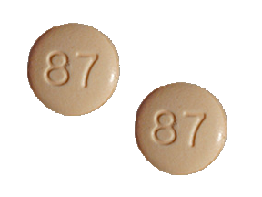






Medication
10:57 am
Monday
Tuesday
Wednesday
Thursday
Friday
Saturday
Sunday
Med name
Med name
Med name
8:00 am
11:00 am
6:00 pm
Change

Slide 9

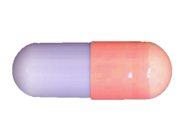
Add Medication
10:57 am
Enter Medication Name
Search
Results
Notes
Add
Notes:
can search for drugs to add to list
To be used mostly by doctors

Slide 10
Medication
10:57 am
Med Name
x
2
Medication details
To be taken at: 6:00pm
Dosage
Notes:
Detailed notes on medication

Slide 11




Robot Assistant
10:57 am

Slide 12
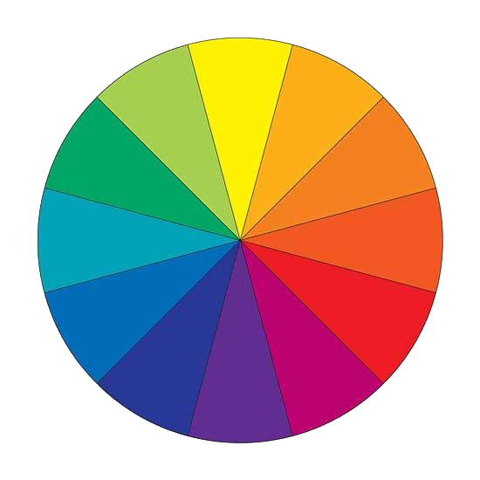






Personalisation
10:57 am
Change Colour Scheme
Select Colour
Reset
Notes:
Select which area user wants to change colour scheme and the select colour wanted.

