Slide 1





10:57 am
Smart Assistant
Settings

Slide 2







Exercises
10:57 am
Tai Chi
Hand Grasping
Seated Rowing
Seated Cycling
5 minutes
9 minutes
6 minutes
22 minutes
Add
Notes:
Press Exercise button to do that exercise.
Press + button to add new exercises to list.
Press back button to go back to main page.

Slide 3








Add Exercises
10:57 am
Tai Chi
Exercise Title
Exercise Title
Exercise Title
5 minutes
9 minutes
15 minutes
9 minutes
Tai Chi ,be mindful of your body’s movements as well as your breathing and the sensations that your body is experiencing. Try to move like water
Description
Description
Description
Add
Remove
Add
Remove
Add
Remove
Add
Remove
Notes:
Press tick box to add to personal exercise list.
Press exercise button do a run though of the exercise to see if suitable.
Back button takes you back to exercise page.

Slide 4
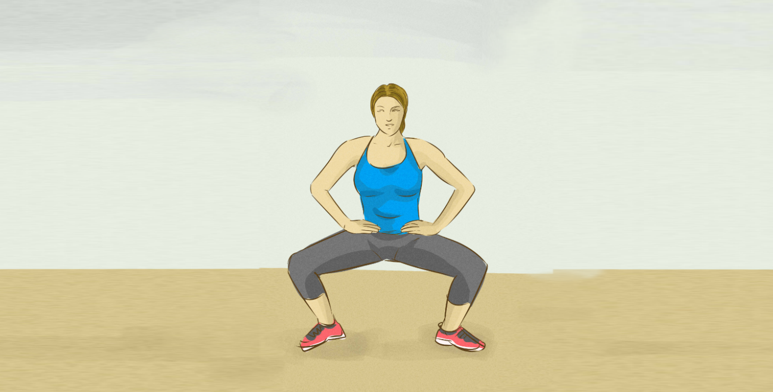
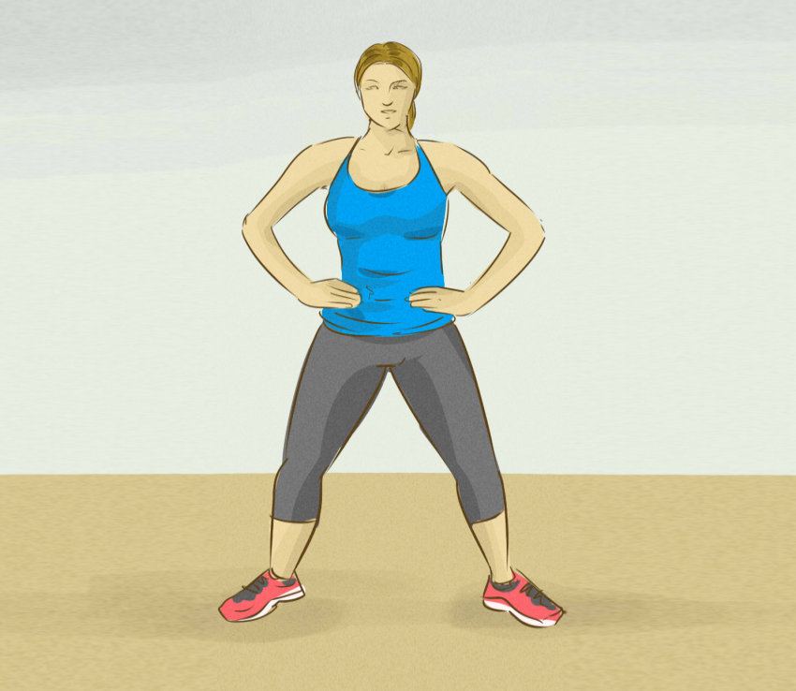

Tai Chi
10:57 am
Notes:
Has animation showing the exercise with voice over.
Can pause at any time by pressing the || button.
Can stop exercise by pressing back button.

Slide 5

Tai Chi
10:57 am
10
Notes:
Can have countdown. For example when a position should be held for a period of time.

Slide 6






Energy
10:57 am
Ground Floor
1st Floor
Bedroom
Kitchen
Hall
Sitting Room
Bathroom
Edit
Notes:
Shows basic layout of house with information on what lights/appliances are on.
Press + button to add/modify room/appliance.
Back take user to main menu

Slide 7




Energy
10:57 am
Bedroom
Ground Floor
+ Add Floor
Smart Appliances
Appliances in Room
Bedroom
Add Room
Delete

Slide 8

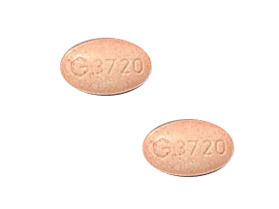
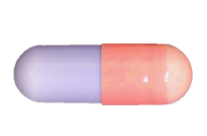
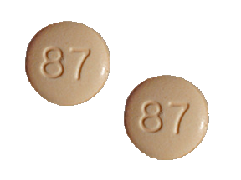






Medication
10:57 am
Monday
Tuesday
Wednesday
Thursday
Friday
Saturday
Sunday
Formohelidrine
Oxytocin
Tetracoloridine
8:00 am
11:00 am
6:00 pm
Change

Slide 9

Add Medication
10:57 am
Enter Medication Name
Search
Results
Notes
Dose:
Add
Notes:
can search for drugs to add to list
To be used mostly by doctors

Slide 10
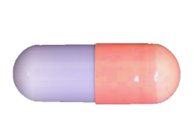
Add Medication
10:57 am
Formohelid
Search
Results:
Formohelidicas
Formohelidiel
Formohelidiate
Formohelidrine
Notes:
Formohelidrine:
Dose – 2x 50 mg tablets taken once in the morning before breakfast.
Tablets are oblong, red and purple capsules.
Do not take if pregnant or if you have fainted in the last three days.
Dose:
Add
Notes:
can search for drugs to add to list
To be used mostly by doctors

Slide 11
Medication
10:57 am
Med Name
x
2
Medication details
Dose – 2x 50 mg tablets taken once in the morning before breakfast.
Tablets are oblong, red and purple capsules.
Do not take if pregnant or if you have fainted in the last three days.
To be taken at: 6:00pm
Dosage
2x 50 mg tablets taken once in the morning before breakfast.
Notes:
Detailed notes on medication

Slide 12




Robot Assistant
10:57 am

Slide 13
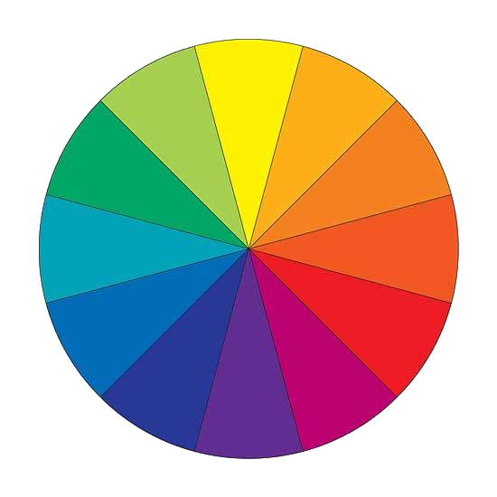






Settings
10:57 am
Change Colour Scheme
Select Colour
Reset
Notes:
Select which area user wants to change colour scheme and the select colour wanted.

