Slide 1
Reactive Programming
By Gordon Rennie and YouTube

Slide 2
What we'll cover
Why use it
Reactive Programming
Reactive Systems
Some demos
Why bother

Slide 3
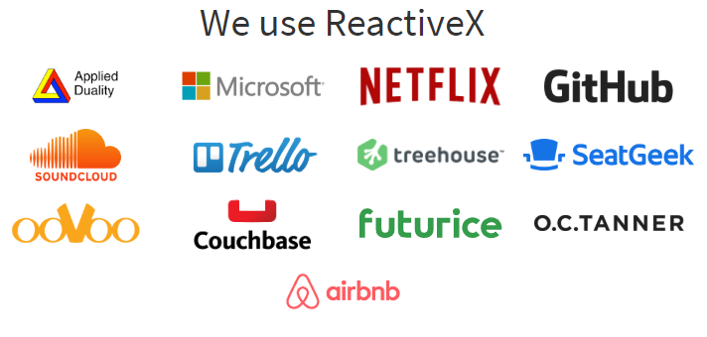
What Do Programmers Do?
Processing data
What data will we be processing
This is what we have to think about in the future
www.reactive.io

Slide 4
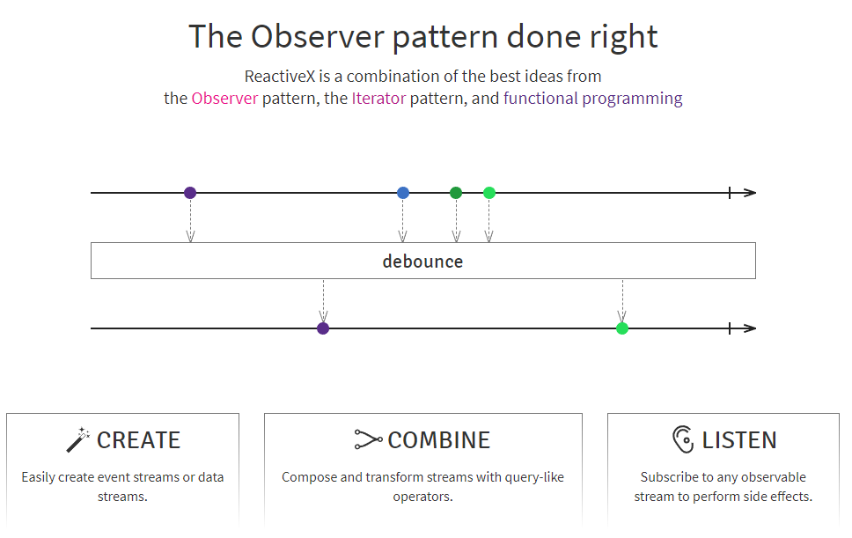
What is reactive
Programming based on asynchronous data streams
www.reactive.io

Slide 5
Message Driven (streams)
Primitive type
Everything is a stream
Streams are ordered data sequences of three types:
Data payload
Error
End of Stream

Slide 6

Observer Pattern
Observer
Observerable

Slide 7
Iterator Pattern
Has next?
Give me next
And again
Until no next

Slide 8
Functional Programming
Programming paradigm (a way of solving a problem)
Rooted in mathematics
Language independent
Key Principles:
All computation is the execution of a series of mathematical functions
Immutable

Slide 9
Building Blocks of Reactive Programming
Observables
Subscribers
Operators
Create
Transform
Filter
Combine
Schedulers
Thread selection

Slide 10
Reactive Programming!= Reactive System

Slide 11
Resilient
How does it cope with failure
How quickly can it recover
Loose coupling
Strong encapsulation
Hierarchies

Slide 12
Responsive
Responds in a “timely” manner
Ensures good user experience
High usability and utility
Users more likely to return

Slide 13
Elastic
Stays responsive under varying workload
Input rate determines resource allocation
Designs should be free of bottlenecks

Slide 14
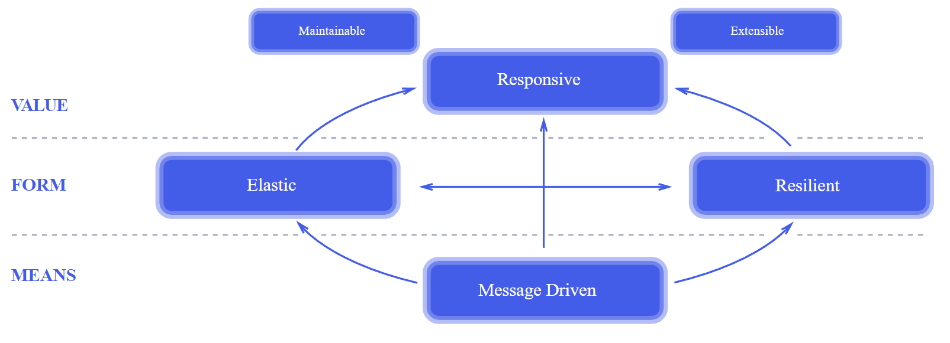
The Reactive Manifesto
https://www.reactivemanifesto.org/

Slide 15
Why Reactive?
Asynchronous programming is HARD
But more and more we need it
Meeting customer needs
If we want to survive

Slide 16


What is Asynchronous Programming
Network
Memory
Our System
UI

Slide 17
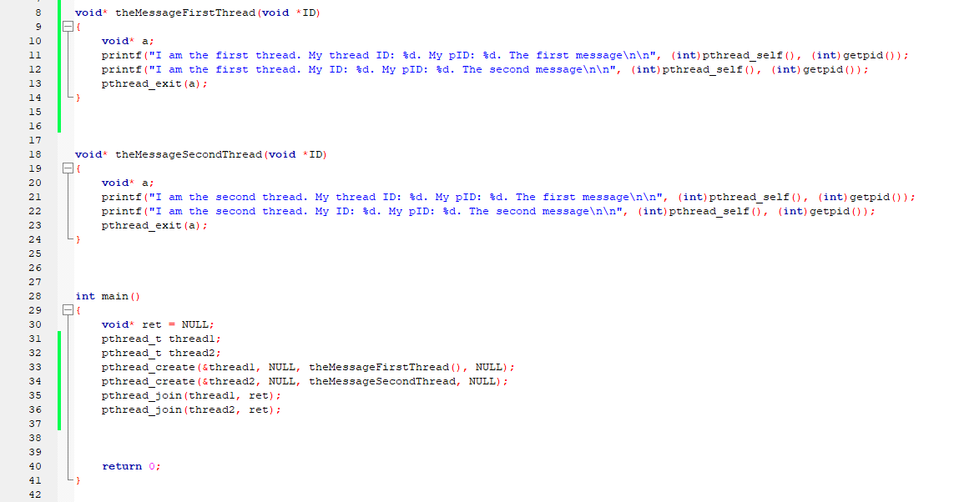
Threads?

Slide 18
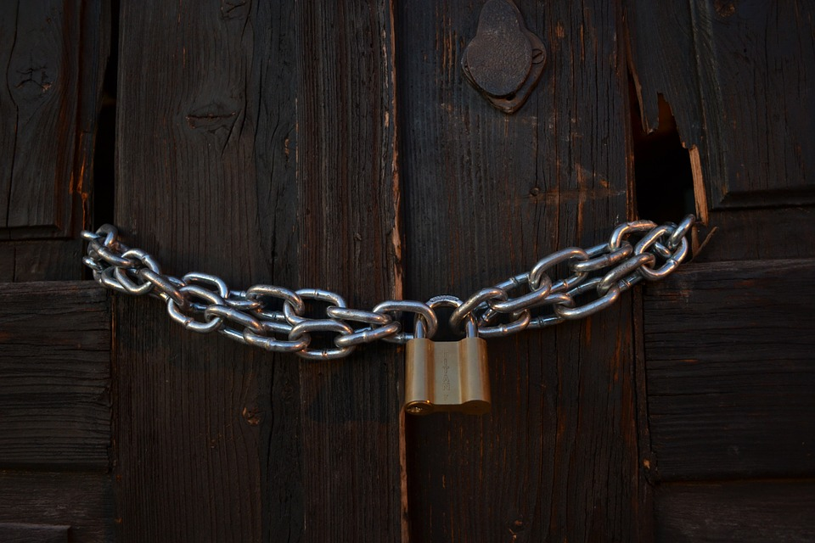
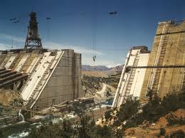
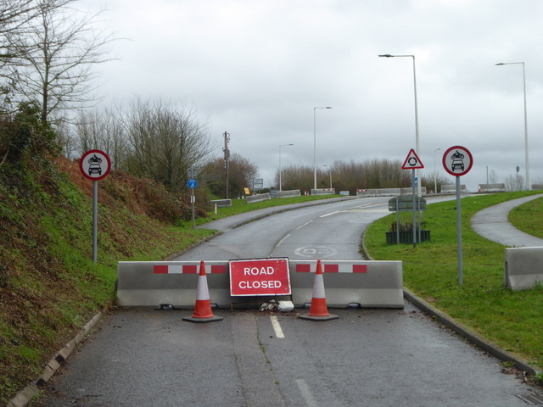
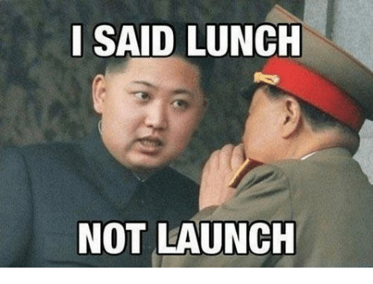
Async – Use Threads?
Blocking?
Data races
Deadlocks
Often added at the end – rebuild everything
Notes:
Blocking
Race conditions – solved by locks
Deadlocks – caused by locks

Slide 19

Customer Needs

Slide 20
Have we already made one
GUI?
Action Listener? – call backs. You register yourself to be 'called back'
Whenever an event is trigger you do an action
Issues with this.
Call back hell... large web of call backs can be very hard to understand.
NOT a stream

Slide 21
ReactiveX

Slide 22
How do we make a reactive program
Java ReactiveX (JRX)

Slide 23
Why bother?
Issues that RX encounters
Back Pressure

Slide 24
Back Pressure
Produces an event every second
Takes two seconds to process each event

Slide 25
Buffering
Buffer()
Put the over produced stuff somewhere and deal with it when ready.

Slide 26
Grouping Elements
Window()
Set size of window and batch process the elements

Slide 27
Skipping
Wait for x amount of time to pass
Sample()
Takes last item and emits it

Slide 28
Skipping
Wait for x amount of time to pass
ThrottleFirst()
Takes first item and emits it

