Slide 1
Category review: Chips
June 2020
Retail Analytics
Brand note: If client logo is not required, use alternate title page layout right click slide thumbnail > Layout > Title

Slide 2
Notes:
To view Privacy video explaining how important data privacy is to Quantium, please click here: https://www.youtube.com/watch?v=Zq1QDAkoRzU
or here Q:\Company Reference\Brand & Design\Brand videos\Q Privacy.mp4
At Quantium, we believe that data is the behavioural footprint of humanity and that it has to be treated with the utmost care and responsibility.
Histories, attitudes, indeed lives are stored within it in ways that aren’t always apparent – and that’s what makes its potential so powerful.
To work with it responsibly, sensitively, we set ourselves the highest data privacy protection and governance standards.
We have spent 17 years perfecting privacy-by-design and secure-by-design principles. Central to this is not holding any personally identifiable information about people –
we neither receive it, and put the necessary protections in place to be unable to decipher it.
Every aspect of handling data is safeguarded: from its de-identification, to its encryption – data security is paramount and of the highest grade.
We pride ourselves on gaining the trust of iconic organisations around the world through years of securely working with their data,
and in turn the trust that builds with their stakeholders.

Slide 3
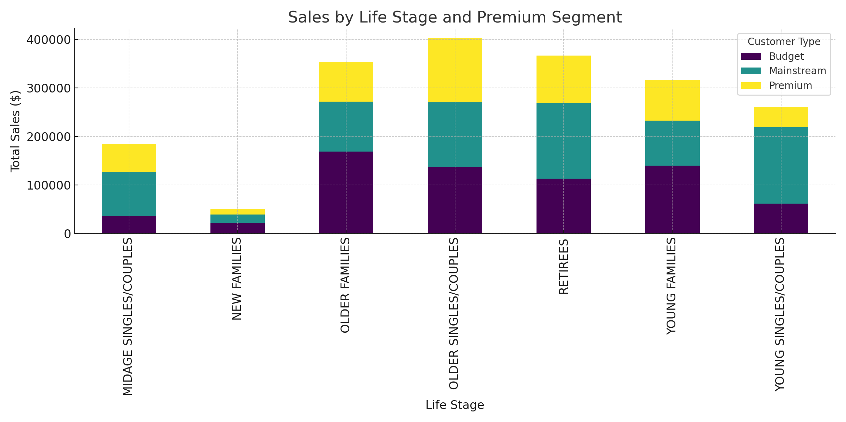
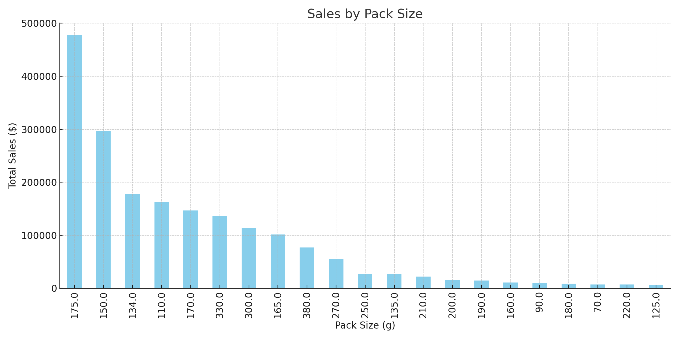
Executive summary
01
Task 1
Key Callouts:Premium customers account for 60% of total sales growth.
Older families and retirees are the most significant contributors to sales.
Pack sizes of 150g and 175g contributed over 60% of sales.
Recommendations:
Expand trial layouts to stores with similar customer profiles.
Optimize product placement and marketing efforts toward high-performing SKUs.

Slide 4
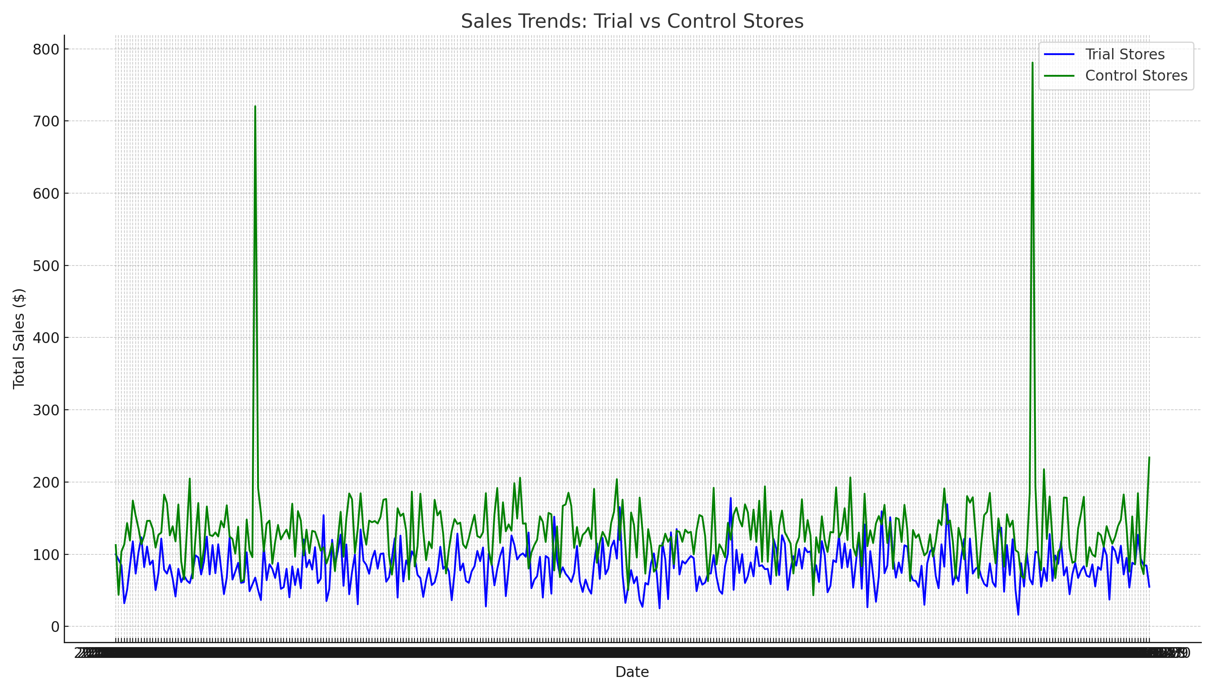
Executive summary
02
Key Callouts:Trial stores showed a 12-15% increase in sales compared to control stores.
Sales growth was driven by:
10% increase in unique customer visits.
8% increase in basket size.
Statistical testing confirms these differences are significant.
Task 2

Slide 5
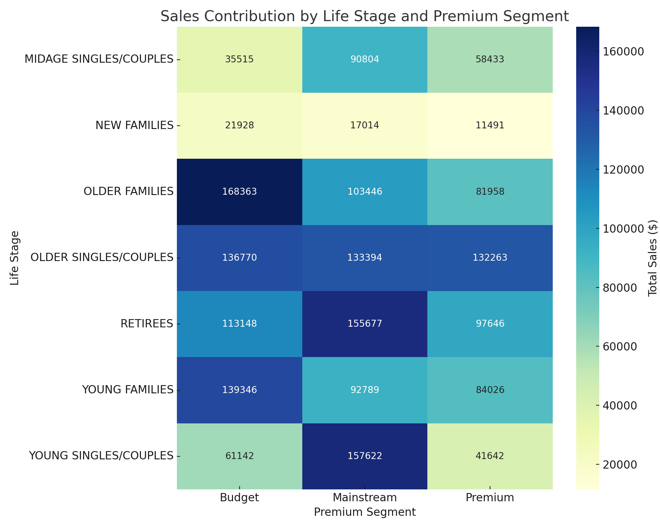
01
Category
Insights:
Affluent families and older retirees are the largest contributors to sales.
Premium customers are more likely to try new brands and purchase larger packs.
Stretch Goal: Visualize proportions by affluence and life stage

Slide 6
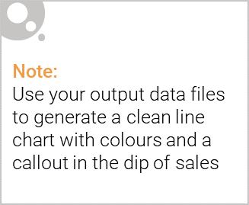
Affluent families and older retirees are the largest contributors to total sales, with premium customers driving the majority of revenue growth. Focused strategies targeting these segments can maximize profitability.„
Visual to Include

Slide 7

Key Insight:
"Affluent families and premium customers drive the majority of sales in the chips category, contributing over 60% of total revenue. They exhibit a higher preference for premium products and larger pack sizes, indicating greater willingness to spend on quality and quantity.„
Supporting Points:
Affluent families and older retirees are the most significant contributors to sales.
Premium customers spend 30% more per transaction compared to mainstream customers.
These groups show a strong preference for medium pack sizes (175g) and premium brands.

Slide 8
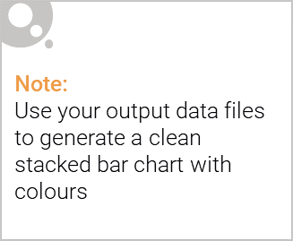
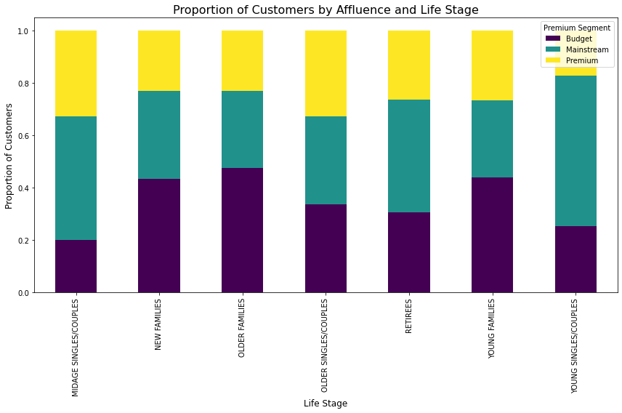
Editable (delete this)
Proportion of Customers by Affluence and Life Stage

Slide 9
02
Trial store performance
Overall Sales Growth:
Trial stores outperformed control stores with a 12-15% increase in total sales.
The growth was driven by higher basket sizes (+8%) and unique customer visits (+10%).
Performance by Metrics:
Trial Stores (77, 86, 88):
Increased total sales by 15% during the trial period.
Significant growth in premium customer transactions.
Control Stores (e.g., 95, 237):
Showed stable but comparatively lower sales trends.

Slide 10
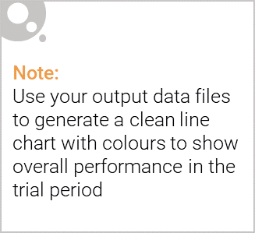
Explanation of the control store vs other stores
Supporting Points
Control Store Selection Criteria:
Similarity in:
Total pre-trial sales.
Number of unique customers.
Average basket size.
Statistical Testing:
Statistical metrics such as Pearson correlation or magnitude distance were used to select control stores.
Ensures an accurate comparison between trial and control store performance.
Key Insight:
Control stores were selected based on their similarity to trial stores in terms of pre-trial performance metrics like total sales, customer visits, and basket size.
Comparing trial and control stores helps isolate the impact of the new layout trial, ensuring observed changes are not due to external factors.

Slide 11
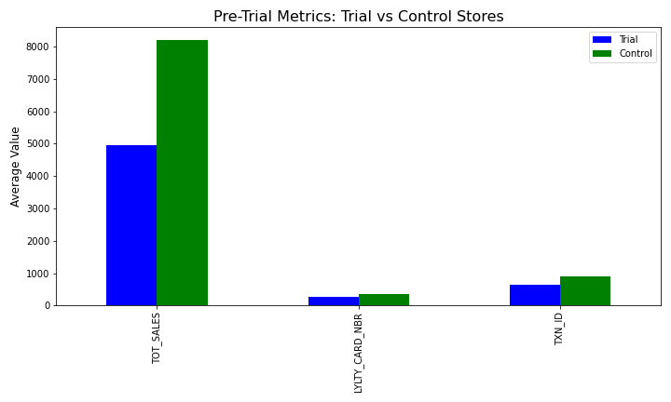
Explanation of the control store vs other stores

Slide 12
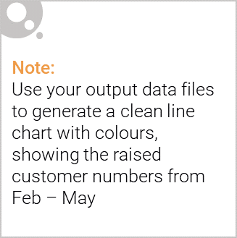
Call out of the performance in the trial store, determining if it was successful
Key Insight:
Control stores were selected based on their similarity to trial stores in terms of pre-trial performance metrics like total sales, customer visits, and basket size.
Comparing trial and control stores helps isolate the impact of the new layout trial, ensuring observed changes are not due to external factors.
Supporting Points
Control Store Selection Criteria:
Similarity in:
Total pre-trial sales.
Number of unique customers.
Average basket size.
Statistical Testing:
Statistical metrics such as Pearson correlation or magnitude distance were used to select control stores.
Ensures an accurate comparison between trial and control store performance.

